Slide 1
Lecture 7 CAD Connections

Slide 2
CAD Connections
What will you learn from this presentation:
Geometry Import Properties
CAD Connections
Uni/Bi-Directional Connectivity
Named Selection Manager

Slide 3
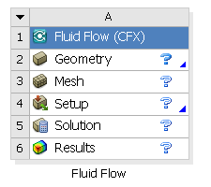
Preprocessing Workflow
Geometry Creation
OR
Geometry Import
Meshing
Solver
Geometry Operations
Sketches and Planes
3D Operations
Meshing Methods
Boolean, Body Operations, Split, etc
Hybrid Mesh: Tet, Prisms, Pyramids
3D Operations
Extrude, Revolve, Sweep, etc
Hexa Dominant, Sweep meshing
Geometry Cleanup and Repair
Assembly Meshing
Geometry Import Options
Automatic Cleanup
Global Mesh Settings
Direct CAD/Bi-Directional CAD
Merge, Connect, Projection, Flow Volume Extraction, etc
Local Mesh Settings
Sizing, Body/Sphere of Influence, Match Control, etc

Slide 4
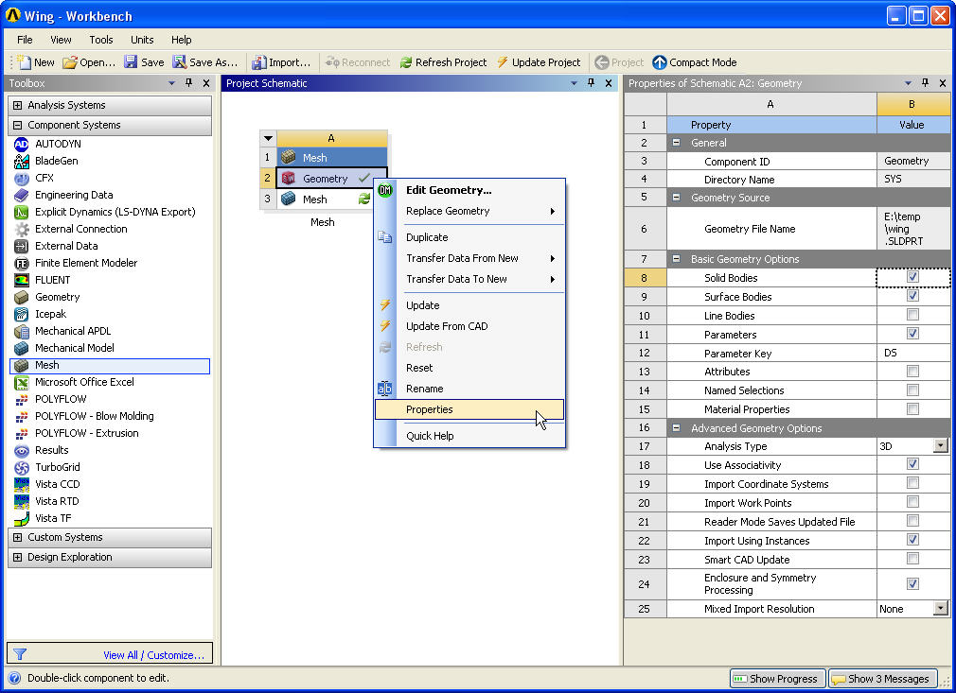
Geometry Properties (1)
Geometry Properties are import and data transfer related properties which will be applicable for imports
Right click on Geometry cell on Project Schematics and select Properties
Most of the settings for import can be done through “Basic Geometry Options” and “Advanced Geometry Options”
Several things can be setup as default such as
Default analysis type (3d/2d)
Import/export options
Parameters
Named Selections, etc.

Slide 5
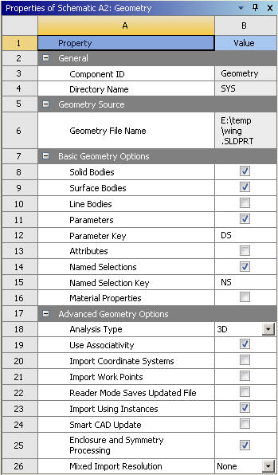
Geometry Properties (2)
Basic Properties :
Select ‘Parameters’ option for importing parameters defined in CAD package
‘Parameter Key’ filters the parameters from CAD that enter Workbench
If ‘Parameter Key’ is not specified, all parameters from CAD enter Workbench
Similarly, Named Selections key controls the selections from CAD entering WB

Slide 6
Geometry Properties (3)
Advanced Properties :
Select ‘Use Associativity’ to establish association between CAD and WorkBench
Import Coordinate Systems, Work Points, etc. defined in CAD
Smart CAD Update :
If selected, changes made in other options get updated in the model

Slide 7
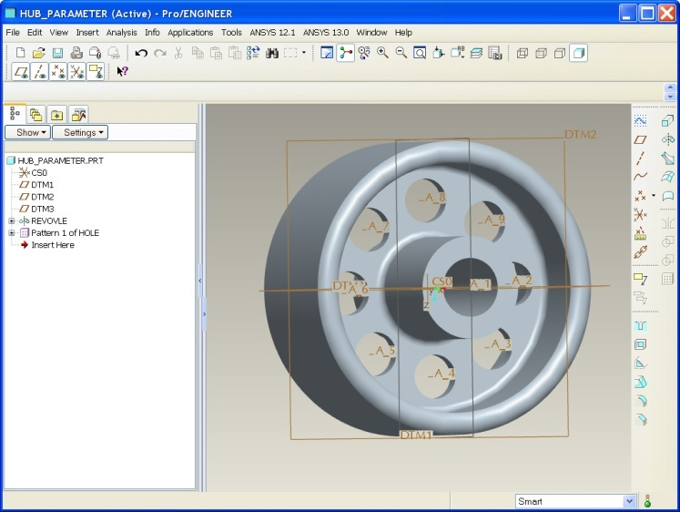
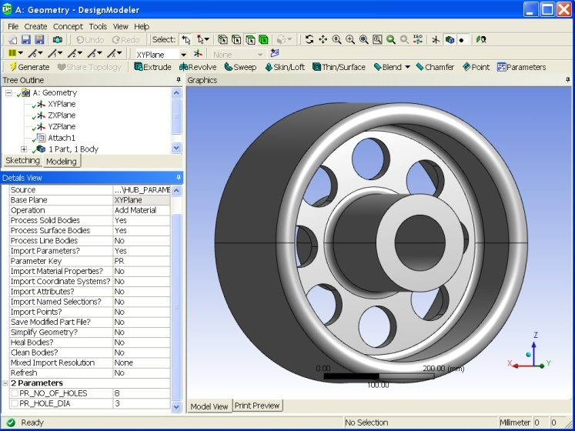
CAD Connections: Introduction
CAD Connections
Transfer CAD geometry to DesignModeler/Meshing
Two approaches
Approach I (Import)
Import neutral/native CAD files directly into DesignModeler
Uni-directional connectivity
Approach II (Direct Connection)
Use Plug-In (Associative Interface)
Bi-directional CAD Connectivity
ANSYS Direct CAD Interface
Pro/ENGINEER
DM

Slide 8
CAD Connections: Supported Readers & Plug-Ins/Interfaces
Reader Version
ACIS (*.sat, *.sab) 22
ANSYS BladeGen (.bgd) 12
Catia V4 (*.model,*.exp,*.session,*.dlv) 4.2.4
Catia V5 (*.CATPart, *.CATProduct) V5-6R 2012
Catia V5 CADNexus CAPRI CAE V5R 20, R21
Catia V5 CADNexus CAPRI CAE V5R 19
Creo Parametric (*.prt, *.asm) 1.0
Gambit (*.dbs) 2.4
IGES (*.igs, *.iges) 4.0, 5.2, 5.3
Autodesk Inventor (*.ipt, *.iam) 2012
JT Open (*.jt) 8.0, 8.1
Monte Carlo N-Particle (*.mcnp)
NX (*.prt) 8.0
Parasolid (*.x_t/b, *.xmt_txt/bin) 24.1
SolidWorks (*.sldprt, *.sldasm) 2012
Step (*.stp, *.step) AP203, AP214
Reader/Plug-In/Interface Version
Autodesk AutoCAD (*.dwg, *.dxf) 2012, 2013
Creo E/Direct Modeling (*.pkg,*.bdl,*.ses,*.sda,*.sdp,*.sdac,*.sdpc)
17.0, 18.0, 18.1
Creo P (Pro/Engineer) (*.prt, *.asm) Creo Parametric 1.0, 2.0
Wildfire 5.0
Autodesk Inventor (*.ipt, *.iam) 2012, 2013
NX (*.prt) 6.0, 7.5, 8.0
Solid Edge (*.par,*.asm,*.psm,*.pwd) ST3, ST4
SolidWorks (*.sldprt, *.sldasm) 2011, 2012
TeamCenter (Plug-In) Unified 8.1 with NX 7.5 Unified 8.3 with NX 7.5.2 Engineering 9.1 with NX 8.0
SpaceClaim (SCDM) (*.scdoc) 2012 SP1
For Full Platform/OS Specific Support Consult Documentation (CAD Integration)

Slide 9
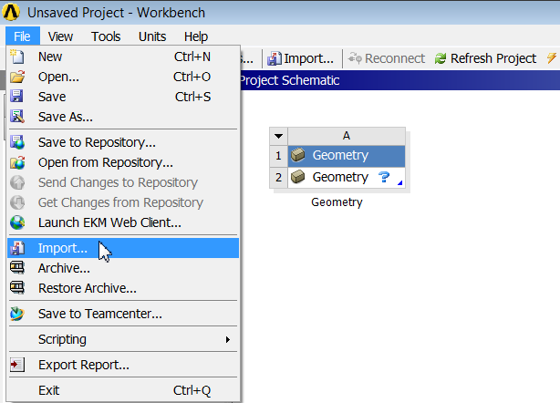
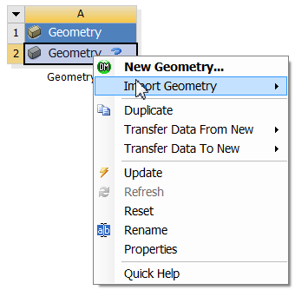
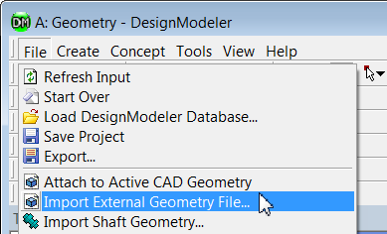
CAD Connections: Approach I
Three ways to import file in WB
Import option on Workbench project page (File → Import)
Geometry cell on project page
Right click for Context Menu
Import in existing DM session
Appends the geometry file to existing geometry in DM
Multiple imports possible

Slide 10
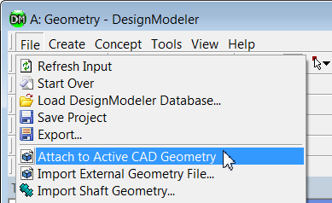
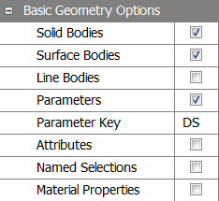
CAD Connections: Approach II
Launch Workbench from CAD system
Bi-Directional CAD Connectivity
Export parameters from CAD to Workbench
Parameter change in CAD reflects in Workbench and vice versa
Bidirectional import from DM session
Attach to Active CAD Geometry
Imports active CAD geometry in DM
Can attach only saved CAD sessions
Parameter Key
Prefix key for importing parameters
Default filter set to DS. Remove to import all parameters
Direct CAD Connection in UG NX
Attach option in DM
Parameter Check Box & Key

Slide 11
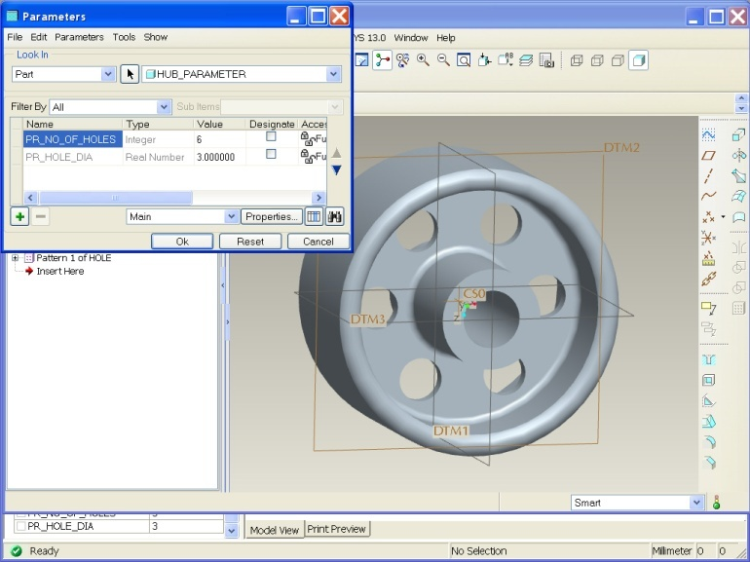
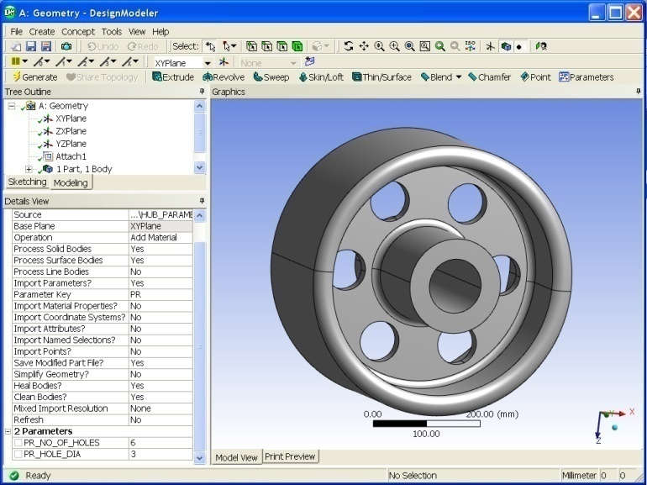
CAD Connections: Bi-Directional CAD
Parameterized Hole Dia and No of Holes
Parameters from CAD to Workbench
Parameters from Workbench to CAD
Pro/ENGINEER
DesignModeler

Slide 12
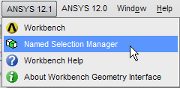
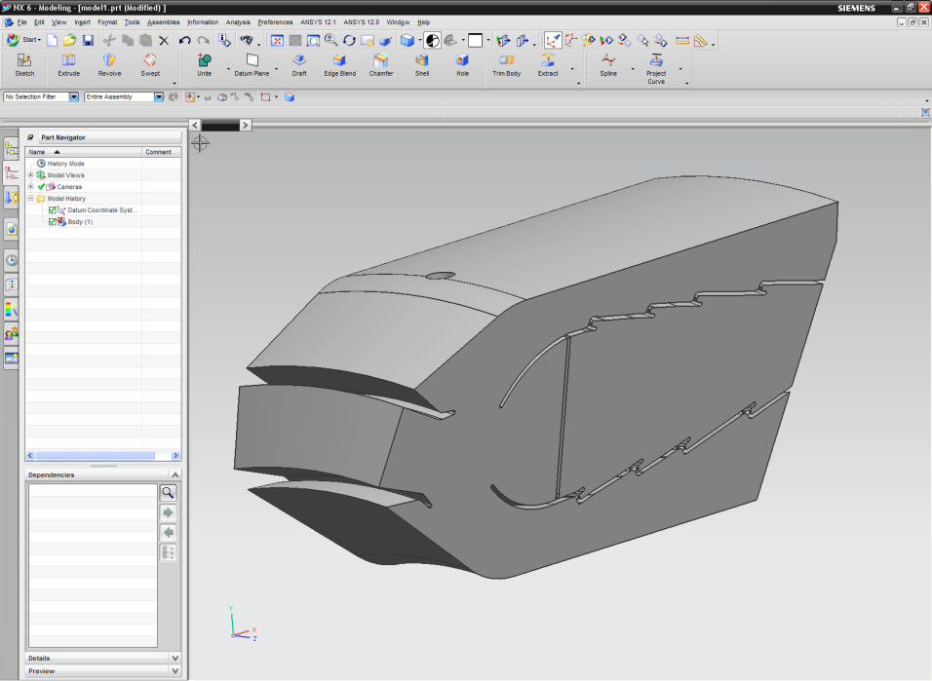
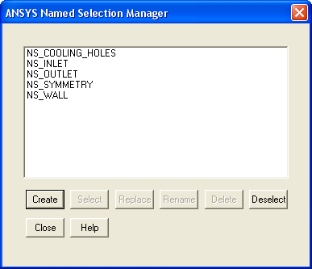
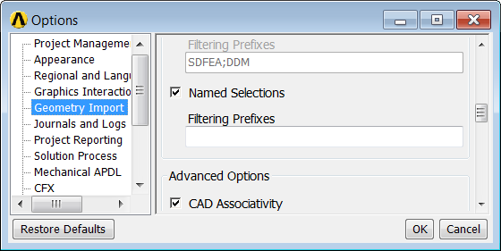
CAD Connections: Named Selection Manager
Named Selections
Define in CAD & transfer to WB
Define directly under WB
Named Selection filter under WB
By default the filter is set to NS
Available if the “Import Named Selections” option is set to Yes
Default filter set to NS. Remove to import all parameters
Named Selection Manager in UG NX
Workbench Geometry Import Options

Slide 13
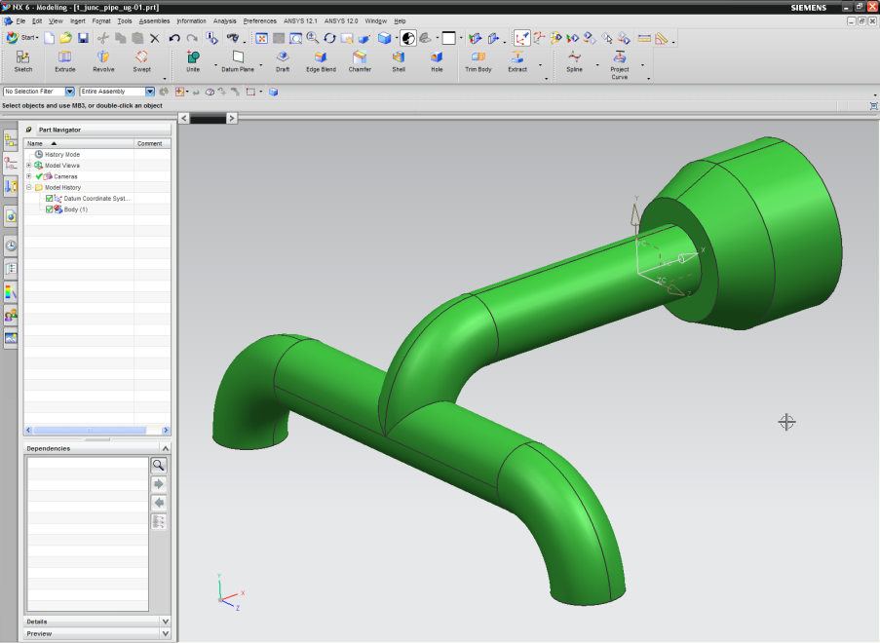
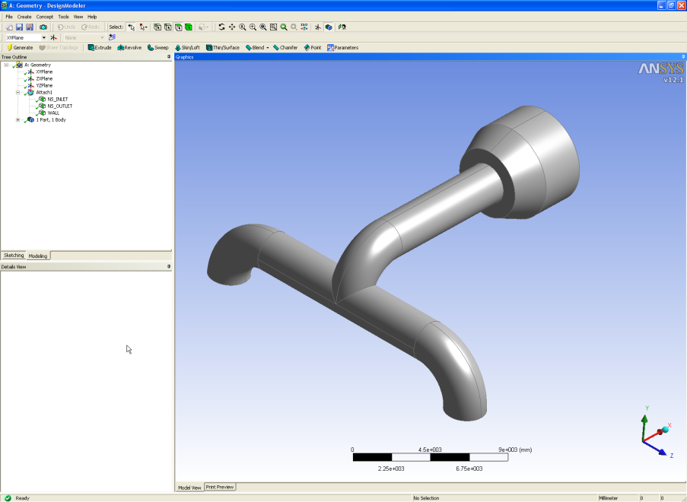
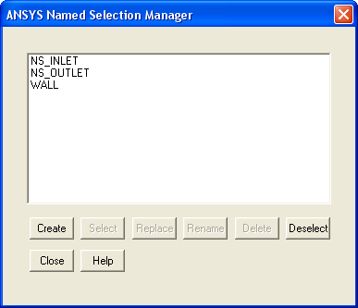
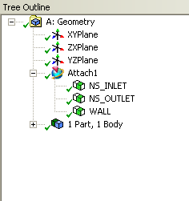
CAD Connections: Named Selection Manager
Named Selection defined in UG NX
Named Selection imported in WB

Slide 14
Pre-requisites for CAD Connections
For all CAD packages
CAD correctly installed and licensed
Correct ANSYS Inc. license
For CATIA
Compatible version of CATIA V5 CAD program (R17, R18, R19, R20 or R21).
IBM LUM 4.6.8 or DSLS configured with a CATIA V5 (MD2, HD2, or ME2) license.
CADNexus CAPRI Gateway V3.15.2.
For UG NX
All NX bodies must be within a 1000 x 1000 x 1000 meter cube, centered about the origin of the absolute coordinate system.
For UG NX
Some solids, surfaces and lines containing Bspline geometries may not import correctly into the DesignModeler application, but should import correctly in the ANSYS Mechanical application.
NX 5.0.6 or higher is recommended for importing models containing spot welds
After installation of ANSYS Workbench, importing an NX model using the Reader mode requires the CAD be launched one time.
Refer to the documentation for further details on licensing requirements

Slide 15
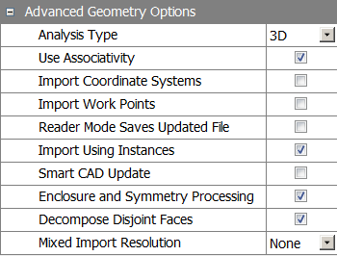
CAD Connections: Advanced Geometry Options
Analysis Type
Specify 2D or 3D simulation
Use Associativity
To allow CAD associativity
Import Coordinate Systems
Import CAD coordinate system
Import Work Points
Import work points defined in CAD
Reader Mode Saves Updated File
Save CAD file at the end of update
Import Using Instances
Import part instances from CAD
Smart CAD Update
Accelerate refresh of modified parts
Enclosure and Symmetry Processing
Automatically creates named selections if turned ON
Mixed Import Resolution
Import parts with mixed dimensions

Slide 16
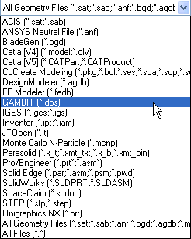
Gambit Reader
Importing Legacy Gambit Models
This is a stand-alone reader that does not require an installation of the GAMBIT program or GAMBIT licenses.
Supports real and virtual geometry import.
No CAD associativity.
No CAD Parameters.
Supports GAMBIT volumes, faces, edges, and vertices (excluding stand-alone vertices).Reads Real (ACIS) geometry from a Gambit database
Does not include reading meshing information

