Slide 1
Workshop 2 Meshing Methods

Slide 2
Introduction
Background
This workshop will introduce different meshing methods available in ANSYS Meshing. A CAD file will be imported directly into the Meshing Application. Access to DesignModeler is required for the final stage of the workshop which demonstrates how decomposition can influence mesh methods.
Objectives
Automatic (Tet Patch Conforming)
Tet Patch Independent
Multizone
Assembly Meshing (CutCell)
Decomposition for Sweep Meshes
Automatic (Tet & Sweep)

Slide 3
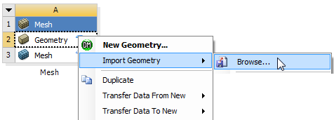
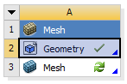
Project Startup
Create the Project
Start Workbench.
Start → All Programs → ANSYS 14.5 → Workbench 14.5
Drag and drop a Mesh Component System into the Project Schematic.
Right click on the Geometry cell (A2) and select Import Geometry → Browse.
Locate the file “component.stp” in the Meshing workshops Input-Files folder and select it. The geometry cell will show a check mark indicating it is up to date.
Double click the mesh cell (A3) to start Meshing.

Slide 4
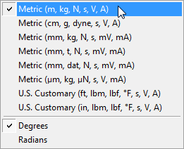
Units
Set Units
From the main menu select Units and, if it is not already set, specify Metric (m...).

Slide 5
Preparation
Planning
This CAD file contains a single body representing a component in a ventilation system.
Flow enters through the upper pipe, passes through the chamber and exits through the lower pipe. There a several small circular vents imprinted on the chamber front face.
Almost all mesh methods can be applied here, the selection of which method to use depends on speed, memory usage, requirement for defeaturing and any mesh specific solver restrictions.
We will demonstrate how different methods are applied (including inflation) and highlight important differences in the resulting meshes.

Slide 6
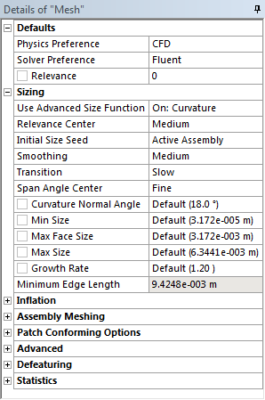
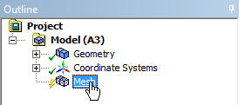
Global Mesh Settings
Mesh
In the Outline, select the Mesh object to display Details of “Mesh”.
In Details of “Mesh”, set the following under Defaults;
Physics Preference: CFD.
Solver Preference: FLUENT.
Under Sizing, set;
Relevance Center: Medium.
Use Advanced Size Function: On: Curvature.

Slide 7
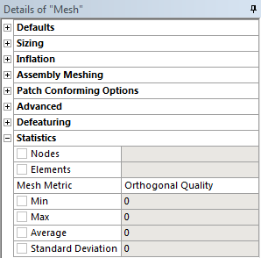
Global Mesh Settings
Mesh
Under Statistics, set;
Mesh Metric: Orthogonal Quality.

Slide 8
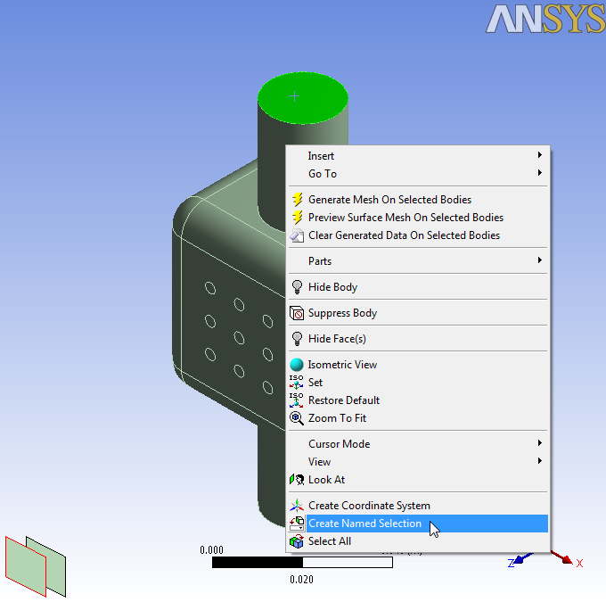
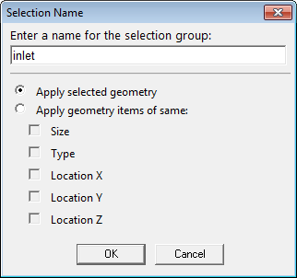
Named Selections
Add Named Selections
Select the Face Selection Filter.
Select the top face as shown below, right click and select Create Named Selection from the Context Menu.
In the Named Selection Dialog Box type the name “inlet” and click OK.

Slide 9
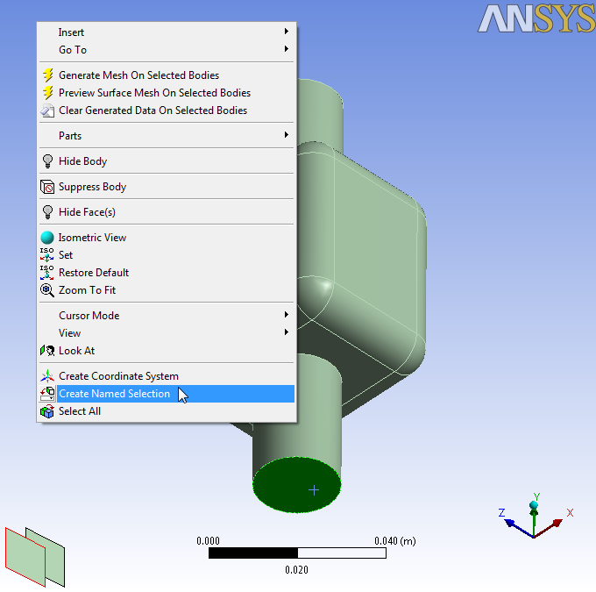
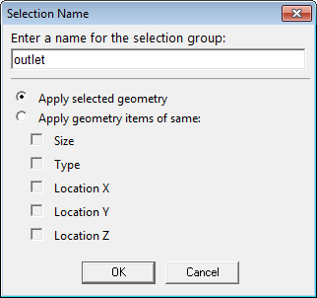
Named Selections
Add Named Selections
Do the same for the lower face as shown below, this time entering the name “outlet”.
The Named Selections will be listed in the Outline (right).

Slide 10
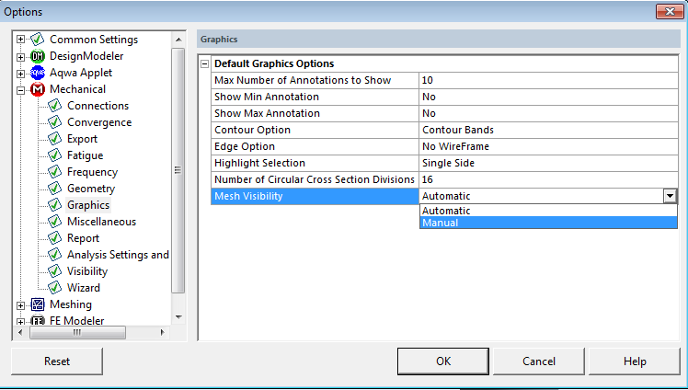
Activating “Show Mesh” Toggle button
In Meshing, go to Tools → Options
This will open Options window
In Options window, under Mechanical → Graphics, set “Mesh Visibility” to Manual
This setting will activate functioning of Show Mesh button in toolbar
Pressing this button will hide/show display of mesh in meshed bodies

Slide 11
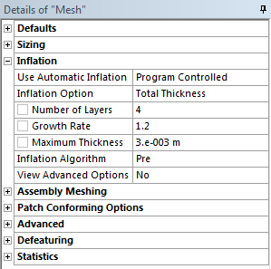
Global Inflation & Automatic Method
Setup Global Inflation
In Details of “Mesh” set the following under Inflation.
Use automatic Inflation: Program Controlled.
Inflation option: Total Thickness.
Number of Layers 4.
Maximum Thickness 0.003m.
This will generate inflation layers on all faces excluding those we have created Named Selections for.
Generate the mesh.

Slide 12
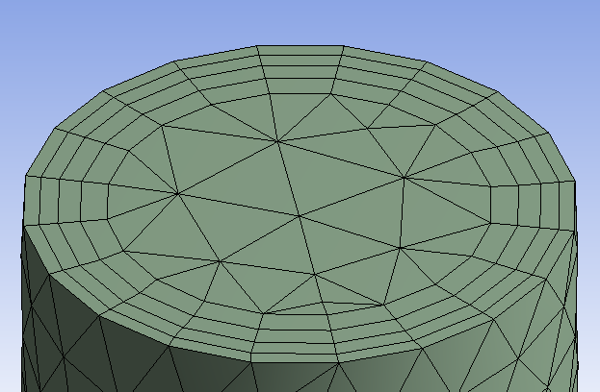
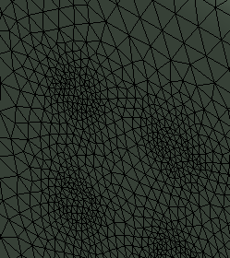
Automatic Method
View the Mesh
Right click in the Graphics Window and select Isometric View from the Context Menu.
Use Show Mesh button to display mesh
The Automatic Method has selected the Tetrahedrons Method using the Patch Conforming Algorithm.
The mesh has conformed to all geometric details.
All surfaces except the inlet and outlet Named Selections have been inflated.

Slide 13
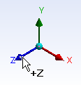
Automatic Method
Create a Section Plane
Snap to the +Z view using the Axis Triad.
Select the Section Plane button.
Create a Section Plane by clicking, dragging and releasing as shown vertically down through the mesh.
Restore the Isometric View using the right click Context Menu or the Axis Triad.

Slide 14
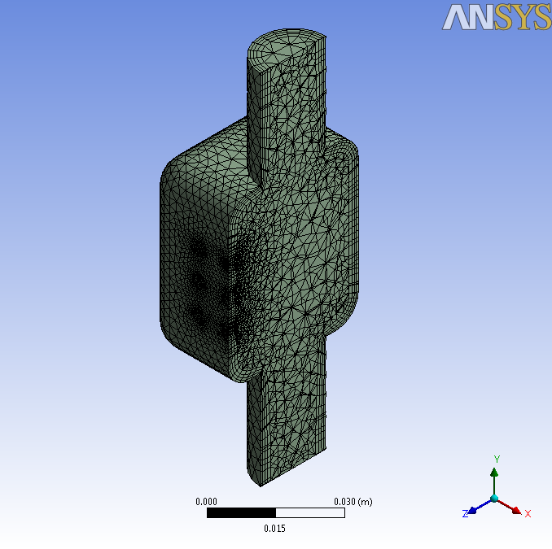
Automatic Method
View the Mesh Interior
Zoom in using the Box Zoom button to inspect the mesh. Use the Zoom to Fit button to restore the view extents.
The default Automatic Method always uses Patch Conforming Tetrahedrons and/or Sweep depending on the Geometry – in this non-sweepable case just Patch Conforming Tetrahedrons were used. We’ll now look at how other methods can be accessed.
Switch off the Section Plane by unchecking the box in the Panel.

Slide 15
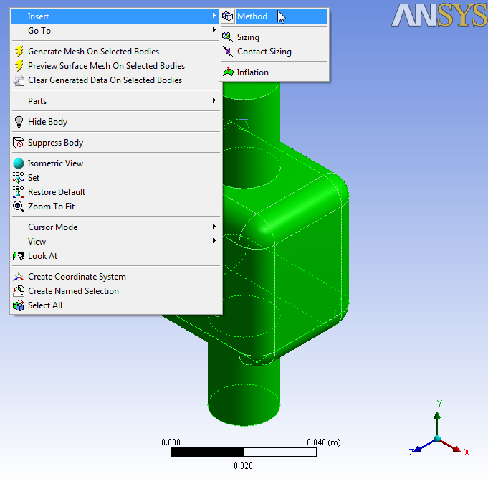
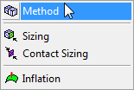
Inserting Methods Manually
Insert a Method
Right click on the Mesh object in the Outline and select Clear Generated Data from the Context Menu selecting Yes when prompted to confirm.
Select the Body Selection Filter.
In the Graphics Window, select the body, right click and select Insert > Method from the Context Menu as shown.

Slide 16
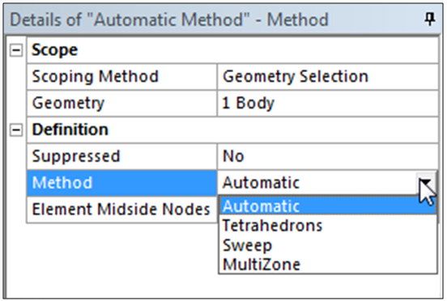
Setting Method Details
Set Method Details
A Method Object, defaulting to Automatic, is inserted in the Outline.
In the Method Details the Method Type is accessed via a drop down box exposing the available mesh methods.
The Method set here is applied to the body initially selected.

Slide 17
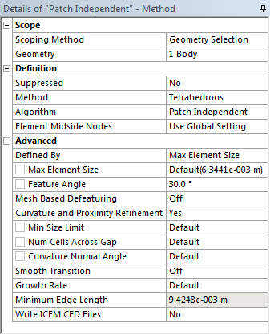
Tetrahedrons Patch Independent
Set Method Details
The Automatic Method is the same as the default we have just demonstrated.
Set Method to Tetrahedrons.
Set Algorithm to Patch Independent.
We have already seen Patch conforming used with the Automatic Method.
When Patch Independent is selected a number of Patch Independent specific settings appear controlling sizing and defeaturing. These can be left to the defaults.
Generate the mesh.

Slide 18
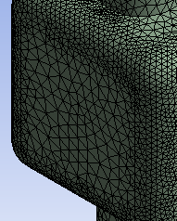
Tetrahedrons Patch Independent
View the Mesh
The Patch Independent Method uses a different and specific type of inflation algorithm (Post), the message box may indicate this along with a warning regarding mesh resolution. You may have also noticed it has taken more time to generate the mesh.
Note the automatic defeaturing of the small imprinted faces present on the geometry.
This behaviour can be useful for defeaturing large CAD models.
Switch on the Section Plane to view the mesh interior.

Slide 19
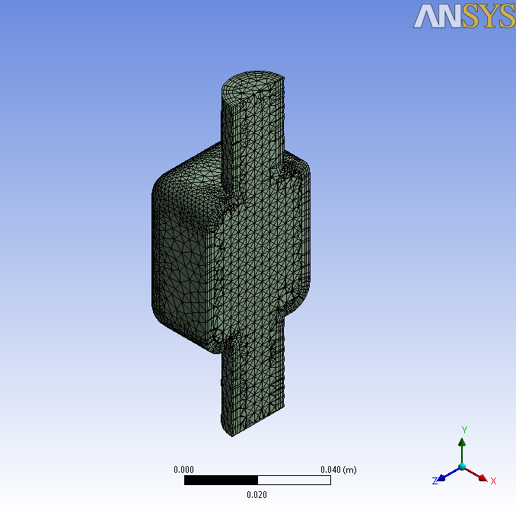
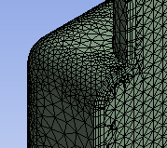
Tetrahedrons Patch Independent
View the Mesh Interior
Note the inflation and internal structure of the mesh.
When ready to proceed, switch off the Section Plane and clear the mesh as before. By right clicking on the Mesh Object in the Outline and Selecting Clear Generated Data from the Context Menu.

Slide 20
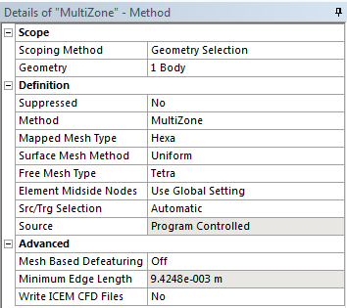
MultiZone
Set Method Details
Select the Method Object in the Outline (it assumes the name of the current set Method).
In the Details change the Method to MultiZone.
The details will change to those specific to the MultiZone Method
Set Surface Mesh method to “Uniform”
Set Free Mesh Type to “Tetra”
Generate the mesh.

Slide 21
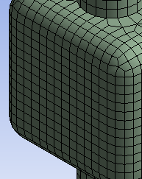
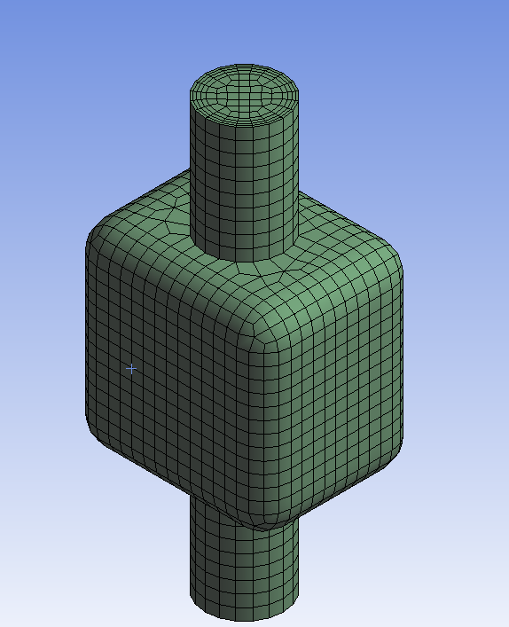
MultiZone
View the Mesh
MultiZone has generated an all quad surface mesh.
Note again, the automatic defeaturing of the small imprinted faces present on the geometry.
Multizone is also a method that is categorised as Patch Independent and, like the Tetrahedrons Patch Independent Method is capable of automatic defeaturing.
Switch on the Section Plane to view the mesh interior.

Slide 22
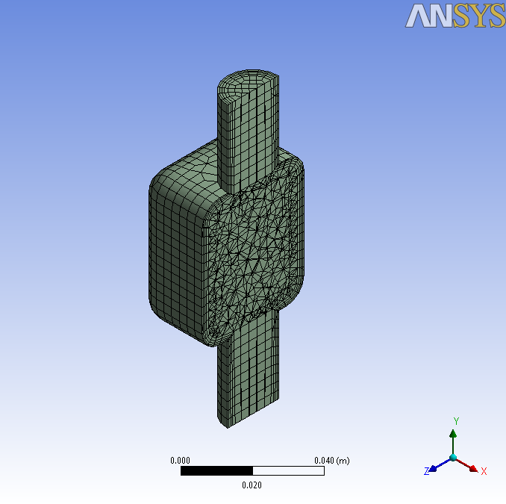
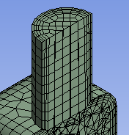
MultiZone
View the Mesh Interior
MultiZone has automatically created structured hex cells where possible and used tetrahedrons elsewhere.
The type of mesh used in the unstructured region was determined by the Free Mesh setting which we set to Tetra.
This automatic decomposition is, in the Meshing Application, a feature unique to MultiZone.
Switch off the Section Plane and clear the mesh when ready to proceed.

Slide 23
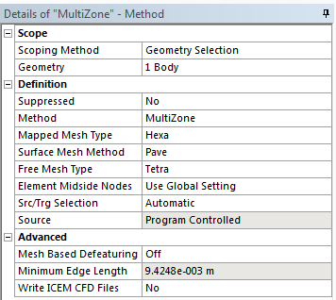
MultiZone
In the Details, change Surface Mesh Method to “Pave”.
Keep Mapped Mesh Type to “Hexa”
Keep Free Mesh Type to “Tetra”
Generate the mesh.

Slide 24
MultiZone
View the Mesh
MultiZone has again generated an all quad surface mesh.
Note again, the automatic defeaturing of the small imprinted faces present on the geometry.
See the difference between surface meshes created by this “Pave” method and previous “Uniform” method (especially for circular source faces)

Slide 25
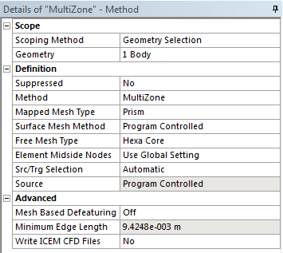
MultiZone
In the Details, change Mapped Mesh Type to “Prism”.
Set Surface Mesh Method to “Program Controlled”
“Program Controlled” tries the best suitable method for that particular face for best quality
Set Free Mesh Type to “Hexa Core”
Generate the mesh.

Slide 26
MultiZone
View the Mesh
MultiZone has generated a quad + tri surface mesh.
The circular source face has tri mesh (except quad imprints of Inflation) for generating prisms/wedges by extruding it
In central non-structured region, it has mostly created quads on surface as Hexa Core was selected
Switch on the Section Plane to view the mesh interior.

Slide 27
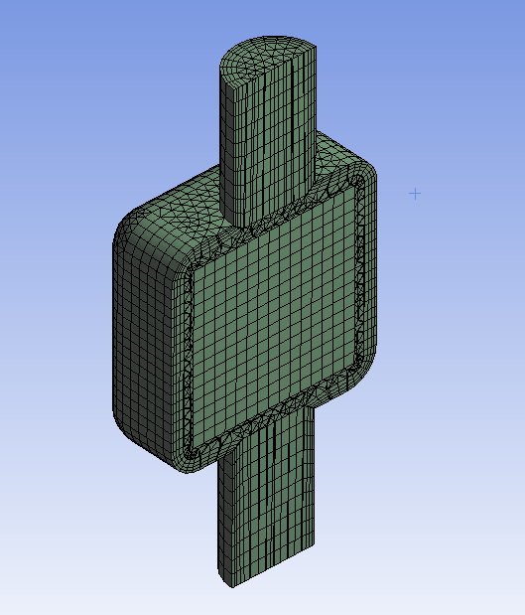
MultiZone
View the Mesh Interior
MultiZone has automatically created structured hex cells where possible and created mostly hex elements in unstructured regions as “Hexa Core” was selected.
To capture boundary features, it has created tet near boundary
It has created pyramids for transition from hex to tet
Switch off the Section Plane and clear the mesh when ready to proceed.

Slide 28
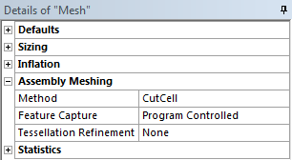
Assembly Meshing - CutCell
Activate Assembly Meshing
Assembly Meshing is not inserted as a method but must be activated in the Global Details.
Suppress the Method Object by right clicking on it in the Outline and selecting Suppress.
This will deactivate the method but will preserve the settings should we decide to reuse it.
Select the Mesh Object in the Outline to display Details of “Mesh”.
Under Assembly Meshing set Method to CutCell and Tessellation Refinement to None.

Slide 29
Assembly Meshing - CutCell
Set Model Material
Assembly meshing requires that the model material be specified either in the geometry application or in meshing.
Select the body in the Outline as shown to display its details.
In the Details, under Material, set Fluid/Solid to Fluid.
Generate the Mesh.

Slide 30
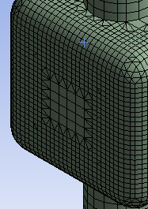
Assembly Meshing - CutCell
View the Mesh
Assembly/CutCell produces a cartesian CutCell mesh which imprints to the geometry.
It is a Patch Independent method and so demonstrates defeaturing. It produces a large quantity of hex cells and is useful in cases that would otherwise require significant geometry cleanup.
Switch on the Section Plane to view the mesh interior.

Slide 31
Assembly Meshing - CutCell
View the Mesh Interior
The Assembly Meshing/CutCell method has filled the geometry with primarily hex cells using Tetrahedron, Pyramid and Wedge cells where required.
Switch off the Section Plane and clear the mesh when ready to proceed.
We will now look at Sweep Meshing.
In the Details of “Mesh”, under Assembly Meshing Set Method to None to deactivate it.

Slide 32
Save the Project
If you do not have access to DesignModeler the workshop is now complete and you can save the Project.
From the Workbench Project Page use the file menu and save the project as “AMWS2.wbpj” to your working folder.
If you do have access to DesignModeler proceed to the next slide.

Slide 33
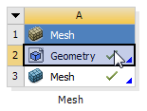
Sweep Meshing
Sweep Requirement
The Sweep Method can produce high quality, accurate meshes quickly.
In order to generate a sweep mesh we must have sweepable bodies.
We will decompose the geometry in DesignModeler to illustrate how this can be accomplished.
From the Workbench Project Page, launch DesignModeler by double clicking the Geometry Cell (A2).
Leave the Meshing Application Open.

Slide 34
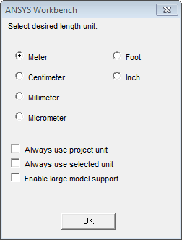
DesignModeler
Set Units
When DesignModeler starts up select Meter in the Units Selection Box and click OK.

Slide 35
Preparation
Planning
A simple way of decomposing this geometry into sweepable bodies would be to separate the upper and lower cylindrical bodies.
As separate bodies they meet the criteria for the Sweep Method.
Source Face
Mappable Side Face
Decompose by Slicing
Target Face
Single Body
Multi-Body

Slide 36
Decomposition
Slice the Geometry
The geometry import will require generation first.
Click Generate.
Select Slice from the Create Menu.
In the Details View set Slice Type to Slice by Edge Loop.
Activate the Edges Selection Box and select the two edges as shown.
Apply the selection.
Generate.

Slide 37
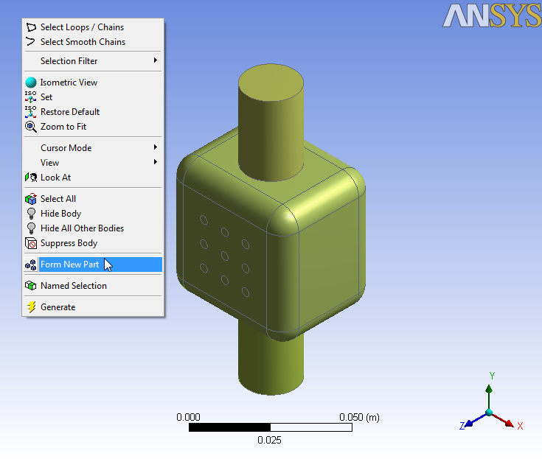
Decomposition
Slice the Geometry
Select the three bodies, right click and select Form New Part from the Context Menu.
Check you have 1 Part, 3 Bodies .
Close DesignModeler.

Slide 38
Automatic Method (Tetra & Sweep)
Method Setup
In the Meshing Application right click on Geometry in the Outline and select Update Geometry from Source.
Like Patch Conforming Tetrahedrons, we can insert the Sweep Method manually or simply allow the Automatic Method to allocate the methods for us.
We will mesh the modified geometry using the Automatic Method to demonstrate this.
Since we have deactivated assembly meshing and suppressed the method we had used earlier the Meshing Application will now default to the Automatic Method.

Slide 39
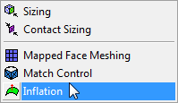
Automatic Method (Tetra & Sweep)
Inflation for Sweepable Bodies
The Global Program Controlled Inflation we have used so far is not compatible with Sweep meshing so we must create a local inflation control.
Select the two faces as shown, right click and select Insert > Inflation from the Context Menu.
The Meshing Application will inflate from the boundary edges of these faces and treat them as source faces for the sweep meshes.

Slide 40
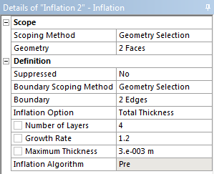
Automatic Method (Tetra & Sweep)
Inflation for Sweepable Bodies
In Details of “Inflation ” activate the Boundary Selection Box, select the two edges bounding each of the source faces as shown and apply the selection.
Set the Following;
Inflation Option: Total Thickness.
Number of Layers: 4.
Maximum Thickness 0.003m.
Generate the mesh.

Slide 41
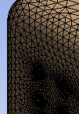
Automatic Method (Tetra & Sweep)
View the Mesh
The Automatic Method has produced hex swept meshes with inflation in the cylindrical bodies and Patch Conforming Tetrahedrons in the Chamber body.
Switch on the Section Plane to view the mesh interior.

Slide 42
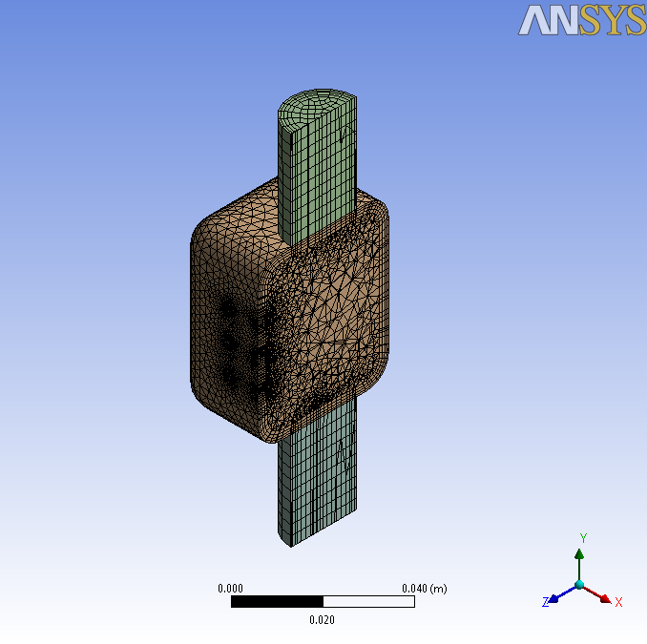
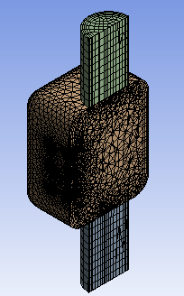
Automatic Method (Tetra & Sweep)
View the Mesh Interior
The global inflation used in the chamber body has ‘stair stepped’ down to the interface between the bodies (you will have seen a message indicating this)
You could add a local inflation control to the chamber body to create continuous layers.
Although Sweep meshes generally require more consideration during geometry construction or CAD decomposition they produce good quality meshes quickly and efficiently and when combined with tetrahedral methods prove to be an accurate, flexible and well validated approach.

Slide 43
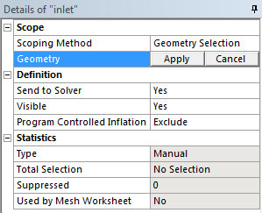
Named Selections
Reassign Named Selections
You can reassign the Named Selections by selecting them in the outline.
Activate the Geometry Selection Box in the Details, reselect the appropriate face and apply.
Do this for the outlet too.

Slide 44
Save the Project
This completes the workshop.
From the main menu select File → Close Meshing
Workbench will save any application data.
From the Workbench Project Page use the file menu and save the project as “AMWS2.wbpj” to your working folder.

