Slide 1
Workshop 06 Using Moving Reference Frames and Sliding Meshes

Slide 2
I Introduction
Workshop Description:
The flow simulated is a vertical axis wind-turbine in which 4 outer blades rotate relative to an inner hub, itself turning about a central axis.
Learning Aims:
This workshop teaches two different strategies for handling moving objects within the flow domain.
Using a Moving Reference Frame approach (which uses a steady-state solution).
Using a Sliding Mesh approach (a transient calculation in which the parts are actually moved each timestep).
Learning Objectives:
To understand ways of simulating moving parts, as well as introducing transient simulations and generating images on-the-fly.
Introduction
MRF Setup
Summary
Solve & Postpro
Sliding Mesh
Solve & Postpro

Slide 3
Introduction
To understand the motion we will be simulating, play the supplied movie file
‘ws6-mesh-animation.avi’. The centers of the blades rotate about the axis displayed in the picture while each individual blade simultaneously rotates about its own center.
The first part of this workshop will simulate this motion without actually moving the parts. Local accelerations can be added as source terms to each grid cell to account for the motion of the parts. This technique is known as a Moving Reference Frame (MRF) approach.
The second part of this workshop will actually move
the parts relative to each other. This technique is
known as a Sliding Mesh approach.
Blade ‘ypos’
Blade ‘xneg’
y
Blade ‘xpos’
x
Blade ‘yneg’
Introduction
MRF Setup
Summary
Solve & Postpro
Sliding Mesh
Solve & Postpro

Slide 4
Part 1 : Using Moving Reference Frames
Introduction
MRF Setup
Summary
Solve & Postpro
Sliding Mesh
Solve & Postpro

Slide 5
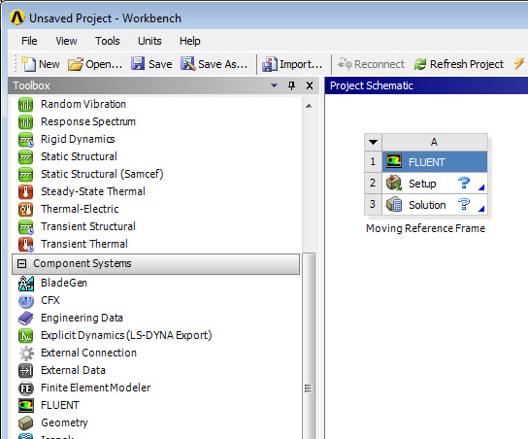
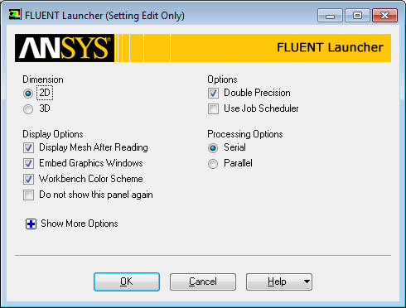
Starting Fluent in Workbench
Launch Workbench
Start > Programs > ANSYS 14.5 > Workbench 14.5
Drag Fluent (‘Component Systems’) into the project schematic
Change the name to Moving Reference Frame
Double click on Setup
Choose 2D and
“Double Precision” under
Options and retain the other
default settings
Introduction
MRF Setup
Summary
Solve & Postpro
Sliding Mesh
Solve & Postpro

Slide 6
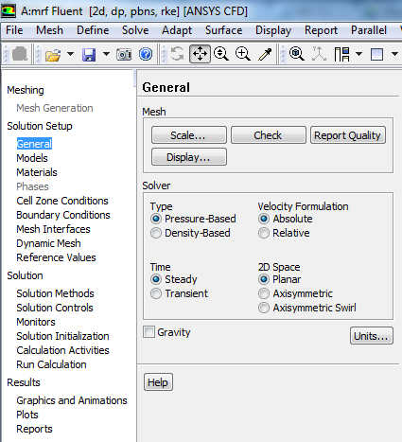
Import Mesh
[In Fluent] File > Import > Mesh
Select the mesh file ws6-simple-wind-turbine.msh and OK.
Check the scale (Problem Setup > General > Scale). The blades are 1m radius from the origin (0,0), with the outer bounding box +/- 5m in all directions.
After reading the mesh, check the grid using Mesh > Check option or by using Check under Problem Setup > General.
The mesh check will fail! A number of warning messages such as “WARNING: Unassigned interface zone detected for interface xx” will be displayed.
To allow for the motion later in this workshop, there are intentional non-conformal interfaces (where the mesh nodes do not match across an interface). These need to be paired up in the solver so that interpolation across the interface can occur – so fluid can flow freely through.
More generally, if in DesignModeler you produce several different parts, the mesh will also be non-conformal, and you will need to perform the next step to make sure the solver interpolates across the interface, otherwise the interfaces would act like walls when the flow is calculated.
Introduction
MRF Setup
Summary
Solve & Postpro
Sliding Mesh
Solve & Postpro

Slide 7
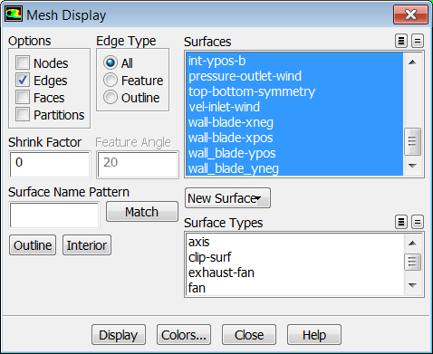
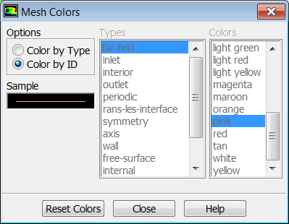
Display Mesh
To display the mesh such that the zones have different colors, as in the picture on slide 3, select Display > Mesh from the menu bar, click the Colors… button, and select Color by ID.

Slide 8
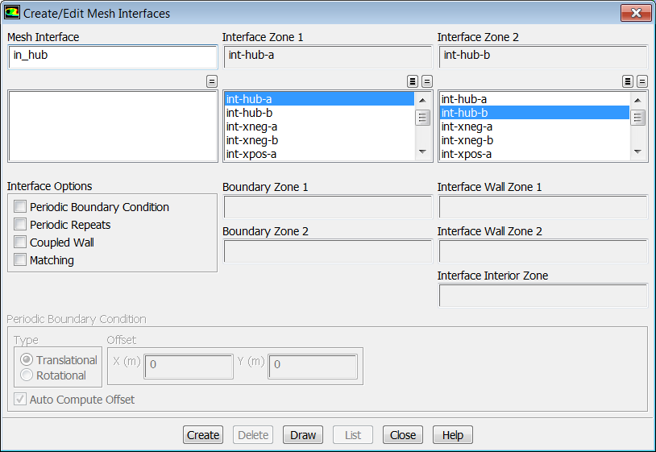
Mesh Interfaces
Under Solution Setup > Mesh Interfaces
Click Create/Edit
Enter “in-hub” in the field below Mesh Interface
Select “int-hub-a” in the column below Interface Zone 1
Select “int-hub-b” in the column below Interface Zone 2
Click Create
Note how the nodes do not match across the interface.
The boundary on the black side is ‘Int-hub-a’ and the red side is ‘Int-hub-b’
Introduction
MRF Setup
Summary
Solve & Postpro
Sliding Mesh
Solve & Postpro

Slide 9
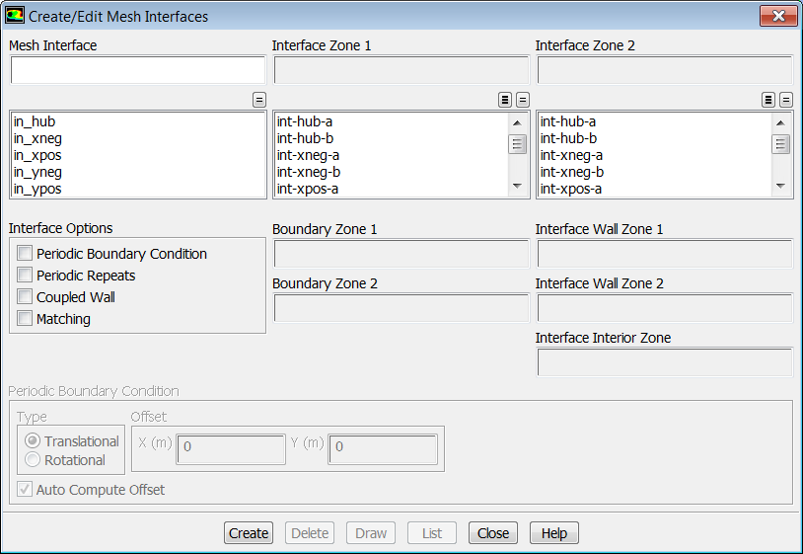
Mesh Interfaces
Create the interfaces in_xneg, in_xpos, in_yneg and in_ypos as described in the table below to the left. After all the interfaces have been created the mesh interface panel should appear as it does on the right:
Mesh Interface | Interface Zone 1 | Interface Zone 2
in_hub | int-hub-a | int-hub-b
in_xneg | int-xneg-a | int-xneg-b
in_xpos | int-xpos-a | int-xpos-b
in_yneg | int-yneg-a | int-yneg-b
in_ypos | int-ypos-a | int-ypos-b
Introduction
MRF Setup
Summary
Solve & Postpro
Sliding Mesh
Solve & Postpro

Slide 10
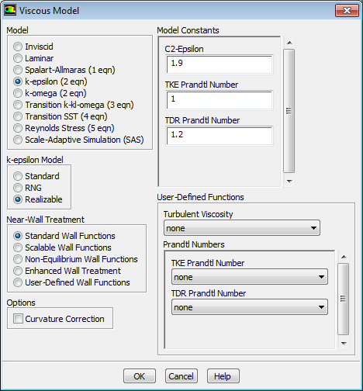
Setting up the Models
Keep the Pressure Based, Steady State solver
Solution Setup > General > Solver
Turbulence model
Solution Setup > Models > Viscous
Double click and select k-epsilon (2 eqn) under
Model and Realizable under k-epsilon model and retain the other default settings
Materials
For Materials, keep the default properties of
the material air:
density: 1.225 kg/m³
viscosity: 1.7894e-5 kg/(m·s)
Introduction
MRF Setup
Summary
Solve & Postpro
Sliding Mesh
Solve & Postpro

Slide 11
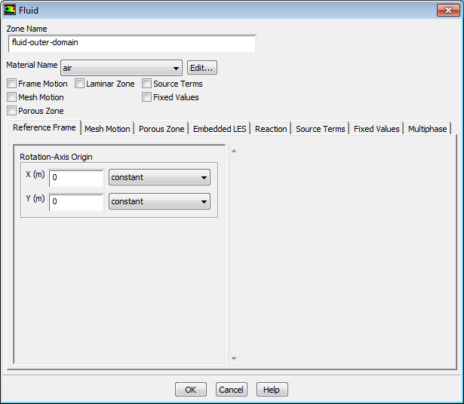
Cell Zone Conditions (1)
Under Solution Setup > Cell Zone Conditions
Select fluid-outer-domain and click Edit
Observe air is already selected and click OK
fluid-outer-domain
fluid-blade-ypos centroid at (0,1)
fluid-rotating-core
centroid at (0,0)
fluid-blade-xneg
centroid at (-1,0)
fluid-blade-xpos
centroid at (1,0)
fluid-blade-yneg
centroid at (0,-1)
Introduction
MRF Setup
Summary
Solve & Postpro
Sliding Mesh
Solve & Postpro

Slide 12
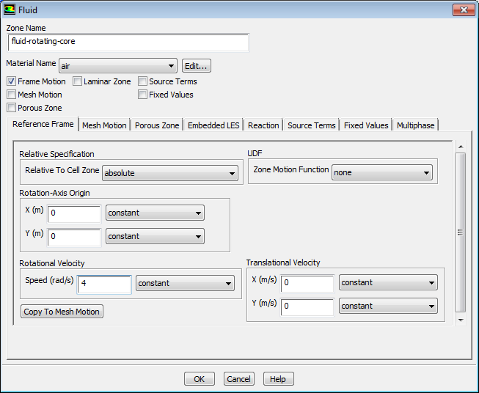
Cell Zone Conditions (2)
Select fluid-rotating-core and click Edit
Observe air is already selected
Click Frame Motion, to activate the Moving Reference Frame model
Retain the (0 0) as Rotational-Axis Origin
Select 4 rad/s as Rotational Velocity and click OK
We can account for the motion of the parts, even in a steady state solver by using this technique. By specifying the rotation of the core, all the grid cells are given an additional source term to account for the local acceleration. This is known as using a moving reference frame.
Introduction
MRF Setup
Summary
Solve & Postpro
Sliding Mesh
Solve & Postpro

Slide 13
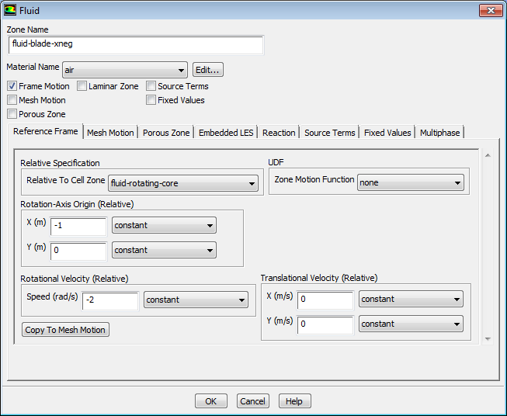
Cell Zone Conditions (3)
Select fluid-blade-xneg and click Edit
Observe air is already selected
Click Frame Motion, to activate the Moving Reference Frame model
Set the Rotational-Axis Origin to [-1 0] (see figure on Slide 9)
Set the Rotational Velocity to -2 rad/s (note negative)
Select fluid-rotating-core as Relative Specification and click OK
This zone is rotating about its own axis, which is 1m away from the global (hub) axis. The rotation speed is half that of the outer hub.
Introduction
MRF Setup
Summary
Solve & Postpro
Sliding Mesh
Solve & Postpro

Slide 14
Cell Zone Conditions (4)
Repeat the instructions on the previous Slide for the other 3 blades:
Zone fluid-blade-xpos Axis [1 0] Speed -2rad/s Relative fluid-rotating-core
Zone fluid-blade-yneg Axis [0 -1] Speed -2rad/s Relative fluid-rotating-core
Zone fluid-blade-ypos Axis [0 1] Speed -2rad/s Relative fluid-rotating-core
It is worth taking a moment to check back through all the cell zones just defined to make sure the settings are correct.
Axis is different for each zone
Introduction
MRF Setup
Summary
Solve & Postpro
Sliding Mesh
Solve & Postpro

Slide 15
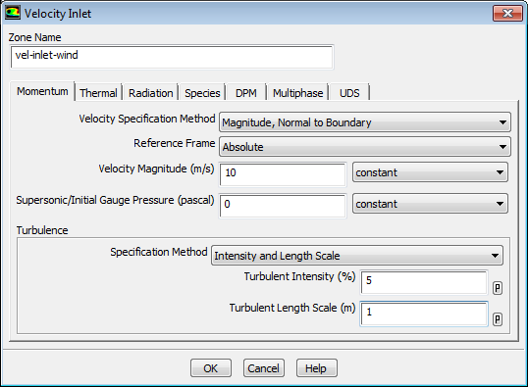
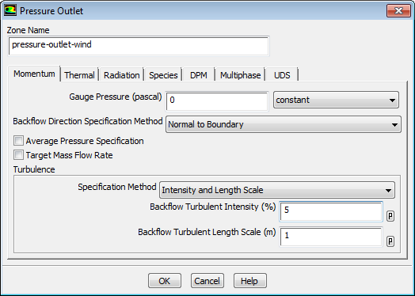
Boundary Conditions (1)
Under Solution Setup > Boundary Conditions
vel-inlet-wind
Select vel-inlet-wind, click Edit and set 10 m/s as Velocity Magnitude
Choose Intensity and Length Scale under Turbulence
Set Turbulent Intensity to 5 % and Turbulent Length Scale to 1 m and click OK
pressure-outlet-wind
Select pressure-outlet-wind, click Edit and set 0 Pa as Gauge Pressure
Choose Intensity and Length Scale under Turbulence
Set Turbulence Intensity to 5 % and Turbulent Length Scale to 1 m and click OK
Introduction
MRF Setup
Summary
Solve & Postpro
Sliding Mesh
Solve & Postpro

Slide 16
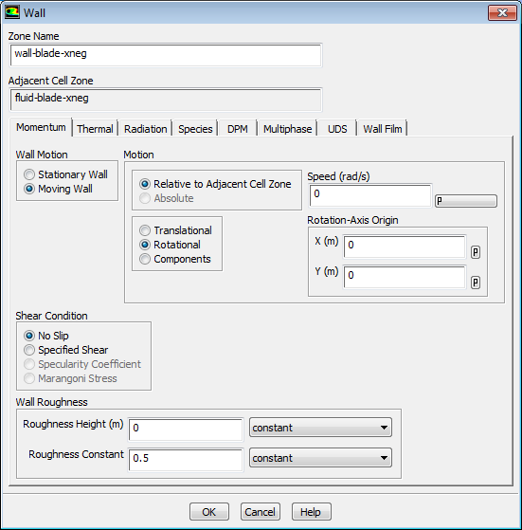
Boundary Conditions (2)
Under Solution Setup > Boundary Conditions
Rotating wall
Select wall-blade-xneg then Edit
select Moving Wall under Wall Motion
Select Rotational under Motion and retain 0 rad/s as Speed relative to cell zone
The solver needs to know the speed of the wall so as to properly account for wall shear. Since the motion has been set in the cell zone, we will simply tell the boundary condition to use the same conditions (that is, zero velocity with respect to the cell zone).
Note that this panel will tell you which cell zone is adjacent to this wall – look at the greyed-out box on the second line.
Introduction
MRF Setup
Summary
Solve & Postpro
Sliding Mesh
Solve & Postpro

Slide 17
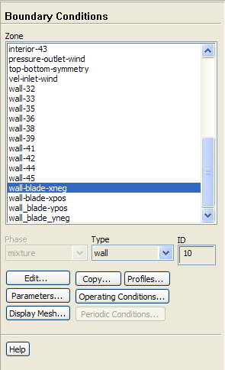
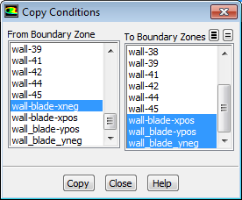
Boundary Conditions (3)
Select Copy
Select wall-blade-xneg
Select the three other blades zone (wall-blade-xpos, wall-blade-yneg, wall-blade-ypos)
Click Copy, then OK
Copy the boundary conditions to other zones
To save time, when boundaries have identical parameters, we can copy from one to (many) others.
Introduction
MRF Setup
Summary
Solve & Postpro
Sliding Mesh
Solve & Postpro

Slide 18
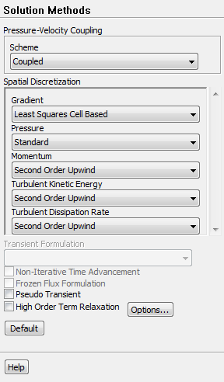
Solution Methods
Under Solution > Solution Methods
Select “Coupled“ for Pressure-Velocity Coupling
Select “Second Order Upwind“ for the turbulence equations
Under Solution > Solution Controls
Retain the default settings
Under Solution > Solution Initialization
Retain Hybrid Initialization
click Initialize
Introduction
MRF Setup
Summary
Solve & Postpro
Sliding Mesh
Solve & Postpro

Slide 19
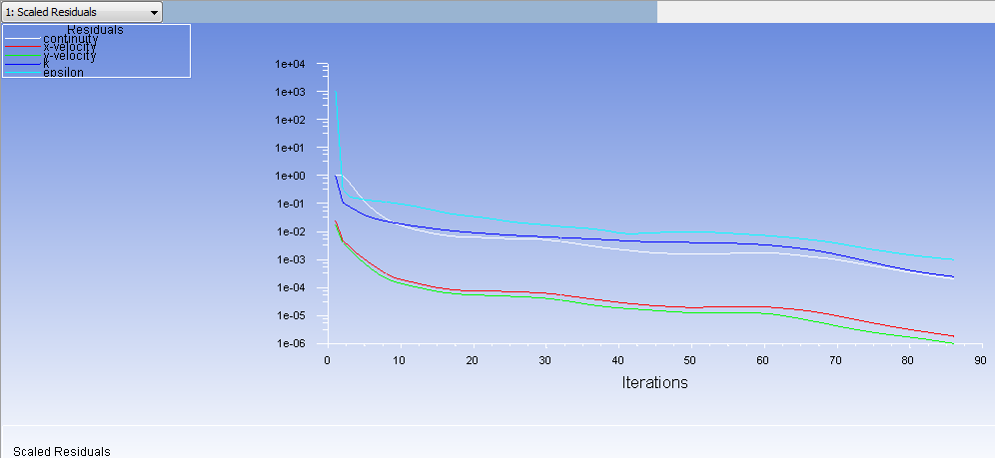
Write Case and Data File
The model is now ready to run.
First Save the Project to your normal working directory
File > Save Project
Then Run the Calculation
Set 250 as Number of Iterations
Click Calculate to start the steady state simulation
It will reach the default convergence criteria in about 100 iterations
Generally you should always do further checks to determine convergence. However to save time in this example we will simply assume the default convergence criteria are sufficient.
Introduction
MRF Setup
Summary
Solve & Postpro
Sliding Mesh
Solve & Postpro

Slide 20
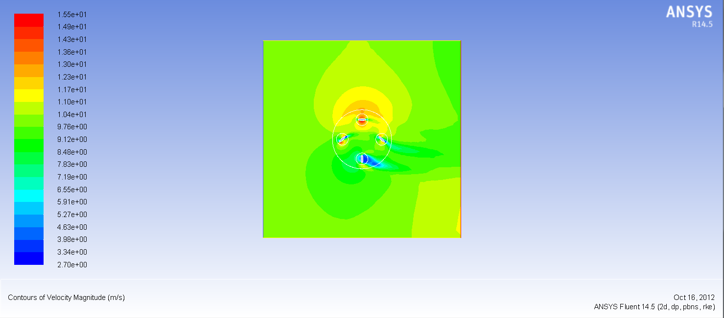
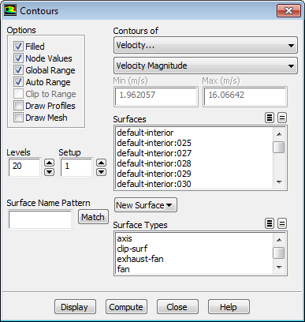
Post-Processing
Post-process the results in Fluent
Results > Graphics and Animations
Select Contours and click Set Up
Select Velocity under Contours of and Velocity Magnitude below that
Tick the box “Filled“, but do not select any surfaces, then Display
Zoom in on the hub using the middle mouse button, by drawing a box from top-left to bottom-right
It is not necessary to select a plotting surface when using Fluent in 2D. By default the plot value is shown on all cells.
Drag zoom box with middle mouse button.
Opposite direction (right to left) will zoom out
Use ‘Fit To Window’ to reset if necessary
Introduction
MRF Setup
Summary
Solve & Postpro
Sliding Mesh
Solve & Postpro

Slide 21
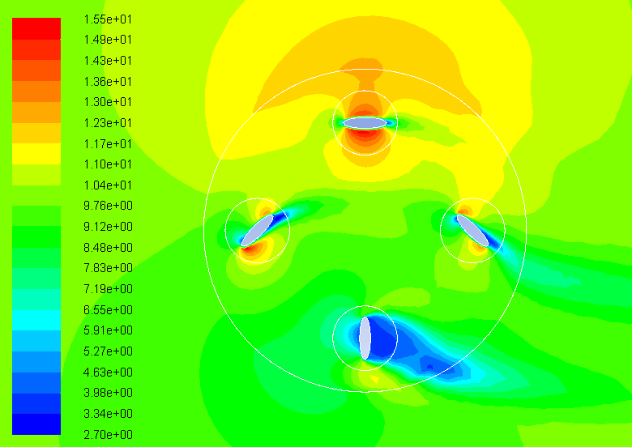
Post-Processing [2]
The Velocity contours should look like this:
Without the cell zone motion (MRF) this would have looked much more symmetrical between top and bottom
You can save this image from Fluent for use in a report:
File > Save Picture
TIFF, and Colour
Resolution 1200 x 1200
‘Save’
10 m/s wind
4 rad/s Hub Rotation
Save the project
File > Save Project
Close Fluent, and return to the ANSYS Workbench window.
Introduction
MRF Setup
Summary
Solve & Postpro
Sliding Mesh
Solve & Postpro

Slide 22
Part 2 : Using Sliding Meshes
Introduction
MRF Setup
Summary
Solve & Postpro
Sliding Mesh
Solve & Postpro

Slide 23
Sliding Meshes - Introduction
There are times when the MRF assumption used in Part 1 is an over-simplification of the problem.
Only one position of the hub relative to the incoming wind was simulated
There will also be some vortices that affect each blade from other blades that have just passed upwind.
In this next part, we will actually move the relative positions of all the components within Fluent, and solve this in a transient (time-dependent) manner.
Introduction
MRF Setup
Summary
Solve & Postpro
Sliding Mesh
Solve & Postpro

Slide 24
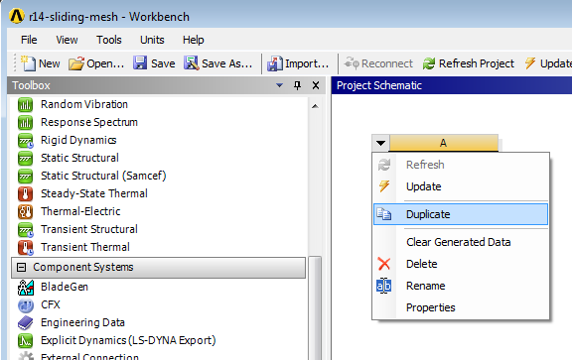
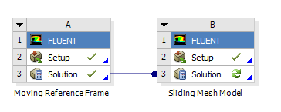
Preparing Workbench
On the Workbench Project Page, right-click on the arrow at the top of the Fluent model, and select ‘Duplicate’
Name the newly created copy ‘Sliding Mesh Model’
Drag the results over from the MRF model (drag a line from cell A3 to B3)
This is so we can use the steady-state solution as a starting point for the new Sliding Mesh computation.
Launch Fluent by double clicking on the new Solution cell (B3)
The message “Note: zone-surface: cannot create surface from sliding interface zone” appears when Fluent opens and reads the case and data files. It simply means the boundaries of the non-conformal interfaces match exactly, such that there are no non-overlapping sections on either side of the interface.
Introduction
MRF Setup
Summary
Solve & Postpro
Sliding Mesh
Solve & Postpro

Slide 25
Model Setup – General Comments
All the model setup values (boundary conditions, etc) are available in the new Fluent session.
You may want to have a look (boundary conditions, plot velocity contours etc) to observe this for yourself. It is important to have opened Fluent by double clicking on the Solution cell (not the Setup cell) in the previous slide.
The following slides will show how to change this model to a sliding mesh case.
Introduction
MRF Setup
Summary
Solve & Postpro
Sliding Mesh
Solve & Postpro

Slide 26
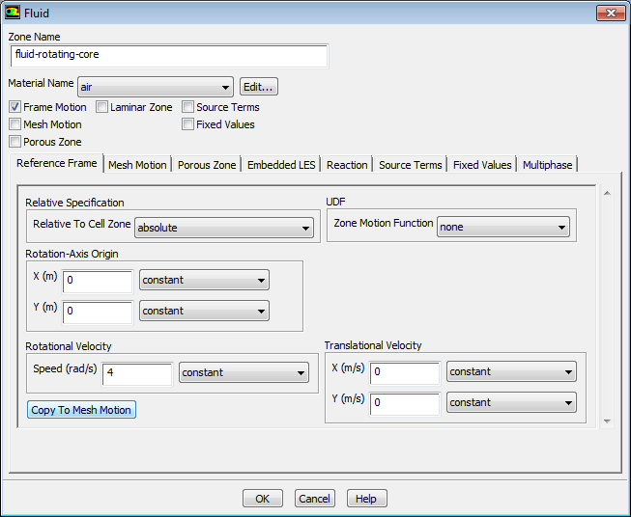
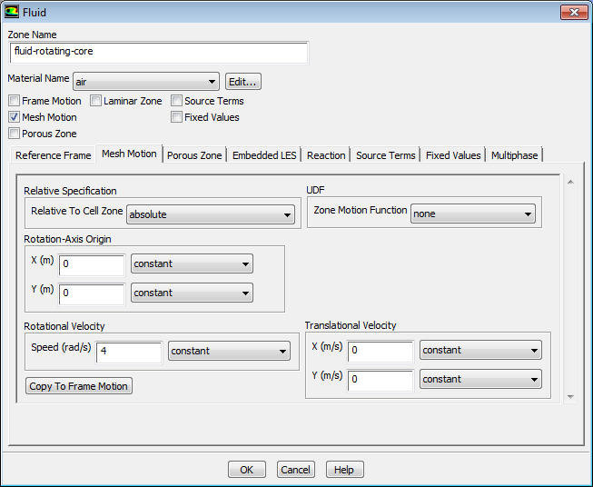
Solver Setup
Select Transient solver
Solution Setup > General > Solver > Transient
Under Solution Setup > Cell Zone Conditions
Select fluid-rotating-core and click Edit
Click Copy to Mesh Motion in the
Reference Frame Tab to activate the Sliding Mesh model
The motion type is changed from ‘Frame Motion’
to ‘Mesh Motion’
Move to the Mesh Motion Tab and observe the
rotation speed has been transferred
click OK
Introduction
MRF Setup
Summary
Solve & Postpro
Sliding Mesh
Solve & Postpro

Slide 27
Setting up Cell Zones
Repeat this process for the 4 blade regions:
fluid-blade-xneg
fluid-blade-xpos
fluid-blade-yneg
fluid-blade-ypos
For each zone, on the Reference Frame tab, click “Copy to Mesh Motion“.
On the Mesh Motion tab, verify the axis,
rotation speed, and “relative to cell zone“
fields are correct.
For all four blades, their motion should
be relative to zone “fluid-rotating-core“.
Therefore not only will each blade rotate
about its own axis, but in addition its axis
will translate to follow the motion of the
hub region (fluid-rotating-core).
Introduction
MRF Setup
Summary
Solve & Postpro
Sliding Mesh
Solve & Postpro

Slide 28
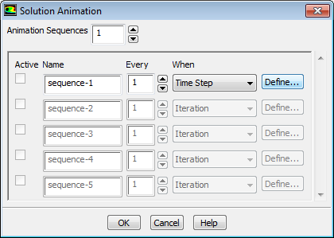
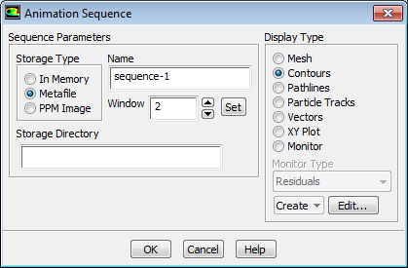
Setting up an Animation
Solution > Calculation Activities > Solution Animations > Create/Edit
In the Solution Animation Panel increase the Animation Sequences to 1
Select Time Step under When and click Define
In Animation Sequence Panel select Window 2, SET, then Contours
It is very useful with transient simulations to record key-frames of the solution progress. Not only does this help understand the result, but also aids de-bugging if the settings are not as intended.
Introduction
MRF Setup
Summary
Solve & Postpro
Sliding Mesh
Solve & Postpro

Slide 29
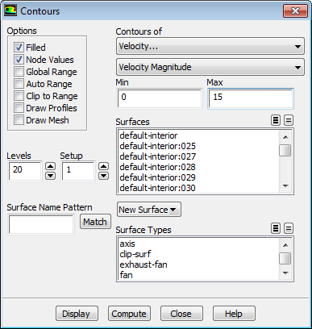
Setting up an Animation [2]
On the Contour Panel:
Set Contours of Velocity > Velocity Magnitude
Select ‘Filled’
Deselect Global Range, Auto Range and Clip to Range
Enter Min=0, Max=15
Deselect all surfaces
Click ‘Display’
Close the Contour Panel
OK the Animation Sequence Panel
OK the Solution Animation Panel
Graphic layout:
Enable 2-window display
Use the middle mouse button
to zoom in on the blades in
graphic window 2
Forcing a Max and Min value will ensure all frames in the animation are consistent.
Introduction
MRF Setup
Summary
Solve & Postpro
Sliding Mesh
Solve & Postpro

Slide 30
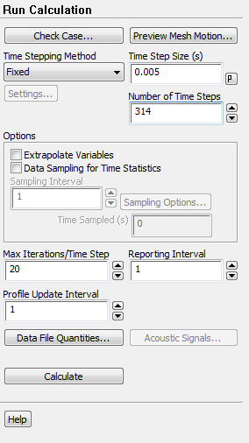
Write Case and Data File
The model is now ready to run
First Save the Project to your normal working directory
File > Save Project
Then Run the Calculation
Set 0.005s as time step size
Set 314 as number of time steps
4 rads/sec equates to 1.57secs/rotation. 0.005s x 314 = 1.57s
Click Calculate to start the transient simulation
At each time step, Fluent iterates until the solution has converged for the current time step (or the maximum number of iterations per time step is reached), then advances to the next time step and iterates until the solution has converged, and so on until the prescribed 314 time steps have been completed. The total number of iterations required is around 2300.
An Initialization of this case is not necessary because we want to continue the simulation with “start condition” of the Moving Reference Frame calculation already performed
If you are running short of time you can stop the simulation early and proceed to checking the results (next slide). We suggest you allow the solver to perform at least 79 timesteps (0.4secs), the device will have moved 90°
Introduction
MRF Setup
Summary
Solve & Postpro
Sliding Mesh
Solve & Postpro

Slide 31
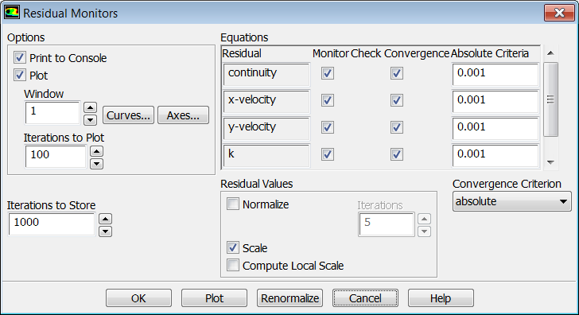
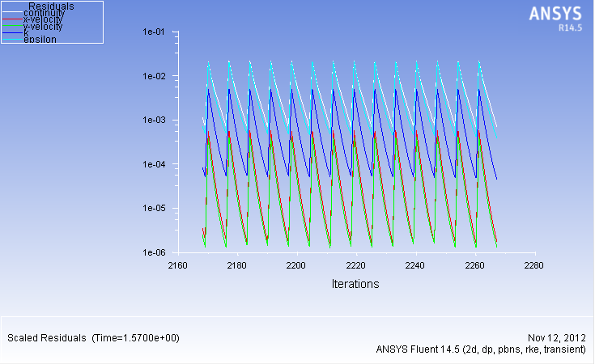
Residual Plots in Transient Simulations
If you have time to run the transient calculation, and did not move ahead to the post-processing steps, the residual plot (change the number of iterations to plot to 100 before displaying) will look like the figure below. The residuals form a sawtooth pattern, with high values at the beginning of the time step which then decrease over a number of iterations until the convergence criteria are reached.
Convergence achieved – solution advances to next time step

Slide 32
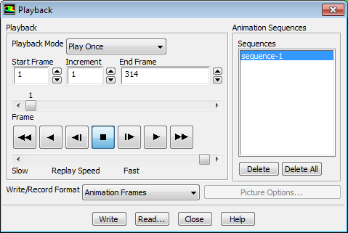
Reviewing the Solution
When the calculation is complete:
Graphics and Animations > Solution Animation Playback > Set Up....
Selecting the ‘Play’ button will let you review the animation
Alternatively you can select Write/Record Format, and select MPEG
Wait a few moments while the animation is built
The animation will appear in the folder:
working directory\workbench_project_name\dp0\FLU-1\Fluent\sequence-1.mpeg
Save the Project
File > Save Project
Introduction
MRF Setup
Summary
Solve & Postpro
Sliding Mesh
Solve & Postpro

Slide 33
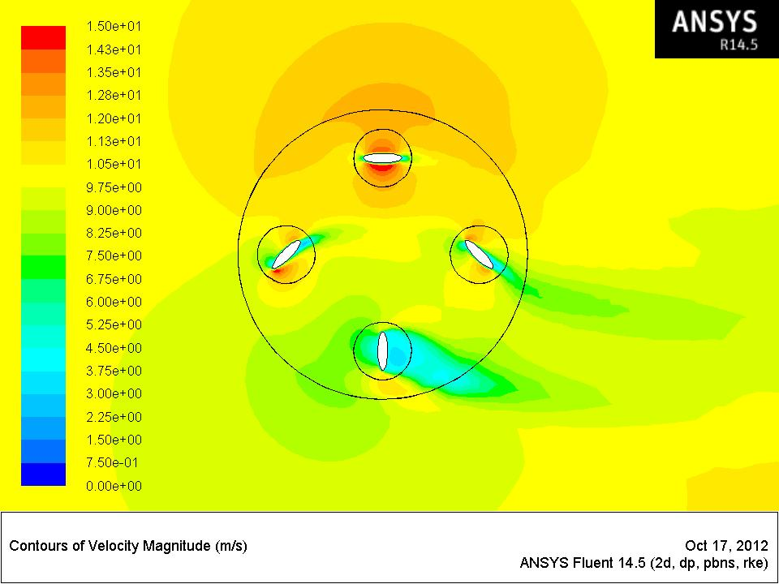
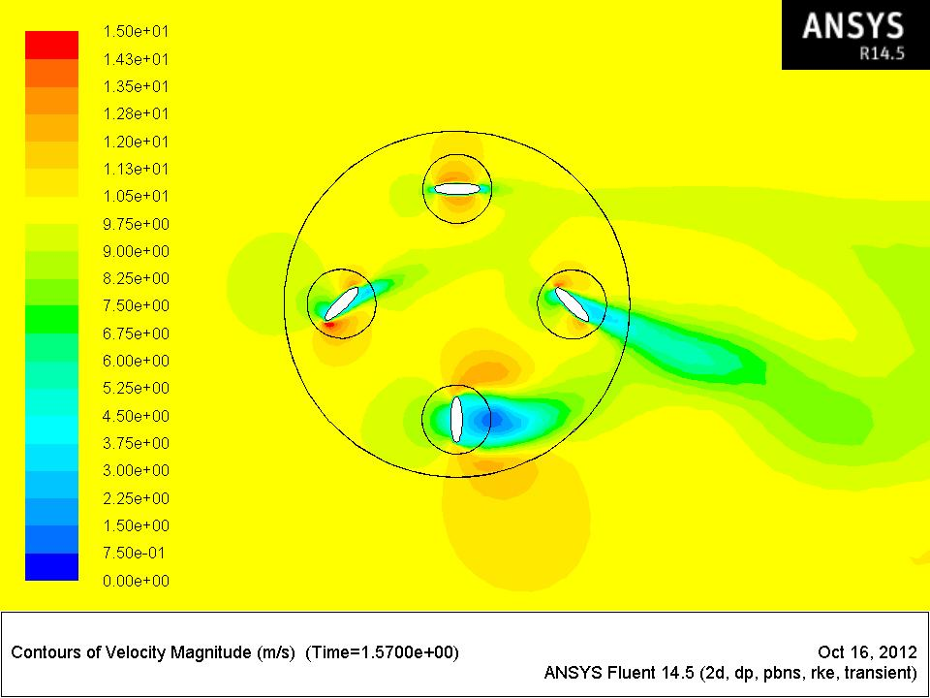
Comparing the Results
The images below show a comparison of the result from the MRF and sliding mesh approaches. (Colour scale from 0 to 15 m/s)
Although the MRF approach gave a useful qualitative indication of the velocity field and wake behind the blades, a full transient approach is needed to accurately predict the flow field.
MRF Result (Part 1)
Sliding Mesh Result (Part 2)
Introduction
MRF Setup
Summary
Solve & Postpro
Sliding Mesh
Solve & Postpro

Slide 34
Optional Extras
If you have finished early, ahead of the rest of the class, you may want to investigate reporting the torque on the blades by computing the moment about the rotational axis.
Use Report → Forces → Moments (and set appropriate axes).
Pick the 4 blades.
Compare the result from the two cases computed.
The Moment Coefficient can also be plotted as a graph during the solution process Monitors → Moment.
Click the ‘Help’ button on this panel and follow the link to ‘Monitoring Force and Moment Coefficients’ to find out more.
Note that this reports a coefficient, which uses the values set in
Report → Reference Values (see help pages).
Once set, if you run the solver on for further timesteps, you will see how the moment varies sinusoidally as the device rotates.
Introduction
MRF Setup
Summary
Solve & Postpro
Sliding Mesh
Solve & Postpro

Slide 35
Summary
This workshop has shown two techniques for performing a CFD simulation where objects move within the flow domain.
Using MRF techniques, the flow can quickly be simulated using a steady-state solver by applying appropriate acceleration terms to each grid cell. Although this works, it was not ideal for this particular scenario. In the case of this wind turbine, the underlying physics of this case require a transient simulation. Vortices break off the upwind blades, and the downwind blades pass through these.
Therefore this workshop has also shown how the fluid region can be modified by the solver at every timestep. There is no need to go back to the pre-processor to generate a new mesh at each step.
The key feature needed in the mesh in order to do this was to have different, disconnected (non-conformal) cell zones. Since they are disconnected, Fluent could move them as a rigid body.
If the parts actually change shape, there are further tools available in Fluent (the Dynamic Mesh Model) which allow the mesh to both move and deform, such that mesh nodes can be repositioned (smoothed) or grid cells can be added or removed where necessary.
Introduction
MRF Setup
Summary
Solve & Postpro
Sliding Mesh
Solve & Postpro

