Slide 1
Workshop 3 Global Mesh Controls

Slide 2
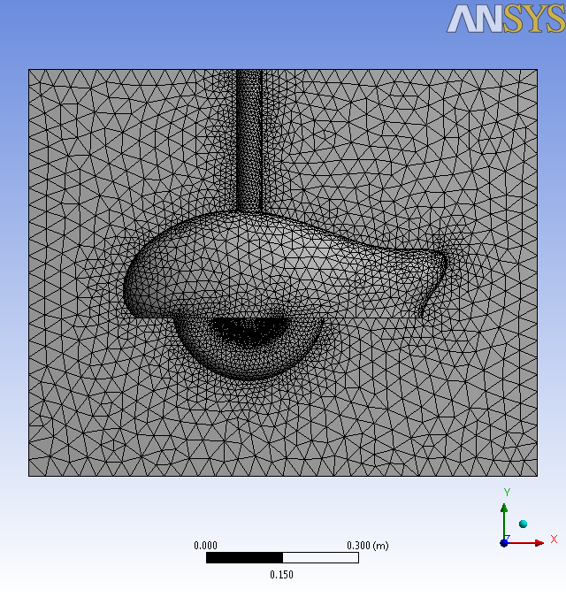
Introduction
Background
This workshop will demonstrate the use of global controls for mesh sizing and inflation. This workshop will use a CAD file imported directly into the Meshing Application.
Objectives
Starting ANSYS Meshing
Generating a mesh
Using Advanced Size Functions
Curvature
Proximity
Inflation

Slide 3
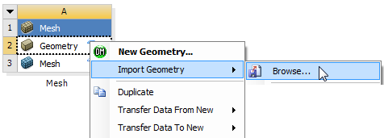
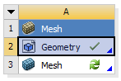
Project Startup
Create the Project
Start Workbench.
Start → All Programs → ANSYS 14.5 → Workbench 14.5
Drag and drop a Mesh Component System into the Project Schematic.
Right click on the Geometry cell (A2) and select Import Geometry → Browse.
Locate the file “main-gear-clean.stp” in the Meshing Workshops Input-Files folder and select it. The geometry cell will show a check mark indicating it is up to date.
Double click the mesh cell (A3) to start Meshing.

Slide 4
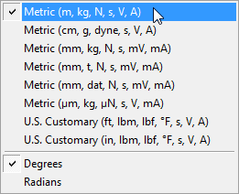
Units
Set Units
From the main menu select Units and, if it is not already set, specify Metric (m...).

Slide 5
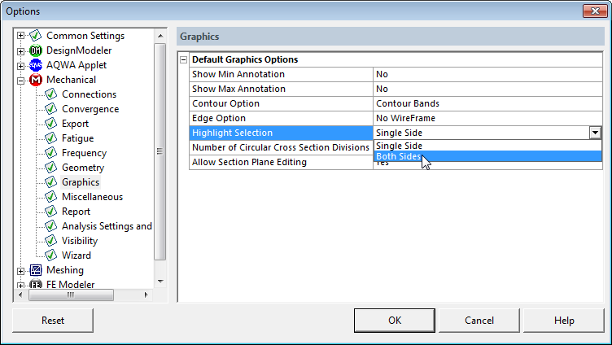
Options
Set Display Options
From the Main Menu, select Tools → Options.
In the Options Panel expand Mechanical and select Graphics.
Set the Highlight Selection option to Both Sides and click OK.

Slide 6
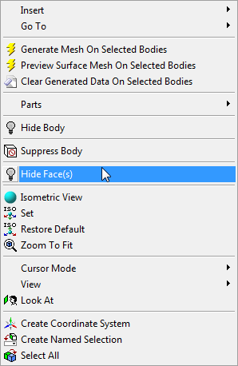
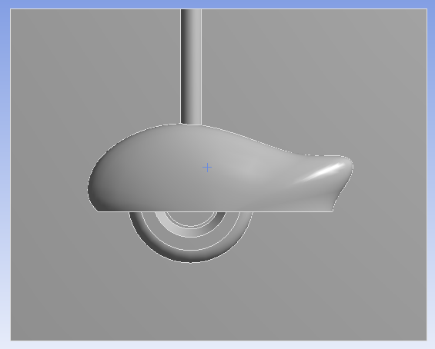
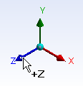
Geometry
View the Geometry
Select the Face Selection Filter.
Left click to select the face then right click and select Hide Face(s) from the context menu as shown (right).
Snap the view to the +Z Axis using the Axis Triad as shown (below).

Slide 7
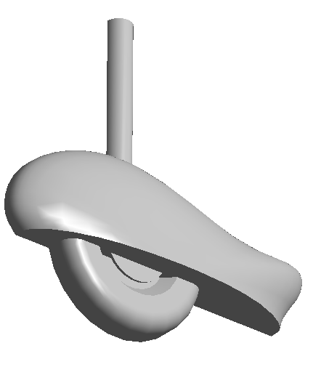
Preparation
Planning
This CAD file contains a single body streamlined main landing gear geometry.
Symmetry is assumed.
The arrangement of the geometry and presence of complex curved surfaces would make decomposition into hex sweepable volumes impractical.
The Tetrahedrons Method combined with Advanced Size Functions to capture curvature would be a good candidate for this application.
Since the CAD is of a good quality the Patch Conforming Algorithm will be used.
Inflation will be used as the mesh is intended for an external aerodynamic analysis where boundary layer resolution will be required.

Slide 8
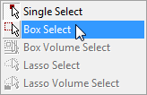
Named Selections
Add Named Selections
Select the Face Selection Filter
Select Box Select.
Click, drag and release from top left to bottom right to draw a box around the landing gear surface as shown (right).
The landing gear surfaces will be selected.

Slide 9
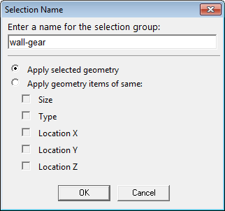
Named Selections
Add Named Selections (Continued)
Right click and select Create Named Selection from the Context Menu as shown (below).
In the Named Selection Dialog Box type the name “wall-gear” as shown (right).
Click OK.

Slide 10
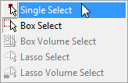
Named Selections
Add Named Selections (Continued)
Revert back to Single Select.
Snap the view to isometric using the iso-ball.
Select the face as shown and, using the same method, create a Named Selection “outlet”.

Slide 11
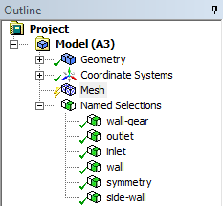
Named Selections
Add Named Selections (Continued)
Create further Named Selections as shown (below).
For multiple face selections hold down the CTRL key while selecting.
For the last selection right click and select Show Hidden Face(s) to restore the face hidden earlier.
inlet
wall
symmetry
side-wall

Slide 12
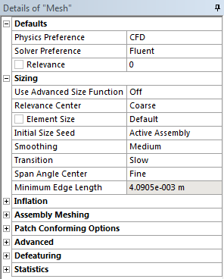
Global Mesh Settings
Mesh
In the Outline, select the Mesh object to display Details of “Mesh”.
In Details of “Mesh”, set the following under Defaults;
Physics Preference: CFD.
Solver Preference: FLUENT.
Under Sizing, set;
Use Advanced Size Function: Off

Slide 13
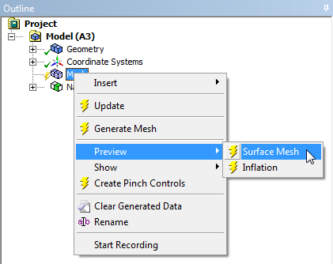
Preview
Preview Surface Mesh
Before generating a volume mesh we should check that the surface mesh is satisfactory.
In the Outline, right click on the Mesh object and select Preview→Surface Mesh.
A mesh will be generated on all surfaces using the global settings applied so far.

Slide 14
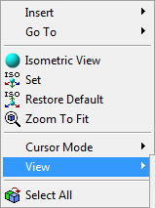
Section Plane
Preview Surface Mesh (Continued)
Right click in the graphics window and select View → Left (corresponds to -X).
Select the Section Plane Tool.
Create a Section Plane by clicking, dragging and releasing as shown vertically down through the mesh.

Slide 15
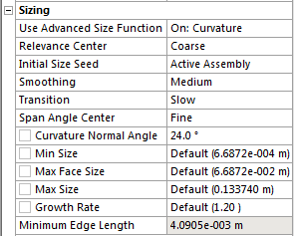
ASF Off
Review the Surface Mesh
Right click and select View → Front.
With the Advanced Size Function set to Off the surface mesh is very low quality taking no account of surface curvature and containing rapid size changes.
In Details of “Mesh”, as shown, under Sizing set;
Advanced Size Function: On: Curvature.
Curvature Normal Angle: 24.
Preview the surface mesh again with the new settings.

Slide 16
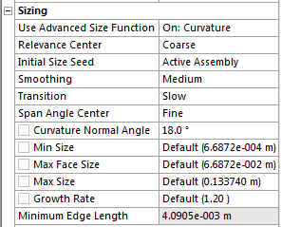
ASF Curvature
Review the Surface Mesh
Much better! With the Advanced Size Function set to Curvature the surface mesh has automatically refined to the surface curvature.
The surface mesh also adheres to a specified growth rate.
We’ll now look at controlling the curvature refinement.
In Details of “Mesh”, as shown, under Sizing set;
Curvature Normal Angle: 18.
Preview the surface mesh again with the new settings.

Slide 17
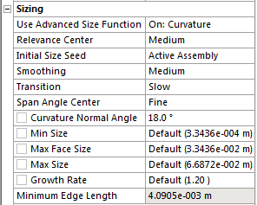
ASF Curvature
Review the Surface Mesh
By decreasing the Curvature Normal Angle the refinement to surface curvature increases.
We’ll now look at controlling the overall limits for minimum and maximum sizes using the Relevance Center setting.
In Details of “Mesh”, as shown, under Sizing set;
Relevance Centre: Medium.
Notice that the Min, Max Face and Max Size values have changed.
Preview the surface mesh again with the new settings.

Slide 18
Relevance Center
Review the Surface Mesh
By increasing the Relevance Center from Coarse to Medium the Global limits on the mesh sizes have changed.
This change has forced smaller mesh sizes in the far field and allowed smaller sizes where required on the surfaces.

Slide 19
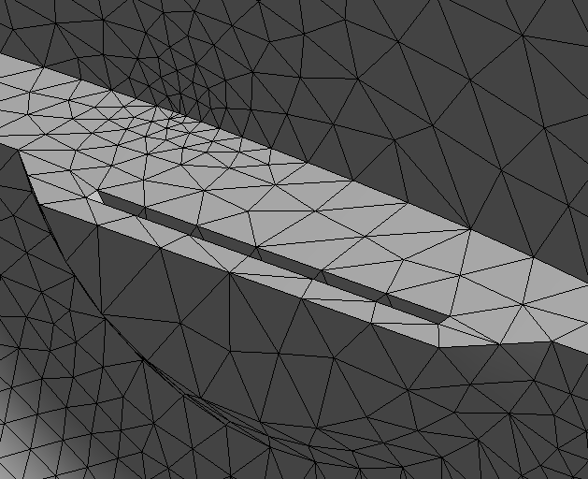
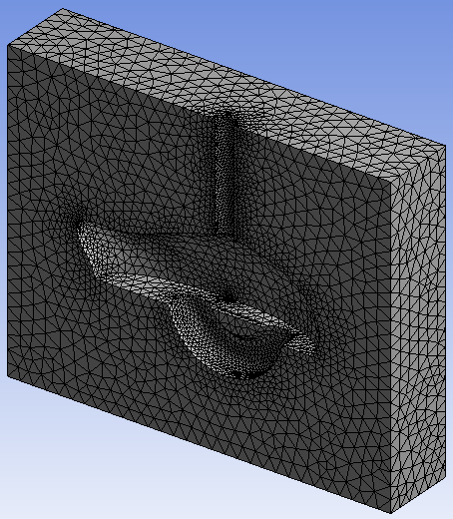
ASF Proximity
Refine for Proximity
Switch off the Section Plane by unchecking it in the Section Planes Panel.
Rotate the mesh such that the symmetry face is visible as shown (lower right)
Zoom in to the region highlighted – this is the lower half of the disc brake.
There is a gap between the disc and the wheel rim.
To adequately resolve for flow through this gap we need to ensure a minimum number of cells span the gap. Just one, as in this case, is not sufficient.
One Cell Spanning Gap

Slide 20
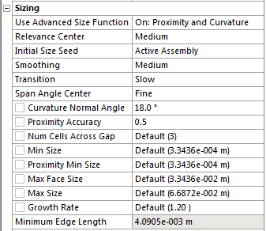
ASF Proximity
Refine for Proximity (Continued)
In Details of “Mesh”, as shown, under Sizing set;
Use Advanced Size Function: Proximity and Curvature.
Num Cells Across Gap to 3.
Preview the surface mesh again with the new settings.

Slide 21
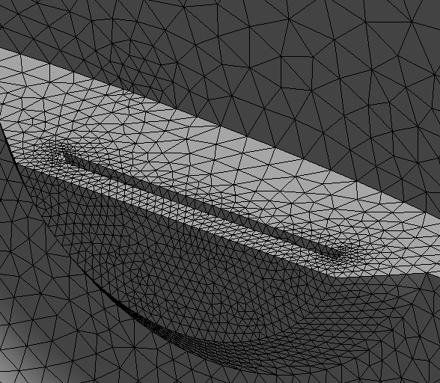
ASF Proximity
Refine for Proximity (Continued)
Note the new surface mesh (right) now automatically refined for both Proximity and Curvature.
One Cell Spanning Gap
Three Cells Spanning Gap

Slide 22
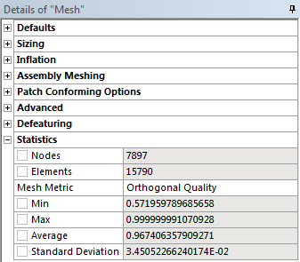
Quality
Check Surface Quality
Before moving onto setup inflation it is prudent to check the quality of the surface mesh.
There is little point attempting to generate inflation and a volume mesh on a poor quality surface mesh.
In Details of “Mesh”, as shown, under Statistics set;
Mesh Metric: Orthogonal Quality.
For good quality volume mesh, the min value for Orthogonal Quality should be greater than 0.4-0.5 for surface mesh.
It is, so we can proceed.
You may have slightly different figures than shown here.

Slide 23
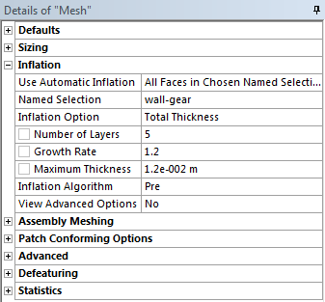
Inflation
Add Inflation
Right click and select View → Back.
In Details of “Mesh”, as shown, under Inflation set;
Use Automatic Inflation: All Faces in Chosen Named Selection
Named Selection: wall-gear
Inflation Option: Total Thickness
Maximum Thickness: 0.012m*
In the Outline, right click on the Mesh object and this time select Preview→Inflation.
*Inflation layer thickness should be defined to capture the boundary layer. This depends upon the flow characteristics and will need to be evaluated on a case by case basis, the value here is an example.

Slide 24
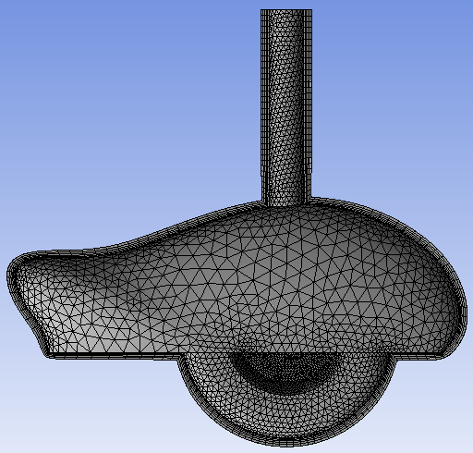
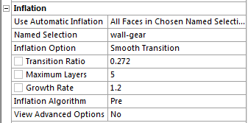
Inflation
Add Inflation (Continued)
The surface mesh has been inflated on all surfaces within the Named Selection “wall-gear” to a maximum total thickness of 0.012m.
Now try a different option, under Inflation set Inflation Option to Smooth Transition and preview inflation again.
0.012m

Slide 25
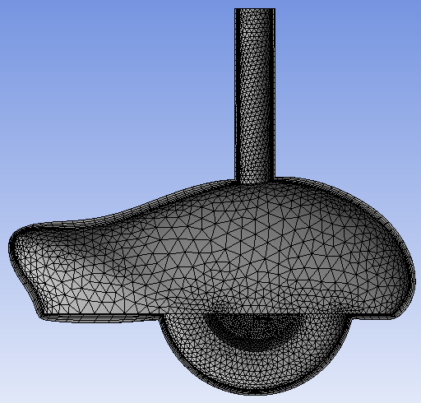
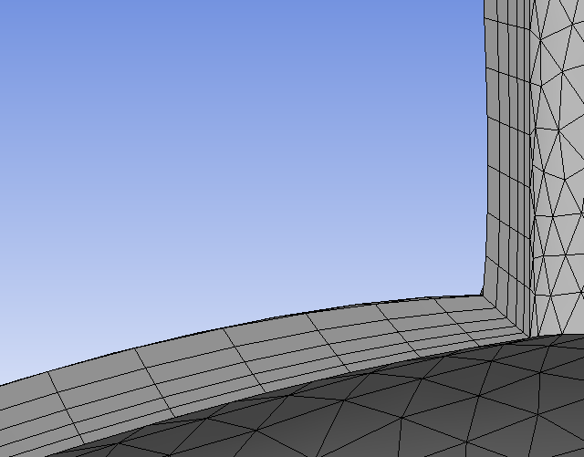
Inflation
Add Inflation (Continued)
The new inflation has a thickness defined automatically as a function of the surface mesh size.
Smooth Transition ensures a constant rate of volume change between inflation cells and the tetrahedron cells. It is useful in cases such as these where the surface mesh size varies extensively.
Variable Thickness

Slide 26
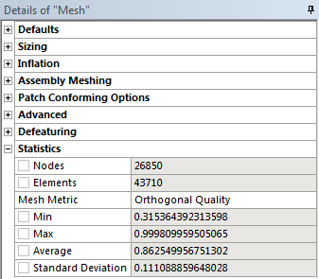
Quality
Check Inflation Quality
Again, before moving on to the complete volume mesh it is prudent to check the quality of the inflation mesh.
The quality is acceptable so we can proceed.

Slide 27
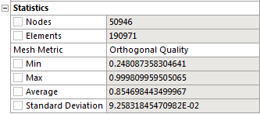
Generate Mesh
Generate the Complete Mesh
With appropriate global settings and having checked the quality in the previewed inflation mesh we can now generate the complete mesh.
In the Outline, right click on the Mesh object and select Generate Mesh or click the Generate Mesh button in the Toolbar.
When the mesh is generated check quality.
Right click in the Graphics Window and select View → Top.
Create a Section Plane through the middle of the mesh as shown.

Slide 28
View Mesh
View Mesh Interior
The mesh is now ready to be transferred to the solver.
This completes the workshop.
Note that for training purposes the bounding box for this geometry is relatively small. In reality, particularly for aerodynamic simulations, the boundaries (inlet, outlet & side-walls) would be further away as dictated, for example, by wind tunnel dimensions.

Slide 29
Save the Project
This completes the workshop.
From the main menu select File → Close Meshing
Workbench will save any application data.
From the Workbench Project Page use the file menu and save the project as “AMWS3.wbpj” to your working folder.

