Slide 1
Lecture 4 Planes and Sketches

Slide 2
Planes and Sketches
What you will learn from this presentation:
Concept of Planes and Sketches
How to create Planes and Sketches
Sketching Interface
Sketching Toolboxes
How to Draw, Modify, Dimension and Constrain Sketches

Slide 3
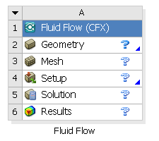
Preprocessing Workflow
Geometry Creation
OR
Geometry Import
Meshing
Solver
Geometry Operations
Sketches and Planes
3D Operations
Meshing Methods
Boolean, Body Operations, Split, etc
Hybrid Mesh: Tet, Prisms, Pyramids
3D Operations
Extrude, Revolve, Sweep, etc
Hexa Dominant, Sweep meshing
Geometry Cleanup and Repair
Assembly Meshing
Geometry Import Options
Automatic Cleanup
Global Mesh Settings
Direct CAD/Bi-Directional CAD
Merge, Connect, Projection, Flow Volume Extraction, etc
Local Mesh Settings
Sizing, Body/Sphere of Influence, Match Control, etc

Slide 4
Concept of Planes and Sketches
A plane is required to create a 2D sketch
Also required for some body operations
2D/3D geometry can be constructed using a sketch as a base object
Sequence to create a basic 3D geometry
Create or select an existing plane
Create a sketch on the plane
Apply a modeling operation to the sketch
Select desired plane
Create sketch on selected plane
Create 3D geometry through Extrusion operation from the sketch

Slide 5
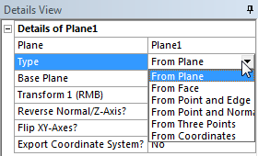
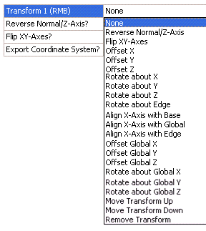
Planes
Working with Planes
At start-up, three default planes are available (XY, ZX & YZ) on which sketches can be created
New planes can be created to host sketches elsewhere
Create Plane
In the Details View set the Plane Type.
This determines how the plane is created, for example, by transforming an existing plane or from a selected face.
Optionally apply one or more transformations
Two examples follow...>

Slide 6
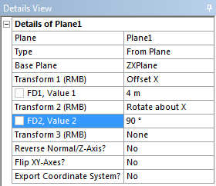
New Plane Creation Example: From Plane
Create new plane by transforming existing plane
Set Type to From Plane and select Base Plane (ZX Plane)
Apply Transform 1 (Offset X 4m)
Apply Transform 2 (Rotate about X 90)
Transforms use LOCAL coordinate system
Add as many transforms as required
New plane
Transform 1
Transform 2

Slide 7
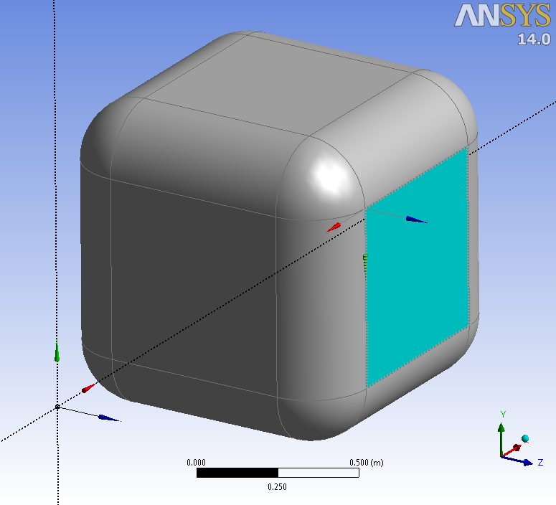
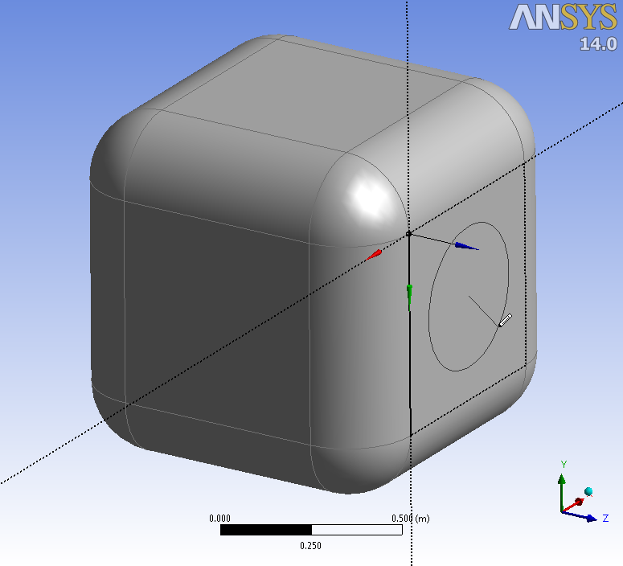
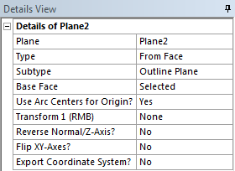
New Plane Creation Examples: From Face
Create new plane on geometry surface
Set Type to From Face and select Base Face (on geometry)
Generate plane and create sketches
Can be completed in one step
Select face and enter sketching mode (plane and sketch are created automatically)

Slide 8
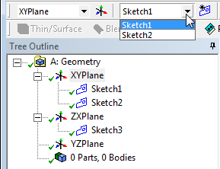
Sketch Creation
XYPlane is active
Create New Sketch
Creates a new sketch (empty pad for graphical sketching) on the active plane
New sketches are placed in the Tree Outline beneath their associated plane
To start creating the Sketch, switch to Sketching mode
Selecting a Plane with no sketches and entering sketch mode automatically creates a sketch
Multiple sketches can be created in any given plane
New sketches are created in the active plane. Check which plane is set to active before creating the new sketch.
Only sketches on active Plane are displayed in drop down

Slide 9
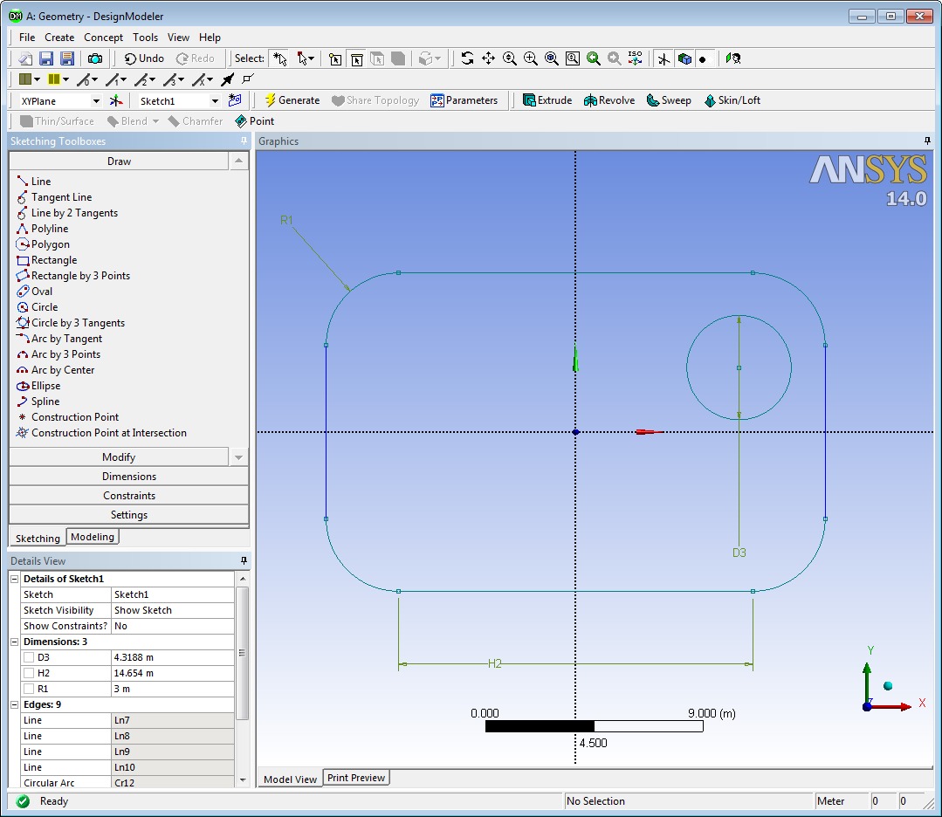
Sketching Interface
Sketching tools are arranged in five toolboxes - Draw, Modify, Dimensions, Constraints and Settings
Sketching toolboxes are available when you switch to sketching mode
Details of the current sketch (Dimensions, Constraints etc) are displayed in the Details View.

Slide 10
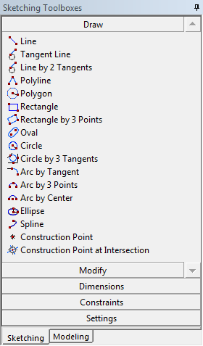
Draw Toolbox Examples: Circle
Many options are straight forward to use
GUI status bar provides instructions for completing each operation. For example, when Circle is selected…
Another example, Spline…>
Follow instructions in the status bar: Choose location for centre point
Follow instructions in the status bar: Define Radius
Done!

Slide 11
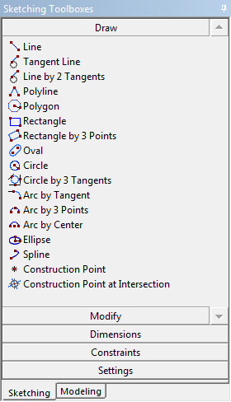
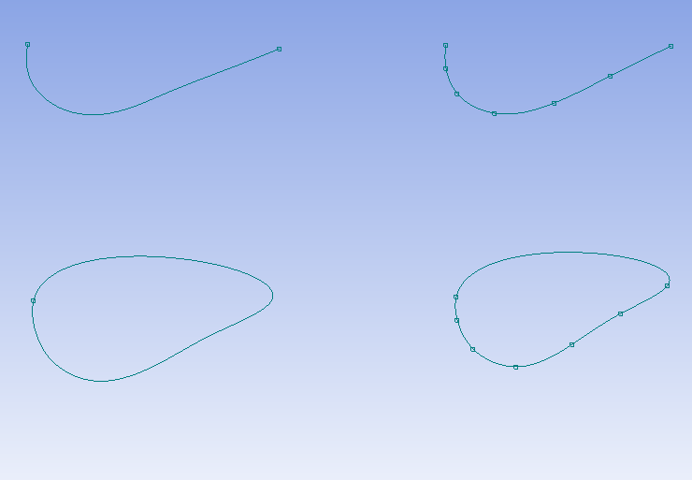
Draw Toolbox Examples: Spline
Right click provides additional commands
Instructions issued in the status bar
Open End
Open End with Points
Closed End with Points
Closed End

Slide 12
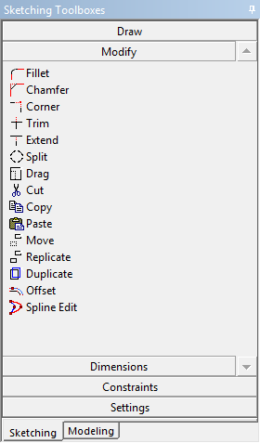
Modify Toolbox Examples: Fillet, Chamfer, Corner, Extend, Trim
L2
L1
L3
L4
Fillet( L1, L2)
Chamfer( L2, L3)
Corner( L1, L4)
Trim( L3)
Extend( L4, L3)

Slide 13
Modify Toolbox Examples: Split
Using Split
Right click to specify option
For segments option a field will appear in the toolbox
Split Edge at Selection
Split Edges at Point
Split Edge at all Points
Split Edge into n Equal Segments

Slide 14
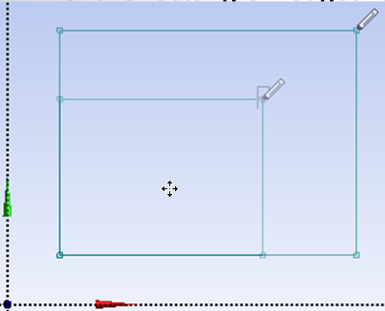
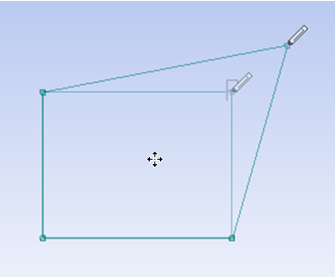
Modify Toolbox Examples: Drag
Drag a point or edge to a desired location
Can also be used for scaling (up or down) the sketch
How the model changes depends on what is selected, existing constraints and dimensions
Examples here, dragging a corner point connected to horizontally and vertically constrained edges compared to the same where edges are unconstrained.
Can pre-select multiple entities before issuing the Drag function
Select corner point of rectangle and drag

Slide 15
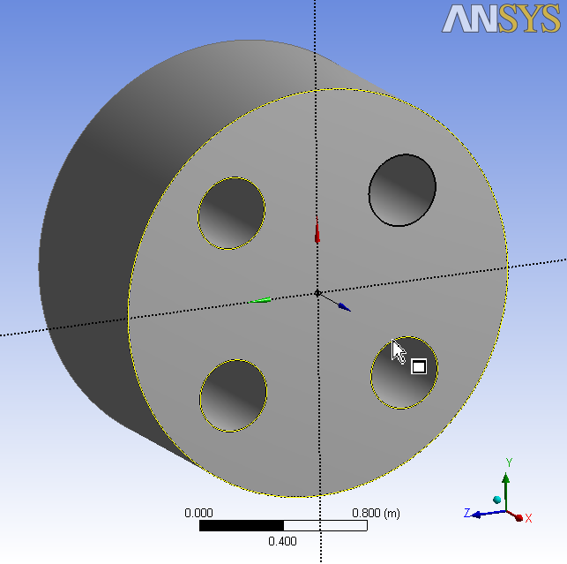
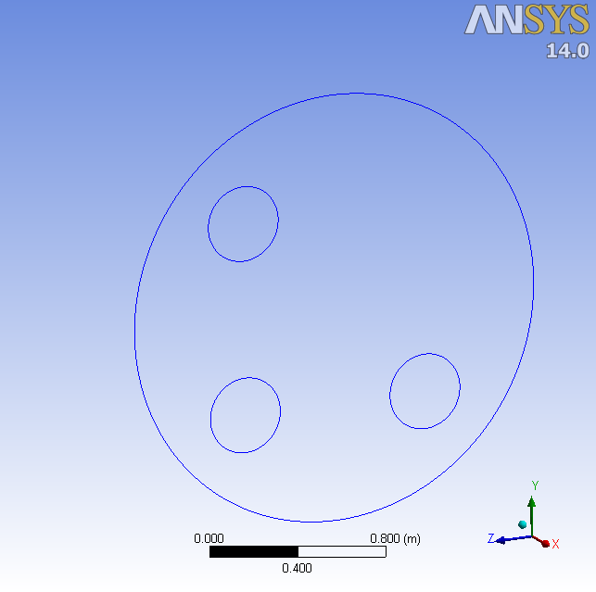
Modify Toolbox Examples: Duplicate
A new sketch can be created by referencing existing geometry
Allows selected boundaries of plane to be duplicated as new sketch entities
All sketches have to be in the same plane
Create Plane From Face
Select Required Edges
Duplicate to Sketch

Slide 16
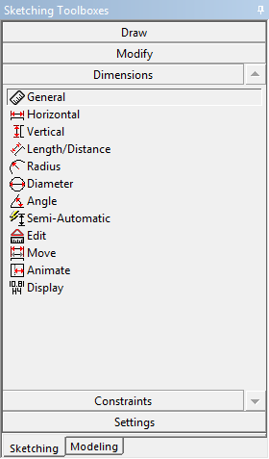
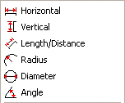
Dimensions Toolbox
Used for specifying dimensions of sketch entities
Pick specific dimension types or..
General
Selects appropriate dimension type based on entity selection
Right click provide quick access to specific dimension types
Semi-Automatic
Cycles through entities until sketch is fully constrained (or) user chooses to exit
Two examples follow...>

Slide 17
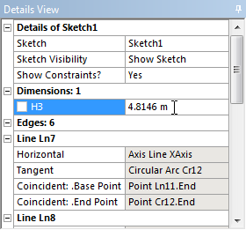
Dimensions Toolbox Example 1
Using the General Tool to dimension a horizontal line
Click to select entity
Click to position dimension
Dimension is automatically numbered
Dimension value can be edited under the Details View

Slide 18
Dimensions Toolbox Example 2
Using the General Tool to dimension an angle
Right click, specify Angle
Click to select first entity
Click to select second entity
Right click, select Alternate Angle to scroll through options

Slide 19
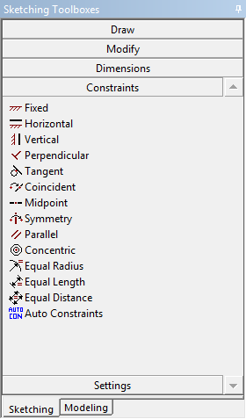
Constraints Toolbox
Constraints can be applied on sketch entities
Manually - Pick required constraint, select entity to be constrained
Automatically - Indicates and suggests the constraint and automatically snaps to a location or orientation while you are sketching (automatic on by default).
Four examples
Constraints can be added or removed manually on existing sketch entities
Global ON/OFF applies constraints with respect to all entities in the active plane
Horizontal
Vertical
Point
Coincident

Slide 20
Constraints Toolbox – cont….
Color Coding:
Indicates constraint status
Teal: Under-constrained
Blue: Well Defined
Black: Fixed
Red: Over-Constrained
Gray: Inconsistent or Unknown
Example:
Circle with radius dimension
Under constrained (centre point is free)
Adding 2 more dimensions, fully constrains the sketch, hence all lines turn blue
Alternatively, adding a Fixed constraint to the centre point fully constrains the sketch
Black
Black
Blue
Teal
Blue
Blue
Fixed Constraint on Centre

Slide 21
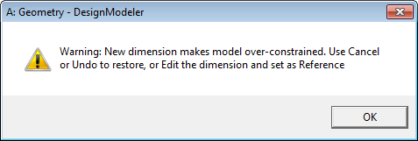
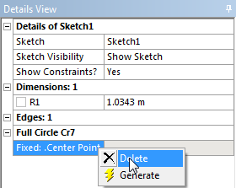
Constraints Toolbox – cont….
How can sketches become over-constrained?
Too many dimensions
Example – radius & diameter on a circle. Sketch turns red when over-constraining dimension is applied.
Viewing & removing contraints
Sketch details view, set Show Constraints to Yes
Pick entity, constraints are listed. Right click, Delete.
Example - removing Fixed constraint on circle centre point

Slide 22
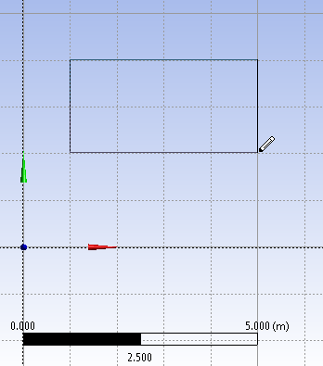
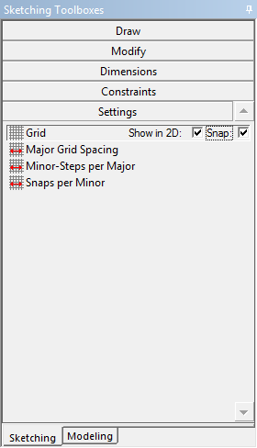
Settings Toolbox
Grid & Snap
Displays the grid lines in the sketching area, to make sketching easier
Snap option can be used to snap geometry to grid
Snaps per Minor
Allows snapping to points between minor grid lines
Click to enable check boxes
The rectangle is snapped halfway between two minor grid lines if Snaps per Minor is set to 2

Slide 23
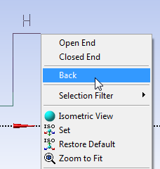
Sketching Tips
Ruler allows to get a quick sense of scale while sketching
“Look At” tool will help orient the display such that plane, sketch or selected entity normal to your view
Many operations become easier via a right click context menu on the graphics screen
Undo/Redo buttons are available in sketch mode only
Multiple undo’s allowed
IMPORTANT: Each plane stores its own Undo “stack”
The “Back” operation (available via RMB) acts like a micro undo during multi-step sketching operations (eg polyline)
Note: Only one sketch is active at a time!

Slide 24
Sketch Instancing
Allows copies of sketches to be added in other planes
Features:
Can only be placed in planes lower in the tree outline than the plane with the base sketch
Can be scaled and rotated
Edges are fixed: cannot be moved, edited, or deleted
Sketch is persistent: gets automatically updated when changes in base sketch are made
Can be used just like normal sketches for creating other features except:
Cannot be used as base sketches for other Instances
Not included in the pull-down list of sketches

Slide 25
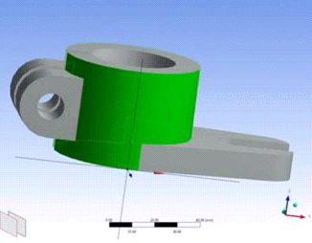
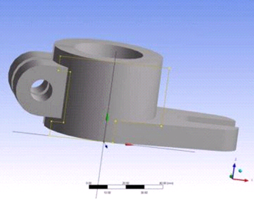
Sketch Projection
Project 3D geometry onto a plane to create new sketch entities
Select vertices, edges, surfaces or bodies to project
Cannot be modified using normal sketch tools
Remain associated to input geometry (updates automatically if 3D geometry changes)
3D Geometry selected for projection
Sketch projected onto existing plane

Slide 26
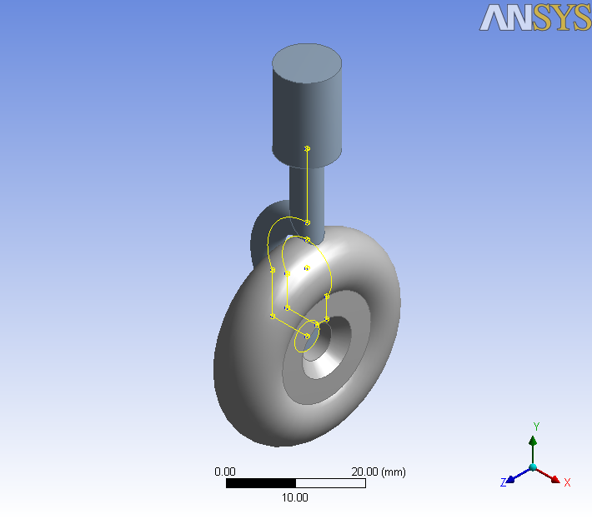
Workshop 2 – Sketching

Slide 27
Appendix
Contents
List of Sketching Tools
Example: Creating Concentric Cylinder
Modify Toolbox: Offset
Modify Toolbox: Cut/Copy
Modify Toolbox: Paste
Modify Toolbox: Replicate, Move
Dimensions Toolbox: Move, Animate, display

Slide 28
Sketching Tools
All the sketching tools are segregated into five categories

Slide 29
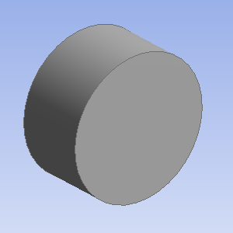
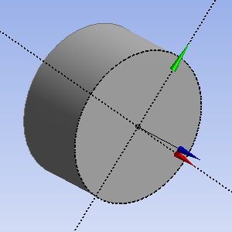
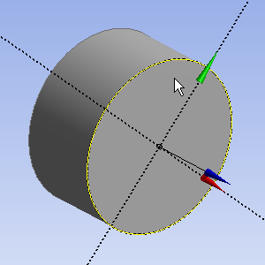
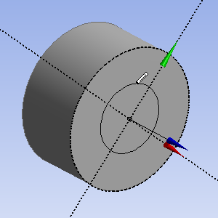
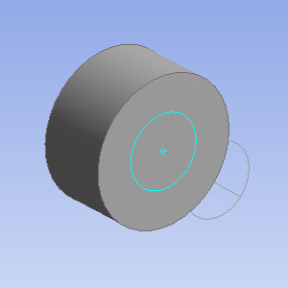
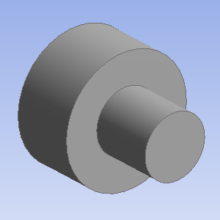
Example: Creating Concentric Cylinder
Select circular face of cylinder and create Outline plane
Go to sketching mode and select outline of plane i.e. circular edge
Select Offset option in Modify toolbox and create an offset circle
Go to modeling mode and select Extrude feature. Select the sketch containing circle as base object for extrude.
Generate extrude feature to create concentric cylinders as shown
Step 1
Step 2
Step 3
Step 4
Step 5

Slide 30
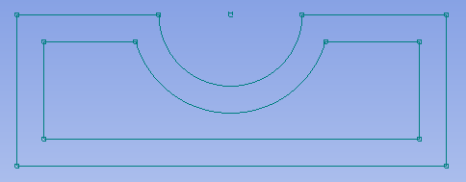
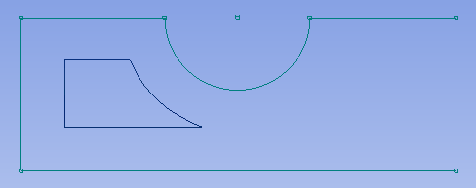
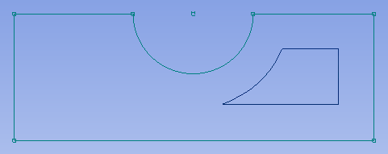
Modify Toolbox: Offset
Offset Distance
Offset
A sketch can be offset
Selection options
End selection
Place offset
Three options to perform “offset”
Distance
Offset side
Offset area
Offset Side : Inside
Cursor located on Left
Cursor located on Right
Offset Area : Depends on location of cursor

Slide 31
Modify Toolbox: Cut/Copy
Cut / Copy
Used to cut or copy selected entities and paste to required location
Requires the selection of a paste handle (RMB) relative to which the Paste will be performed
The paste handle is the location to which the cursor is attached while moving the image to new position to paste
RMB paste handle options:
Clear Selection
Use Plane Origin as Paste Handle: The 0.0, 0.0 location of the plane will be used as the paste handle
If Cut or Copy is exited without selecting a paste handle, a default will be used
Copy: RMB options

Slide 32
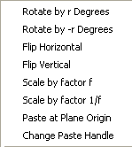
Modify Toolbox: Paste
Paste
Used to paste entities selected during cut or copy operation
Entities can be pasted into current or a new sketch, even if it is on different plane
After copying entities, Paste operation can be performed multiple times
RMB Paste options:
Rotate by +/- r Degrees
Flip Horizontally / Vertically
Scale by Factor f or 1/f
Paste at Plane Origin
Change Paste Handle
Paste: RMB options

Slide 33
Modify Toolbox: Replicate, Move
Replicate
The Replicate operation is equivalent to the Copy operation, followed by a Paste
After selection of entities, the RMB options change to the Paste RMB options
Note: Replicate option is used to copy sketches. Duplicate option is used instead to copy features of a solid body on to the plane.
Move
The Move command functions the same as the Replicate operation with the exception that the original selection is moved to a new location instead of being copied

Slide 34
Dimensions Toolbox: Move, Animate, display
Move function allows placement of dimension to be modified
Animate function allows to visualize the dynamic changes for a selected dimension within a specified range
Display function is used to display dimensions in Graphics Window in the form of Name and/or Value
Dimensions can be modified from Details view or through RMB click

