Slide 1
Workshop 5e Applications – Manifold

Slide 2
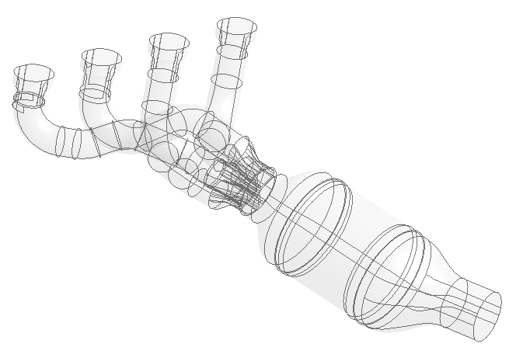
Introduction
Background
This workshop illustrates how to use DM to create fluid domain from imported complex solid geometry, and mesh the model with acceptable quality using defeaturing tools.
Objectives
Creating fluid domain
Cleaning and decomposing geometry to match physical analysis
Creating virtual entities
Setting local refinements on surfaces of interest
Defining program controlled inflation
Checking mesh quality / influence of defeaturing / pinch settings
Inlets
Porous media
Outlet

Slide 3
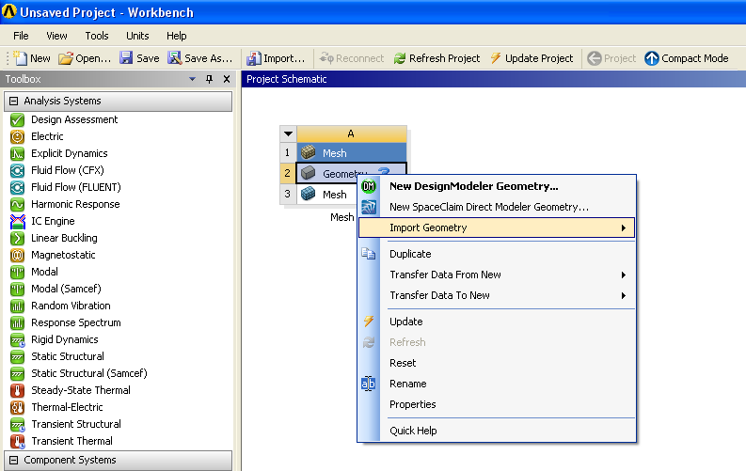
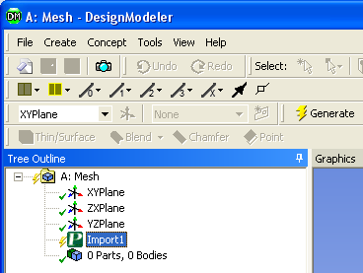
Project Startup
Launch Workbench 14.5
In the project page, drag a ‘Mesh’ component
RMB on the ‘Geometry’ box and open parasolid file exhaust_man.x_t
Double-click on ‘Geometry’ to open Design Modeler, choose millimeters as unit.
Click on Import1 and in Details View → Operation select “Add Material” and then click ‘Generate’ to import the geometry

Slide 4
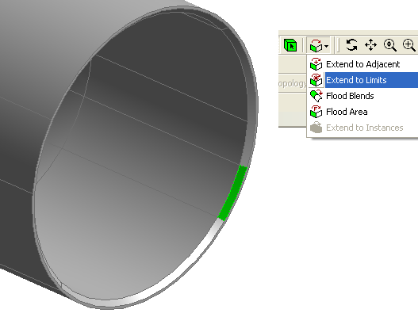
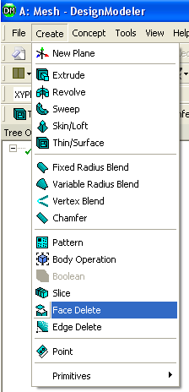
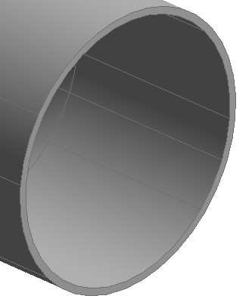
Geometry Cleanup
To prepare the fluid volume extraction, we need to remove the unnecessary details from the original solid body. On this geometry, the chamfer at the outlet can be removed.
Select one of the chamfer surfaces, then click on ‘Extend to Limits’
Go to Create → Face Delete, click ‘Apply’ to validate the selection (7 faces should have been selected).
Generate.

Slide 5
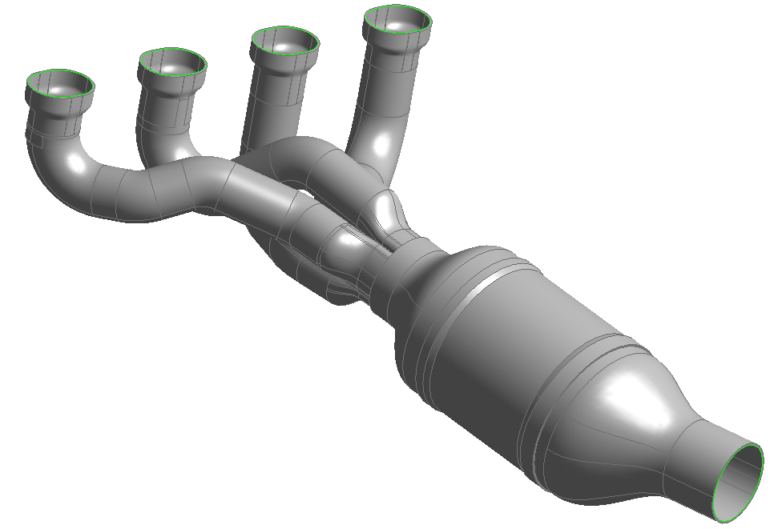
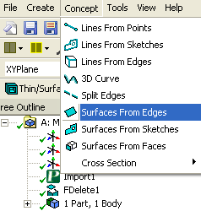
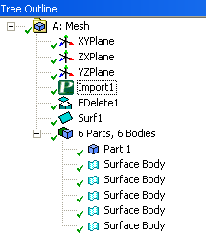
Fluid Extraction
The definition of an internal fluid domain is typically done by filling the existing solid body.
This can be done either by selecting the wetted surfaces, either by defining capping surfaces. In this case the latter solution is easier and will be chosen.
Select one inner edge on each inlet/outlet surfaces and click on ‘Extend to Limits’ to get edges loops.
Select Concept → Surfaces from Edges. Click apply to validate the selection (47 edges) and generate to create the 5 surface capping bodies (added in the tree under the solid body).

Slide 6
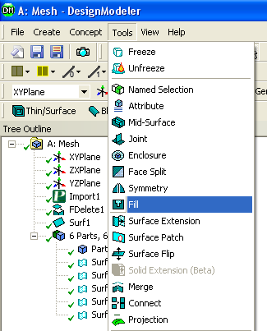
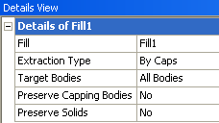
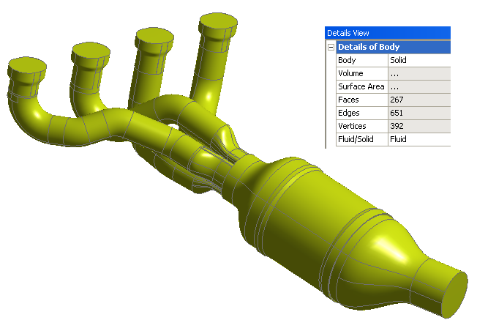
Fluid Extraction
Go to Tools → Fill and select ‘By Caps’. Let the Target to ‘All Bodies’ and set both ‘Preserve Capping Bodies’ and ‘Preserve Solids’ to ‘No’.
Generate.
The extracted body has been created and the other bodies have been deleted. Check that the new body is recognized as a fluid zone.

Slide 7
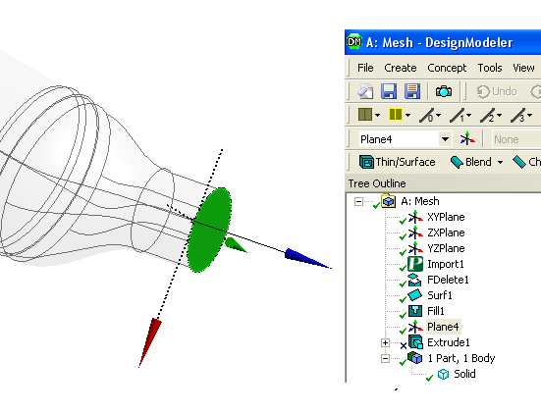
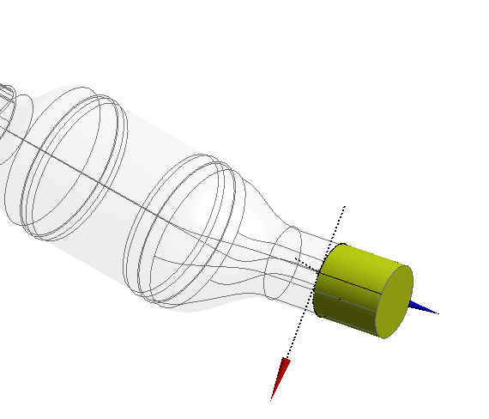
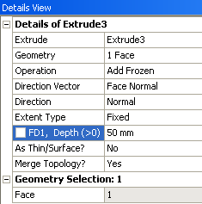
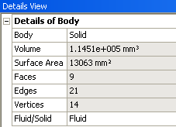
Domain Extension
We are going to extrude the outlet to prevent the backflow issues.
Select the outlet surface, click Create → Extrude, and create a 50mm–long frozen body (set values as shown on the right). The ‘Direction Vector’ is set to ‘Face Normal’ by clicking again on the outlet face (check extrusion preview)
Generate. The outlet cylindrical body has been added to the tree. Define it as a fluid body in the detail view.

Slide 8
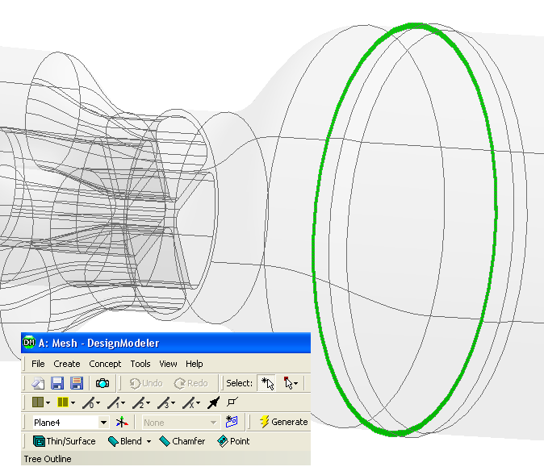
Domain Decomposition
We aim now to simplify the topology around the porous zone so as to create a separated, cylindrical porous body. We will use a cylinder based on an existing face to slice the original main fluid.
In one operation we will separate the unwanted volumes near the porous zone (they will be deleted afterwards) and create the porous volume (to be able to set porous in the solver).
Click on the surface highlighted in the image here, then Click on ‘New Plane’ and press Generate.
Select the newly created plane, add a
new sketch.

Slide 9
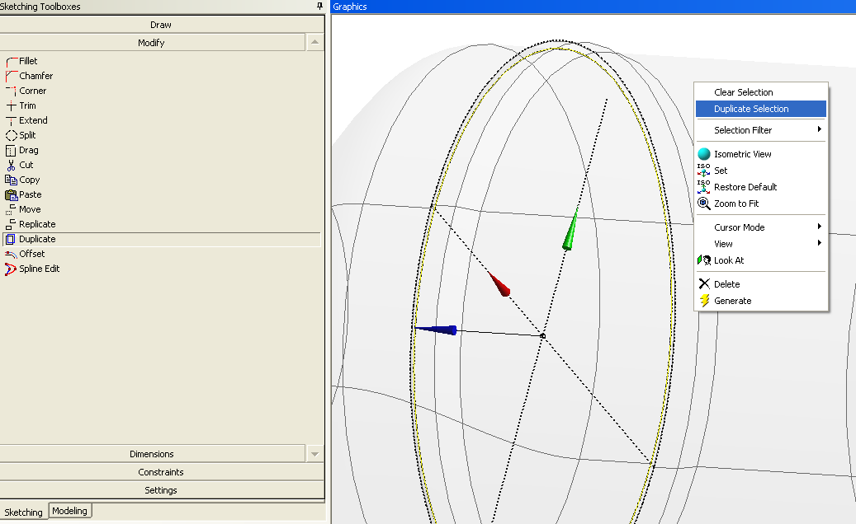
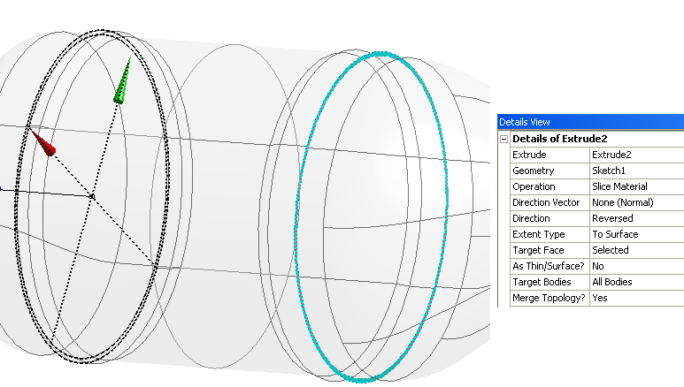
Domain Decomposition
Switch to the Sketching tab, go to ‘Modify’ panel and select ‘Duplicate’
Select the inner dotted circle (2 edges). RMB and ‘Duplicate Selection’.
Go to the Modeling tab and select the sketch in the tree.
Select Create → Extrude with the following settings : - Operation : Slice Material - Direction : Reversed - Extend Type : To Surface, with selection of the surface shown on the right.

Slide 10
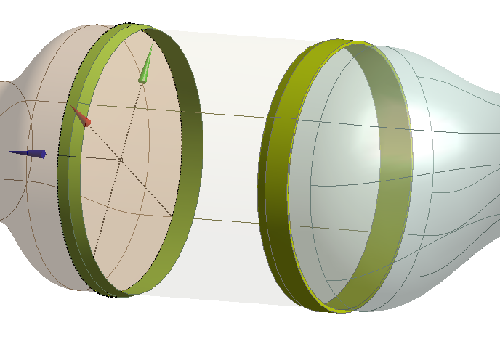
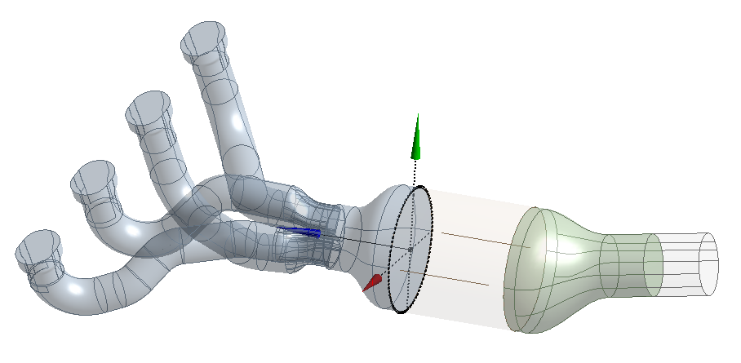
Domain Decomposition
Finally, to delete the two unwanted bodies as highlighted in image here,
select them and go to Create →
Body Operation. Set Type as ‘Delete’
and press Generate.
We now have a fully decomposed fluid domain, with 4 bodies.

Slide 11
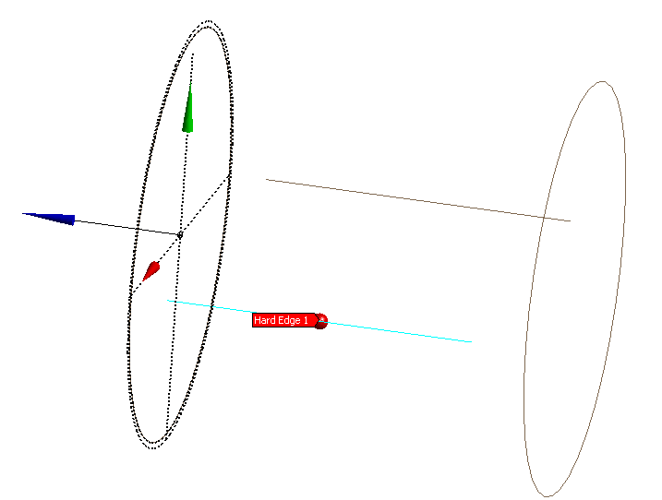
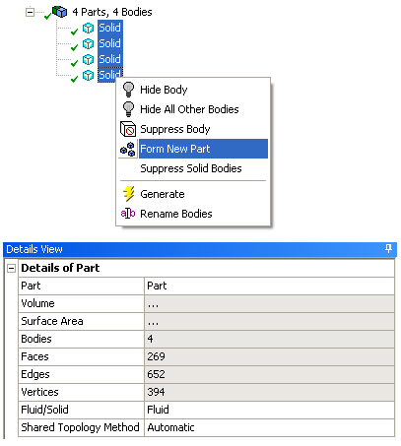
Pre-mesh Geometry Preparation
Some geometric entities may lead to meshing issues. DM provides a certain number of repair tools to “clean” the geometries. For instance, we will use here a hard edge correction.
Go to Tools → Repair → Repair Hard Edges and change ‘Find Faults Now’ to ‘Yes’. Check the two hard edges on the porous body and Generate : both edges will be deleted.
As we are looking for conformal mesh, we need to create a multi-body part gathering the 4 bodies.
Select the 4 bodies in the tree, RMB and ‘Form New Part’ and check that the part is recognized as a fluid one in the detail view.

Slide 12
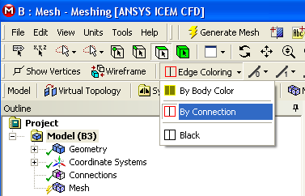
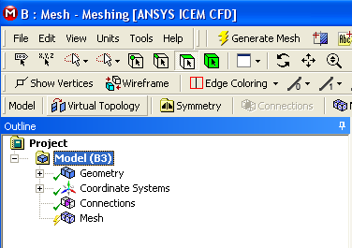
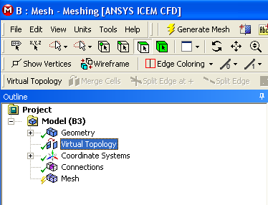
Mesh Initialisation
Close DM. Then, in the Workbench project page, double-click on the ‘Mesh’ box to open ANSYS Meshing.
Set the units to millimeters and color the edges by Connection.
‘Model (B3)’ being selected, click on Virtual Topology to add it in the Outline.

Slide 13
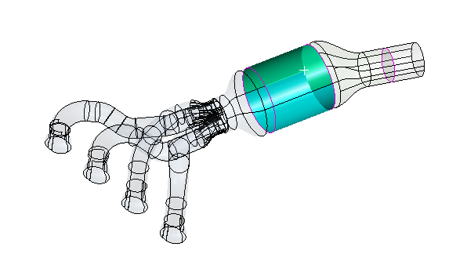
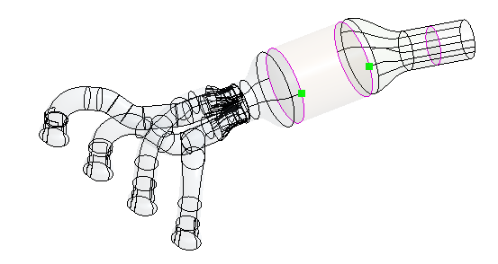
Defining Virtual Entities
We are now going to create two kinds of virtual entities (VE) : - split VEs : splitting a cylindrical face to help the automatic block decomposition used by the MultiZone method. - merge VEs : gathering small neighboring cells to avoid skewed features.
For the split VE operation : with ‘Virtual Topology’ selected in the Outline, choose the vertex selection filter and select the two points next to the cylindrical porous body (press Ctrl for multiple selection). Select ‘Split Face at Vertices’ in the toolbar.
Repeat the operation for the two corresponding points on the other side : two virtual faces will be created on the initial lateral face, providing two edges to base the mesh creation on.

Slide 14
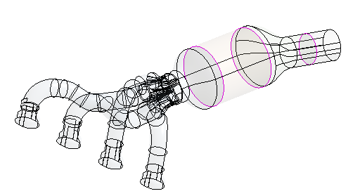
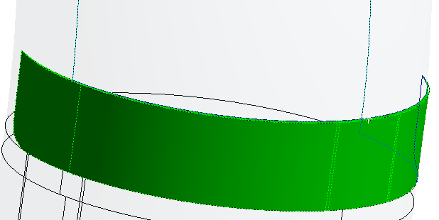
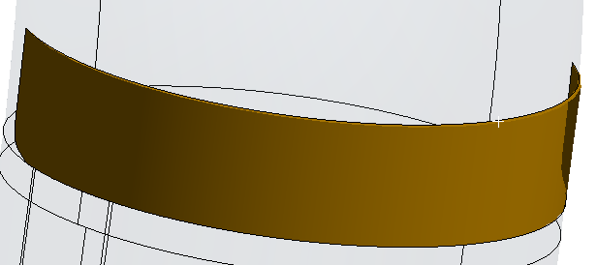
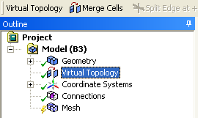
Defining Virtual Entities
For the merge VE operation : zoom in to the inlet as shown below. Select all the faces highlighted (7 faces) and click ‘Merge Cells’ in the toolbar : one single virtual cell will created on the existing 7 faces enabling the mesh to be unconstrained by the original small faces.
7
6
3
5
1
2
4

Slide 15
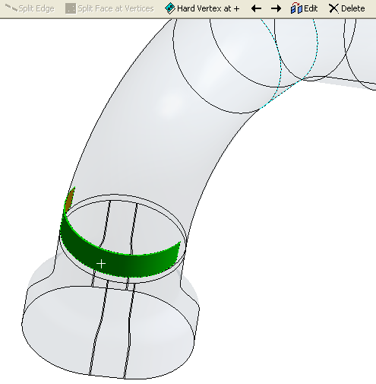
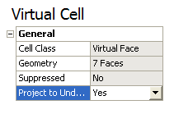
Defining Virtual Entities
The final stage of the virtual cell creation is to make sure that the virtual cell matches the “real” geometry.
Select the virtual cell, and click ‘Edit’ in the toolbar. In the Virtual Topology Properties box, select ‘Yes’ for the ‘Project to underlying geometry’ option.

Slide 16
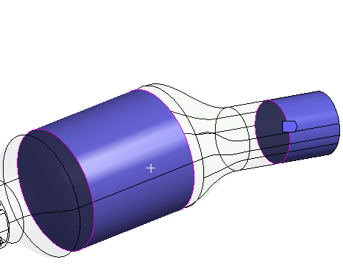
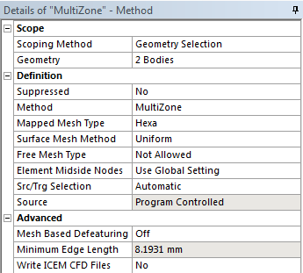
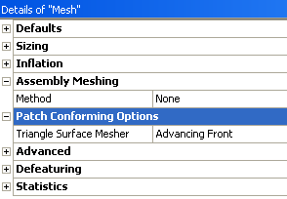
Defining Meshing Methods
The first step is to define a MultiZone method for the two cylindrical bodies. With ‘Mesh’ selected in the Outline, select both of them, right click, Insert → Method and choose MultiZone.
Set Surface Mesh Method to ‘Uniform’
Keep Source/Target selection to ‘Automatic’
The two other bodies will be meshed using the default Patch Conforming Tetrahedron algorithm. Therefore no further method definition is needed here.
However, in the ‘Mesh’ details view, switch the ‘Triangle Surface Mesher’ option to ‘Advancing Front’. This algorithm generally provides a smoother surface mesh.

Slide 17
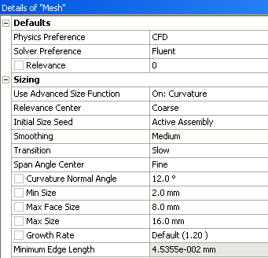
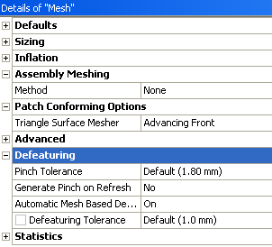
Defining Mesh Global Sizing Controls
In the details view of ‘Mesh’ in the Outline : make sure that ‘CFD’ and ‘Fluent’ are selected for the Physics and Solver Preferences respectively.
Expand the Sizing box. Make sure ‘Curvature’ is selected as Advanced Size Function and set the following global sizing values : - Curvature Normal Angle : 12° - Min Size : 2 mm - Max Face Size : 8 mm - Max Size : 16 mm - Growth Rate : 1.2
Expand ‘Defeaturing’ in the ‘Mesh’ details view. Make sure the values are set as shown (right). Activation of automatic defeaturing enables the Meshing application to automatically defeature small features and dirty geometry according to the Defeaturing Tolerance specified here.

Slide 18
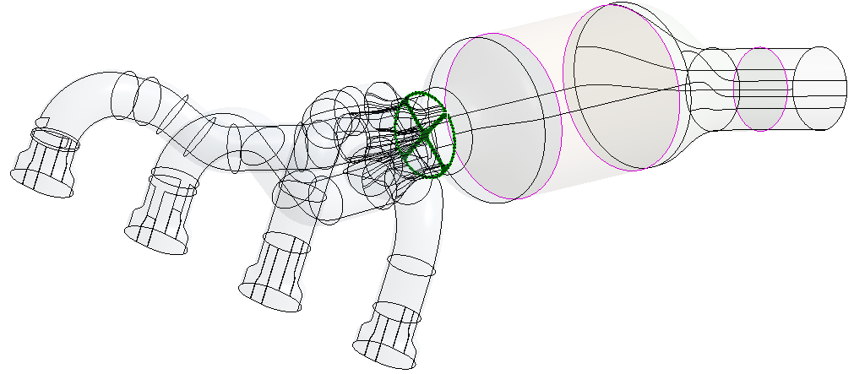
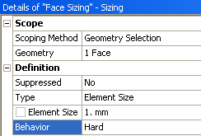
Defining Mesh Local Sizing Controls
To properly refine the zones of interest, we need to define local sizing on them. These will locally over-rule global sizing values.
With ‘Mesh’ selected in the Outline, select the cross face as shown highlighted. Right click, Insert → Sizing. Define a 1 mm sizing on this face, selecting ‘Hard’ as behaviour since this size is smaller than the global min size and will be ignored otherwise.

Slide 19
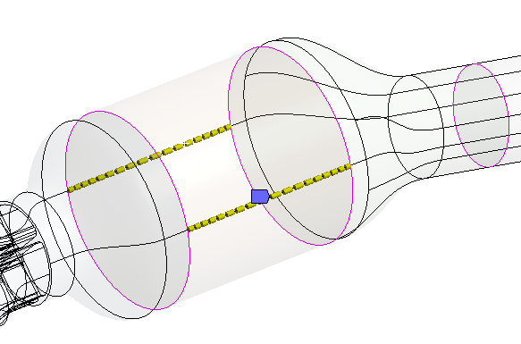
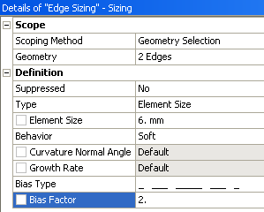
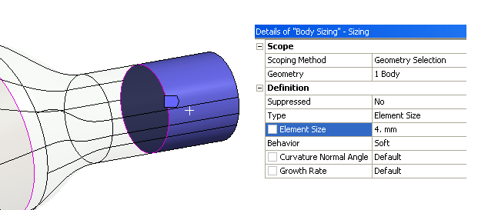
Defining Mesh Local Sizing Controls
Select the two edges created with the virtual face split. Define a 6 mm sizing on them, with a symmetric bias (refined close to the cylinder ends) and a bias factor of 2
Select the second cylindrical body near the outlet, and define a 4 mm body sizing on it.

Slide 20
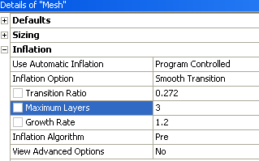
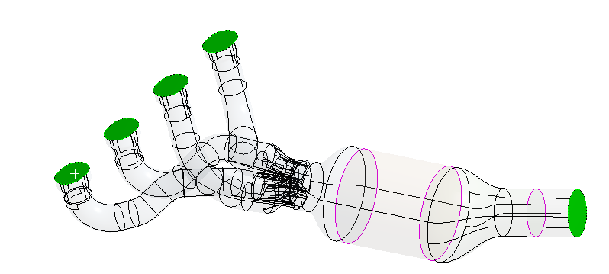
Defining Inflation Controls
For this workshop, we will activate automatic program controlled inflation. This will inflate the mesh on every surface, except those linked to extra properties (Named Selections, Mechanical load, ...).
In the ‘Mesh’ detail view, expand the Inflation box and set the ‘Use Automatic Inflation’ option to ‘Program Controlled’. Set Maximum Layers to 3 leaving other parameters to default values.
Select the four inlet surfaces, RMB → Create Named Selection and name it “inlets”. Repeat the operation by naming the outlet surface “outlet”.
Generate the mesh.
inlets
outlet

Slide 21
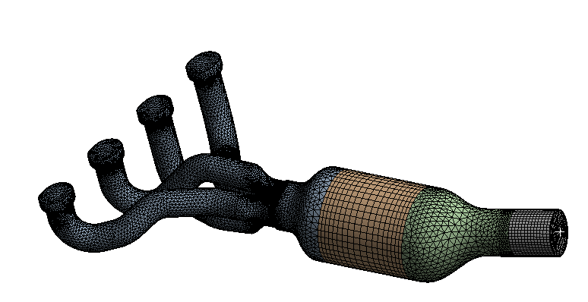
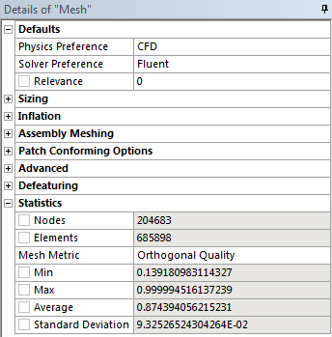
Mesh Statistics
Check Quality
Before using a mesh in any solver it is important to check the mesh quality.
Quality is defined through various metrics which measure the degree to which each mesh cell varies from an ideal shape.
In the Details of Mesh panel expand Statistics. Click in the box to the right of Mesh Metric and select Orthogonal Quality.
The minimum value for Orthogonal Quality is important and should not fall below 0.05. The minimum for this mesh is approximately 0.14 which is acceptable. (Quality in your case may vary slightly)

Slide 22
Optional tasks

Slide 23
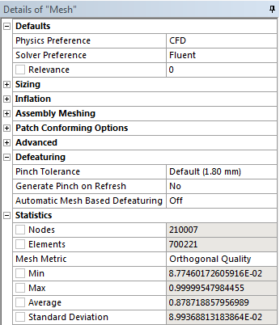
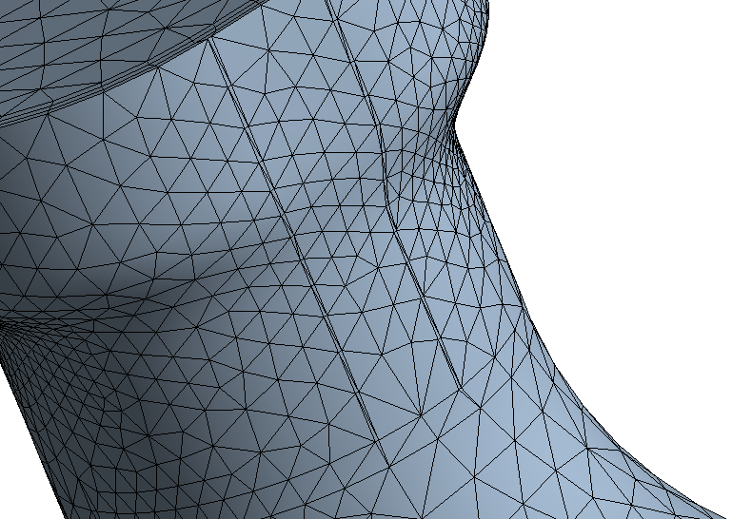
Influence of Defeaturing
Expand the Defeaturing box in the ‘Mesh’ detail view, turn off the Automatic Mesh Based Defeaturing.
Generate again the mesh and check the quality of the mesh.
The quality has decreased to about 0.09, which would still be acceptable. However, we can see several skewed cells near the inlets as a result of the deactivation of automatic defeaturing. These can alternatively be fixed using Pinch controls (see next slide).
(Quality in your case may vary slightly)

Slide 24
Pinch Controls Creation
We will now create automatic Pinch controls to fix the mesh issues shown on the previous slide. The idea is to measure the width of the skewed cells and to define a greater global pinch tolerance to make sure the mesh issues are addressed.
As we have a 0.31 mm width (values can vary according to the chosen cell), we will input 0.35 for the Pinch tolerance of the Defeaturing box. Right click on Mesh in the Outline and click ‘Create Pinch Controls’ : the Pinch controls will be added to the tree, and you can click on each one to locate them.
Generate the mesh. The min orthogonal quality has been improved (about 0.22) and we have now a much cleaner mesh.

Slide 25
Save the Project
This completes the workshop.
From the main menu select File → Close Meshing
Workbench will save any application data.
From the Workbench Project Page use the file menu and save the project as “AMWS5e.wbpj” to your working folder.

