Slide 1
Lecture 8 Parameterization

Slide 2
Parameterization
What is Parameterization?
Parameterization helps execute a set of operations repeatedly with different input values
Useful for analyzing multiple design points by modifying geometry/topology parameters
Sketch dimensions, Plane creation inputs, 3D operation values etc. can all be treated as parameters
Parameters can be linked with each other through expressions (defined in DesignModeler or Workbench)
Parameters can be controlled from Workbench (no need for DesignModeler to be open)

Slide 3
Types of Parameters
Parameterized Dimension
Geometric Parameters
Changes the dimensions or locations of a given feature
Does not necessarily change the total number of entities in the model
Example, parameterized dimension
Topological Parameters
Modifying the feature itself by adding or removing geometry
Can change total number of entities in the model
Example, parameterized number of copies in a Pattern Feature.
Parameterized Topology

Slide 4
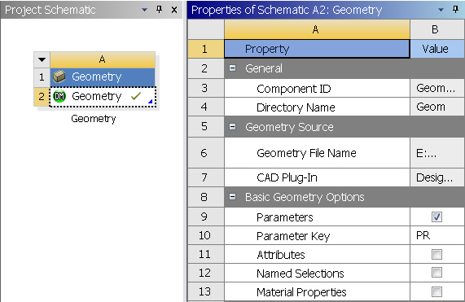
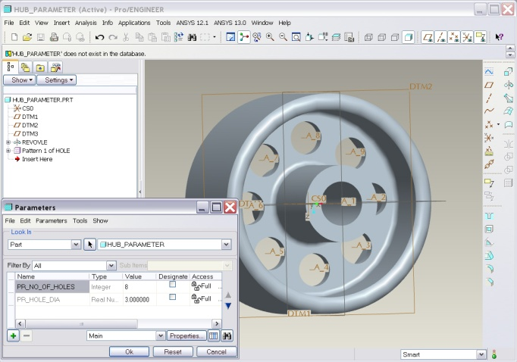
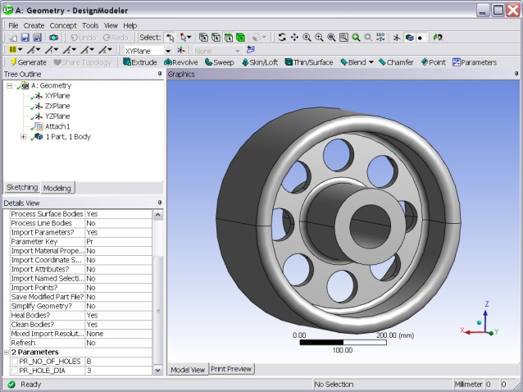
Parameters from CAD
Parameters from CAD packages can be transferred to DM
Filtering option for User Defined Parameters only
Can maintain Bi-Directional CAD connectivity
Geometry Property
CAD Parameters
Bi-Directional
Associativity
DM Parameters

Slide 5
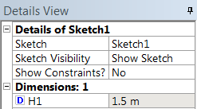
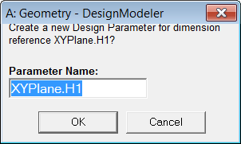
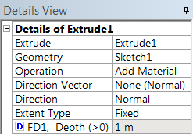
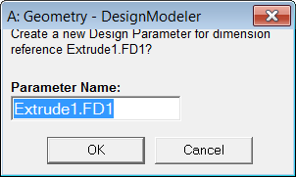
Creating Parameters in DesignModeler
Procedure & Examples
Any input prefixed with the “□” symbol can be parameterized
Toggle “□” to “D” to parameterize that particular input
Default Parameter Name Pattern:
Feature Name.Dimension Reference
For example;
A dimension reference (H1) for a sketch created on the XYPlane = XYPlane.H1
A dimension reference (FD1) for Extrude1 = Extrude1.FD1
Parameter name can be changed.
Expressions created in the Parameter Manager.
Sketch Dimension
Extrude Dimension

Slide 6
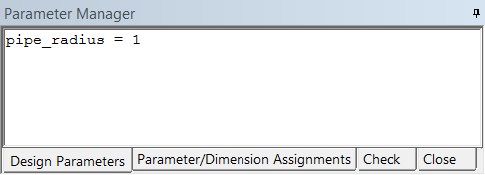
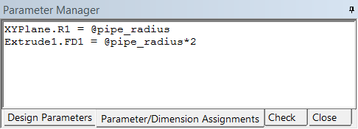
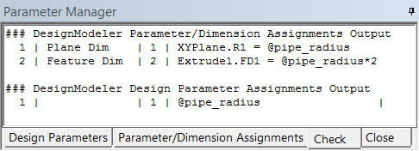
Parameter Manager
Using the Parameter Manager
Access using Toolbar button or from Tools Menu.
There are four tabs, the first “Design Parameters” lists all the existing parameters and assigned values.
Parameter name is either default or user defined name.
The Second tab, “Parameter/Dimension Assignments”, contains expressions relating the original dimension reference to the value set in the Design Parameters tab.
Third tab, “Check”, evaluates expressions.

Slide 7
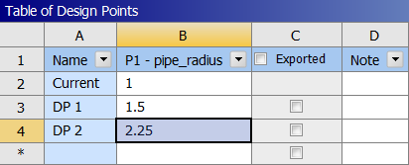
Parameter Manager
Parameters in Workbench
Parameters listed in the Design Parameters Tab are exposed in the Workbench Interface.
Multiple Design Points can be created using different values of the parameterized independent variable.
Dependent variables referenced in the DesignModeler Parameter Manager (Parameter/Dimension Assignments) will be updated for each Design Point.
Updates will be performed in the background.

Slide 8
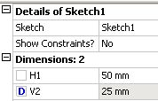
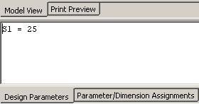
Driven/Dependent Parameters (1)
Driven Parameters: are parameters which take on values based on the value of a “driving” design parameter.
Example: given the rectangular section shown here, with dimensions S1 for height and S2 for width, drive the value of the width according to the formula, S2 = 2*S1.
S2
S1
In DesignModeler we would proceed as follows:
Dimension the sketch height and width.
Create a design parameter called S1.
S1 will be our “driving” parameter.
Continued . . .

Slide 9
Driven/Dependent Parameters (2)
By inspecting the details for our sketch (previous page), we can see the width dimension assignment is called H1.
The “H” in H1 indicates a horizontal dimension, while the “V” in V2 indicates a vertical dimension.
From the Parameter/Dimension Assignments, notice the dimension assignment for S1 is:
Knowing the “internal” parameter name for our driven parameter will be “XYPlane.H1”, we can type the following formula in the Parameter/Dimension Assignment tab.

Slide 10
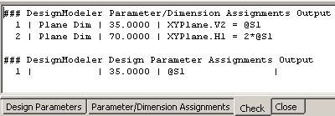
Driven/Dependent Parameters (3)
At this point, we could verify our formula by simply changing values for S1, re-generating the model, and checking to make sure the width is always equal to 2*S1.
If the regeneration of the model fails due to a mistake in our formula, we could encounter problems trying to undo the operation.
DesignModeler contains a more elegant solution to validating parametric formulae:
By moving to the “Check” tab, parametric assignments are evaluated and the result displayed.

Slide 11
Driven/Dependent Parameters (4)
The check window is split into two output sections:
Parameter/Dimension Assignments
Design Parameter Assignments
The sections are listed as “output” since each definition is displayed according to its definition as well as its output value.
In the above case, it can be seen that our parameter “S1” is assigned a value of 35.000 (design parameter section).
Similarly, driven parameter “XYPlane.H1” evaluates to 70.000.
Since we wish to drive XYPlane.H1 to the value 2*S1 we verify the value of 70.000 makes sense.

Slide 12
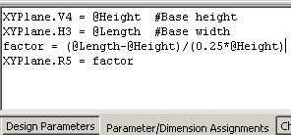
Auxiliary Variables
Auxiliary variables are parameters that do not directly define a sketch or feature dimension.
Typically used as a constant value or factor.
Example:
Here, we have defined 2 design parameters (@Height and @Length).
We now create a variable named “factor” using the formula shown.
Finally, we set the radius dimension “R5” equal to our variable.
Note, this example is for demonstration only. We could have simply directly defined R5 with the formula used to define the variable.

Slide 13
Parameter Functions
Functions can be utilized to capture design intent and other relationships among parameters.
Functions are operations that return a single value
ABS(X)
EXP(X)
LN(X)
SQRT(X)
SIN(X) (in degrees)
COS(X)
TAN(X)
For X between –1 and +1:
ASIN(X) & ATAN(X) (return value between -90 & 90 degrees)
ACOS(X) (returns value between zero & 180 degrees)
Examples…
A=acos(-1) # evaluates to –90
B=abs(X) # evaluates to |X|

Slide 14
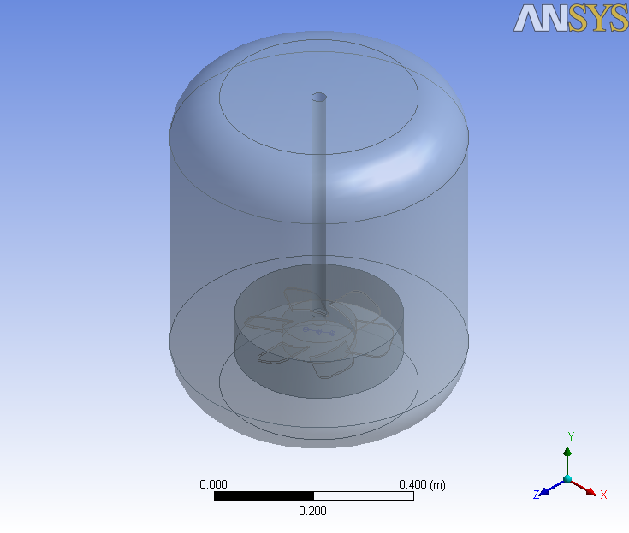
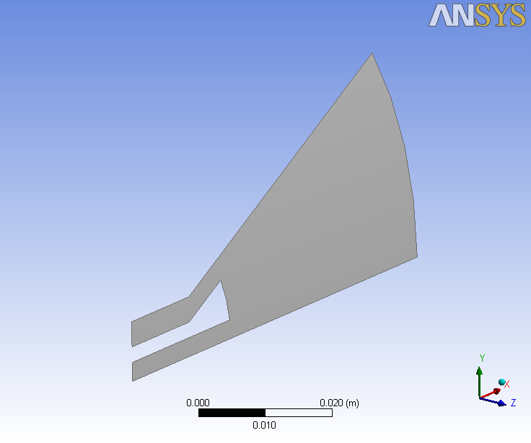
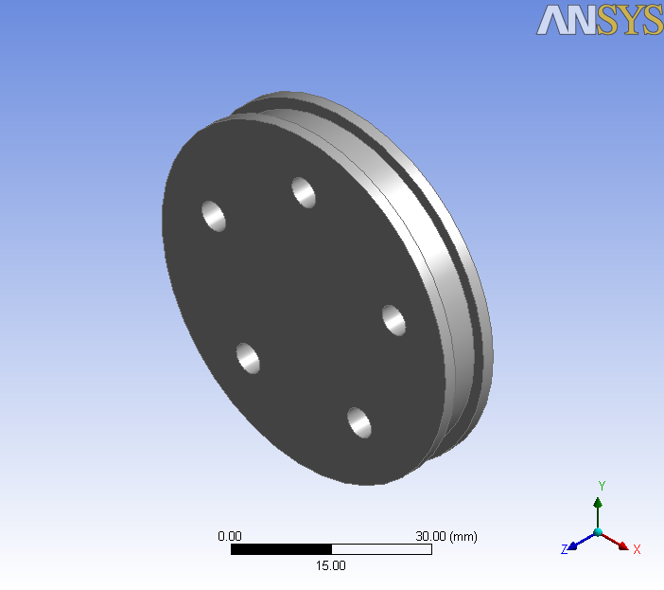
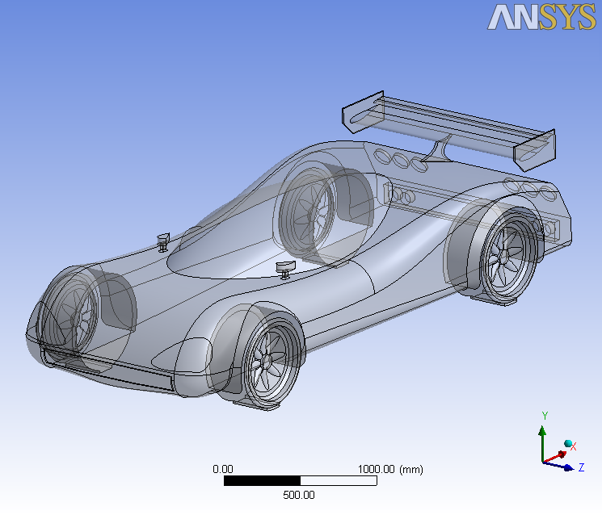
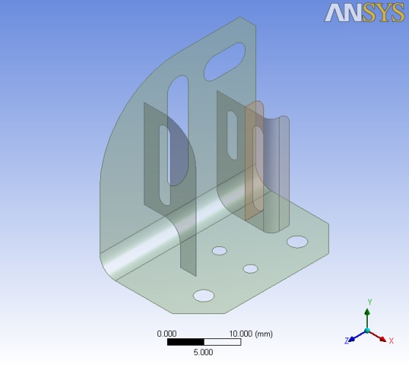
Workshops 5 (Applications Choice)
5a Mixing Tank
5c Combustion Chamber (2d)
5e Pulley
5b Automotive Aero
5d Bracket

