Slide 1
Lecture 6 Geometry Simplification and Repair

Slide 2
Geometry Simplification & Repair
What will you learn from this presentation:
Typical geometry issues
Analysis Tools
Dedicated Repair Tools
Automation
Examples
Other repair & defeaturing tools
Mid-surfaces, Surface Extension and Joints

Slide 3
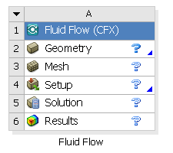
Preprocessing Workflow
Geometry Creation
OR
Geometry Import
Meshing
Solver
Geometry Operations
Sketches and Planes
3D Operations
Meshing Methods
Boolean, Body Operations, Split, etc
Hybrid Mesh: Tet, Prisms, Pyramids
3D Operations
Extrude, Revolve, Sweep, etc
Hexa Dominant, Sweep meshing
Geometry Cleanup and Repair
Assembly Meshing
Geometry Import Options
Automatic Cleanup
Global Mesh Settings
Direct CAD/Bi-Directional CAD
Merge, Connect, Projection, Flow Volume Extraction, etc
Local Mesh Settings
Sizing, Body/Sphere of Influence, Match Control, etc

Slide 4
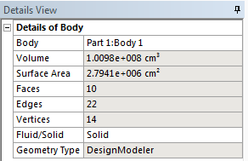
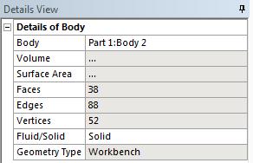
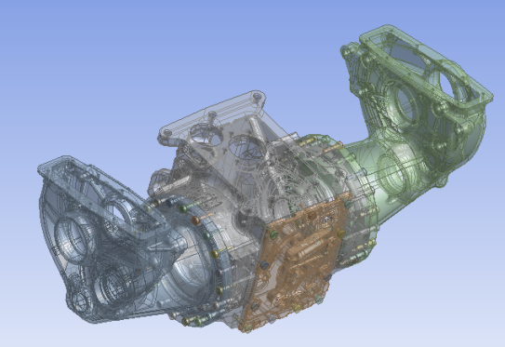
Geometry Types
Import/Attach in R14.5 supports two options for target geometry type:
Workbench Geometry: Form of geometry representation that is used by various applications within ANSYS WB, including WB Mechanical and WB Meshing.
Workbench type bodies must be converted to Parasolid for some operations
Conversion from Workbench format to DesignModeler format will occur automatically as needed by some operations
Avoids time-consuming conversion of entire assembly during import if only some of the bodies will be worked on/modified in DM
DesignModeler Geometry: Geometry representation which is used only by the DesignModeler application.
DM, Parasolid, IGES, STEP, and MCNP import only as native DM type (Parasolid)
Note: Almost all geometry editing operations are performed in this geometry representation. Geometry in versions of DesignModeler prior to DesignModeler 14.5 are entirely in this form.
Notes:
Workbench option just brings in the B-Rep, DM brings in the parasolid.

Slide 5
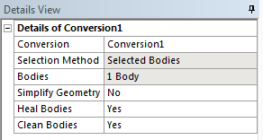
Conversion
Why some operations may fail if Geometry Type is Workbench?
DM features will automatically convert the geometry to DM type before performing the particular feature operation
However, sometimes the conversion step can fail in which case the feature will also fail
Reasons for failure
The conversion of WB type body that is disjoint might have produced multiple DM type bodies
Failure to convert specific faces of WB body may cause the resultant DM body to be of a different type, e.g. a surface body instead of solid body
A non-manifold configuration of WB geometry may fail to construct an equivalent DM representation
Conversion of some bodies can be done manually
Avoids time-consuming conversion of entire assembly during import
User can selectively control mixture of WB Type and DM Type bodies for most efficient use of operations
Parasolid body cleaning operations available per set of bodies being converted
Can be used to manually Heal, Simplify and/or Clean selected bodies

Slide 6
Geometry Cleanup/Repair: Introduction
Why Repair?
Several translation methods available to enable data exchange with CAD/CAE systems
Direct Integration/CAD Readers
Import of generic CAD formats (IGES, ACIS etc)
Translation can:
Return incomplete, corrupt, or disconnected geometry
Requires repair
Return geometry details unnecessary for CAE analysis
Requires defeaturing
How to Fix?
Geometry cleanup
Processes required to prepare geometry for meshing
Fix incomplete or corrupt geometry and connect disconnected geometry
Remove unnecessary details (defeaturing)
Decompose geometry into meshable sections

Slide 7
Geometry Cleanup/Repair: Introduction
DM provides geometry tools to:
Analyze
Repair
Modify/Simplify
All these commands are available under the Tools Menu
May need to view the model in wireframe mode to visualize the defects
DM also give the ability to color edges depending on connectivity

Slide 8
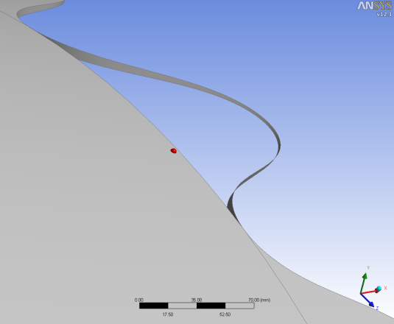
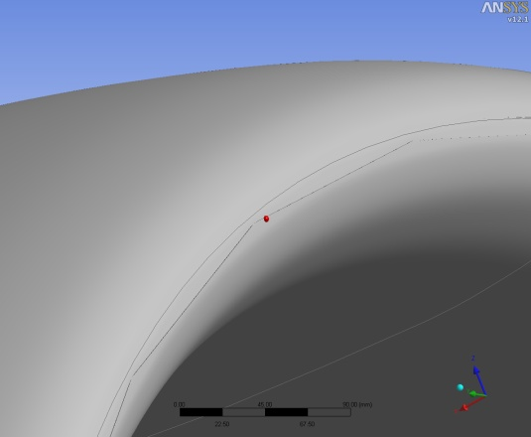
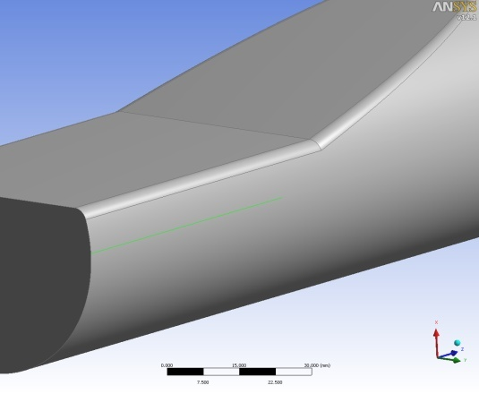
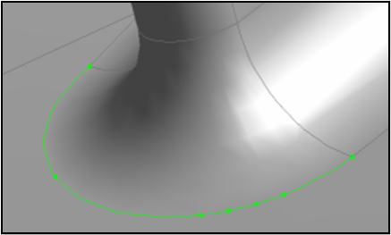
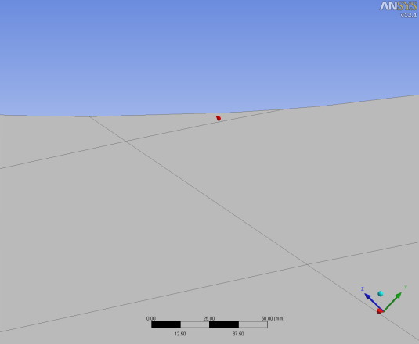
Typical Geometry Issues
Many potential issues
Missing faces
Sliver faces
Hard edges
Small edges
Sharp angles
Others …
These issues must be fixed to
Create watertight volume bodies
Prevent meshing issues
Missing faces
Sliver faces
Hard Edges
Small edges
Sharp angles

Slide 9
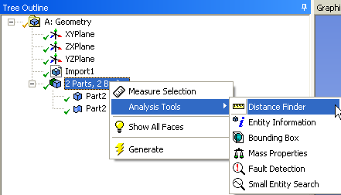
Analysis Tools
Set of features that provide information, detect faults in geometry
RMB on the part

Slide 10
Repair Tools
Easy search and fix of unwanted geometrical features or geometric errors
Can be executed on both frozen and active bodies
Repair Types
Repair Hard Edges
Repair Edges
Repair Seams
Repair Holes
Repair Sharp Angles
Repair Slivers
Repair Spikes
Repair Faces

Slide 11
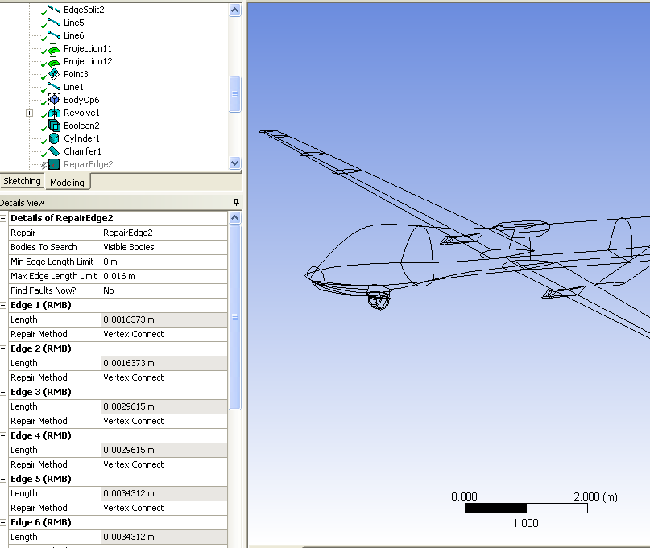
Repair: Automation
Automatically detects and lists out geometrical issues
Highlights the location of fault in the geometry
Zooms into the location, when clicked on the items in the list
Proposes fixes to the issues
Choose a different method to fix, if needed
Analyze the list
Fix issues all at once
Upon clicking “Generate”
Can’t be done one after the other

Slide 12
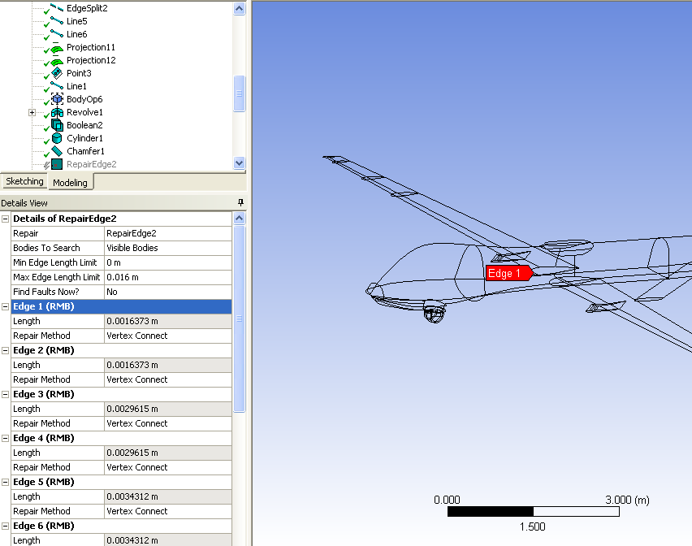
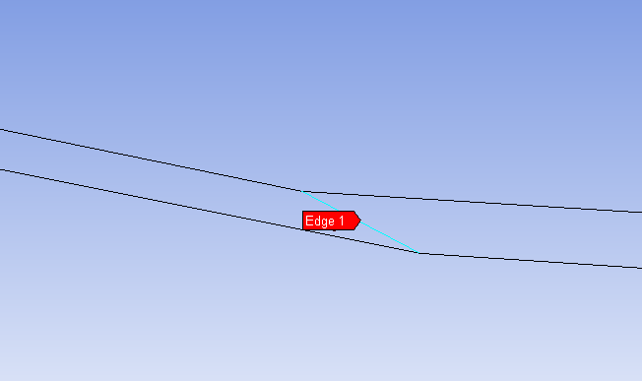
Repair: Automation
Automatically detects and lists out geometrical issues
Highlights the location of fault in the geometry
Zooms into the location, when clicked on the items in the list
Proposes fixes to the issues
Choose a different method to fix, if needed
Analyze the list
Fix issues all at once
Upon clicking “Generate”
Can’t be done one after the other

Slide 13
Repair: Automation
Automatically detects and lists out geometrical issues
Highlights the location of fault in the geometry
Zooms into the location, when clicked on the items in the list
Proposes fixes to the issues
Choose a different method to fix, if needed
Analyze the list
Fix issues all at once
Upon clicking “Generate”
Can’t be done one after the other

Slide 14
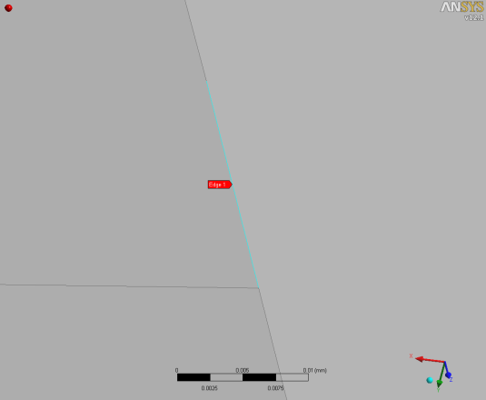
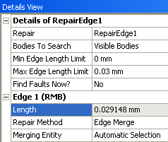
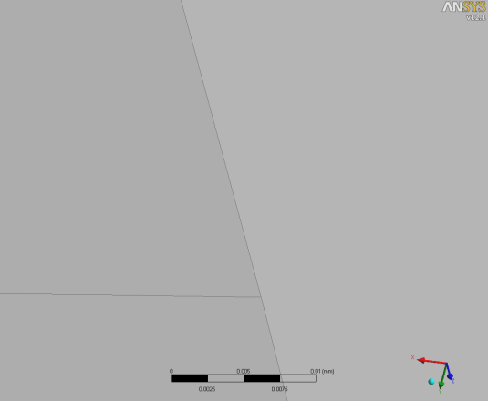
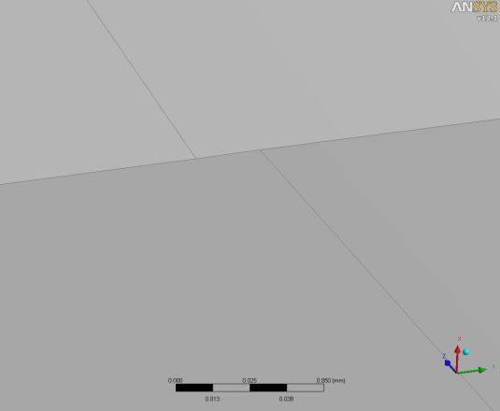
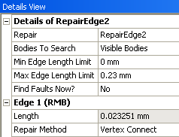
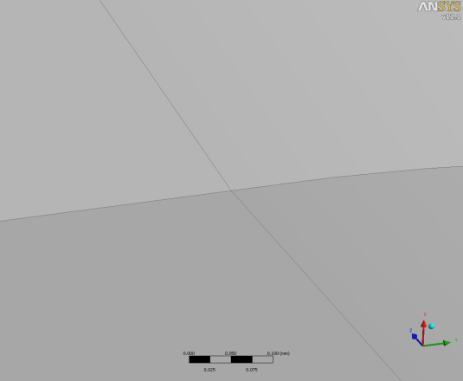
Repair: Example
Repair Edges
Small edge in the model
Details View of Repair Edges
Small edge removed
Small edge in the model
Details View of Repair Edges
Small edge removed

Slide 15
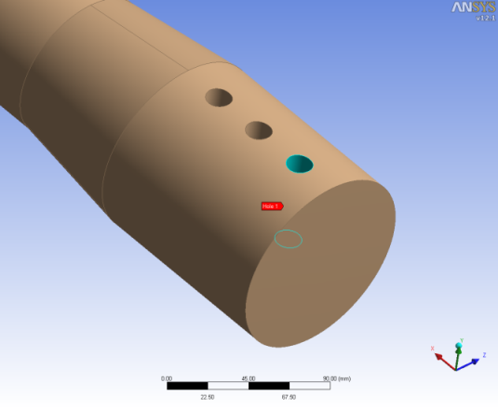
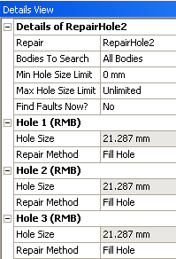
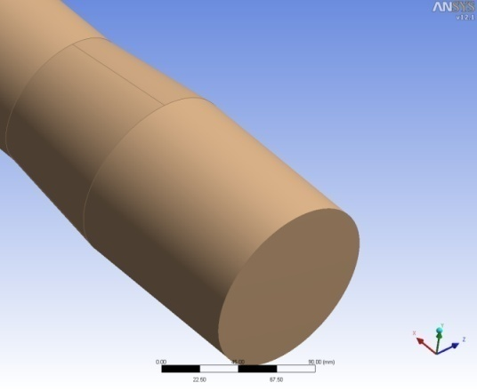
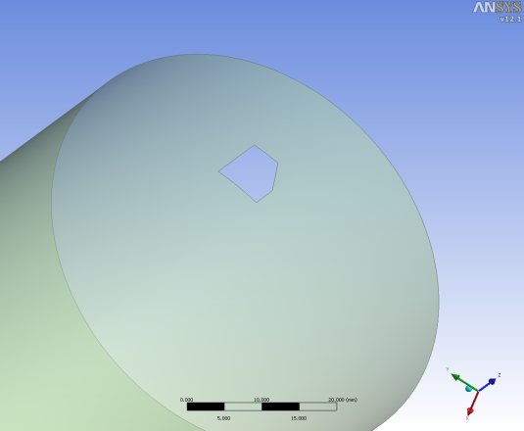
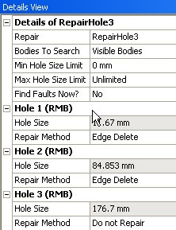
Repair: Example
Repair Holes
Holes in a solid body
Details View of Repair Holes
Holes removed
Hole in a surface body
Details View of Repair Holes
Hole removed

Slide 16
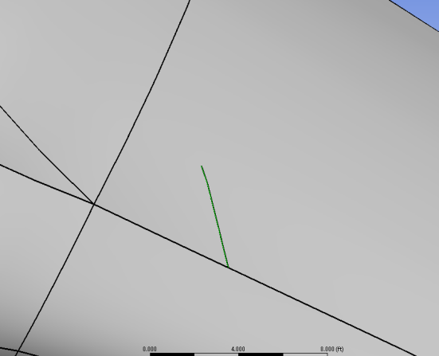
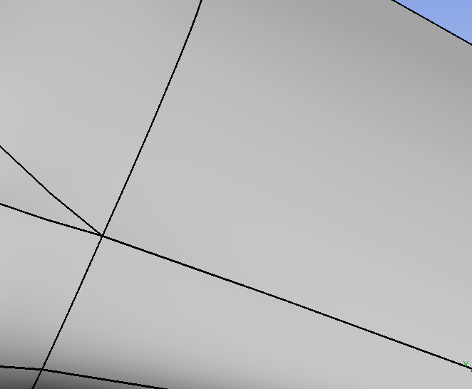
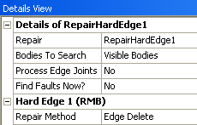
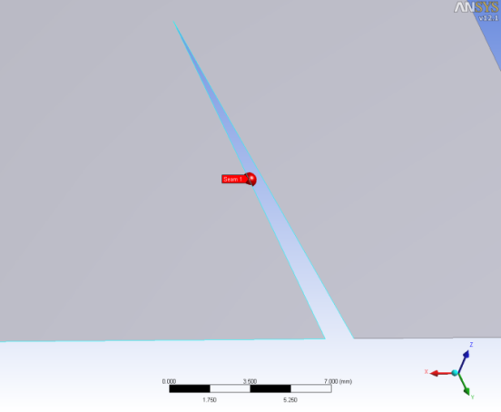
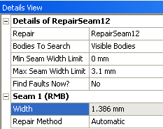
Repair: Example
Repair Hard Edges
Repair Seams
Details View of Repair Hard Edges
Hard edge in the model
Hard edge removed
Small crack in the model
Details View of Repair Seams
Small crack removed

Slide 17
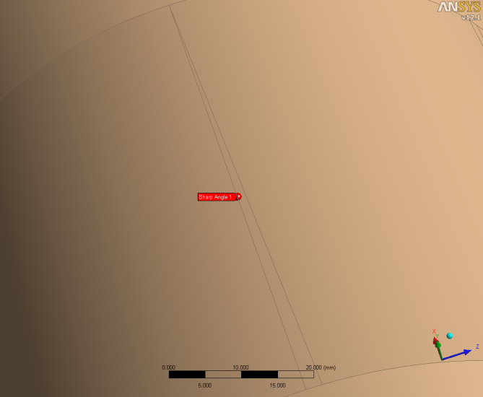
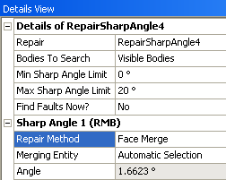
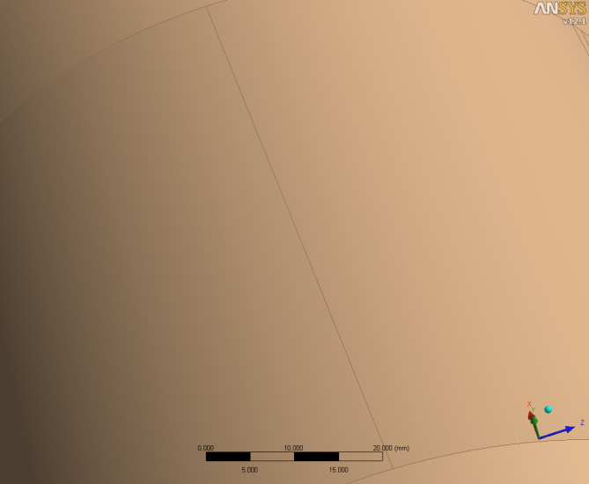
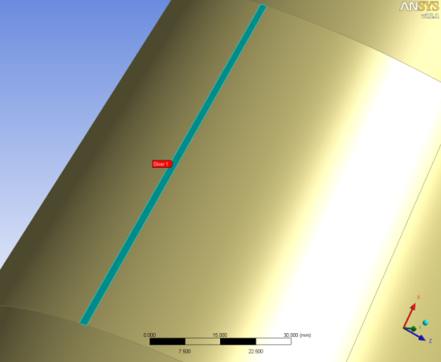
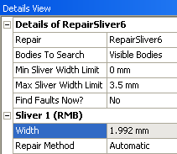
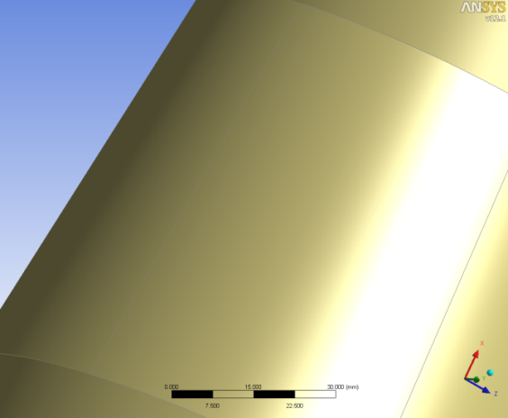
Repair: Example
Repair Sharp Angles
Repair Slivers
Sharp angle in the model
Details View of Repair Sharp Angles
Sharp Angle removed
Sliver face in the model
Details View of Repair Slivers
Sliver face removed

Slide 18
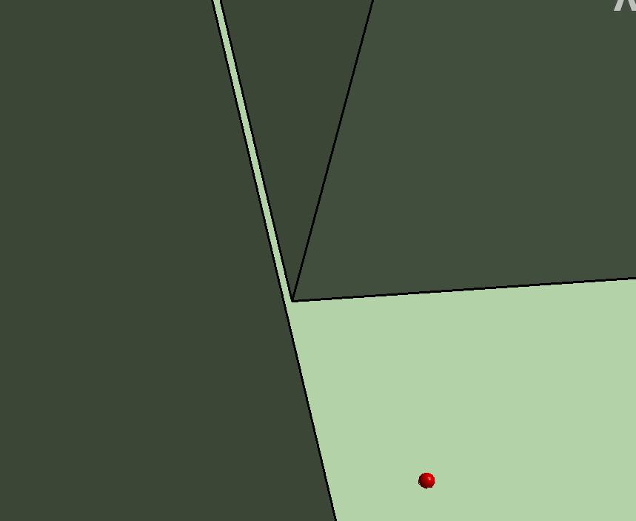
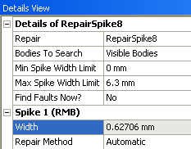
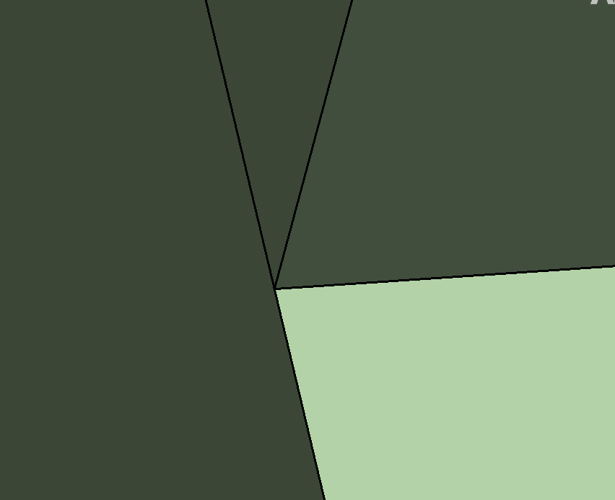
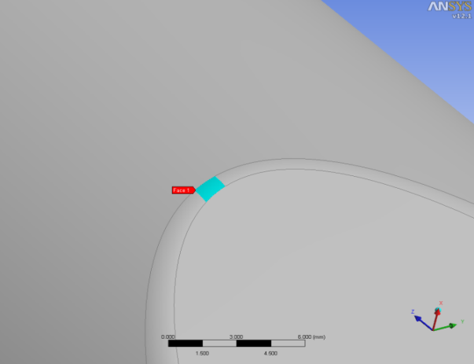
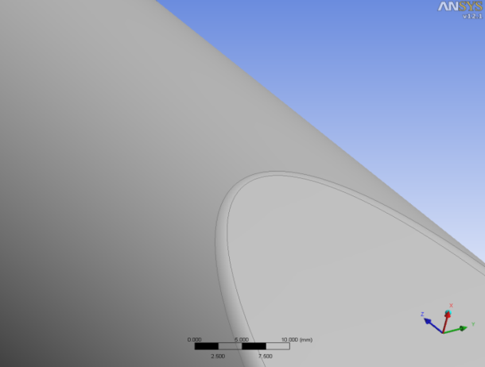
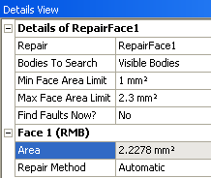
Repair: Example
Repair Spikes
Repair Faces
Details View of Repair Spikes
Spike in the model
Spike removed
Small face in the model
Details View of Repair Faces
Small face removed

Slide 19
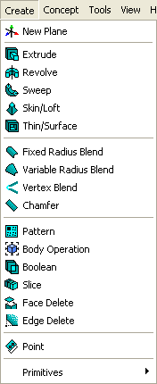
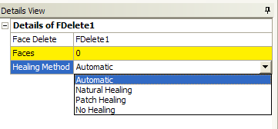
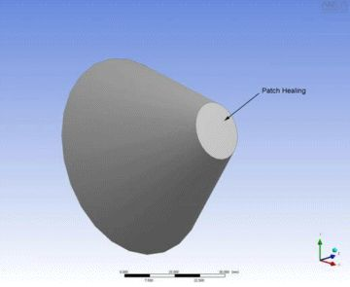
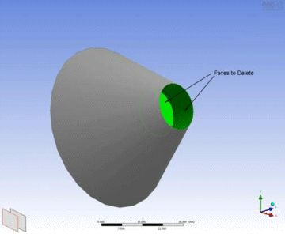
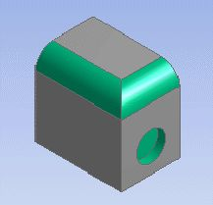
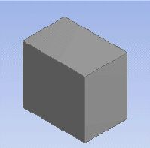
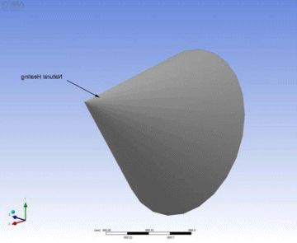
Face Delete
Used to remove features such as fillets, chamfers, holes etc., and automatically heal the geometry at those locations
Four Options for Healing: Automatic, Natural, Patch or No healing
Edge Delete also available (see Appendix)
Patch Healing
Automatic
Natural Healing

Slide 20
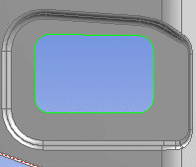
Edge Delete
Used to remove blends, chamfers, and holes from surface bodies
Can also be applied to imprinted edges from all body types
Can choose healing types: Automatic, Natural or No healing

Slide 21
Merge
Merges a set of edges or faces
Useful to reduce model complexity
Type
Edge merging
Face merging
Method
Manual: user selects the entities to merge
Automatic: clusters of entities to merge are automatically selected and highlighted
Edge Merging
Details View of Merge

Slide 22
Face Split
Allows faces to be broken down by:
Points and Edges
Combinations of sketch and 3D geometry
Locations
“Click” on the surface
Do not need to close the loop

Slide 23
Surface Patch (1)
Fills the gaps in surface bodies
Requires closed loop of edges
Edges can be from different surface bodies
Allows selection of multiple patch operations in a single go
Natural Healing
Details View of Surface Patch
Gap filled using Surface Patch
Model with a hole
Patch Healing

Slide 24
Surface Patch (2)
Surface Patch
[Main Menu] Tools → Surface Patch
Attempts to fill gaps in the model
Uses similar healing methods as face delete (natural and patch)
Complex gaps may result in multiple surfaces being created to fill them
2 holes selected for patching
Two patches created using multiple surfaces

Slide 25
Projection
Allows projection of points on edges/faces and edges on faces/bodies
Options
Points on edge or face
Edge on face or body
Works on both frozen as well as active bodies
Details View of Projection

Slide 26
Projection: Example (1)
Edge on Face
Edge projected on face
Type: Edges on Face
Edge projected on face with ‘Extend Edges’ option YES
Edge to project
Extend Edges: Yes

Slide 27
Projection: Example (2)
Points on Edge/Face
Points projected on face
Type: Points on Face
Points projected on edge
Points to project
Type: Points on Edge

Slide 28
Body Operation: Sew
Sews selected surface bodies to form a single surface body where they have edges common to within a given Tolerance
Create Solids? option enables surface bodies forming a closed domain to be converted to solid bodies

Slide 29
Fill
Creates internal fluid volume
Two options
By Cavity : user must select all wetted surfaces
By Caps : user must create closing surfaces at inlets and outlets, and select bodies
Internal fluid volume extracted using Fill
Details View of Fill
Cap surface bodies must be selected

Slide 30
Enclosure
Creates enclosure around the bodies
Useful for external aerodynamic analysis
Can be used for extracting internal flow domain
Input
All or selected bodies
Shape of enclosure
Extent of enclosure
Output
A frozen body around the selected parts with specified extents
Internal flow volume as a result of automatic Boolean subtract
Supports symmetry models
Full or partial models can be included in enclosure
Enclosure created for an airplane

Slide 31
Enclosure: External Flow Example
Using Symmetry
Model
User Defined Shape Enclosure

Slide 32
Symmetry
Defines symmetry for the model
Input
All or selected bodies
Up to three symmetry planes
Operation
Symmetry planes slice the model
Output
Sliced model (part lying on the positive side of the axis is retained)
Tip: The symmetry tool can be used as visualization tool when discovering the model (then the operation is deleted)
Details View of Symmetry
Note : Faces that are coincident with the symmetry plane are tagged with a “Symmetry” named selection under AMP
Using Symmetry

Slide 33
Symmetry: Example
Symmetry using XY plane
Full Model
Symmetry using XY & ZX plane

Slide 34
Connect
Aligns and possibly joins a set of vertices, edges or faces
Properties
Location property
T-junction property
Vertex Connect
Details View of Connect

Slide 35
Connect: Example (1)
Edge Connect
Location: Interpolated
Both edges moved to interpolated location
Model with a gap
Location: Preserve First
Second edge moved to first edge location

Slide 36
Connect: Example (2)
Edge Connect
Using
T-Junction
Model with a gap

Slide 37
Connect: Example (3)
Face Connect
Additional options as per edge connect
Model with a gap

Slide 38
Surface Extension
Allows extension of surface bodies to the desired extent
Extension type
Natural: Based on gradients of selected edges
User Defined: User specifies the direction
Details View of Surface Extension
Model with gap
Model with gap closed

Slide 39
Workshop 4 – Geometry Cleanup

