Slide 1
Workshop 5b Applications – Automotive Aero

Slide 2
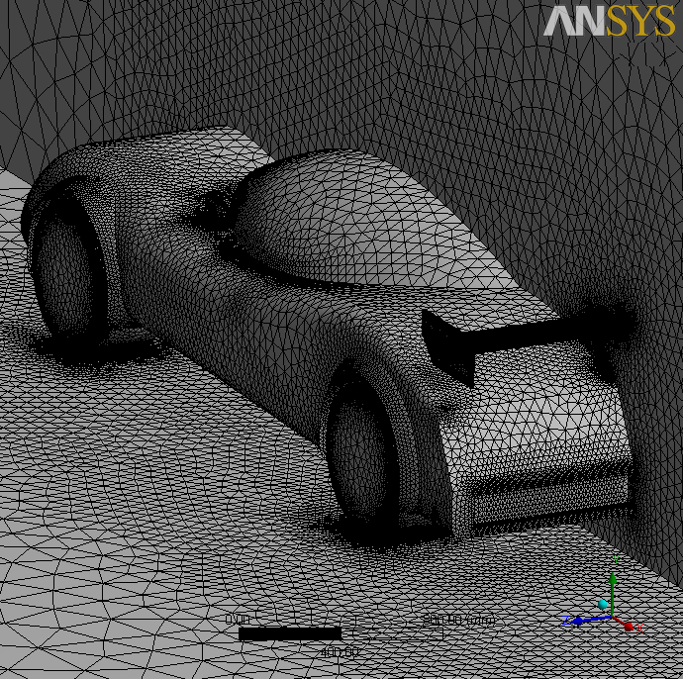
Introduction
Background
This workshop will demonstrate the practical application of ANSYS Meshing to an automotive external aero model.
Objectives
Generating a Tetrahedral Patch Conforming mesh
Local Mesh Controls
Body of Influence
Inflation
Using Advanced Size Functions
Named Selections
Virtual Topology

Slide 3
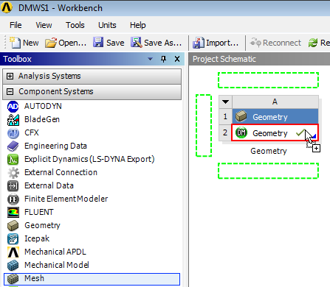
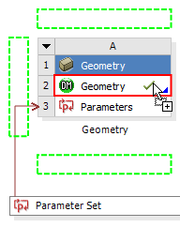
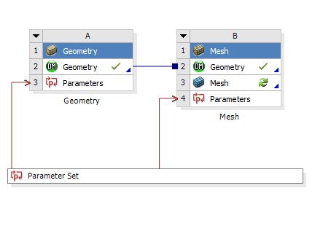
Project Startup
Create the Project
Start Workbench.
Start → All Programs → ANSYS 14.5 → Workbench 14.5
If have access to DesignModeler, follow the instructions below.
This workshop uses the geometry created in workshop 5b of the DesignModeler course. Open your saved project (DMWS5b) and drag and drop a Meshing component system onto the Geometry Cell (A2) as shown. If you did not complete this workshop, a copy is provided in the Meshing Workshops “Input-Files” folder.

Slide 4
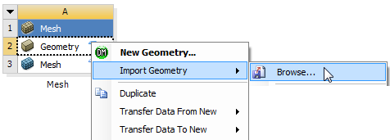
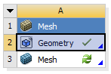
Project Startup
Create the Project
If you do not have access to DesignModeler follow these instructions
Drag and drop a Mesh component system into the Project Schematic .
Right click on the Geometry cell (A2) and select Import Geometry → Browse.
Locate the file “auto-aero.stp” in the Meshing Workshops Input Files folder and select it. The geometry cell will show a check mark indicating it is up to date.

Slide 5
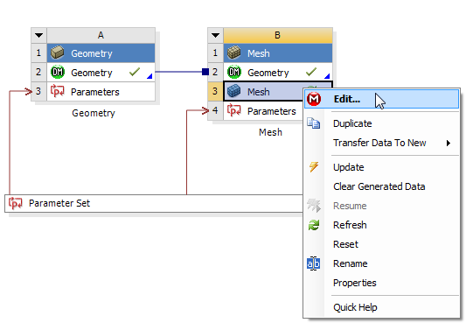
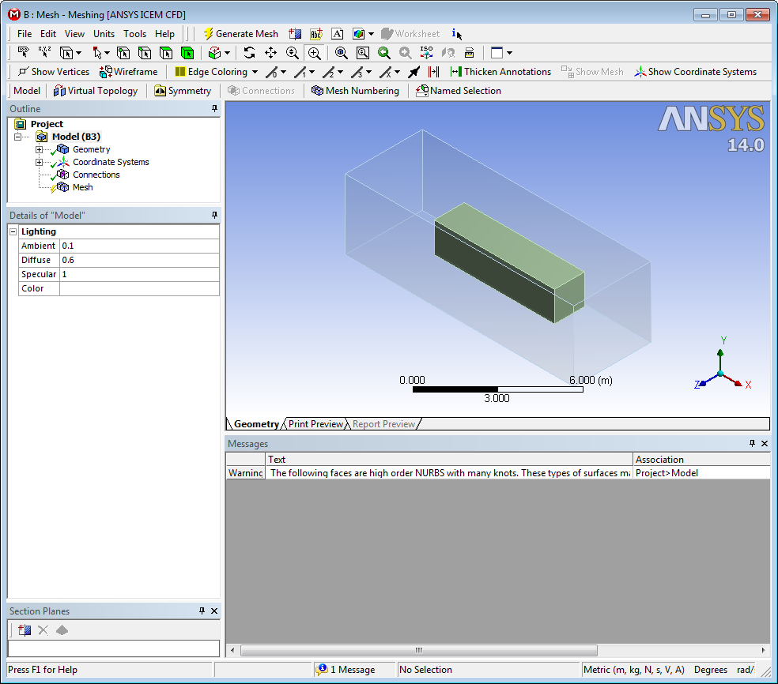
Project Startup
Starting Meshing
On the Mesh cell right click and select Edit
Double clicking on the Mesh cell can also startup Meshing
ANSYS Meshing will start up and load the geometry

Slide 6
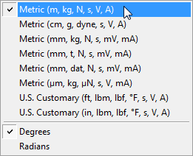
Units
Set Units
From the main menu select Units and, if it is not already set, specify Metric (m...).

Slide 7
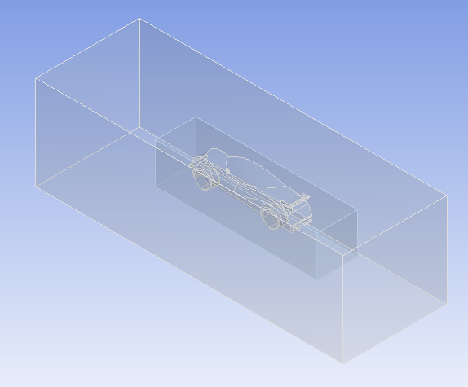
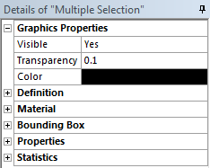
Geometry
View the Geometry
Expand the Geometry Object in the Outline and select both bodies (CTRL click to multiple select).
In the Details View, under Graphics Properties set Transparency to 0.1.

Slide 8
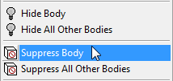
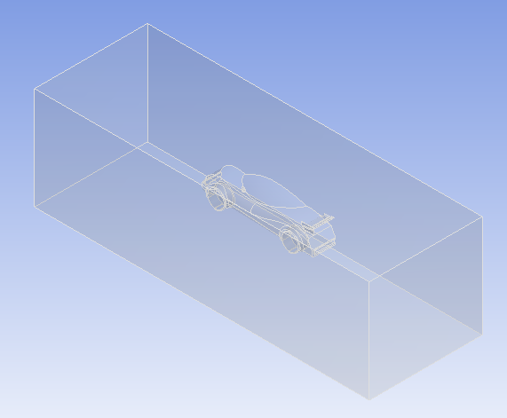
Geometry
View the Geometry
The smaller box will be used later in the workshop. For now we will suppress it.
Right click on the second of the two bodies listed under Geometry in the Outline and select Suppress Body from the Context Menu.

Slide 9
Preparation
Planning
This geometry contains a symmetric model of a car incorporating aerodynamic rear wing elements. The mesh is intended to be used in an external aerodynamic analysis.
The car body is complex with curved surfaces and some narrow gaps. The Tetrahedrons Method combined with Advanced Size Functions to capture curvature and proximity would therefore be a good candidate. Since the geometry is clean the Patch Conforming Algorithm will be used.
Inflation will also be used on the car and ground surfaces to capture boundary layer gradients.

Slide 10
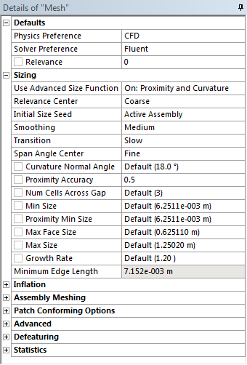
Global Mesh Controls
Mesh
In the Outline, select the Mesh object to display Details of “Mesh”.
In Details of “Mesh”, set the following under Defaults;
Physics Preference: CFD.
Solver Preference: FLUENT.
Under Sizing, set;
Use Advanced Size Function: On: Proximity and Curvature.

Slide 11
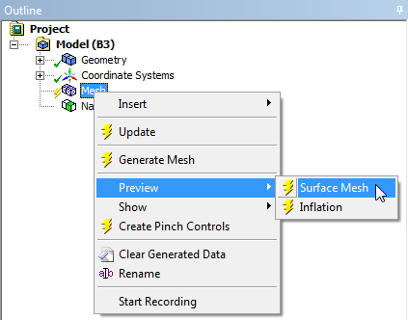
Preview
Preview Surface Mesh
Before generating a volume mesh we should check that the surface mesh is satisfactory.
In the Outline, right click on the Mesh object and select Preview → Surface Mesh.
A mesh will be generated on all surfaces using the global controls applied so far.

Slide 12
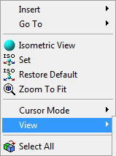
Section Plane
Preview Surface Mesh (Continued)
Right click in the graphics window and select View → Left.
Select the Section Plane Tool.
Create a Section Plane by clicking, dragging and releasing as shown vertically down through the mesh.

Slide 13
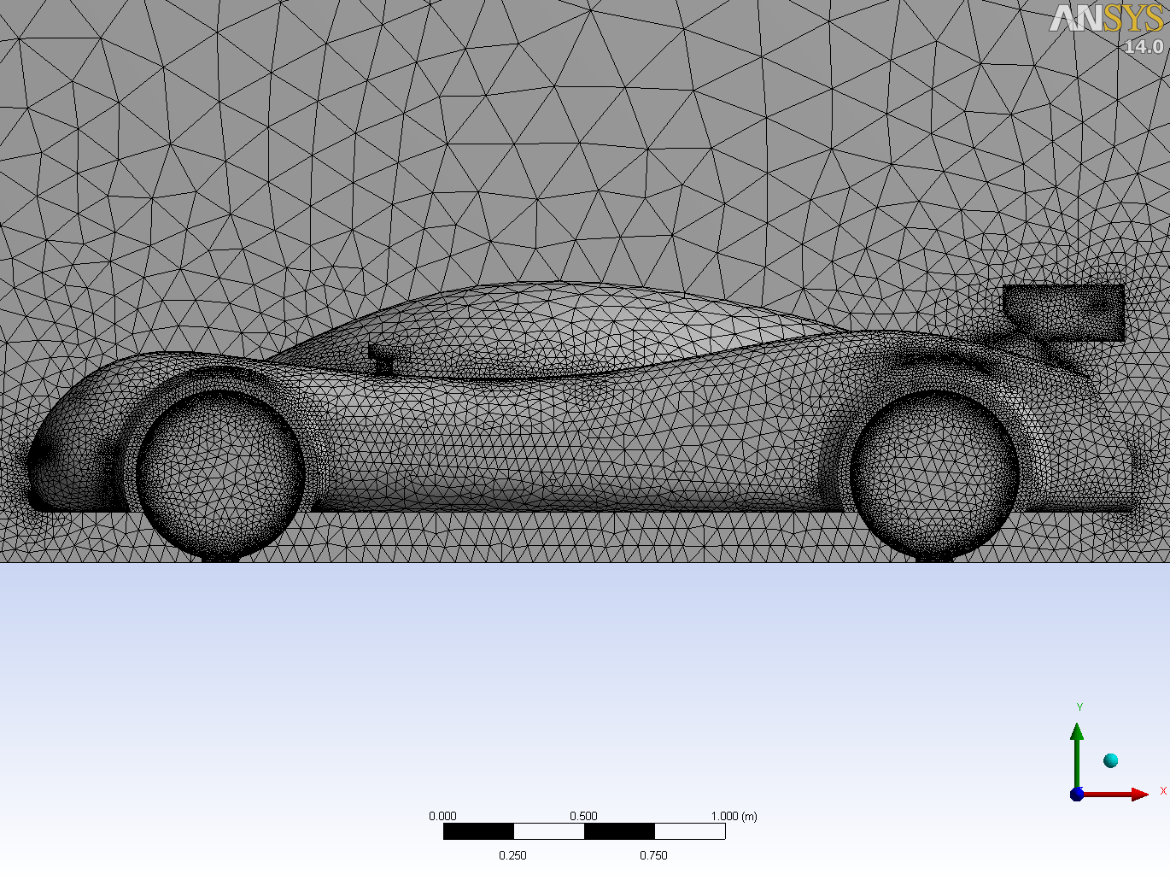
Review
Review the Surface Mesh
Right click in the Graphics Window and select View → Front.
Zoom in as shown using the Box Zoom Tool.
The surface mesh has been refined automatically for curvature (car body, wheels, rear wing elements) and proximity (wheel arches, between wing elements).
However, there are some areas which could be improved. Before clearing the surface mesh we will look at these areas in more detail.

Slide 14
Review
Review the Surface Mesh
There are two locations where the proximity size function has created small elements due to edges in close proximity. Since the faces bound by the edges are almost tangential there is no need for this refinement.

Slide 15
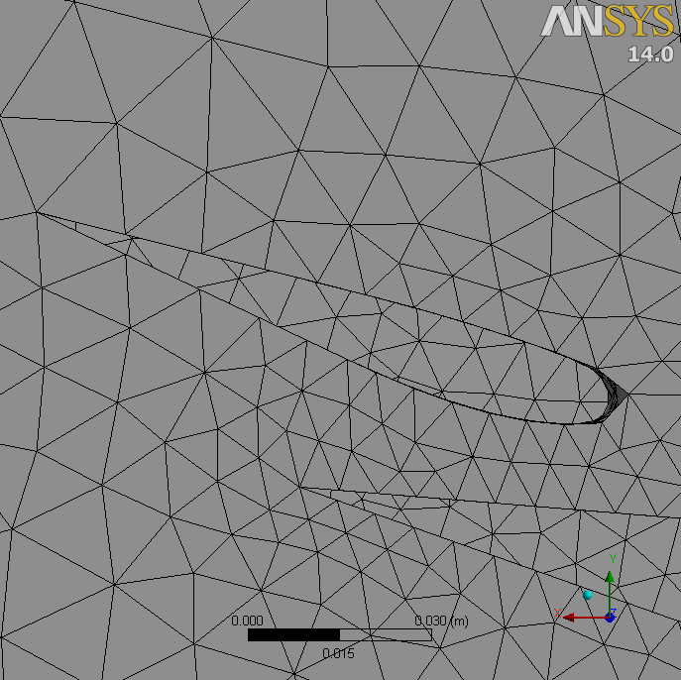
Review
Review the Surface Mesh
Right click in the Graphics Window and select View → Back.
Zoom in as shown using the Box Zoom Tool.
Note that the leading edge geometry of the smaller of the two wing elements is not well refined.

Slide 16
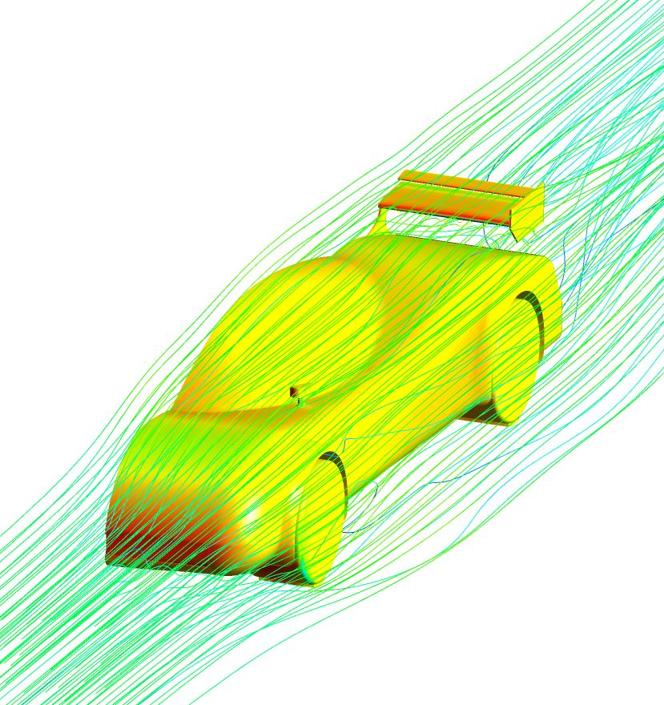
Preparation
Planning
The two issues identified in the initial surface mesh can be dealt with by creating Virtual Topology to ‘merge’ small faces and by making adjustments to size parameters respectively.
In addition to rectifying these issues we will also add some controls to accommodate for the type of analysis the mesh will be used for.
Solution gradients are often high in the vicinity of bodies in external aerodynamic solutions. To help capture these gradients we will use a Body of Influence to limit the cell size surrounding the car geometry.
We require high accuracy in the region of the rear wing. A local sizing will therefore be scoped to the faces forming the rear wing geometry.
Since we expect turbulent boundary layers in the solution we will apply an inflation control to capture the boundary layer.

Slide 17
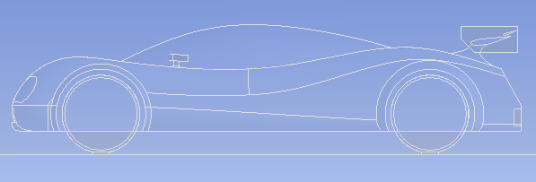
Virtual Topology
Add Virtual Cell
Select the Model object in the Outline.
Select Virtual Topology using the button in the Toolbar.
Right click in the Graphics Window and select View → Front.
Zoom into the car body.

Slide 18
Virtual Topology
Add Virtual Cell
Select the Face Selection Filter and select the six faces as shown. The smaller faces are highlighted (CTRL click to multiple select).
Right click and, from the context menu, select Insert → Virtual Cell.
The six faces are replaced with a single Virtual Cell.
The edges bounding the original six faces are not present on the Virtual Cell. The mesh will now be unconstrained in these areas.

Slide 19
Global Size Controls
Edit Minimum Size
Right click in the Graphics Window and select View → Back.
Select the Mesh object in the Outline and zoom into the leading edge of the smaller of the two rear wing elements.
The circle adjacent to the cursor represents the minimum cell size returned by the size function.
To allow the curvature of the wing to be refined to 18° (the default Curvature Normal Angle set in the Global Controls) we must reduce the minimum size.

Slide 20
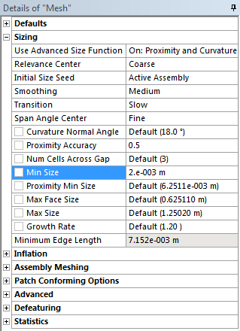
Global Size Controls
Edit Min Size
In the Details of “Mesh”, under Sizing, change the value of Min Size to 0.002m and press enter.
The new circle adjacent to the cursor updates reflecting the new minimum size.

Slide 21
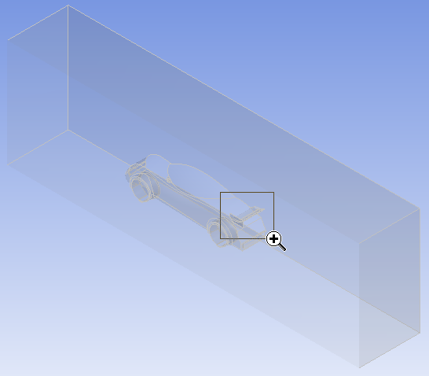
Local Size Controls
Add Local Face Sizing
Right click on the Mesh Object in the Outline and select Clear Generated Data from the Context Menu to clear the mesh. Answer Yes.
Set the view to isometric using the iso ball.
Zoom into the rear wing section of the geometry.

Slide 22
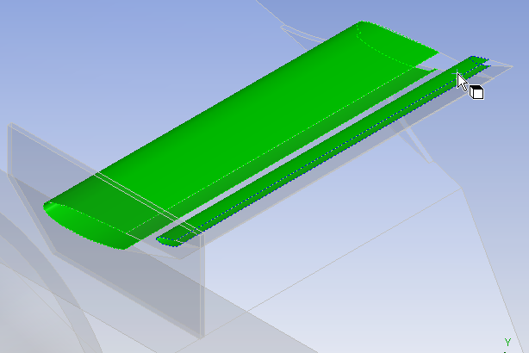
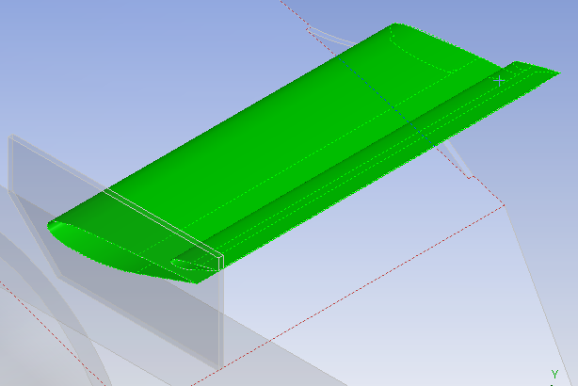
Local Size Controls
Add Local Face Sizing
Select the Face Selection Filter and select the two front faces of the wing elements as shown (CTRL click to multiple select).
Select Extend to Limits from the Toolbar.
All faces forming the wing elements are now selected.

Slide 23
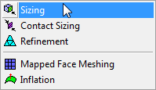
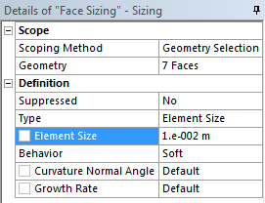
Local Size Controls
Add Local Face Sizing
Right click in the Graphics Window and select Insert → Sizing from the context menu.
In the Details View set Element Size to 0.01.
Ensure Behaviour is set to Soft.
This local sizing will prevent the mesh on the wing element surfaces from increasing to the max value specified in the Global Size Controls. The soft setting will allow the sizing to be reduced as required by curvature refinement.

Slide 24
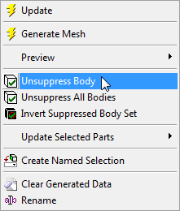
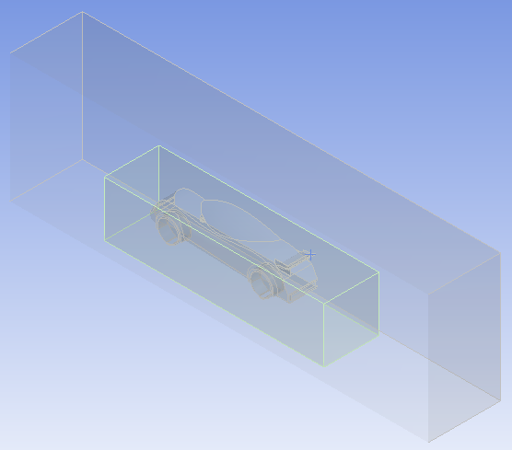
Local Size Controls
Add Body of Influence
Right click on the suppressed body in the Outline and select Unsuppress Body from the Context Menu.
Click the Zoom to Fit button in the Toolbar.

Slide 25
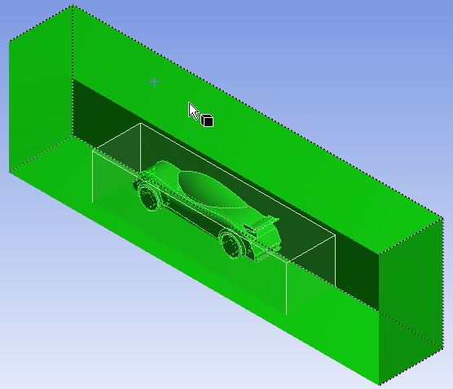
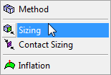
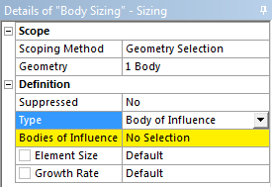
Local Size Controls
Add Body of Influence
Select the Body Selection Filter and select the large outer body as shown.
Right click in the Graphics Window and select Insert → Sizing from the Context Menu.
You may need to reselect the Mesh Object in the Outline in order to see the correct Context Menu.
In the Details View set Type to Body of Influence.

Slide 26
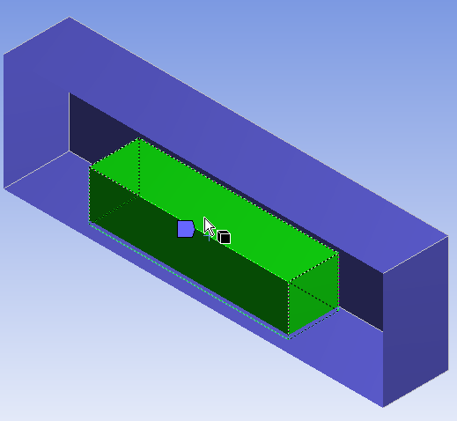
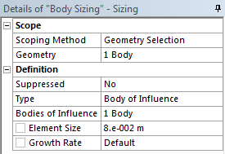
Local Size Controls
Add Body of Influence
In the Details View (Continued);
Activate the Bodies of Influence Selection Box (click in the box to the right of Bodies of Influence so that Apply/Cancel appear).
Select the smaller body and apply the selection.
Set Element Size to 0.08m.
This control will ensure the mesh size within the extents of the smaller body will not exceed 0.08m (smaller sizes as required by the global proximity/curvature functions and local face sizing will be allowed). The Body of Influence itself will not be meshed.

Slide 27
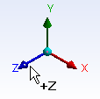
Geometry
Hide Body
Select the smaller body, right click and select Hide Body from the Context Menu.
Switch off the Section Plane by unchecking the box in the Section Planes Panel.
Orientate the View to +Z by clicking the +Z axis triad.
Select the Mesh Object in the Outline.

Slide 28
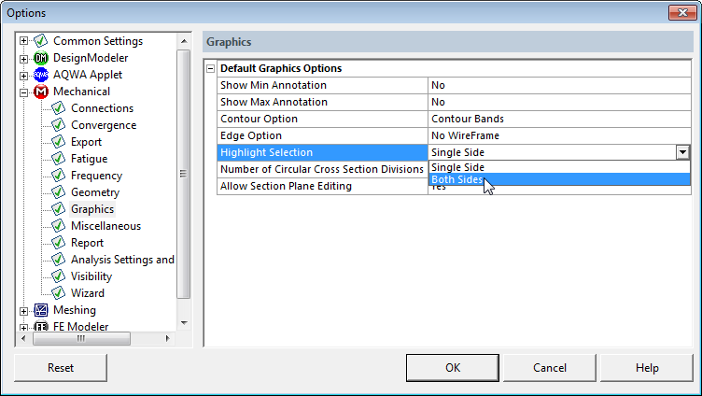
Options
Set Display Options
From the Main Menu, select Tools → Options.
In the Options Panel expand Mechanical and select Graphics.
Set the Highlight Selection option to Both Sides and click OK.

Slide 29
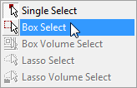
Named Selections
Add Named Selections
Using the Face Selection Filter and the Box Select Tool select all faces of the car body as shown.
Right click and select Create Named Selection from the Context Menu.

Slide 30
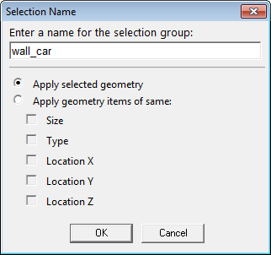
Named Selections
Add Named Selections
In the Named Selection Dialog box enter the name wall_car and click OK.

Slide 31
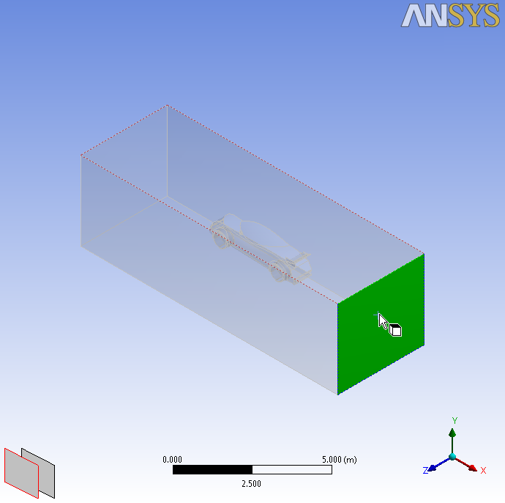
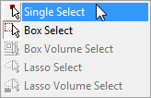
Named Selections
Add Named Selections
Select Single Select.
Set the view to isometric and select the face as shown.
Using the same procedure, create a Named Selection “outlet”.

Slide 32
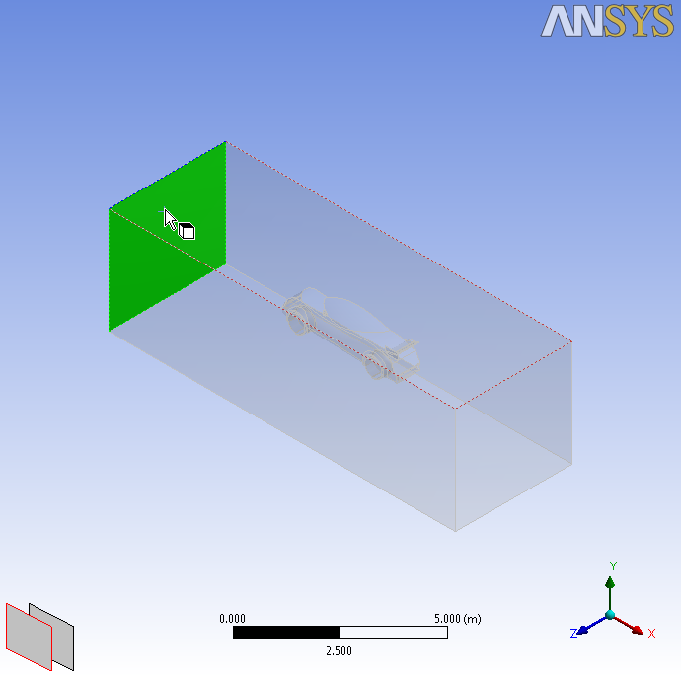
Named Selections
Add Named Selections
To select the next face, click in the position as shown and use the Depth Picking Selection Panes to toggle between foreground and background faces.
Create a Named Selection “inlet”.

Slide 33
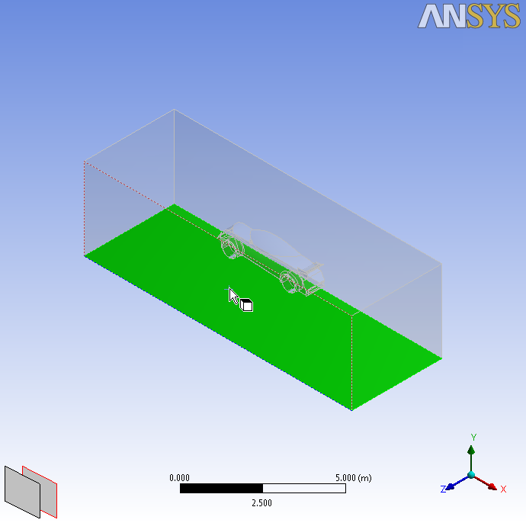
Named Selections
Add Named Selections
Create a Named Selection “wall_ground”.

Slide 34
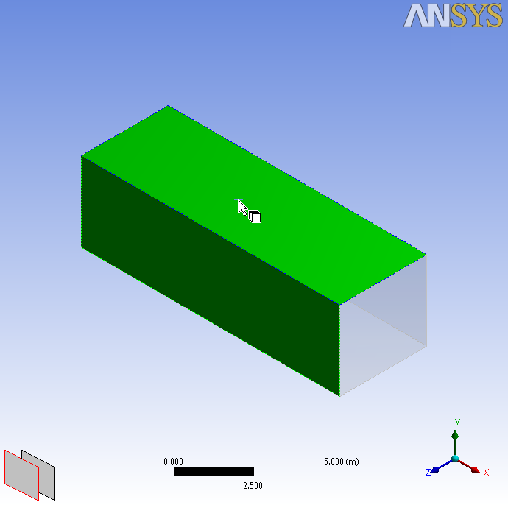
Named Selections
Add Named Selections
Create a Named Selection “wall_tunnel” (CTRL click to multiple select).

Slide 35
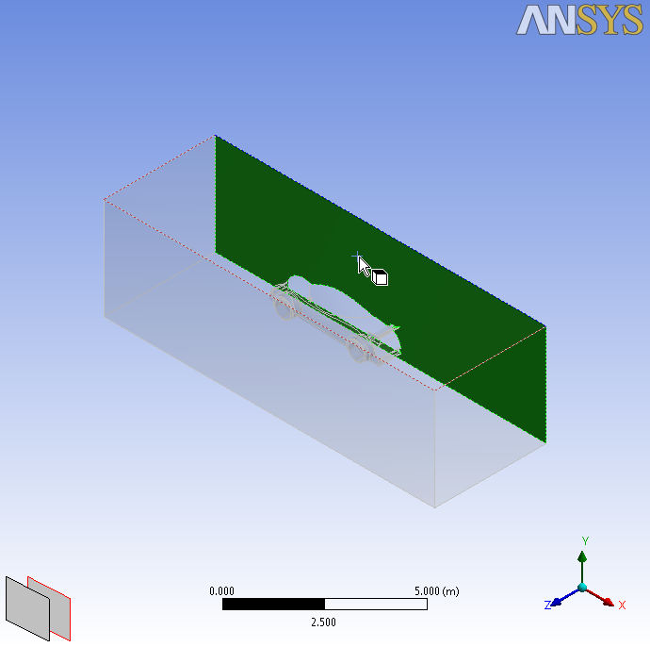
Named Selections
Add Named Selections
Create a Named Selection “symmetry”.

Slide 36
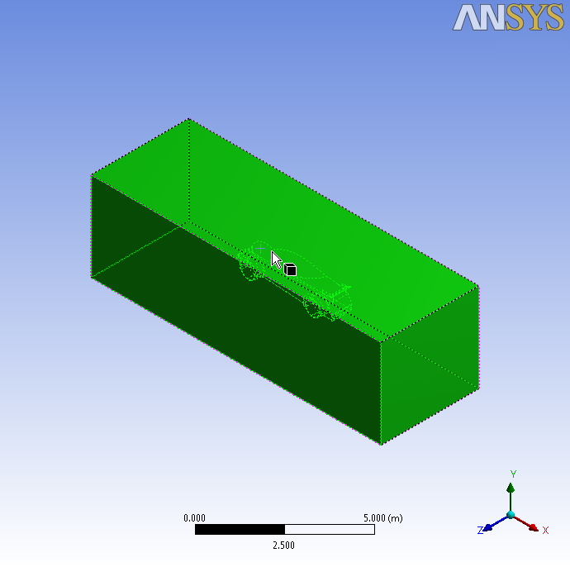
Named Selections
Add Named Selections
Select the Body Selection Filter.
Select the Body.
Create a Named Selection “fluid”.

Slide 37
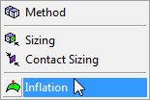
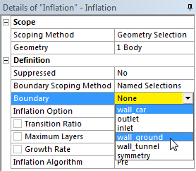
Inflation
Add a Local Inflation Control
Select the Body again, right click and select Insert → Inflation from the context menu.
In the Details View;
Set Boundary Scoping Method to Named Selections.
Click in the Boundary Selection Box and select the Named Selections “wall_car” and “wall_ground” (CTRL click to multiple select). Press enter.
The Boundary Selection Box will now indicate Multiple Entries.

Slide 38
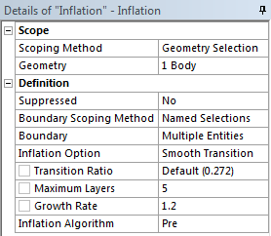
Inflation
Add a Local Inflation Control
In the Details View (Continued);
Leave the remaining inflation parameters set to default as shown.

Slide 39
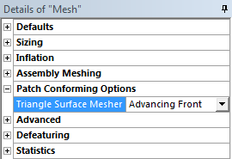
Global Controls
Set Triangle Surface Mesher
Select the Mesh object in the Outline to display the Global Controls (Details of “Mesh”).
Under Patch Conforming Options;
Set Triangle Surface Mesher to Advancing Front.
The Advancing Front Algorithm generally provides a smoother, more uniform surface mesh with respect to size change and quality when compared to the default Program Controlled (Delaunay) algorithm. A comparison is provided in the notes at the end of this workshop for reference.

Slide 40
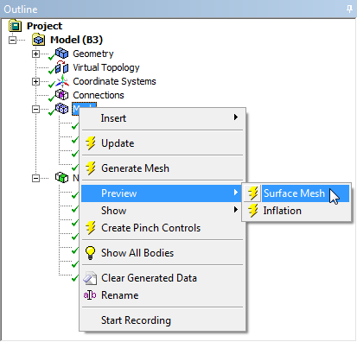
Preview
Preview Surface Mesh
Preview the Surface Mesh to review the changes the additional controls have made.
When the Surface Mesh Preview is complete switch the Section Plane on using the check box in the Section Planes Panel.

Slide 41
Review
Review the Surface Mesh
Right click in the Graphics Window and select View → Front.
Note the refinement within the box region used to define the Body of Influence Size Control.
Zoom in as shown using the Box Zoom Tool.

Slide 42
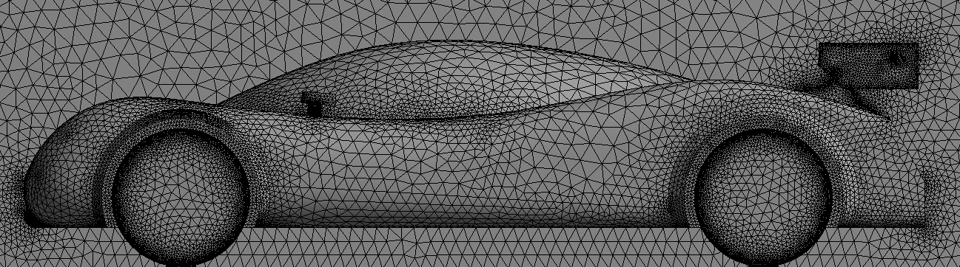
Review
Review the Surface Mesh
The Virtual Cell has removed the high densities in the highlighted locations.
New Surface Mesh
Old Surface Mesh

Slide 43
Review
Review the Surface Mesh
Right click in the Graphics Window and select View → Back.
Zoom in as shown using the Box Zoom Tool.
The Wing Elements are now well resolved due to the reduced Minimum Size.
New Surface Mesh
Old Surface Mesh

Slide 44
Preview
Preview Inflation
Switch off the Section Plane using the check box in the Section Planes Panel.
Preview the Inflation Mesh prior to generating the volume mesh to check quality.

Slide 45
Inflation Mesh
Check the Inflation Mesh
In the Details of “Mesh” under Statistics, set Mesh Metric to Orthogonal Quality.
Minimum Orthogonal Quality is acceptable.

Slide 46
Inflation Mesh
Inspect the Inflation Mesh
Note the Inflation Layer Height varies as a function of surface mesh size (Smooth Transition).

Slide 47
Final Mesh
Generate Volume Mesh
Generate the Mesh.
The final mesh contains approximately 2 million cells and will take several minutes to generate.
When the mesh is complete, check that the quality is acceptable.

Slide 48
Save the Project
This completes the workshop.
From the main menu select File → Close Meshing
Workbench will save any application data.
From the Workbench Project Page use the file menu and save the project as “AMWS5b.wbpj” to your working folder.

Slide 49
Appendix I Triangle Surface Mesher
Advancing Front
Program Controlled (Delaunay)

