Slide 1
Lecture 5 Modeling

Slide 2
Modeling
What will you learn from this presentation:
DesignModeler Concepts
Body Types
Body States (Frozen & Active)
How to create 3D geometry?
How to modify geometry?
How to create 2D geometry?
Concepts in DM from meshing perspective: Multi-body parts, Share topology

Slide 3
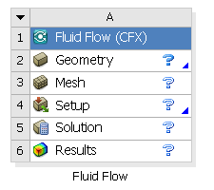
Preprocessing Workflow
Geometry Creation
OR
Geometry Import
Meshing
Solver
Geometry Operations
Sketches and Planes
3D Operations
Meshing Methods
Boolean, Body Operations, Split, etc
Hybrid Mesh: Tet, Prisms, Pyramids
3D Operations
Extrude, Revolve, Sweep, etc
Hexa Dominant, Sweep meshing
Geometry Cleanup and Repair
Assembly Meshing
Geometry Import Options
Automatic Cleanup
Global Mesh Settings
Direct CAD/Bi-Directional CAD
Merge, Connect, Projection, Flow Volume Extraction, etc
Local Mesh Settings
Sizing, Body/Sphere of Influence, Match Control, etc

Slide 4
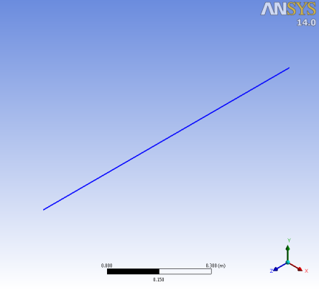
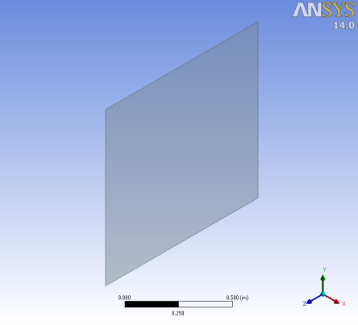
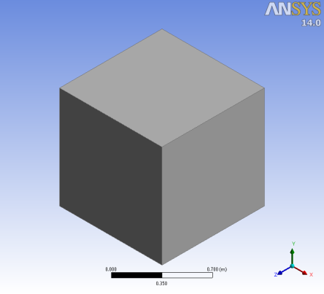
Important DM Concepts: Body Types
In DesignModeler, a body refers to a line, surface or solid
Line body
Has length and consists of point lower entities
Surface body
Has surface area and consists of point & line lower entities
Solid body
Has volume and consists of point, line & surface lower entities
Bodies are listed in the Tree Outline identified by default names and icons
Line body
Surface body
Solid body
Notes:
4

Slide 5
Important DM Concepts: Body States
Active & Frozen
Bodies can exist in one of two states
Active
Frozen
Active bodies merge automatically with bodies in contact or overlapping
Frozen bodies remain independent
Why use frozen bodies?
Meshing; It is often more efficient to mesh a series of smaller topologically simpler bodies than one large complex shape
Solver; Different physical models and boundary conditions can be applied to different areas of the model if they are defined as separate bodies
Notes:
5

Slide 6
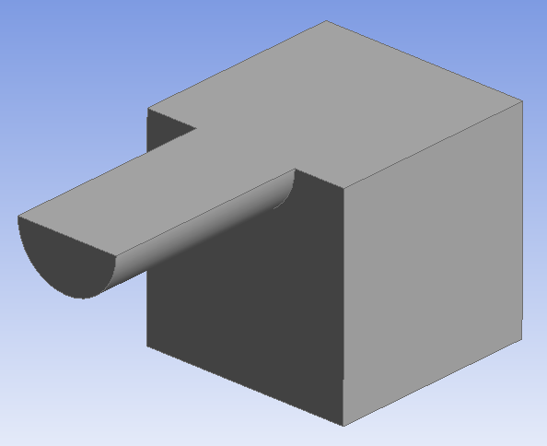
Important DM Concepts: Active Body State
Working with Active Bodies
Example; Two separate extrusions each creating an active body results in one body
How to define a body as active?
Before a body is created - choose ‘Add Material’
After a body has been created as frozen - Use ‘Unfreeze’ operation (available under Tools Menu)
Displayed as Opaque
Blue icon under Tree Outline
Notes:
6

Slide 7
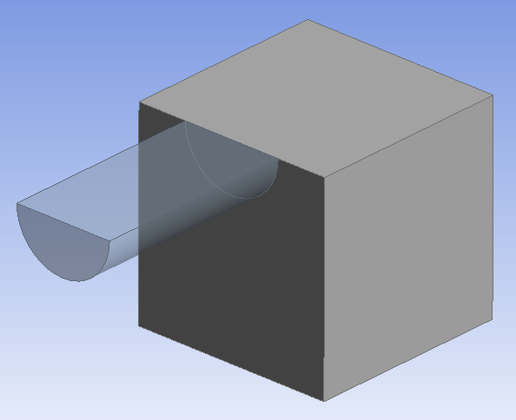
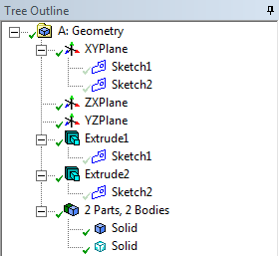
Important DM Concepts: Frozen Body State
Working with Frozen Bodies
Example; Two separate extrusions one of which is frozen results in two separate bodies
How to define a body as frozen?
Before a body is created - choose ‘Add Frozen’
Slicing an active body will convert it to frozen
Can be merged manually using Boolean operations or by converting to ‘Active’ state using ‘Unfreeze’
Displayed as Transparent
Cyan icon under Tree Outline
Notes:
7

Slide 8
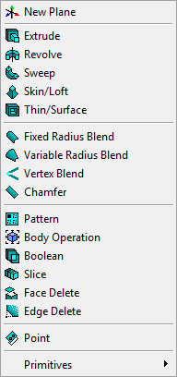
3D Feature Creation
Tools for creating new bodies or modifying existing bodies
Used to create bodies
Requires lower dimensioned geometry as base objects
Results is a line/surface/solid body
Applies blend/chamfer on edges/faces of existing bodies
Used to modify existing bodies
Results in modified or new bodies
Quick creation of primitive shapes (without sketch)

Slide 9
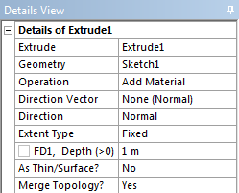
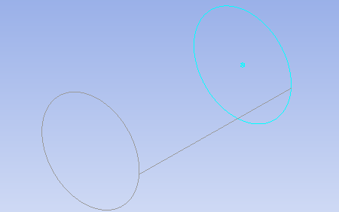
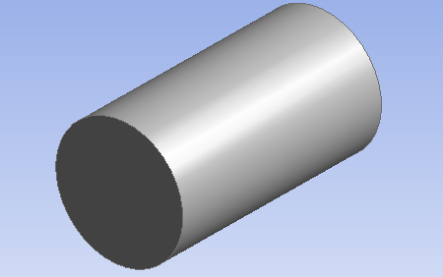
Extrude Feature
Extrude Details
Geometry
Can be a valid Sketch, selected face or Named Selection
Operation
Allows Add Material, Cut Material, Imprint Faces, Slice Material, Add frozen
Discussed in detail in Next 3 Slides
Direction Vector
Automatically sets direction as normal when base object is set to sketch otherwise needs to be specified
Plane axes, geometric edges and faces can be used to specify direction
Preview of the
operation
Sketch
Resultant body

Slide 10
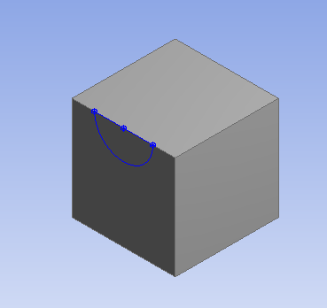
Extrude Feature (cont …)
Add Material
Creates new body and unites with existing active bodies in contact or overlap
Add Frozen:
An independent body is created, with separate faces and edges
Cut Material:
Create holes or modify existing bodies by removing material
Imprint Faces:
Imprints the sketch on the faces of existing body
Slice Material:
Slice out resultant body from the existing Frozen body
Sketch
Add Material
Add Frozen
Cut Material
Imprint faces
Slice Material

Slide 11
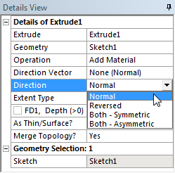
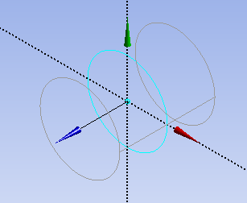
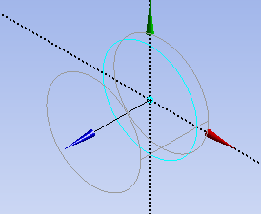
Extrude Feature (cont …)
Extrude Details
Direction
Normal – Extrude Base object Normal to plane
Reversed – Extrude Base object in reverse direction of Normal
Both-Symmetric – Extrude symmetrically in both directions
Both-Asymmetric – Extrude asymmetrically in both directions

Slide 12
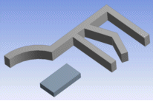
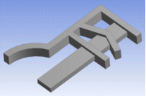
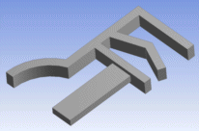
Extrude Feature (cont …)
Extrude Details
Extent Type :
Fixed – Extrude profile by specified distance
Through All – Extrude profile through entire model
To Next – Extrude profile up to first surface encountered
Fixed
Through All
To Next

Slide 13
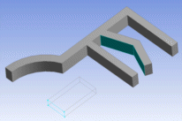
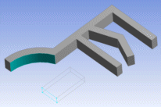
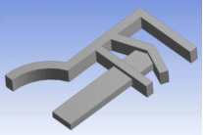
Extrude Feature (cont …)
Extrude Details
Extent Type cont …
To Faces – Extrude profile up to one or more selected faces
To Surfaces – Extrude profile up to surface
To Faces
To Surfaces

Slide 14
Extrude Feature (cont …)
Extrude Details
Thin/Surface
If enabled, a thin surface is extruded out of the base object with a default thickness of zero.
Suitable for creating shell bodies
Options to specify thickness

Slide 15
Extrude Feature (cont …)
Extrude Details
Merge Topology
Yes: Optimizes the topology of feature bodies
No: Leaves the topology of feature bodies unaltered
Tips from a meshing Perspective:
If the small faces are of interest during meshing, then set Merge Topology to ‘NO’
If the small faces are unnecessarily forcing for fine mesh, then set Merge Topology to ‘YES’
No
Yes

Slide 16
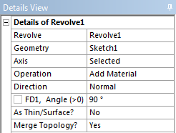
Revolve Feature
Revolve Details
Geometry is rotated to create a body of revolution
Axis
Specify Axis of Rotation for selected Base object (plane axis or edge)
Angle
Specify Rotation Angle
Axis
Base object

Slide 17
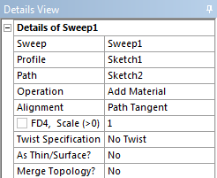
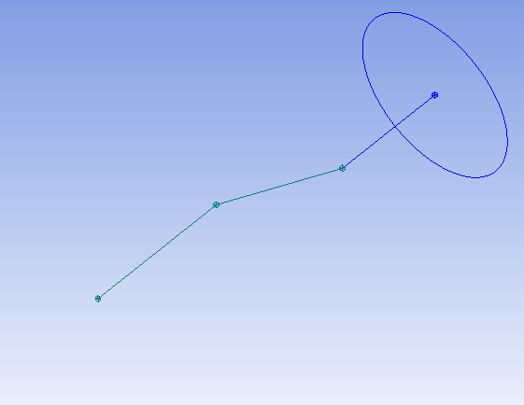
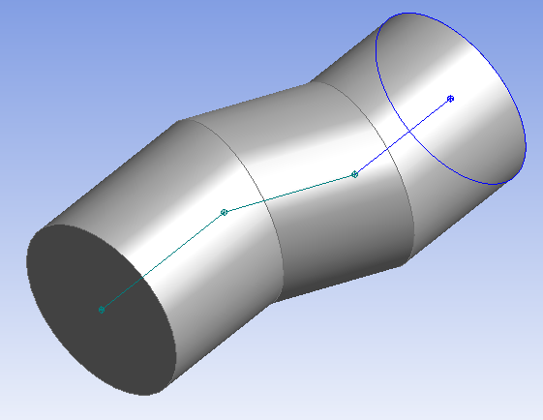
Sweep Feature
Sweep Details
Selected profile is swept along selected path to create bodies
Profile :
Specify the object to be swept
Path :
Specify the path for sweep
Path
Profile

Slide 18
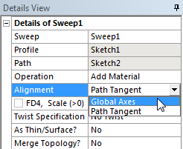
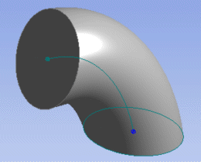
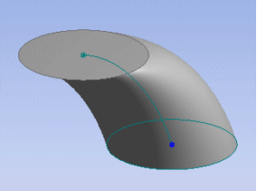
Sweep Feature (cont…)
Sweep Details
Alignment : Specify orientation for profile with respect to swept path
Path Tangent : Reorients the profile to keep its orientation consistent with respect to the path
Global Axes : Profile orientation remains fixed irrespective of shape of the Path
Path Tangent
Global Axes

Slide 19
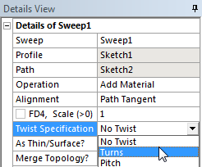
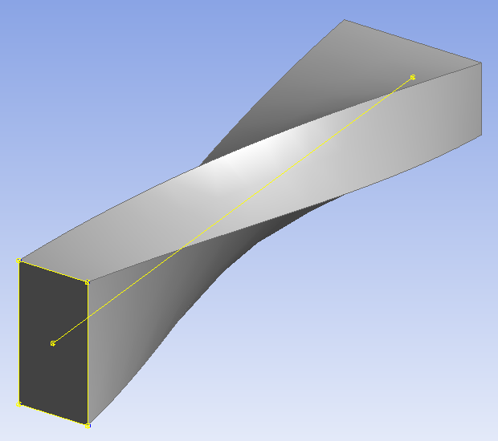
Sweep Feature (cont…)
Sweep Details
Scale
Taper or expand the Profile as it is swept along the path of Sweep
Twist Specification
No Twist : Helical sweep is not created
Turns : Specify number of turns to complete over the path length
Pitch : Specify length per 1 full turn
4m
Notes:
Pitch : distance between 2 turns

Slide 20
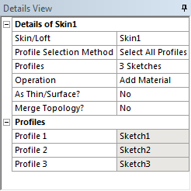
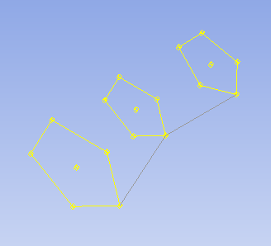
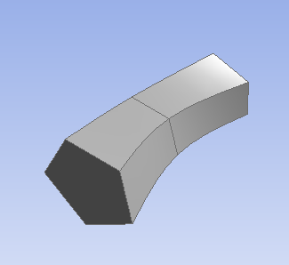
Skin/Loft Feature
Skin/Loft Details
Takes a series of profiles and creates a body fitting through them
All profiles must have the same number of edges
Multiple sketches
Notes:
RMB : Fix Guide Line

Slide 21
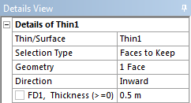
Thin/Surface
Thin Surface Details
Creates Thin Solid or Shell (Surface)
Creation based on Selection Type; Faces to Keep/Faces to Remove/Bodies Only
Faces to Keep: Selected faces used to form the thin solid or surface.
Faces to Remove: Unselected faces used.
Bodies Only: All faces used.
Specification of zero thickness will create a surface body (can specify offset)
Direction for generation of thickness can be inward, outward or both (midplane)
Inward
Outward
Midplane

Slide 22
Fixed Radius Blend
Fixed Radius Blend Details
Creates a blend of specified radius on face/edges
Face Selection
Edge Selection

Slide 23
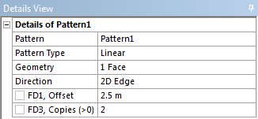
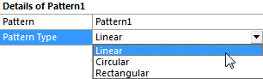
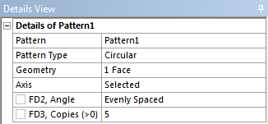
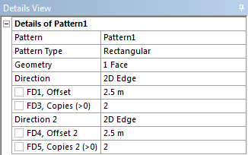
Pattern
Function
Creates copies of selected features
Pattern Type: 3 options
Linear, Circular or Rectangular
Select Geometry (features or bodies)
Specify Direction, Axis, Offset, Copies
Notes:
23

Slide 24
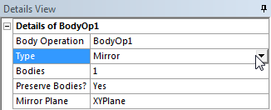
Body Operation
Body Manipulation Tools
Contains eleven general body editing tools
Options vary depending on whether the bodies are Active or Frozen
Cut and imprint are not available when all bodies are Frozen
Select Body Operation, set Type

Slide 25
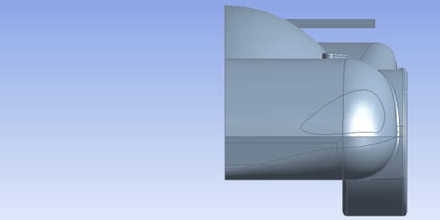
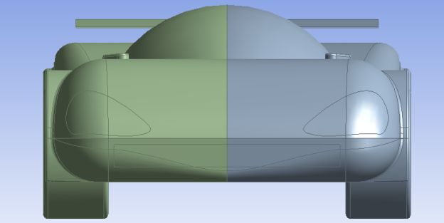
Body Operation: Mirror
Creates a mirror image body reflected in selected plane
Select body or bodies
Set Mirror Plane
Original body deletion controlled by ‘Preserve Bodies’ option
Example – Mirroring car body in the XY Plane preserving the original
XY Plane

Slide 26
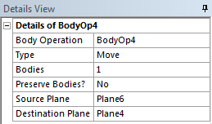
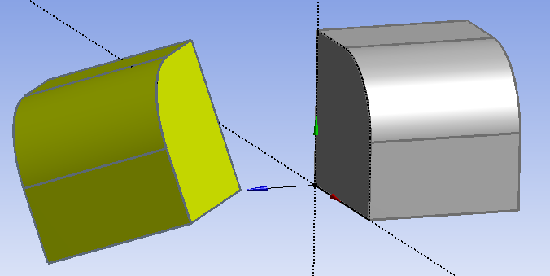
Body Operation: Move
Moves and aligns selected bodies
Select body or bodies
Option to preserve bodies
Set Source and Destination Planes
Example – Aligning two bodies using corresponding source and destination planes on each body respectively

Slide 27
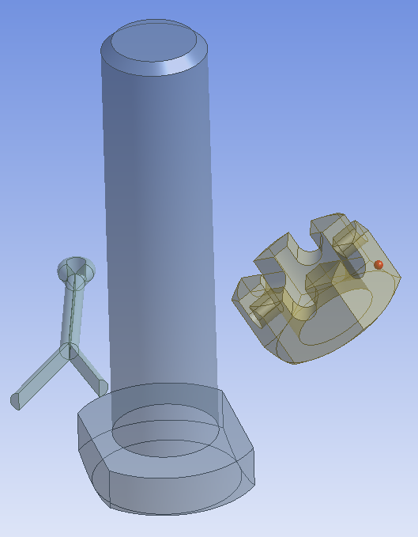
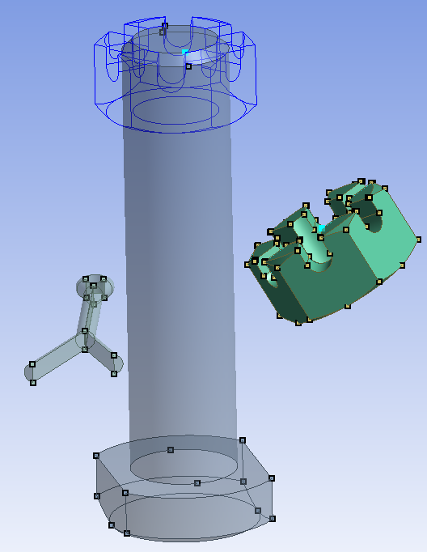
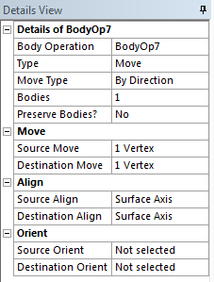
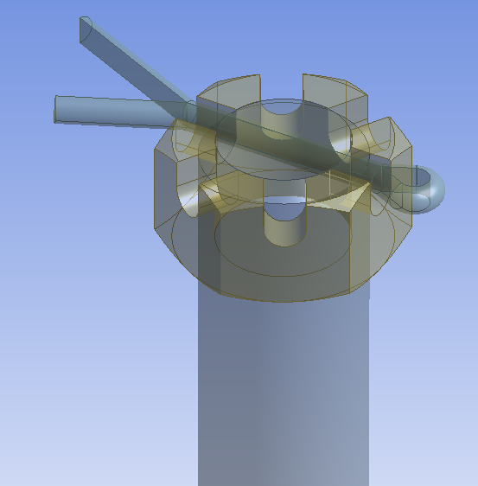
Body Operation: Move, Align and Orient
Using “By Direction” option, one can align bodies by using alignment vertices for aligning axes of bodies and orienting bodies with respect to each other.
User needs to select bodies, pair vertices for Source & Destination Move and directions for Source & Destination Align and/or Source & Destination Orient

Slide 28
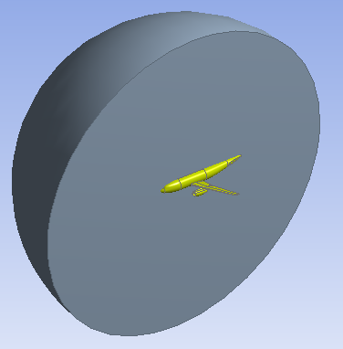
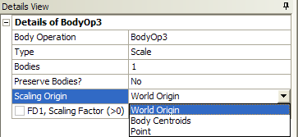
Body Operation: Scale
Scale selected body or bodies
Select body or bodies
Set Scaling origin
World Origin : Global coordinate origin
Body Centroids: Centroid of the bodies selected
Point: Selected Point
Scale up : 2x

Slide 29
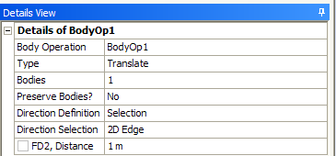
Body Operation: Translate, Rotate
Translate the selected body in a specified direction
Direction can be specified as coordinates or as a straight edge and distance
Rotate selected bodies about a specified axis by a specified angle
Axis can be specified as components or as a straight edge

Slide 30
Body Operation: Slice Material
To Slice out one body from the another body

Slide 31
Boolean
Unite, Subtract and Intersect
Unite: Merges two or more bodies
Subtract: Target Body subtract Tool Body
Intersection:
Union of All Intersections: Regions shared by two or more Tool Bodies
Intersection of All Bodies: Regions shared by all Tool Bodies
Tool Bodies
Intersect all bodies
Union of all intersections
Union of all intersections preserving input bodies

Slide 32
‘Slice’ Operation under ‘Create’
Slice Options
Slice By Plane
Model is sliced by selected plane
Slice Off Faces
Selected faces are sliced off and separate bodies are created from them
Slice Off Edges
Selected edges are sliced off and separate bodies are created from them
Slice by Surface
Selected surface is used as a slicing tool to slice
Slice by Edge Loop
Selected edge loop is used as a slicing tool
Slice Off Faces

Slide 33
Slice Operation Post Share Topology
Slice operation can now be used after Share Topology
Helps to ensure proper connectivity while performing geometry decomposition
Topologies remain shared after slice
It is useful in walking around Limitations
like use of Slice by Plane or Slice by Surface options before the Share Topology Method may merge the target body faces coinciding with the slicing sheet bodies or plane.
Share Topology could be faster and more robust if decomposition is done after it

Slide 34
Primitive Geometries
Used to create 3D primitives quickly

Slide 35
2D Feature Creation
Concept Menu
Tools for creating line & surface bodies
2d Surface Bodies can be created from existing edges, sketches or existing faces
Some solvers (e.g Fluent, ANSYS 2D FEA) require 2d models to be constructed on the XYPlane.
Commonly used concept tools for creating surfaces...>
Further concept tools detailed in separate lecture

Slide 36
Surfaces From Sketches
Used to create Surface bodies from existing sketches
Can be used for 2D analysis
Can be used for creating capping faces required for Fill operation

Slide 37
Surfaces From Faces
Used to create Surface bodies from faces of existing models
Can be used for 2D analysis

Slide 38
Surfaces From Edges
Used to create Surface bodies from existing existing edges and Line bodies
Can be used for 2D analysis
Can be used for creating capping faces required for Fill operation
Surface body created using 2 Line bodies and 2 edges

Slide 39
Suppression
Suppressing Bodies
Behaviour of Suppressed Body
Will not be exported or transferred to other Workbench modules
Not visible in Graphics view
Identified by cross sign in Tree Outline
How to Suppress or Unsuppress?
Select the body to be suppressed, right click and select “Suppress Body”
Select the body/bodies to be unsuppressed, right click and select “Unsuppress Body” option
Suppressed

Slide 40
Visibility
Hiding Geometry
Behaviour of Hidden Bodies
In Tree Outline, Hidden body is identified by transparent “tick-mark” sign
Hidden bodies are transferred to other Workbench modules and can also be exported
Useful when working with complex models
How to Hide or Unhide?
Select the body or face to hide, right click and select “Hide Body”
Right click “Show Body” to restore view
Suppressed

Slide 41
Named Selections
What are Named Selections?
Any number of entities of grouped under one name
Can be created using one of two ways
Select an entity or a group of entities, click RMB, select ‘Named Selection’ from the context menu or…
Select an entity or a group of entities, click on Tools menu and select ‘Named Selection’
In the details view, enter a name for the ‘Named Selection’ or continue with the default name
Click ‘Generate’
Named selections can be assigned to points, lines, surfaces or solids

Slide 42
Uses for Named Selections
Uses
Group entities for reference
Use as geometry for feature creation
Cannot be solids
Define parameters for parametric study
Assign names to boundaries for simulation
When used as boundary names, user must enable the transfer of named selection from DesignModeler to other Workbench modules (like Meshing, Fluent Solver etc.)
For more information on boundary naming please see Appendix
To enable the transfer of Named Selections, in the Workbench window, go to Tools → Options…
Click on Geometry Import, enable the check box next to ‘Named Selections.
Empty the box under ‘Filtering Prefixes’ if all named selections are to be transferred, otherwise only the named selections with the prefix in the textbox will be transferred

Slide 43
Named Selections : Propagation Property
Original Selection
Merge
Split
Copy
Yes
No
Yes – Selection propagates to all resultant entities
No – Selection propagates to just one of the resultant entities or destroyed

Slide 44
Single and Multi-Body Parts
Working with Parts
By default, DM places each body into one part by itself
Single-body parts : Individual parts are meshed separately
non-conformal mesh at interface
Multi-body part : Two or more bodies in a single part
Conformal mesh at interface
Bodies can be grouped into a part in 2 ways :
Select bodies. Click RMB and select Form New Part
Select bodies. Go to Tools → Form New Part
Single-body Parts
Multi-body Parts
Notes:
44

Slide 45
Single and Multi-Body Parts
Case 1: In DM: 1 part,1 body consisting of 1 solid
Result of transferring this geometry to Meshing
contains: 1 solid ,1 body
Entire solid meshed as one entity
No internal faces
DM
DM
Mesh
Notes:
45

Slide 46
Single, Multi Solid Bodies
Case 2: In DM: 3 parts, 3 bodies consisting of 3 solids
Result of transferring this geometry to Meshing
Contains : 3 solids, 3 bodies
Each solid is meshed independently
Nodes are not shared and do not line-up
No connection between the 3 mesh regions for fluid flow and/or heat transfer
Can connect using a Grid Interface in FLUENT/CFX
DM
Mesh
DM
Mesh
Notes:
46

Slide 47
Single, Multi Solid Bodies
Case 3: In DM: 1 multi-body part, 3 bodies/solids
Result of transferring this geometry for Meshing
contains:1 multi-body part, 3 bodies/solids
Each solid meshed independently but node connectivity among solids is preserved
Contains internal face which can be used for Post Processing
DM
Mesh
DM
Mesh
Notes:
47

Slide 48
Share Topology
Works on Multi-body parts only
Common regions among Multi-body parts are not imprinted and connected until the geometry is transferred to a different application (Meshing, Mechanical etc. ).
This process creates ‘Shared Topology’ resulting in changes to the geometry (example illustrated) and occurs automatically during the transfer.
To ensure that Named Selections contain the desired geometry (for use as boundaries) the Share Topology feature can be used manually in DesignModeler when the geometry is complete.
Named Selections for boundaries should be created after this operation.
DM
DM
Before Share Topology
After Share Topology
DM
DM
Notes:
48

Slide 49
Workshop 3 – Modeling

Slide 50
Appendix
Contents
Extrude Merge Topology Example
Variable Radius Blend
Vertex Blend
Chamfer
Create Point
Body Operation Cut Material
Body Operation Imprint
Body Operation Delete
Named Selections for Boundaries in FLUENT

Slide 51
Extrude Feature: Example
Merge Topology : Example
Create a rectangular box by extruding one of side faces as shown in adjacent image
In previous Extrude operation, if Merge Topology option is “No”, the rectangular box will be successfully created using sweep operation
In previous Extrude operation, if Merge Topology option is “Yes”, the rectangular box cannot be created as there is no appropriate face for extrude
No
Yes

Slide 52
Variable Radius Blend
Creates a blend of variable radius on face/edges
The Details view is used to specify the start and end radius
Specify Linear or Smooth Transition for Blend
Linear Blend
Smooth Blend

Slide 53
Vertex Blend
Creates a blend on vertices
Used to blend corners of Surface bodies
The Details view is used to specify the Radius and Vertices

Slide 54
Chamfer
Creates a chamfer on edge/faces
The Details view is used to specify the left and right length or length and angle
Left
Right

Slide 55
Create: Point
Used to create Construction Point, Point Load or Spot Weld
Can choose definition types for creating Construction point :
Single, Sequence by Delta, Sequence by N, From Coordinates File, Manual input
Text file containing external point data in specific format can be imported through From Coordinates File option
External Point Data Format

Slide 56
Body Operation: Cut Material
This option is available when the model has any active bodies
Uses the selected bodies to cut from other active bodies

Slide 57
Body Operation: Imprint
This option is available when the model has any active bodies
Uses the selected bodies to imprint on the active bodies

Slide 58
Body Operation: Delete
Deletes the selected bodies
Deleted bodies can be recovered by deleting or suppressing this Body Operation

Slide 59
Named Selections for Boundaries in Fluent
Named selections can be assigned a name that corresponds to the desired boundary type
“xx” in the names stand for any suffix
Example: one can name a face to be assigned as boundary type of ‘Velocity Inlet’ as ‘inlet1’
First letter of the names can be capital letters or small letters
When such a model is transferred to Fluent, the Fluent solver will automatically recognize the boundary types from the names and assign the boundary type to these boundaries based on their assigned names, saving time for setup.
Named selection | Boundary Type
Inletxx | Velocity Inlet
Outletxx | Pressure Outlet
Wallxx | Walls
Pressure_inletxx | Pressure Inlet
(Other names not recognized as boundary type) | Walls

