Slide 1
Workshop 04 Fluid flow around the NACA0012 airfoil

Slide 2
Introduction
Workshop Description:
The flow simulated is an external aerodynamics application for the flow around a NACA0012 airfoil .
Learning Aims:
This workshop introduces several new skills (relevant for many CFD applications, not just external aerodynamics):
Assessing Y+ for correct turbulence model behaviour
Modifying solver settings to improve accuracy
Reading in and plotting experimental data alongside CFD results
Producing a side-by-side comparison of different CFD results
Learning Objectives:
To understand how to model an external aerodynamics problem, and skills to improve and assess solver accuracy with respect to both experimental and other CFD data.
Introduction
Solving
Summary
CFD-Post Postpro
Fluent Postpro
Setup

Slide 3
Import the supplied mesh file
Start Workbench 14.5
Copy a Fluent ‘Analysis System’ into the project schematic
Import the supplied Fluent mesh file (naca0012.msh) by:
Right click on Mesh (cell A3) and select ‘Import Mesh File’
Browse to the mesh file
Introduction
Solving
Summary
CFD-Post Postpro
Fluent Postpro
Setup

Slide 4
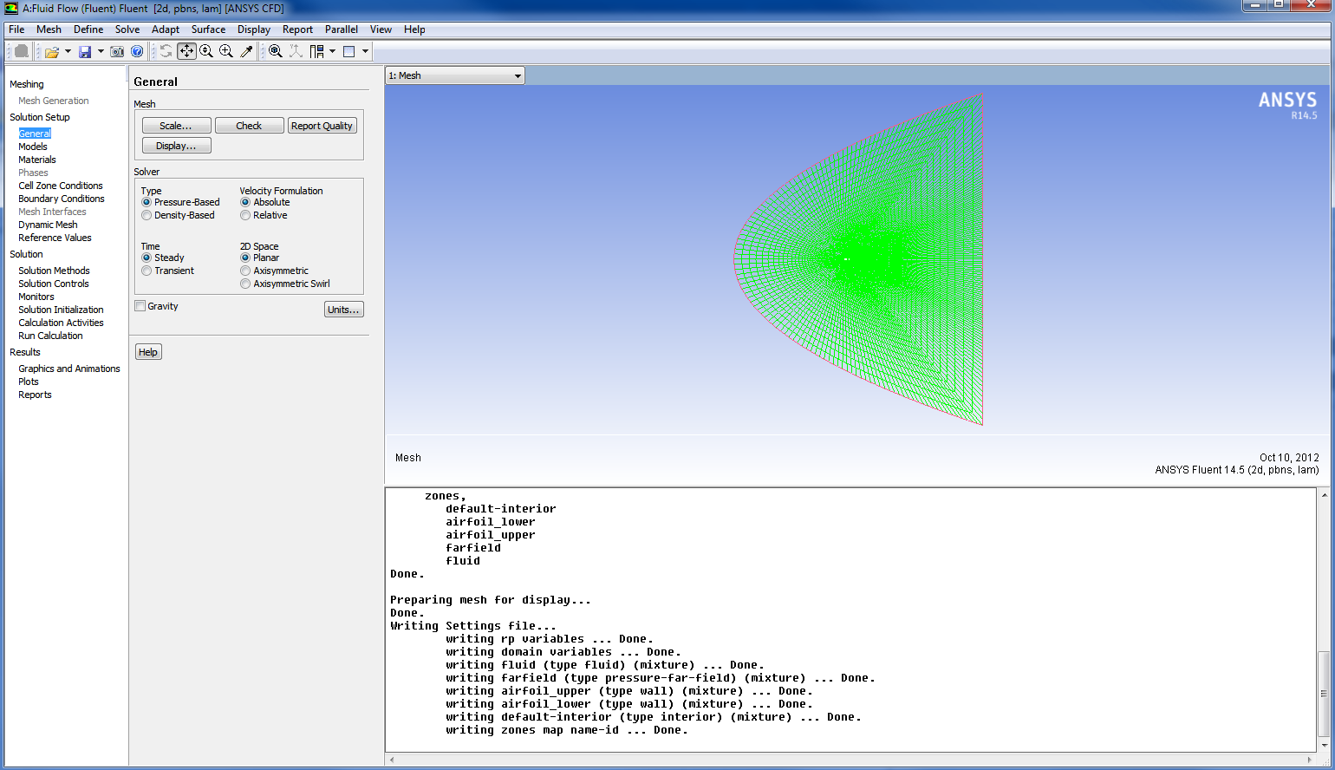
Launch Fluent to set up the case
Double click cell A3 to launch Fluent and unselect double precision in the Launcher panel
Check the mesh
Note there are no errors, and the warnings can be ignored (see next slide)
Check the scale
In this case no action is needed as the domain is the correct size
Introduction
Solving
Summary
CFD-Post Postpro
Fluent Postpro
Setup
Notes:
HE: Double click on A3
Double precision is Off

Slide 5
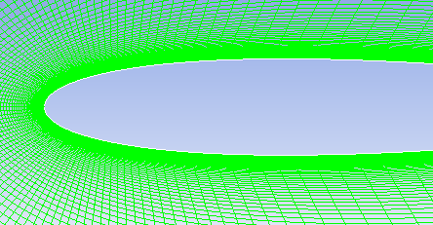
Check the mesh (aspect ratio)
As a guide, the cell aspect ratio should be around 5 or less in the main region of the mesh (away from the boundary layer). However, it is usual to have much higher aspect ratio cells than this in the boundary layer, up to around 100.
In this case, the maximum aspect ratio in the boundary layer is much higher than this, but the mesh was designed in this way due to the need for very low y⁺ values. Away from the boundary layer the maximum aspect ratio is around 5.
For this special case the high maximum aspect ratio is justified. Not all cases require such a well resolved boundary layer mesh.
High aspect ratio cells can give problems in the solver calculations near to the wall, hence the warning when the mesh quality metrics are reported.
Zoom in several times to see the highest aspect ratio cells where the airfoil curvature is relatively low
Introduction
Solving
Summary
CFD-Post Postpro
Fluent Postpro
Setup
Notes:
HE: A zoom in picture at the first cell at the wall with high aspect ratio will help

Slide 6
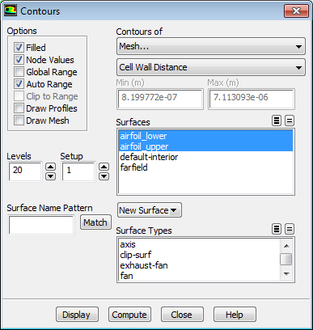
Check the mesh (wall distance check)
The cells need some (any) data before we can begin post-processing. So before we can check the cell wall distance we need to initialise.
Solution Initialization > Standard Initialization >
Initialize
Default values can be used at this stage
Select Graphics and Animations in the navigation pane, choose Contours in the graphics panel, and click Set Up..
Choose Contours of Mesh... and Cell Wall Distance as shown and Click ‘Compute’
The minimum and maximum computed cell wall distances are 8.2×10⁻⁷ m and 7.1×10⁻⁶ m
For the airfoil wall surfaces these are as expected from the mesh design, so we can proceed with our normal set up.
The mesh is designed to have these cell wall distances in order to achieve a target value of y+ (see next slide) for the turbulence model. at the wall-adjacent cells
Introduction
Solving
Summary
CFD-Post Postpro
Fluent Postpro
Setup
Notes:
HE: Initialize or initialise?
HE: Go to Graphics and Animation TAB then select contours from Graphics then Set Up
HE: select surfaces as shown in Figure and deselect Global Range
HE: I recommend that we mention what does this wall distance translates as y+ to connect with the next slide

Slide 7
Check the mesh (some notes on y⁺)
y⁺ is the non-dimensional normal distance from the first grid point (the wall-adjacent cell centre) to the wall and is covered tomorrow in Lecture 6.
If the first grid point is placed within the viscous sublayer (near-wall region, y⁺ ≤ 5), the turbulence model's enhanced wall treatment (EWT) option should be chosen. When using EWT, the intention is to integrate governing equations directly to the wall without using the Universal Law of The Wall for turbulence.
The aspect ratio could be reduced, while keeping the same y⁺ value:
By keeping the same first cell distance and increasing the number of nodes along the wall surface. This reduces the length of cells for a given height so will reduce the aspect ratio whilst significantly increasing the overall cell count .
The aspect ratio could be reduced, while increasing y⁺ value:
By increasing the normal distance of the first grid point from the wall to give y⁺ values of between 30 and 300. This is the valid range of y⁺ for using the wall functions approach.
Introduction
Solving
Summary
CFD-Post Postpro
Fluent Postpro
Setup

Slide 8
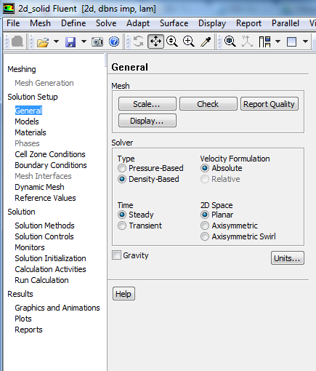
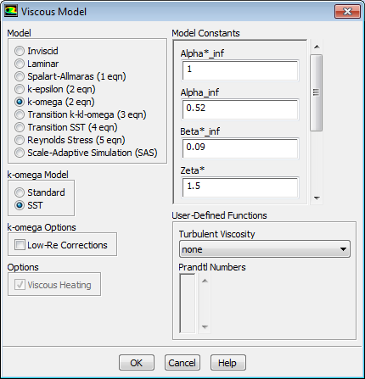
Case Setup: Choose the solver and models
Select the steady-state density-based solver:
General → Density-Based
Models → Viscous
Select k-omega model, then SST
Turn the energy equation on
Introduction
Solving
Summary
CFD-Post Postpro
Fluent Postpro
Setup
Notes:
HE: Models - Viscous- k-omega - then SST

Slide 9
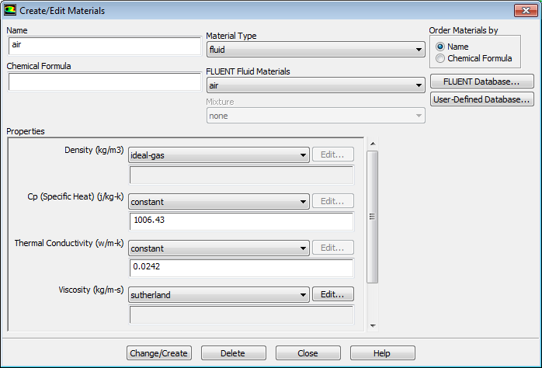
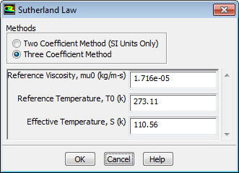
Case Setup: Define Materials
Set the air material properties
Materials → Air
For Density, select ‘Ideal Gas’
For Viscosity, select ‘Sutherland’ and accept the defaults for the ‘Three Coefficient Method’
Press the ‘Change/Create’ button
The Sutherland law for viscosity is well suited for high-speed compressible flow.
For simplicity, we will leave Cp and Thermal Conductivity as constant. Ideally, in high speed compressible flow modeling, these should be temperature dependent as well.
Introduction
Solving
Summary
CFD-Post Postpro
Fluent Postpro
Setup

Slide 10
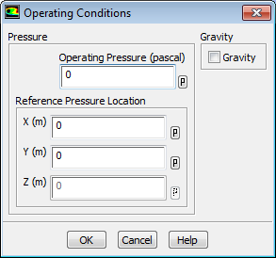
Case Setup: Operating Conditions
Cell Zone Conditions → Operating Conditions
Set Operating Pressure to 0 Pa
Absolute pressure = operating pressure + gauge pressure.
For incompressible flows it is normal to specify a large (typically atmospheric pressure) operating pressure and let the solver work with smaller ‘gauge’ pressures for the boundary conditions, to reduce round-off errors.
For compressible flows, the solver needs to use the absolute values in the calculation, therefore, with compressible flows, it is sometimes convenient to set to operating pressure to zero, and input/output ‘absolute’ pressures.
Introduction
Solving
Summary
CFD-Post Postpro
Fluent Postpro
Setup

Slide 11
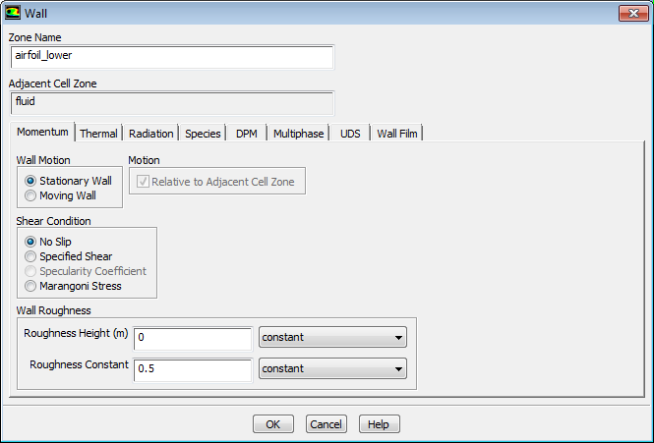
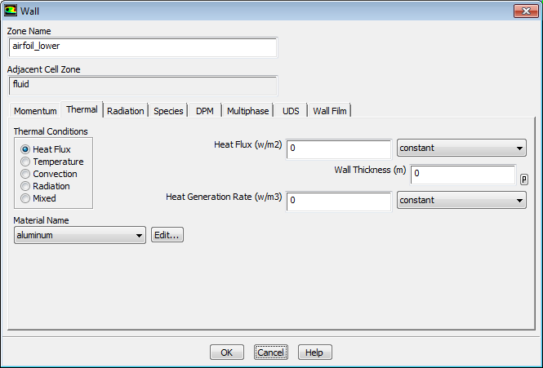
Case Setup: Boundary Conditions
Check the boundary settings for ‘airfoil_lower’ and ‘airfoil_upper’
Check that the boundary zone type is set to ‘wall’
Ensure the wall is set as ‘stationary wall’, and with a heat flux of 0 W/m²
Introduction
Solving
Summary
CFD-Post Postpro
Fluent Postpro
Setup

Slide 12
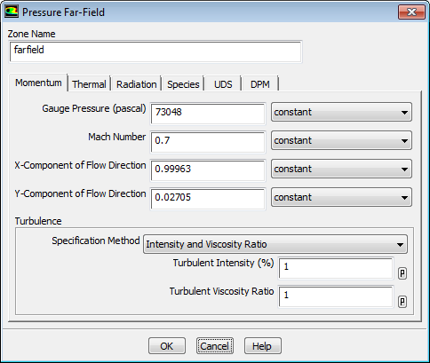
Case Setup: Boundary Conditions
Boundary Conditions → ‘farfield’
Check that the boundary zone type is set to ‘pressure-far-field’ and change if necessary
On the ‘Momentum’ tab
Set Gauge Pressure to 73048 Pa
Set Mach Number to 0.7
Set the flow direction components as shown
The angle of attack (α) in this case is 1.55 deg.
The x-component of the flow is cos α and the
y-component is sin α
Set the far field turbulence:
Select ‘Intensity and Viscosity Ratio’
Set the intensity to 1%
Set the viscosity ratio to 1
On the ‘Thermal’ tab
Set the static temperature to be 283.24 K
After entering the temperature, click OK to exit the panel.
73048
0.7
0.99963
0.02705
Introduction
Solving
Summary
CFD-Post Postpro
Fluent Postpro
Setup
Notes:
HE:What Temperature you used to set Mach number?
Hit Ok and exit the Pressure far-field panel

Slide 13
Case Setup: Boundary Conditions
The pressure-far-field boundary is applicable only when using the ideal-gas law.
It is important to place the far-field boundary far enough from the object of interest.
For example, in lifting airfoil calculations, it is not uncommon for the far-field boundary to be a circle with a radius of 20 chord lengths.
This workshop will compare CFD with wind-tunnel test data therefore we need to calculate the static conditions at the far-field boundary.
We can calculate this from the total pressure, which was atmospheric at 101325 Pa with a Mach number of 0.7 in the test.
The wind tunnel operating conditions for validation test data give the total temperature as T₀ = 311 K
Introduction
Solving
Summary
CFD-Post Postpro
Fluent Postpro
Setup
Notes:
Copied and pasted total and static temperature because of an ugly bug in MS causing random large spaces to appear in between letters in the equation box

Slide 14
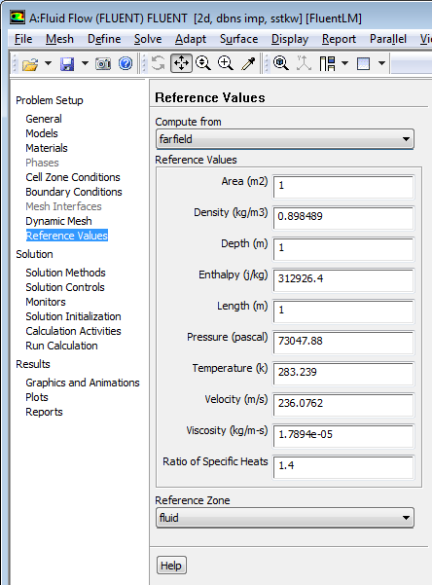
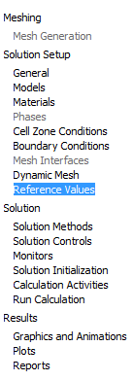
Case Setup: Reference Values
Set the reference values
These are not used to compute the flow solution, but they are used to report coefficients such as Cp
Use the free-stream as a reference condition and select ‘compute from farfield’ in the drop down list
Reference values for velocity, density, temperature, etc. will update from the free-stream values. Refer to the previous slide for how they are computed.
Set the following to represent a chord length of 1m with unit depth:
Reference length = 1m
Reference depth = 1m
Reference area = 1m²
These are not updated from the farfield conditions
Introduction
Solving
Summary
CFD-Post Postpro
Fluent Postpro
Setup
Notes:
Refer to the previous slide for the reference value on how they are computed

Slide 15
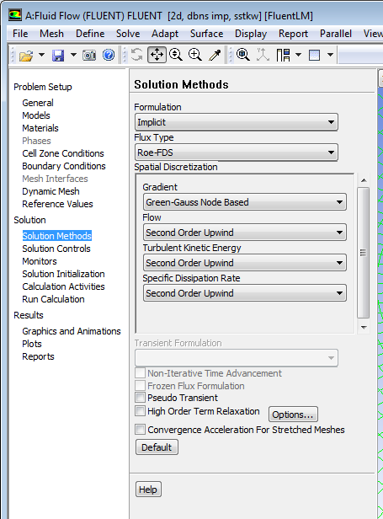
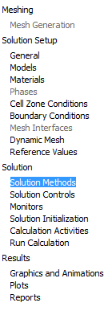
Case Setup: Solution Methods
Solution Methods
Keep the default settings for implicit formulation and Roe-FDS flux type.
The explicit formulation is only normally used for cases where the characteristic time scale is of the same order as the acoustic time scale, for example the propagation of high Mach number shock waves.
The implicit formulation is more stable and can be driven much harder to reach a converged solution in less time.
Change the gradient method to Green-Gauss Node Based.
This is slightly more computationally expensive than the other methods but is more accurate.
Select Second Order Upwind for flow and turbulence discretization.
To accurately predict drag, the default 1st order schemes are not sufficient.
Introduction
Solving
Summary
CFD-Post Postpro
Fluent Postpro
Setup
Notes:
discretization

Slide 16
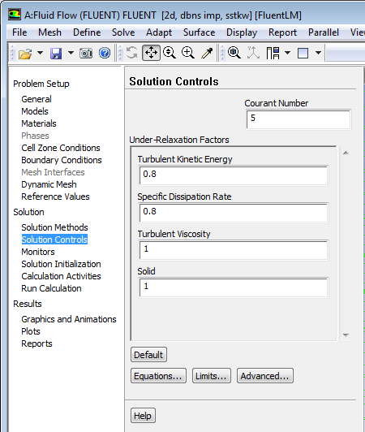
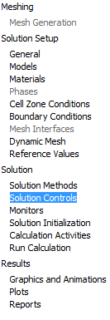
Case Setup: Solution Controls
Keep the default Courant Number and under-relaxation factors (URFs)
The Courant number (CFL) determines the internal time step and affects the solution speed and stability. The default CFL for the density-based implicit formulation is 5.0
A lower CFL me be required during startup (when changes in the solution are highly nonlinear), but it can be increased as the solution progresses
It is often possible to increase the CFL to 10, 20, 100, or even higher, depending on the stability of the solution
As we will be using automatic ‘solution steering’, the choice of CFL at this stage is not important for this case
Introduction
Solving
Summary
CFD-Post Postpro
Fluent Postpro
Setup

Slide 17
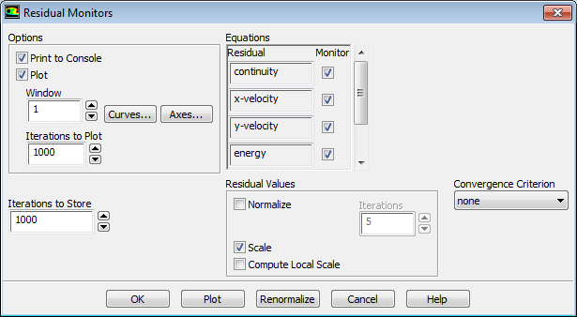
Case Setup: Solution Monitors
Set up residual monitors so that convergence can be monitored
Monitors → Residuals → Edit
Make sure ‘Plot’ is on
Turn off convergence targets by setting the Convergence Criterion to ‘none’ and press OK
This means that the calculation will not stop at pre-defined convergence criteria, but residuals can still be plotted.
Introduction
Solving
Summary
CFD-Post Postpro
Fluent Postpro
Setup
Notes:
Press Ok

Slide 18
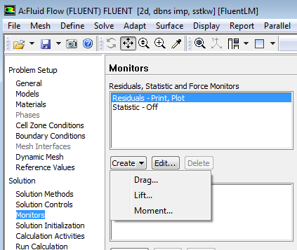
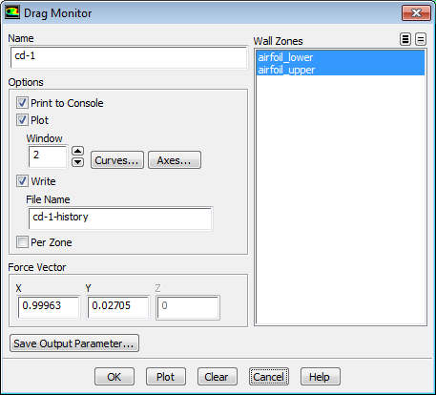
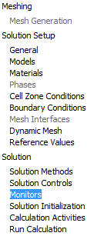
Case Setup: Solution Monitors
Set up a monitor for the drag and lift coefficients on the airfoil
Click on the arrow next to ‘Create’
Select both wall zones and toggle on ‘Print’, ‘Plot’ and ‘Write’.
Remember that the angle of attack (α) is 1.55° so we need to use the force vectors as shown
Lift and drag are defined (perpendicular and parallel respectively) relative to the free-stream flow direction, not the airfoil
Introduction
Solving
Summary
CFD-Post Postpro
Fluent Postpro
Setup

Slide 19
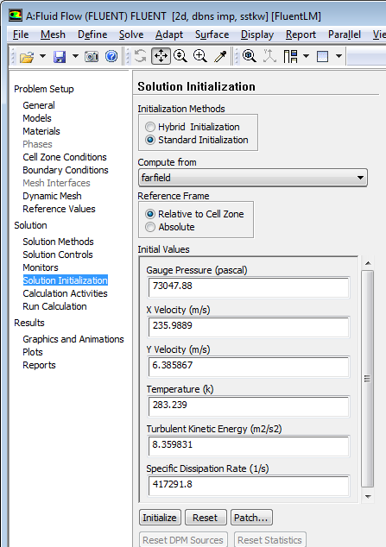
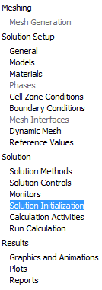
Case Setup: Solution Initialization
Initialize the flow field based on the farfield boundary:
Compute from farfield
Overwrite the existing solution
The initial data was created during the checking stage for the near wall cell distance
Introduction
Solving
Summary
CFD-Post Postpro
Fluent Postpro
Setup

Slide 20
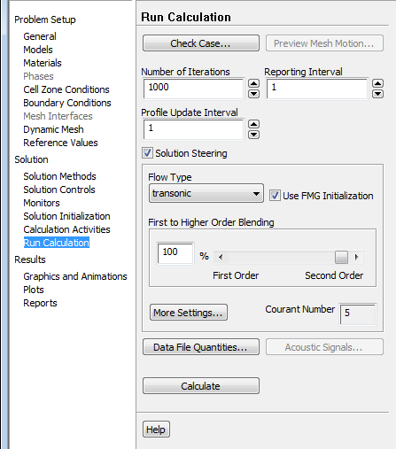
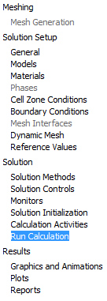
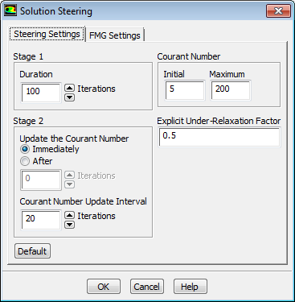
Case Setup: Solution Steering
Check Case
In this model there are no warnings
Run Calculation
Toggle on Solution Steering
Change the flow type to ‘transonic’
More Settings → reduce the Explicit Under-Relaxation Factor to 0.5
In most cases, there is no need to change the explicit under-relaxation factor, but sometimes lowering its value is necessary for stable convergence. The value of 0.5 was found to work well in this case.
Introduction
Solving
Summary
CFD-Post Postpro
Fluent Postpro
Setup
Notes:
HE:Why we reduce the URF to 0.5 (just a hint will be useful)

Slide 21
Case Setup: Solution Steering
Solution Steering
Uses ‘Full-Multi-Grid (FMG) Initialization’ which will compute a quick, simplified solution based on a number of coarse sub-grids. This quick solution can help to get a stable starting point and is a better ‘initial guess’ for the main calculation
Employs robust first order discretization in the early-stages of the main computation, then blends to the more accurate second order schemes as the solution stabilizes
Gradually ramps up the CFL in line with stability
This is recommended for second order discretization and should make the solution more stable
Introduction
Solving
Summary
CFD-Post Postpro
Fluent Postpro
Setup

Slide 22
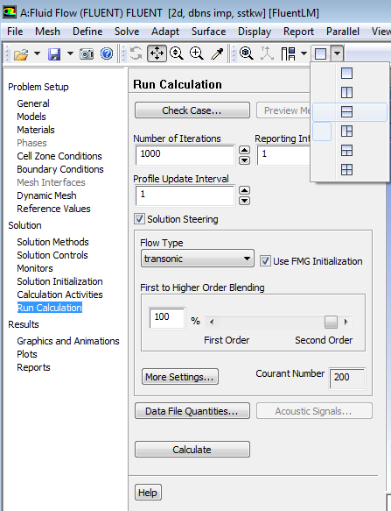
Run Calculation
Set three graphics windows for the residual, lift and drag monitors
File → Save Project
Run Calculation
Set the number of iterations to 1000
Press ‘Calculate’
It is good practice to run and then check the FMG first (by setting the main iteration number to zero and then pressing calculate) before starting the main calculation iterations. The FMG calculation can diverge just as the main calculation can do. Check for non-physical velocities, temperatures, etc. For this workshop, the FMG has already been checked.
The calculation should take about 15 minutes. However to save time you may prefer to read (or import) the supplied pre-converged data file ‘mach_0.7_converged.dat.gz’
Introduction
Solving
Summary
CFD-Post Postpro
Fluent Postpro
Setup

Slide 23
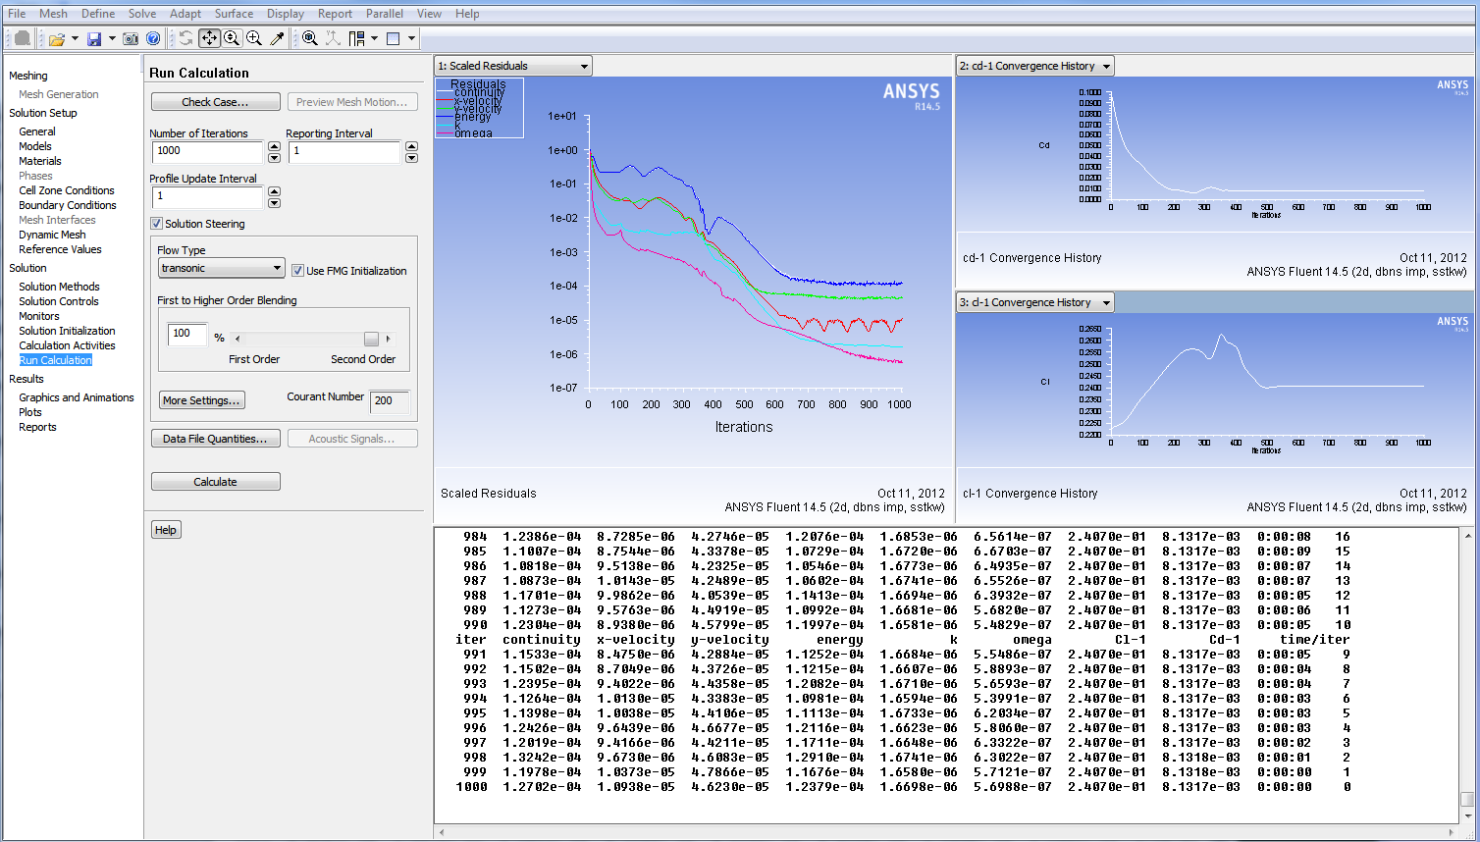
Run Calculation
After 1000 iterations the calculation has converged
Note that the CFL has been steadily ramped up during the calculation by the solution steering algorithm. This can be seen on the residuals plot and the central ‘Run Calculation’ panel
The residuals have converged to low values and the drag and lift monitors are no longer changing
Introduction
Solving
Summary
CFD-Post Postpro
Fluent Postpro
Setup

Slide 24
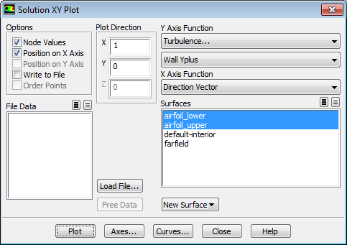
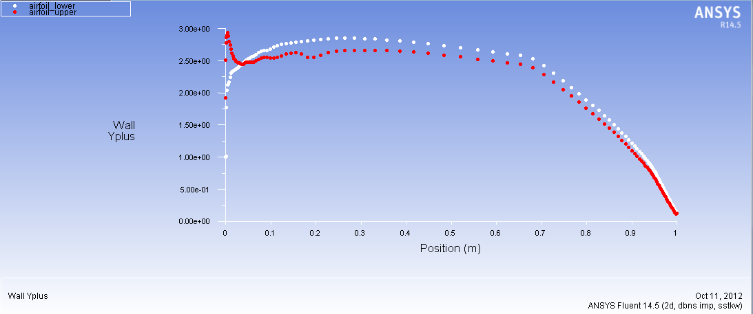
Post-Processing [Fluent]
Plot the y⁺ values along the airfoil surfaces
Plots → XY Plot → Turbulence → Wall Y Plus on both of the airfoil walls.
We can see that y⁺ ≈ 2.5 for much of the surface
In order to obtain a good drag prediction, and for the turbulence model to work effectively, the mesh is well resolved near to the wall, such that the first grid point is located in the viscous sub-layer, with y⁺ of 5 or less
Introduction
Solving
Summary
CFD-Post Postpro
Fluent Postpro
Setup

Slide 25
Post-Processing [Fluent]
Compare the predicted Cl and Cd against the experimental values
From Reference [1], Cl = 0.241 and Cd = 0.0079
The CFD solution calculates Cl = 0.241 and Cd = 0.0081
Good agreement can be seen
Introduction
Solving
Summary
CFD-Post Postpro
Fluent Postpro
Setup

Slide 26
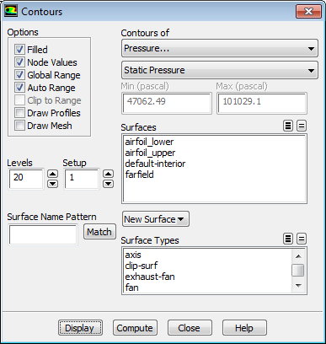
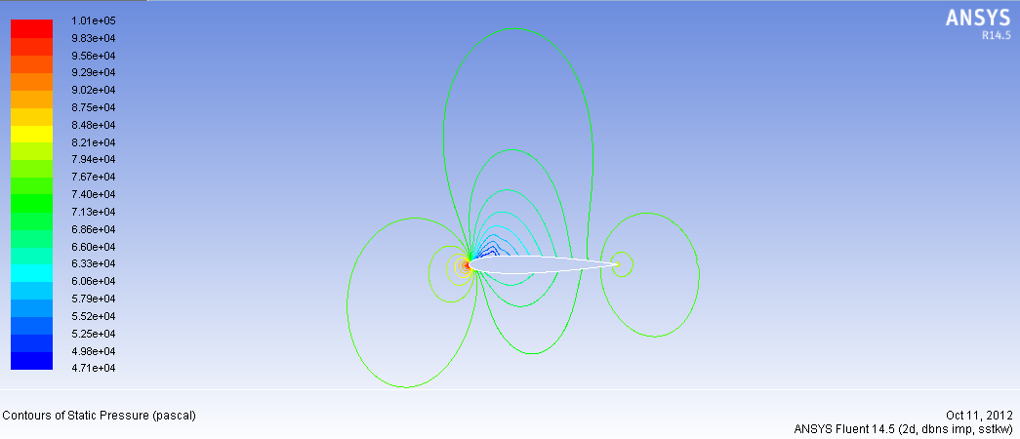
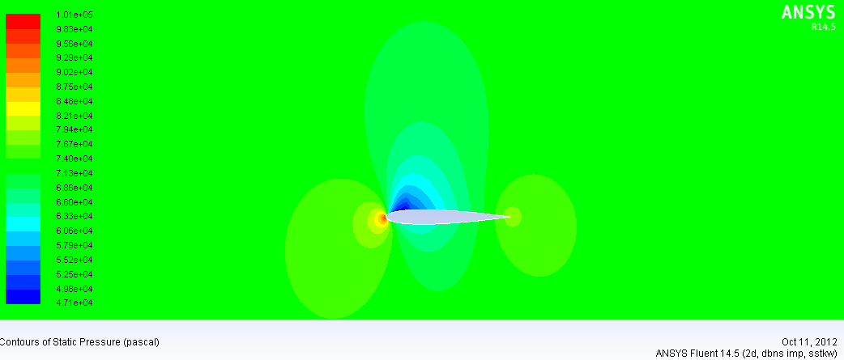
Post-Processing [Fluent]
Examine the contours of static pressure
Graphics and Animations → Contours
Turn off ‘Filled’ to just display the contour lines
Turn on ‘Filled’, display again
Note the high static pressure at the nose, and low pressure on the upper (suction) surface. The latter is expected as the airfoil wing is generating lift.
Introduction
Solving
Summary
CFD-Post Postpro
Fluent Postpro
Setup

Slide 27
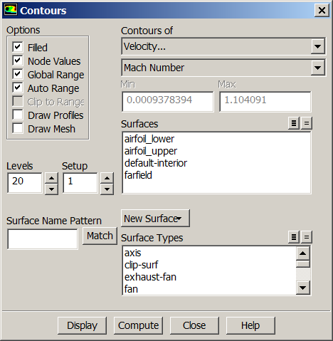
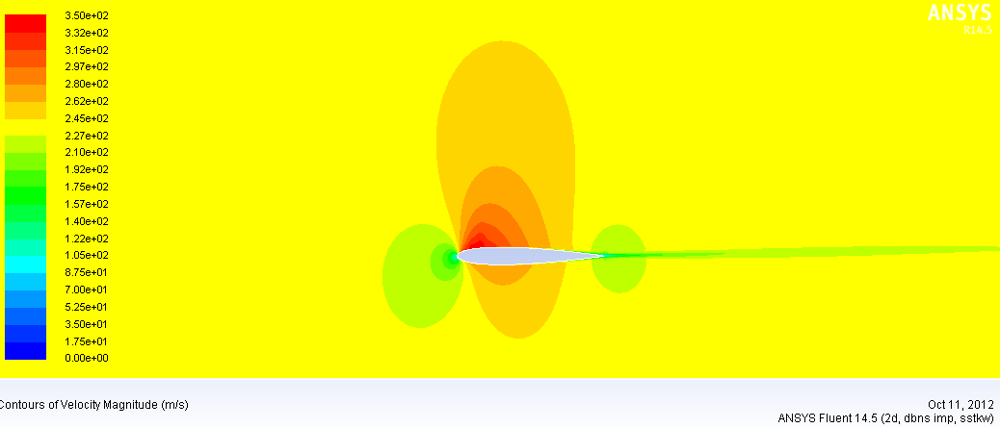
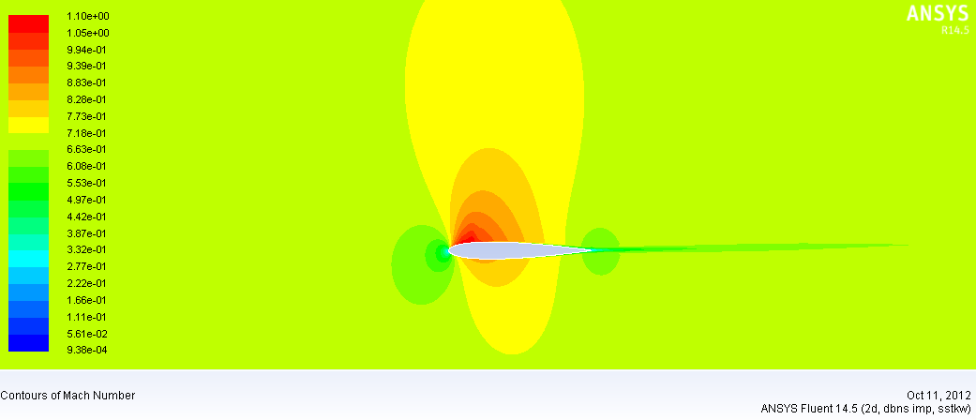
Post-Processing [Fluent]
Examine the contours of Mach Number
Notice that the flow is locally supersonic (Mach Number > 1) as the flow accelerates over the upper surface of the wing
Introduction
Solving
Summary
CFD-Post Postpro
Fluent Postpro
Setup

Slide 28
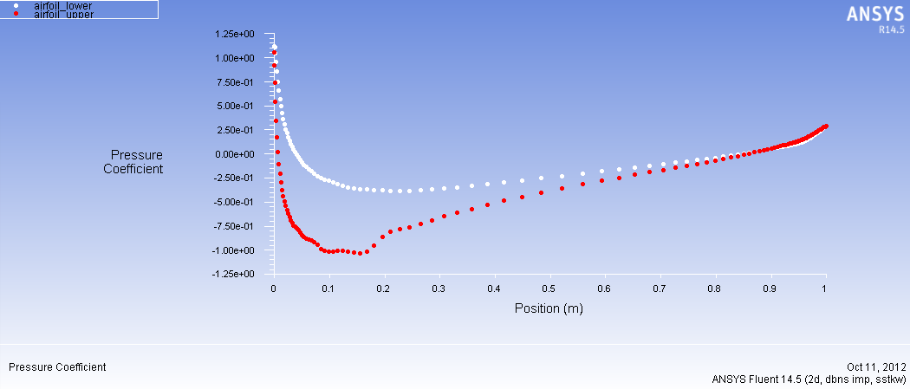
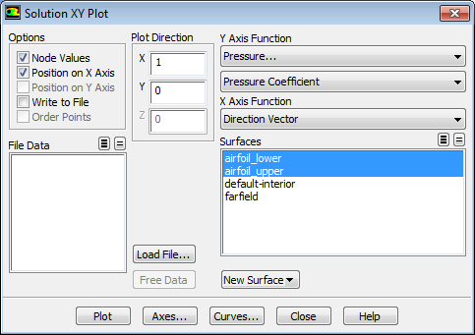
Post-Processing [Fluent]
Plot the pressure coefficient (Cp) along the upper and lower airfoil surfaces
Remember this is under Plots → XY Plot
Introduction
Solving
Summary
CFD-Post Postpro
Fluent Postpro
Setup

Slide 29
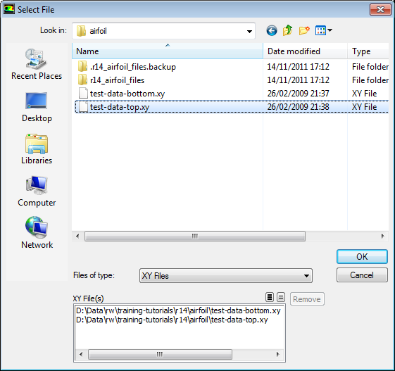
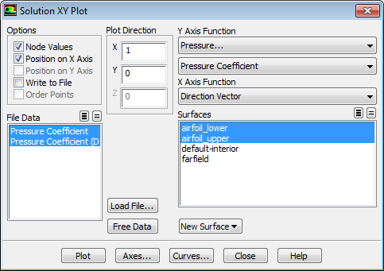
Post-Processing [Fluent]
Load the test Cp data for comparison.
Load File and browse to the .xy files supplied with this workshop. The file location may be different in your training facility.
Introduction
Solving
Summary
CFD-Post Postpro
Fluent Postpro
Setup

Slide 30
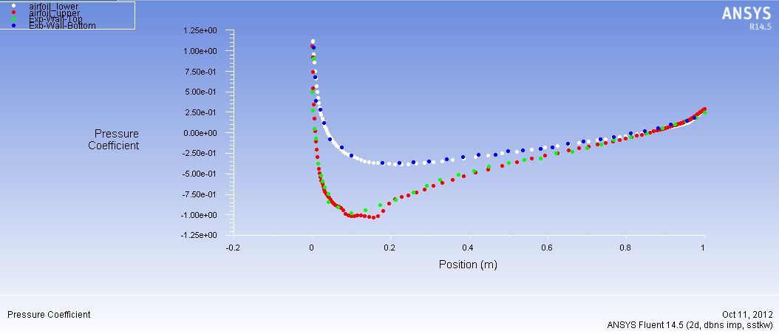
Post-Processing [Fluent]
Once loaded, plot the CFD and experimental Cp results together.
Good agreement can be seen. If further data manipulation is required the XY plot data can be written to a file and then read into a third party tool such as Microsoft Excel
Introduction
Solving
Summary
CFD-Post Postpro
Fluent Postpro
Setup

Slide 31
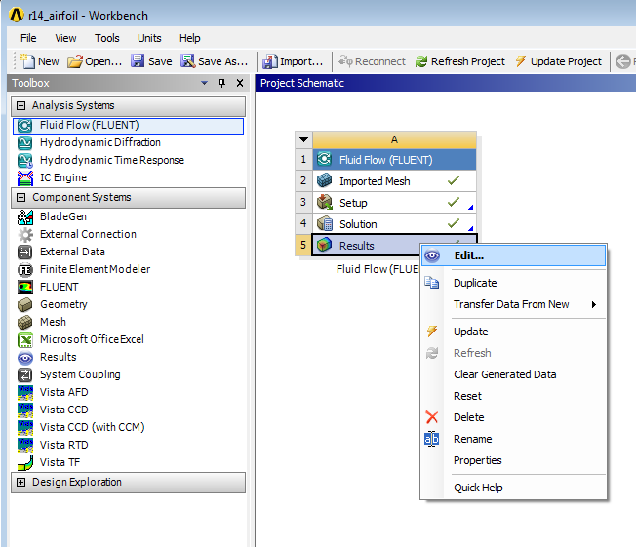
Post-Processing [CFD-Post]
File → Save Project
File → Close Fluent
Additional post-processing will now be performed in CFD-Post
Return to the Workbench Project window and ‘Refresh Project’
Right click the Results cell and select Edit to launch CFD-Post
Introduction
Solving
Summary
CFD-Post Postpro
Fluent Postpro
Setup

Slide 32
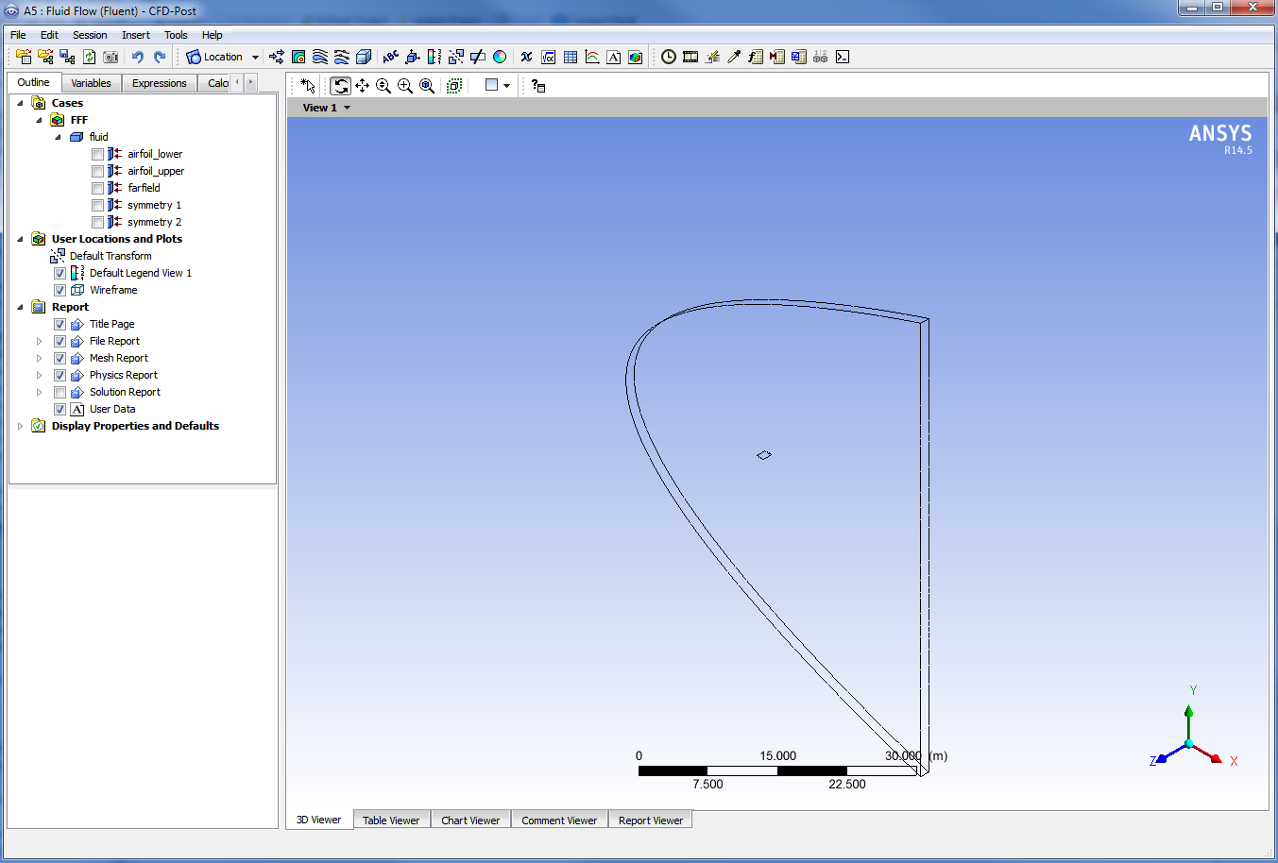
Post-Processing [CFD-Post]
CFD-Post works in 3D, so a unit thickness will be automatically be added to the 2D airfoil, with symmetry side boundaries
Introduction
Solving
Summary
CFD-Post Postpro
Fluent Postpro
Setup

Slide 33
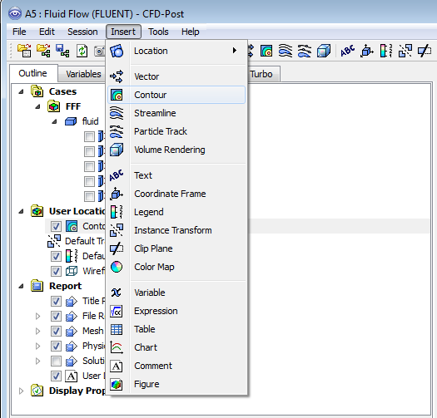
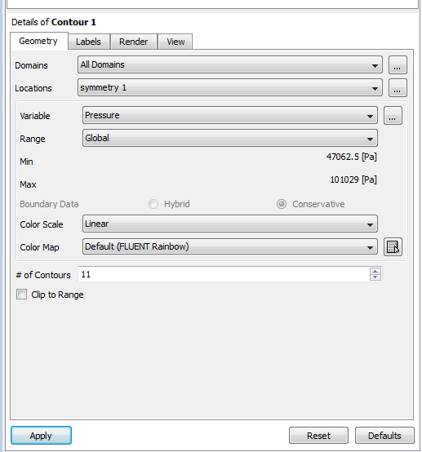
Post-Processing [CFD-POST]
Insert a new Contour and accept the default name ‘Contour 1’
Insert → Contour (or use the icon)
In the details panel, choose an existing location: ‘symmetry 1’
Choose the variable to be ‘Pressure’ then click Apply
Introduction
Solving
Summary
CFD-Post Postpro
Fluent Postpro
Setup

Slide 34
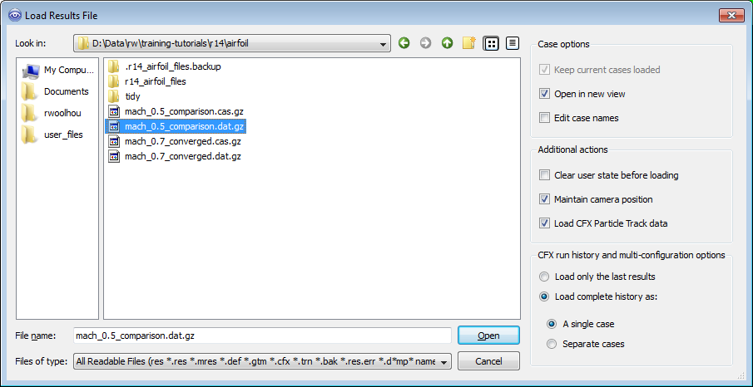
Post-Processing [CFD-Post]
A useful feature in CFD-Post is the ability to load multiple sets of CFD and/or test data, and to then compare any two of them together to generate a difference plot. We have supplied a second set of results files with this tutorial, run at a slightly slower speed (Mach 0.5 instead of Mach 0.7), and we will compare the differences.
File → Load Results and browse to the tutorial folder
Load ‘mach_0.5_comparison.dat.gz’
Introduction
Solving
Summary
CFD-Post Postpro
Fluent Postpro
Setup

Slide 35
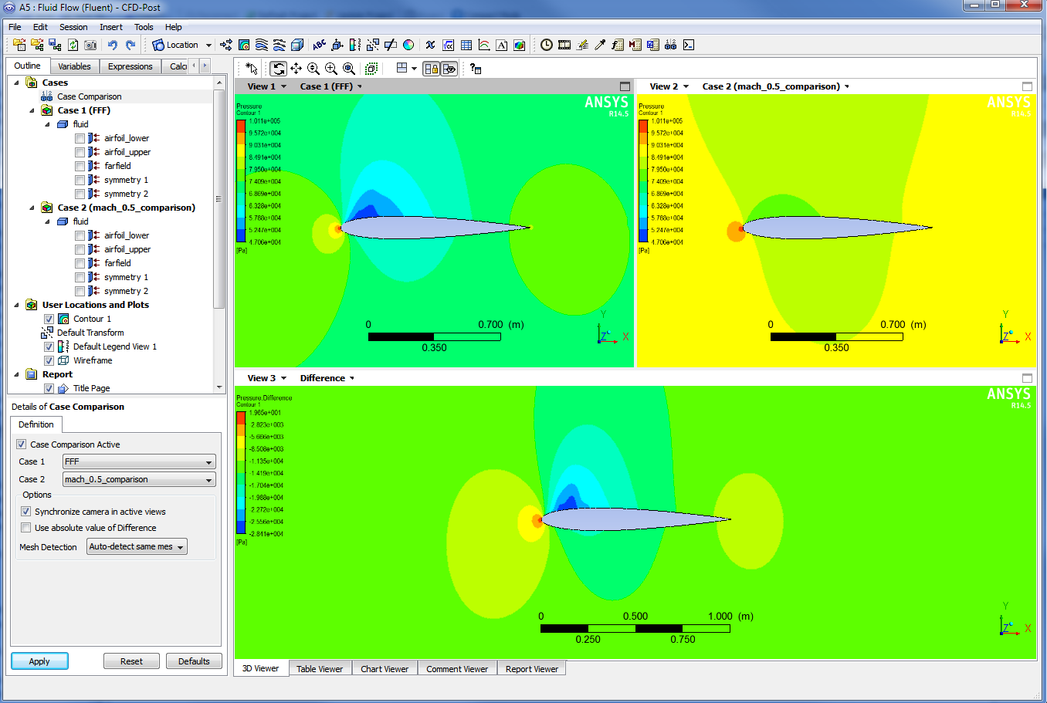
Post-Processing [CFD-Post]
Make sure that two windows are open and that each case is displayed in a different window
Lock the views and visibility so they are synchronised
Double click on ‘Case Comparison’ and set ‘Case Comparison Active’, then click Apply
Case comparison allows the results of the 0.5M and 0.7M simulations to be viewed simultaneously, and the differences quickly identified and quantified. ‘FFF’ refers to the case calculated in Fluent. If you read in two files separately the file name would be listed, as the 0.5M case is in the image.
Introduction
Solving
Summary
CFD-Post Postpro
Fluent Postpro
Setup
Notes:
HE:I tried the 0.7 file as well and there was some differences at the suction side.

Slide 36
Wrap-up
This workshop has shown the basic steps that are applied during CFD simulations:
Defining material properties.
Setting boundary conditions and solver settings
Running a simulation whilst monitoring quantities of interest
Post-processing the results, both in Fluent and CFD-Post
Comparing two sets of results where boundary conditions differ
One of the important things to remember in your own work is, before even starting the ANSYS software, is to think WHY you are performing the simulation:
What information are you looking for?
What do you know about the flow conditions?
In this case we were interested in the lift (and drag) generated by a standard airfoil and how well the solver predicted these when compared to high quality experimental data
Knowing your aims from the start will help you make sensible decisions of how much of the part to simulate, the level of mesh refinement needed, and which numerical schemes should be selected
Introduction
Solving
Summary
CFD-Post Postpro
Fluent Postpro
Setup

Slide 37
References
T.J. Coakley, “Numerical Simulation of Viscous Transonic Airfoil Flows,” NASA Ames Research Center, AIAA-87-0416, 1987
C.D. Harris, “Two-Dimensional Aerodynamic Characteristics of the NACA 0012 Airfoil in the Langley 8-foot Transonic Pressure Tunnel,” NASA Ames Research Center, NASA TM 81927, 1981
Introduction
Solving
Summary
CFD-Post Postpro
Fluent Postpro
Setup

