Slide 1
Lecture 3 Introduction to ANSYS DesignModeler

Slide 2
DesignModeler
What will you learn from this presentation
Process for pre-processing using ANSYS tools
What is ANSYS DesignModeler
How to launch DesignModeler?
DesignModeler interface
Toolbars

Slide 3
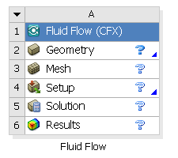
Preprocessing Workflow
Geometry Creation
OR
Geometry Import
Meshing
Solver
Geometry Operations
Sketches and Planes
3D Operations
Meshing Methods
Boolean, Body Operations, Split, etc
Hybrid Mesh: Tet, Prisms, Pyramids
3D Operations
Extrude, Revolve, Sweep, etc
Hexa Dominant, Sweep meshing
Geometry Cleanup and Repair
Assembly Meshing
Geometry Import Options
Automatic Cleanup
Global Mesh Settings
Direct CAD/Bi-Directional CAD
Merge, Connect, Projection, Flow Volume Extraction, etc
Local Mesh Settings
Parasolid Kernel
Sizing, Body/Sphere of Influence, Match Control, etc

Slide 4
Modeling Methods: Feature Based Vs Direct
Feature/History Based Modeling
CAD like approach to create new models with sketch-to-3D operations
Fully parametric
Design changes driven by parametric updates
Captures engineering intent
Analysis focused
Import CAD models and perform geometric operations in preparation for meshing
Supports native CAD parameters
Custom tools to repair, prepare and optimize models for analysis
Maintains feature history
Direct Modeling
Import CAD models and perform geometric operations in preparation for meshing
Easy to edit “dumb” neutral files
Easy to repair, prepare and optimize models for analysis
Custom tools to repair, prepare and optimize models for analysis
Locally parametric
More flexibility to make unplanned and local changes
No features + no constraints = no regeneration failures
Note: ANSYS DesignModeler is a Feature Based Modeler

Slide 5
What is DesignModeler?
Sketching
Modeling
Overview
DesignModeler is a parametric feature-based solid modeler
Designed so that you can intuitively and quickly begin drawing 2D sketches, modeling 3D parts, or importing CAD models for engineering analysis preprocessing.
Application Fundamentals
Two basic modes of operation for geometry creation.
2D Sketching
3D Modeling
Dedicated tools for import & clean-up.
CAD Import & Cleanup

Slide 6
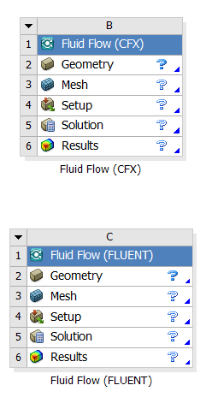
Launching DesignModeler
From Analysis Systems
Eg: Fluid Flow (Fluent), Fluid Flow (CFX)
From Component Systems
Eg: Geometry, Mesh
ANSYS DesignModeler is launched within Workbench
Double click Geometry in the System or right click and select Edit

Slide 7
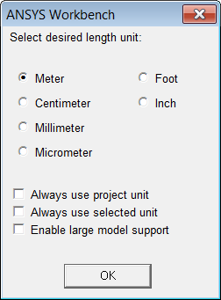
Units
Set up Working Units
Unit selection menu pops up immediately after DM launches
Always use project unit:
Project units set in Workbench will be used
Always use selected unit:
Unit selected from the panel will be used
Enable large model support:
Enable this to create large models within a bounding box of 1000 cubic km.
Units cannot be changed mid-session.

Slide 8
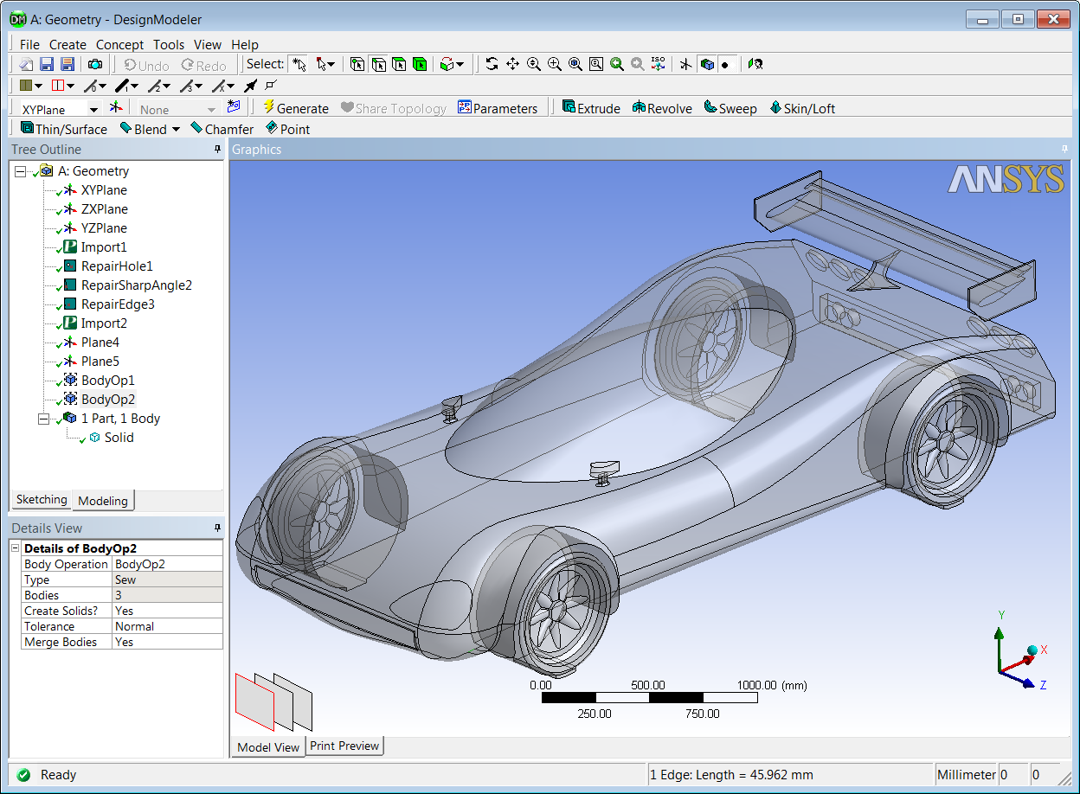
DesignModeler Interface
Toolbars
Tree Outline
Mode Tabs
Graphics Window
Details View
Status/Info Bar
Entity Details Bar
Units Display Bar
Notes:
Consistent AWE GUI layout…

Slide 9
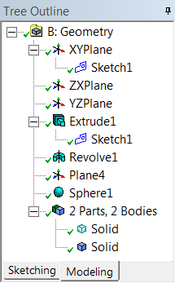
Tree Outline
Working with the Tree Outline
Starts with three default Planes
XY, ZX & YZ
Sketches created on Planes
Modeling Operations listed sequentially (Feature History)
Bodies/Parts listed beneath Modeling Operations
The Tree Outline can used to access, modify or delete modeling operations or sketches created at any point in the model history.
Default Planes
Sequential list of Modeling Operations
List of bodies/parts
created

Slide 10
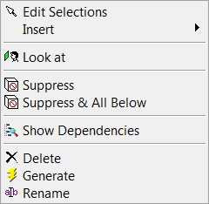
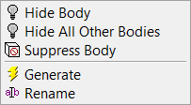
Tree Outline
Context Menus
Right clicking on any feature in the Tree Outline opens context sensitive menus.
Examples;
Insert can be used to add operations anywhere in the tree
Suppress can be used to deactivate a selected operation (can be reactivated)
Delete can be used to delete a selected operation (cannot be reactivated)

Slide 11
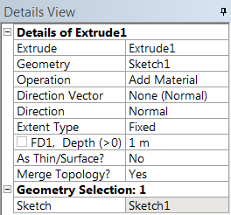
Details View
Working with the Details View
Feature inputs are listed in the Details View
The second column contains user input values or selections.
Activate each box by clicking
Boxes requiring entity selection (Sketch, Geometry etc) will display Apply/Cancel when activated
Yellow boxes indicate that input is required (numeric or selection input).

Slide 12
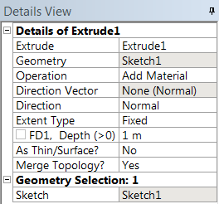
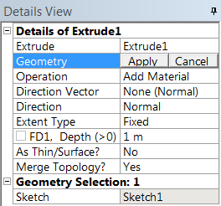
Details View
Working with the Details View
Select an existing feature to edit its details
Gray colored details of previously created feature cannot be modified
To enable editing of all details right click on the feature in the Tree Outline and select Edit Selections.
All details of previously created feature can be modified

Slide 13
Status/Info Bar
Units Display Bar
Displays Unit used in current project
Status/Info Bar
Displays Status of geometry model
Displays dynamic instructions
Eg:
Entity Details Bar
Displays details of entity selected in Graphics Window or Tree Outline.
Eg:

Slide 14
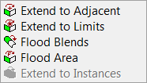
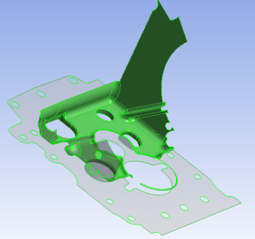
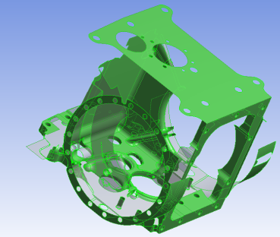
Toolbars: Selection Tools
Example – Box Select
Drag from left to right to select the entities, completely enclosed in the box
Drag from right to left to select the entities, completely and partially enclosed in the box
Entity Selection Mode
New Selection
Single Select
Box Select
Select Points
Select Edges
Select Faces
Select Bodies
Shrink/Expand Face Selection
Extend Selection for multiple entities –
Shrink
Expand

Slide 15
Toolbars: View Controls
View Options
Rotate
Pan
Zoom
Box Zoom
Fit Model to Screen
Magnifier Window
Flip View Back/Forwards
Set Iso View
Display Plane
Display Model
Display Points
Look At
Example – Look At
Snaps view to active plane normal
Example – Rotate
In Rotate, Pan or Zoom mode left click on geometry to set rotation origin (red dot)

Slide 16
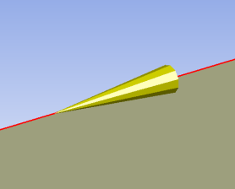
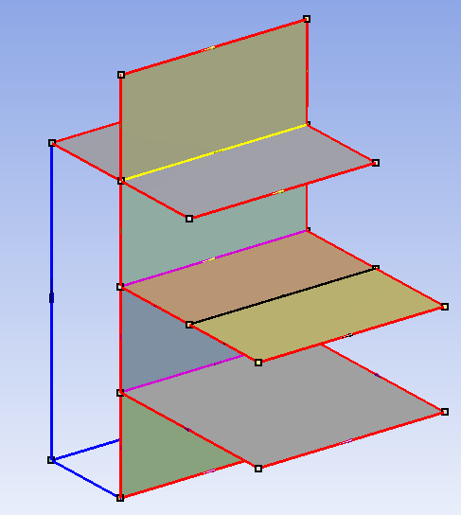
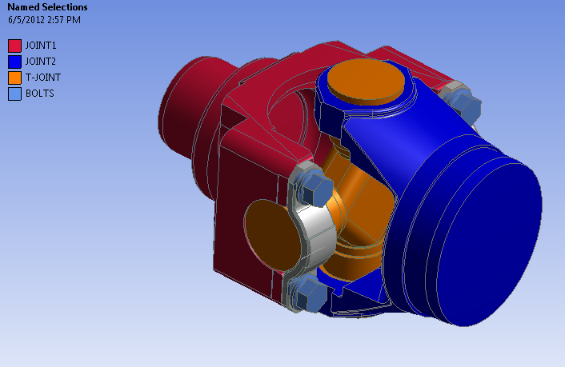
Toolbars: Display Controls
Edge Display Options
Free Edges - 0 face - Blue
Single Edges - 1 face - Red
Double Edges - 2 faces - Black
Triple Edges - 3 faces - Pink
Multiple Edges (>3) - Yellow
Display Edge Direction
Display Vertices

Slide 17
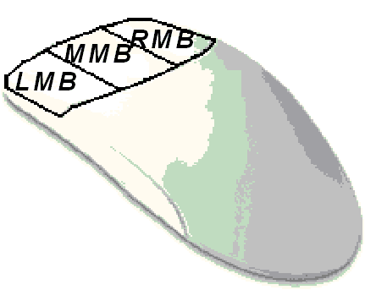
Basic Mouse Controls
Left Mouse Button (LMB)
Geometry selection
Ctrl + LMB adds/removes selected entities
Hold LMB and sweep cursor = continuous selection
Middle Mouse Button (MMB)
Rotate
Shift + MMB : Zoom
Ctrl + MMB : Pan
Right Mouse Button (RMB)
Box Zoom
Opens context menus

Slide 18
Hot Keys
Hot Keys: Hot Keys can help in performing operations quickly
Ctrl-Z/Y: Undo/Redo (sketching mode only)
Ctrl-A: Select All
Ctrl-C/X/V: Copy/Cut/Paste (sketching mode only)
Ctrl-P/E/F/B: Toggle Point/Edge/Face/Body selection filter
F3: Apply
F5: Generate
F6: Display (Shaded/Shaded+Edges/Wireframe)
Full list in Appendix

Slide 19
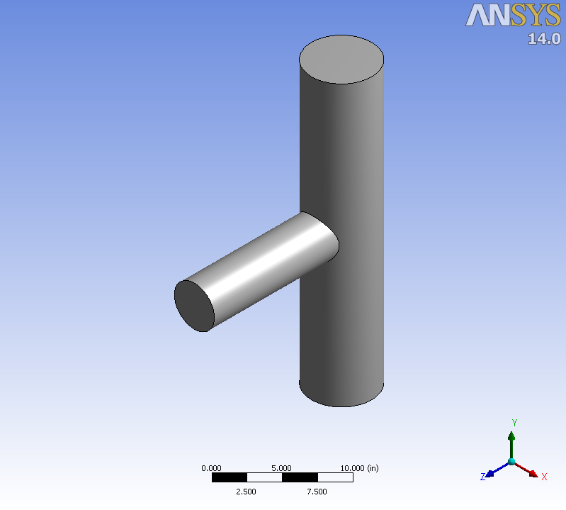
Workshop 1 – DesignModeler Basics

Slide 20
Appendix
Contents
Hot Keys
Mouse Control
Menu Toolbar
Feature Operation Toolbar

Slide 21
Hot Keys
Escape: equivalent to New Selection (if button is not grayed out; also accessible via the Selection Toolbar
Ctrl+A: selects three Body Types: Solid, Surface, and Line
Ctrl+B: equivalent to Selection Filter: Bodies (also accessible via the Selection Toolbar)
Ctrl+C: equivalent to Copy (Sketching mode only; also accessible via the Modify Toolbox)
Ctrl+E: equivalent to Selection Filter: Edges (also accessible via the Selection Toolbar)
Ctrl+F: equivalent to Selection Filter: Faces (also accessible via the Selection Toolbar)
Ctrl+N: equivalent to Start Over option (also accessible via the File Menu)
Ctrl+O: equivalent to Load DesignModeler Database option (also accessible via the File Menu)
Ctrl+P: equivalent to Selection Filter: Points (also accessible via the Selection Toolbar)
Ctrl+S: equivalent to Save Project option (also accessible via the File Menu)
Ctrl+V: equivalent to Paste (Sketching Mode only; also accessible via the Modify Toolbox)
Ctrl+X: equivalent to Cut (Sketching Mode only; also accessible via the Modify Toolbox)
Ctrl+Y: equivalent to Redo (Sketching Mode only; also accessible via the toolbar)
Ctrl+Z: equivalent to Undo (Sketching Mode only; also accessible via the toolbar)
F1: ANSYS Inc. online help with DesignModeler highlighted; for more information, see Help Menu
F2: Install help
F3: Apply (during feature creation; for more information, see Apply/Cancel in Plane)
F4: Cancel (during feature creation; for more information, see Apply/Cancel in Plane)
F5: equivalent to Generate (also accessible via the 3D Features toolbar)
F6: equivalent to Shaded Exterior and Edges, Shaded Exterior, and Wireframe model appearance controls (toggle between three; also accessible via the View Menu)
F7: equivalent to Zoom to Fit (also accessible via the Rotation Modes Toolbar toolbar)

Slide 22
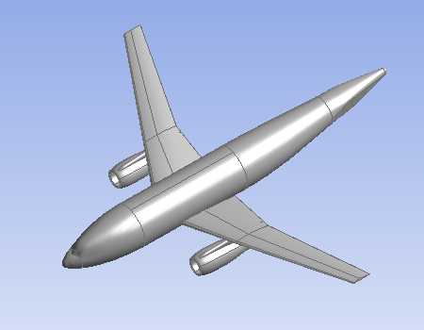
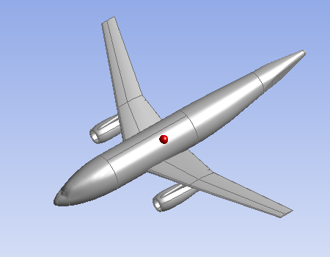
Details on Mouse Control
Rotate Behavior (LMB):
Cursor outside center :
Rotation about Z view
Cursor near center of graphics screen :
Free rotations
Cursor near edge of graphics screen : Rotations about X (top/bottom) or
Y (left/right) axes
While in Rotate, Pan, or Zoom mode:
Left click on model: resets center of view and rotation at cursor location (identified by red dot)
Left click in open area re-centers model and rotation center to Centroid

Slide 23
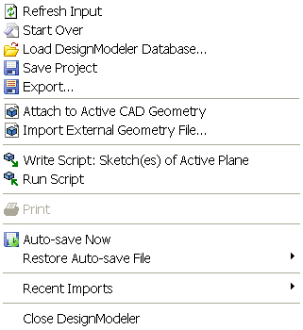
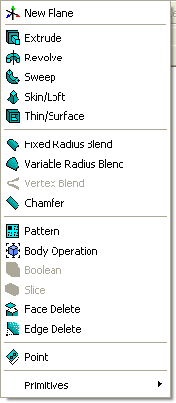
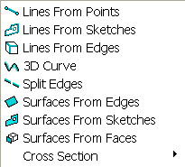
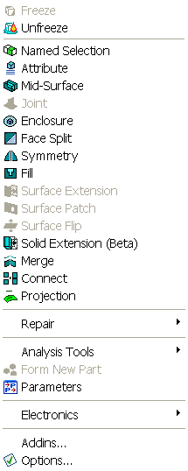
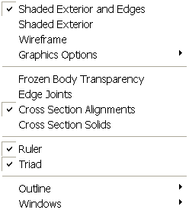
Menu Toolbar

Slide 24
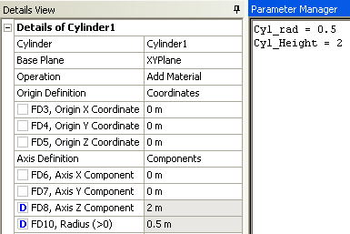
Feature Operation Toolbar
Add/modify solid bodies
Option to parameterize
Plane Toolbar
- Create new plane and new sketch
- List of Planes and sketches
List of Planes
List of Sketches
Create New Plane
Create New Sketch

