Slide 1
Lecture 9 Beams and Shells

Slide 2
Beams & Shells
The features in the Concept menu are used to create and modify line bodies and/or surface bodies which become FE beam or shell models
Features in Tools menu, like Mid-Surface and Joint, are used extensively for modeling Shells
To model Beams and Shells, you can also use:
Create line or surface bodies using the features in the Draw toolbox to design a 2D sketch and/or generate a 3D model
Use the Import external geometry file feature
Extract beams and shells from solids
Other tools like Thin, Extrude, etc.
Line bodies
Lines from points
Lines from sketches
Lines from edges
Surface bodies
Surfaces from line bodies
Surfaces from sketches
Surfaces from 3D edges
Mid-Surface
Joint

Slide 3
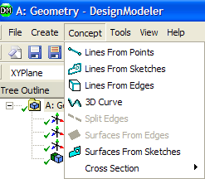
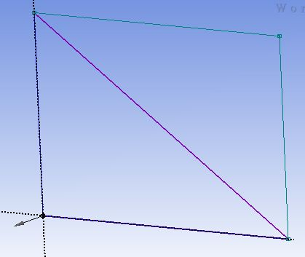
Creating Line Bodies (1)
Lines From Points
[Main Menu] Concept → Lines From Points
Points can be any 2D sketch points, 3D model vertices or Point Feature (PF) points.
A point segment is a straight line connecting two selected points.
The feature can produce multiple Line Bodies, depending on the connectivity of the chosen point segments.
The Operation field allows Add or Add Frozen choices for line bodies.
Point 1
Line Body
Point 2

Slide 4
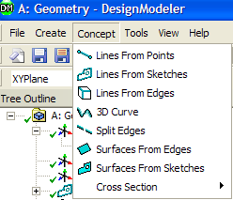
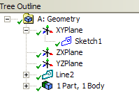
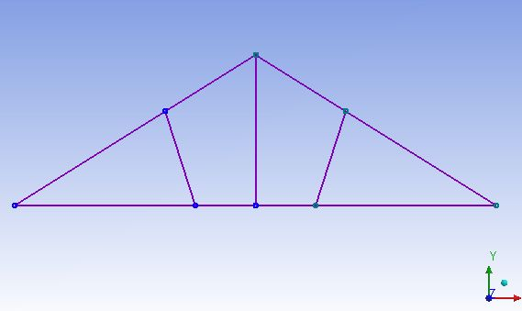
Creating Line Bodies (2)
Lines From Sketches
[Main Menu] Concept → Lines From Sketches
Line bodies created based on sketches and planes from faces
Multiple Line Bodies may be created depending on the connectivity of the edges within the base objects
Select sketches or planes in the feature tree then “Apply” in the detail window
Multiple sketches, planes, and combinations of sketches and planes can be used as the base object for the creation of line bodies

Slide 5
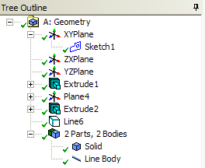
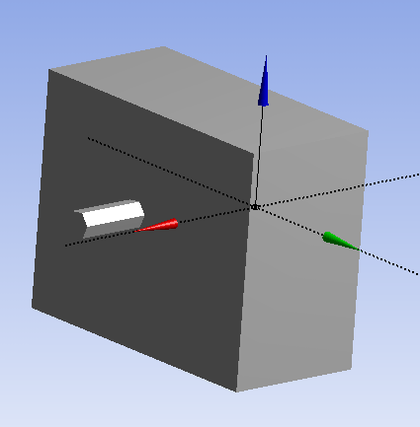
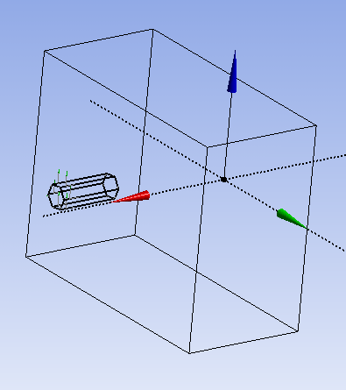
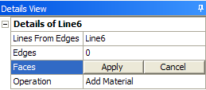
Creating Line Bodies (3)
Lines From Edges
[Main Menu] Concept → Lines From Edges
Creates line bodies based on existing 2D and 3D model edges
Can produce multiple line bodies depending on the connectivity of the selected edges and faces
Can select edges and/or faces through two fields in the detail window then “Apply”
Line Bodies

Slide 6
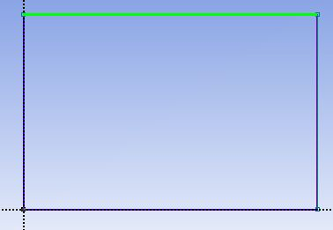
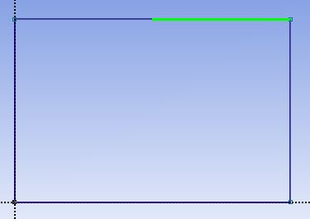
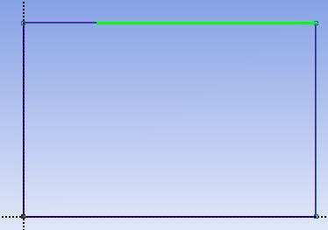
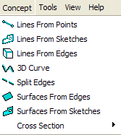
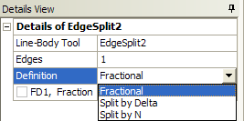
Split Edges
Split Line Body
[Main Menu] Concept → Split Edges
Splits line body edges into two pieces
Split location is controlled by the Fraction property (e.g. 0.5 = split in half).
Other Options:
Split by Delta: Distance between each split is given by Delta along the edge
Split by N: Number of Divisions of the Edge
Selected line
Fraction = 0.5
Fraction = 0.25

Slide 7
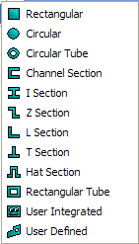
Cross Sections (1)
Cross Sections
Cross sections are attributes assigned to line bodies to define beam properties in the FE simulation
In DM, cross sections are represented by sketches and are controlled by a set of dimensions
Note: Design-Modeler uses a different coordinate system for cross sections than the one used in the ANSYS environment (described later)

Slide 8
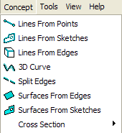
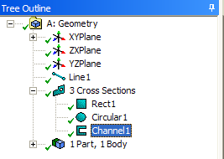
Cross Sections (2)
Cross sections are selected from the Concept menu
A cross section branch is inserted in the tree where each chosen cross section is listed
Concept Menu
List of Cross Sections
Cross Sections in Tree Outline

Slide 9
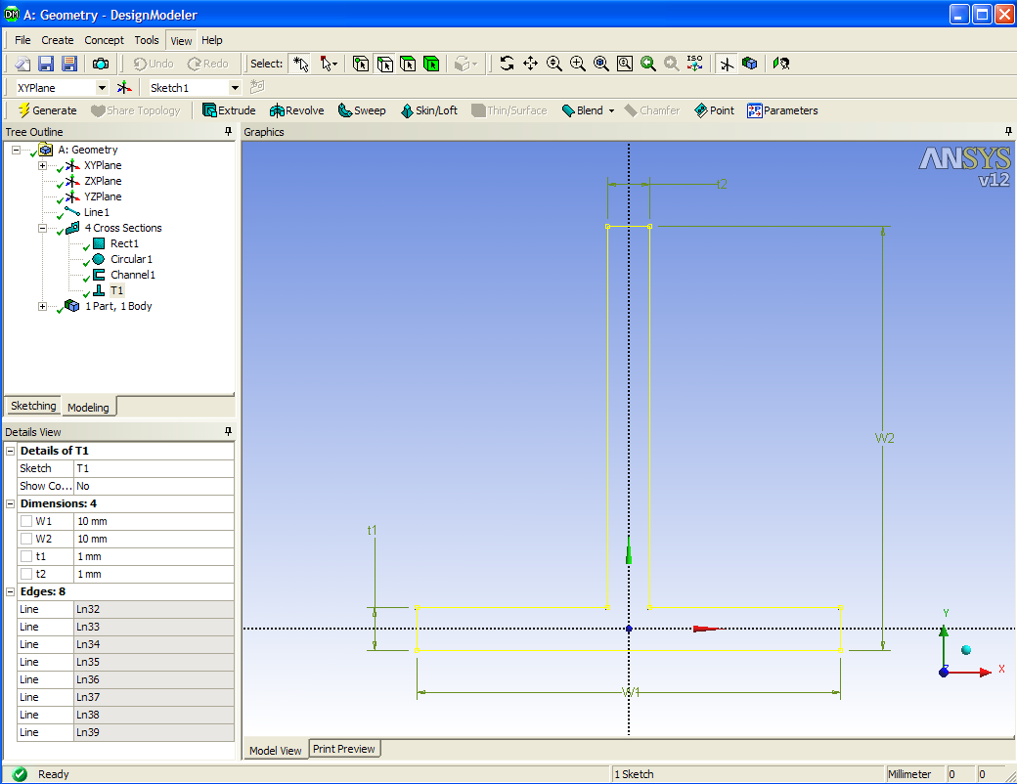
Cross Sections (3)
Highlight the cross section in the Tree to modify dimensions in the Details window

Slide 10
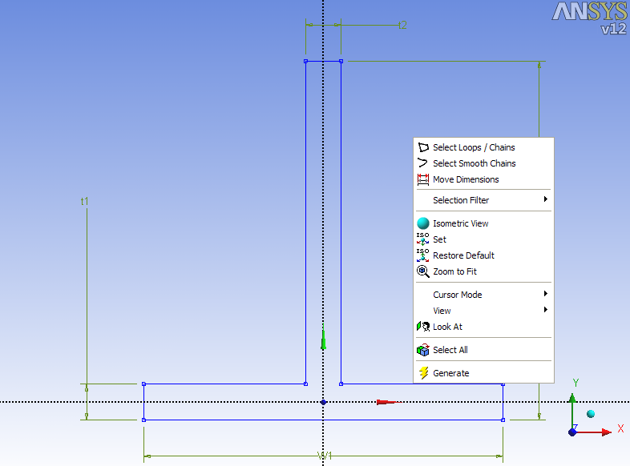
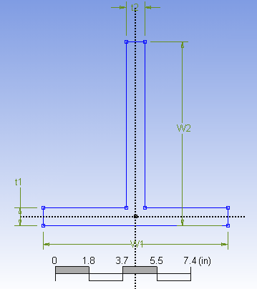
Cross Sections (4)
Dimension Editing
Cross section dimensions can be repositioned via a RMB and choosing Move Dimensions

Slide 11
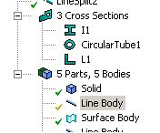
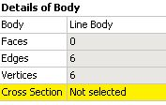
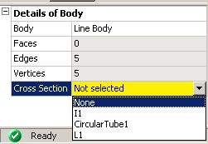
Cross Sections (5)
Assigning a cross section to a line body:
Highlight the line body in the Tree
A cross section property appears in the detail window
Click in this field and choose the desired cross section from the drop down list

Slide 12
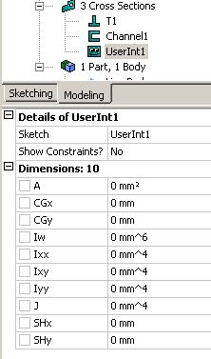
Cross Sections (6)
A User Integrated section can be defined in DM
The cross section is not sketched, rather the cross section’s properties are placed in the details window
A = Area of section.
Ixx = Moment of inertia about the x axis.
Ixy = Product of inertia.
Iyy = Moment of inertia about the y axis.
Iw =Warping constant.
J = Torsional constant.
CGx = X coordinate of centroid.
CGy = Y coordinate of centroid.
SHx = X coordinate of shear center.
SHy = Y coordinate of shear center.

Slide 13
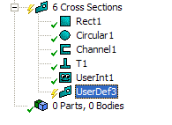
Cross Sections (8)
Steps for creating a User Defined Cross Section:
Select Cross Section → User Defined from Concept Menu
A Cross Section node with an empty sketch will be added in the tree outline
Click Sketching tab to draw the required sketch ( Must be a closed Sketch)
Click Generate. DM will compute the Cross Section properties and show them in the details view. These properties cannot be changed.
Cross Section Node

Slide 14
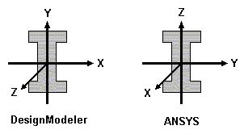
Cross Section Alignment (1)
As shown below, in Design-Modeler the cross section lies in the XY plane
Cross section alignment is defined by:
A local or cross section +Y direction
Default alignment is with the global +Y direction unless that would result in an invalid alignment in which case +Z is used
Note: In the ANSYS Classic Environment, the cross section lies in the YZ plane and uses the X direction as the edge tangent. This difference in orientation has no bearing on the analysis.
Y
Cross Section
Edge Tangent

Slide 15
Cross Section Alignment (2)
A color code is used to indicate cross section status for line bodies in the Viewer
Violet: no cross section assigned
Black: cross section assigned with valid alignment
Red: cross section assigned with invalid alignment
The line body icons in the tree have similar visual aids
Green: cross section assigned with valid cross section alignment
Yellow: no cross section assigned or default alignment
Red: invalid cross section alignment

Slide 16
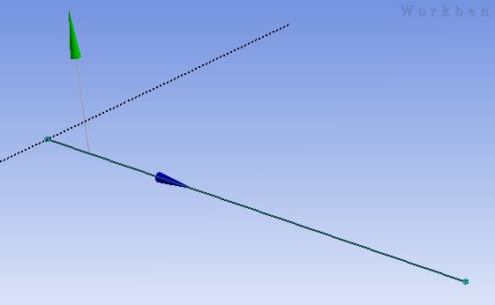
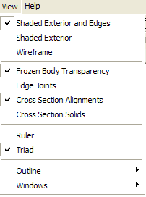
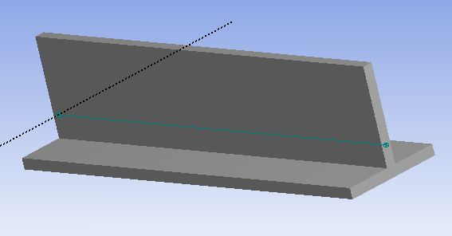
Cross Section Alignment (3)
Checking alignment can be done graphically using the View menu
Choose “Show Cross Section Alignments”
Green arrow = +Y, blue arrow = edge tangent of cross section
Or choose “Cross Section Solids”
+Y
Edge Tangent

Slide 17
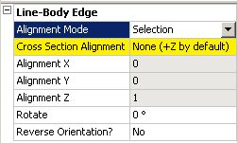
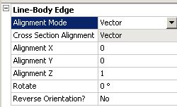
Cross Section Alignment (4)
Because a default alignment is chosen, Cross Section orientation will almost always need to be modified
There are 2 methods for modifying the Cross section alignment, “Selection” and “Vector”
The selection method uses existing geometry (edges, points, etc.) as alignment reference
The vector method uses input according to X, Y, Z coordinate directions
For either method a rotation angle can be input and/or the orientation reversed
Selection Method
Vector Method
To access the Alignment Mode Details, click on the Line Body in the Tree
RMB in the Viewer and Choose “Select All”
Alignment Mode details show up

Slide 18
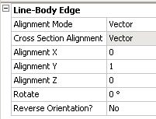
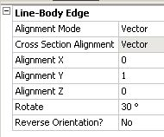
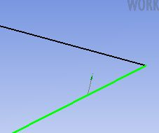
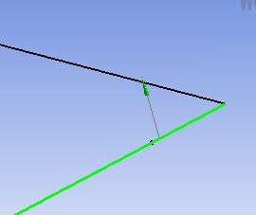
Cross Section Alignment (5)
Modifying the Cross Section orientation by vector
Switch to “Vector” alignment mode
Enter the desired coordinate values
Enter rotation angle if desired
Reverse orientation if desired

Slide 19
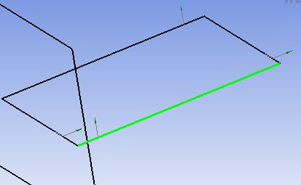
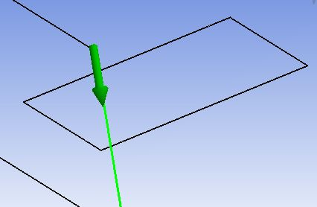
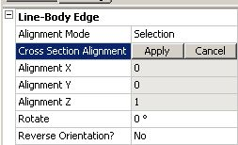
Cross Section Alignment (6)
Modifying the cross section orientation by selection
Select the line body to be aligned in graphics window
Select the geometry to be used for alignment
With “Selection” method active click in the alignment field

Slide 20
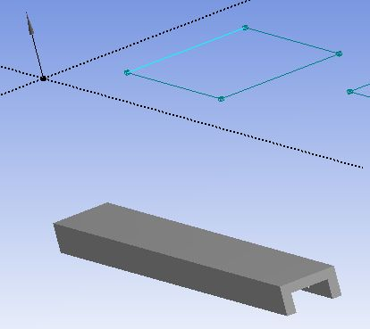
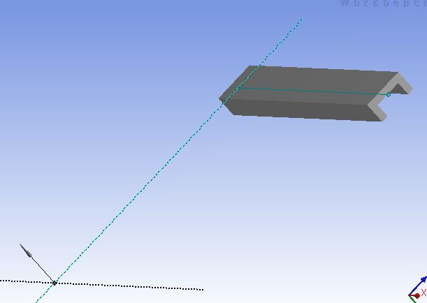
Cross Section Alignment (7)
Alignment using lines or axes
Line chosen for alignment
Y
Axis chosen for alignment
Edge Tangent
Y
Edge Tangent

Slide 21
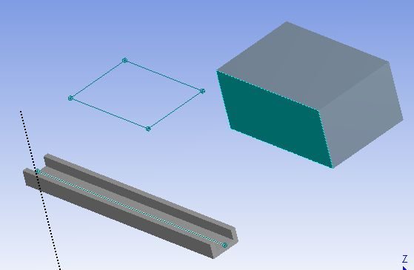
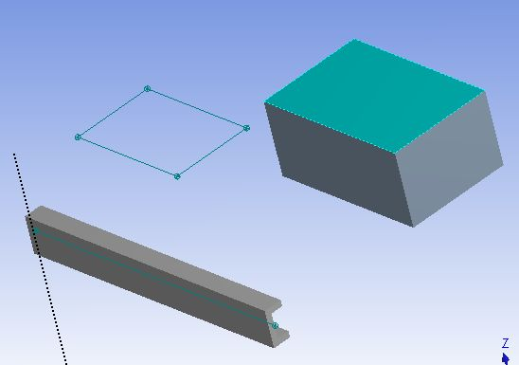
Cross Section Alignment (8)
Alignment using face normal
Edge Tangent
Y
Alignment Faces
Y
Edge Tangent

Slide 22
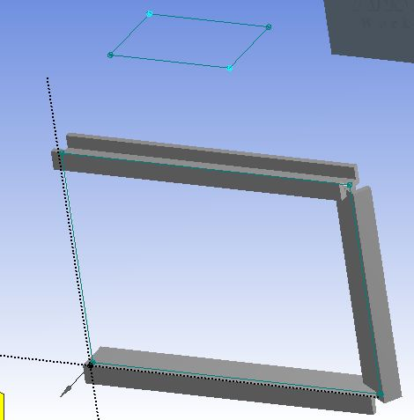
Cross Section Alignment (9)
Alignment using sketch points
Note: The order of point selection determines cross section alignment
1
2D points
2
Y
Selected Line Body
Edge Tangent

Slide 23
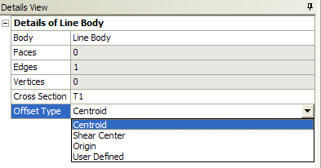
Cross Section Offset (1)
Cross Section Offset
After assigning a cross section to a line body, the Detail property allows users to specify the type of offset to use with the cross section:
Centroid: The cross section is centered on the line body according to its centroid (default)
Shear Center: The cross section is centered on the line body according to its shear center
Note the graphical display for centroid and shear center appear the same however. When analyzed, the shear center is used
Origin: The cross section is not offset and is taken exactly as it appears in its sketch
User Defined: User specifies cross section’s X and Y offsets

Slide 24
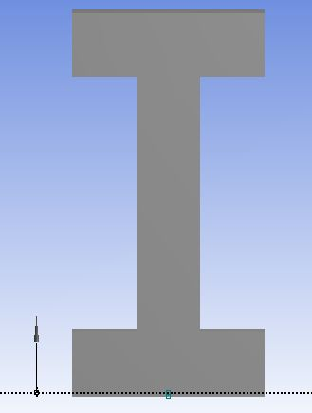
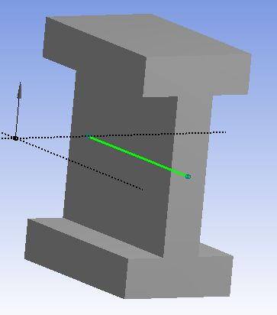
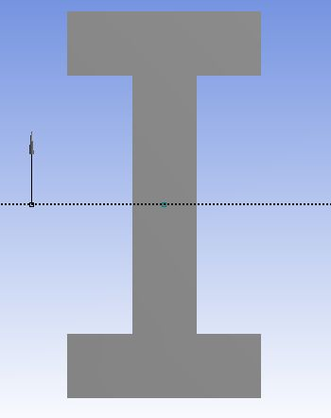
Cross Section Offset (2)
Origin offset (no offset)
Line Body
Line Body with cross section displayed
Centroid/Shear Center offset

Slide 25
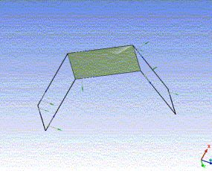
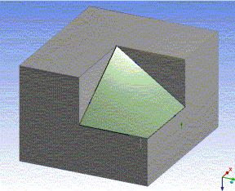
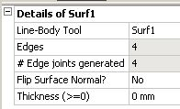
Surfaces From Edges (1)
Surfaces From Edges
[Main Menu] Concept → Surfaces from Edges
Creates surface body using line body edges as the boundary
Line body edges must form non-intersecting closed loops
Each closed loop creates a frozen Surface Body
The loops should form a shape such that a simple surface can be inserted into the model:
Planes, cylinders, tori, cones, spheres and simple twisted surfaces
Planar surface
Non-planar surface
Details window:
Flip surface normals
Input thickness which will be transferred to the FE model

Slide 26
Surfaces From Edges (2)
Creates surfaces from existing body edges
Can be solid or line body edges
Edges must produce non-intersecting closed loops
Existing solid body edges are selected for new surface boundary.
New, frozen, surface body generated (note, solid body is hidden).

Slide 27
Surfaces From Edges (3)
A line body with no cross section can be used to tie together surface models
In this case, the line body acts merely as a mechanism to insure a continuous mesh at the surface boundaries
2 Surface Bodies
Line Body (no cross section)
Result is continuous FE mesh at surface interface

Slide 28
Surfaces From Sketches
Surfaces From Sketches
[Main Menu] Concept → Surfaces from Sketches
Creates surface bodies using sketches as boundaries (single or multiple sketches are OK)
Base sketches must be closed profiles which are not self intersecting
May choose to “Add” or “Add Frozen” operations
Can reverse normal direction “No” in Orient With Plane Normal field
Can enter thickness which will be used in creating the FE model

Slide 29
Mid-Surface
Extracts surface body that is midway between existing solid body faces
Two Options:
Manual: Operates only on user specified face pairs
Automatic: Provides option to search for other matching face pairs
Mid-Surface created for a pipe geometry
Details View of Mid-Surface

Slide 30
Mid-Surface: Manual (1)
Manual Method
Set the Selection Method to “Manual”
Select pair of faces, one pair at a time, in Face Pairs input
The order of selection determines the surface normal direction
Notice the first surface picked is displayed in purple, the second is shown in pink
When the selection is finalized the selected pairs are displayed in dark and light blue colors
Details View of Mid-Surface
Normal Direction
2nd Pick
1st Pick
Solid Model
Color of faces during selection
Color of faces after selection

Slide 31
Mid-Surface: Manual (2)
Multiple surface pairs may be selected for a single mid-surface operation, however they must be selected as opposing pairs
The correct order of selection of faces for the previous example can be as in the image shown on right hand side here
Adjacent face pairs will be grouped together if within the “Thickness Tolerance” (see below)
1
2
3
5
4
6
Order of face selection
T1
T2
If │T1 – T2│ < Thickness Tolerance: surfaces are grouped

Slide 32
Mid-Surface: Automatic (1)
Automatic Method
Switching the Selection Method from “Manual” to “Automatic” exposes several additional options
Bodies to search: Limits search to visible bodies, selected bodies or all bodies
Minimum and maximum threshold sets search range (thickness) for face pairs
Options like Extra Trimming are very useful with “Automatic” method
Provides options for situations where trimming problems with surface bodies occur
Preserve Bodies? allows you to save the solid bodies from which surfaces are created (default is No)

Slide 33
Mid-Surface: Automatic (2)
When the search is complete, the number of pairs detected is listed in the details and displayed graphically
Mid surface creation is completed by Generating the surface body

Slide 34
Mid-Surface: Trimming (1)
Trimming Options
In cases where trimming problems occur there are several options available to attempt corrections
Example:
Using the previous model we generate the surface model without removing the unwanted face pairs
Since the pairs created result in T junctions, trimming problems occur
Notice the mid-surface branch in the tree is displayed with a yellow check indicating there is a problem

Slide 35
Mid-Surface: Trimming (2)
Using the RMB option we can “Show Problematic Geometry”
The resulting plot shows regions where trimming problems have occurred
The default behavior is to intersect any untrimmed surfaces with the original solid body
Other options:
Delete Untrimmed
No Extra Trimming

Slide 36
Mid-Surface: Effects of Maximum Threshold
In this case, Maximum Threshold was increased to intentionally detect unwanted surfaces
Clicking in the Face Pairs field activates selection mode
RMB in the graphics window provides the optional selection modes
In this case. we can choose “Remove Face Pairs”. then select one of the faces to be removed
When selection is complete, press Generate to update the model
Please note that in above steps, when removing face pairs, selecting one of the faces will remove the pair
RMB Options

Slide 37
Mid-Surface: Sewing Tolerance
Sewing Tolerance
If gaps exist in adjacent face pairs, they will be sewn together within the Sewing Tolerance
If Gap < Sewing Tolerance, Surfaces are grouped and connected (Conformal Mesh between them)
Gap

Slide 38
Mid Surface: Selection Tolerance
Selection Tolerance
Tolerance is used to detect face pairs in case of imperfect offsets
Selecting an undetected pair manually, provides feedback on tolerance value required, which can be used for automated selection
Default value is set to zero
Without Selection Tolerance
Selection tolerance value is suggested to user
All the pairs detected successfully with Selection tolerance
Notes:
Mid-surfacing tool now supports a selection tolerance, that can be used to successfully extract mid surfaces even when the face pairs are not exactly parallel. This also provides feedback about what would be an appropriate tolerance. Using that feedback, appropriate tolerance can be specified for a successful result in case of an imperfect pairs.
Post cleanup are improved to provide better connected model.

Slide 39
Joint
Joins surface bodies together such that their contact regions share common edge
Prerequisite for conformal meshes
Takes two or more surface bodies as input
Imprints edges on all bodies where they make contact
Details View of Joint
Surface bodies to be Joined
Surface bodies after Joint

Slide 40
Edge Joints (1)
Edge Joints are the glue that holds together bodies where a continuous mesh is desired
Creating surface and/or line multi-body parts with coincident edges results in automatic creation of edge joints
Joints can be created manually ([Main Menu] Tools → Joint) where no coincident topology exists

Slide 41
Edge Joints (2)
Edge Joints can be viewed by turning on the Edge Joints option in the View menu.
Edge joints are displayed in either blue or red.
Blue: edge joint is contained in properly defined multi-body part
Red: edge joint not grouped into the same part
No Edge Joint
With Edge Joint

Slide 42
Workshop 6 – Beam & Shell Modeling

