Slide 1
Workshop 1 ANSYS Meshing Basics

Slide 2
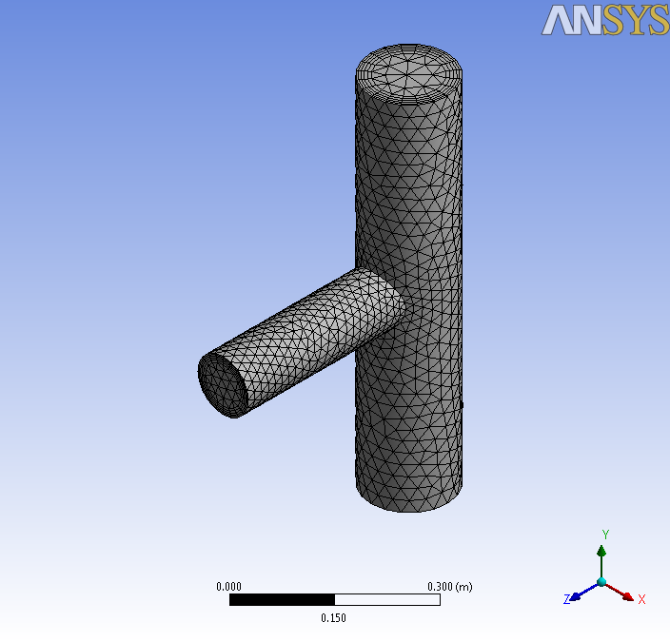
Introduction
Background
This workshop assumes little or no prior experience of ANSYS Meshing. Basic workflow will be demonstrated.
Objectives
Starting ANSYS Meshing
Generating a mesh
Creating Named Selections
Adding Inflation
Examining the mesh
Checking mesh quality
Saving the project

Slide 3
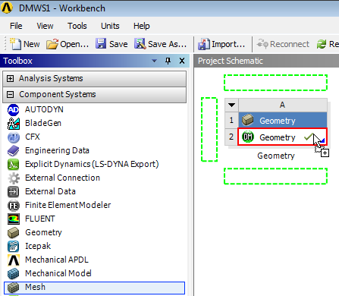
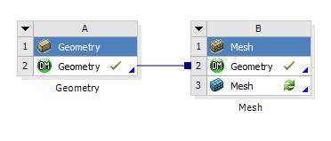
Project Startup
Create the Project
Start Workbench.
Start → All Programs → ANSYS 14.5 → Workbench 14.5
If have access to DesignModeler, follow the instructions below.
This workshop uses the geometry created in workshop 1 of the DesignModeler course. Open your saved project (DMWS1) and drag and drop a Meshing component system onto the Geometry Cell (A2) as shown. If you did not complete this workshop, a copy is provided in “Workshop_Input_Files” folder.
Note: If folder contains an archived project (DMWS1.wbpz), use “File → Restore Archive” option to open it and save project to the same folder

Slide 4
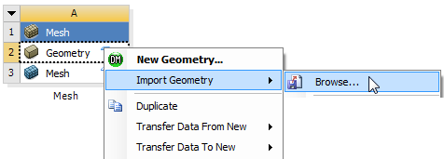
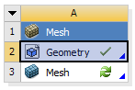
Project Startup
Create the Project
If you do not have access to DesignModeler follow these instructions
Drag and drop a Mesh component system into the Project Schematic .
Right click on the Geometry cell (A2) and select Import Geometry → Browse.
Locate the file “pipe-tee.stp” in the Meshing Workshops Input Files folder and select it. The geometry cell will show a check mark indicating it is up to date.

Slide 5
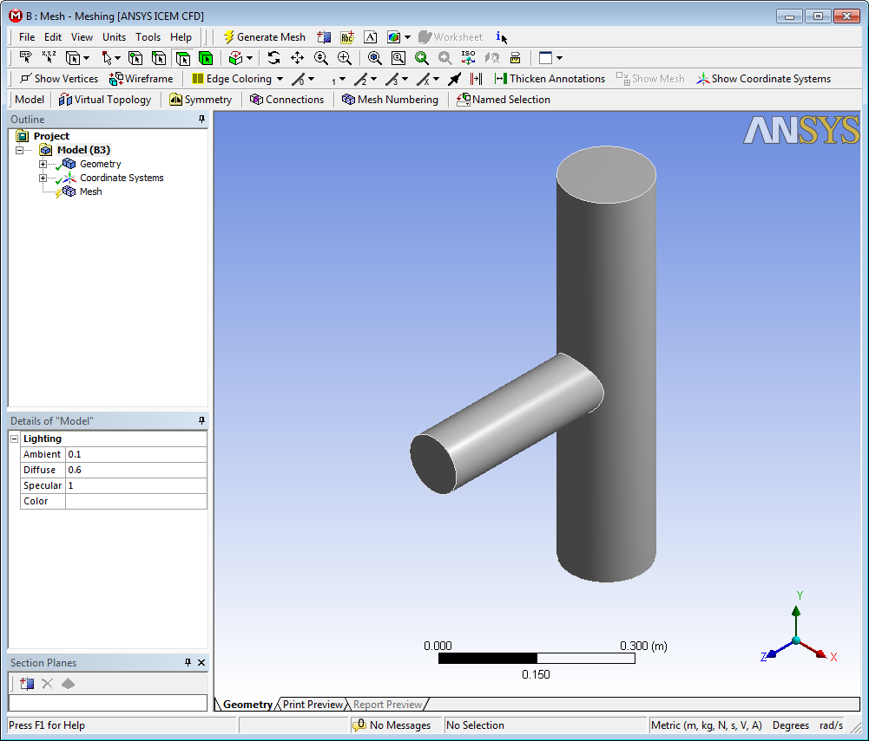
Project Startup
Starting Meshing
On the Mesh cell right click and select Edit
Double clicking on the Mesh cell can also startup Meshing
ANSYS Meshing will start up and load the geometry

Slide 6
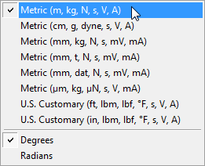
Units
Set Units
It’s good practice to first check and, if required, set the units.
From the main menu select Units and, if it is not already set, specify Metric (m...).

Slide 7
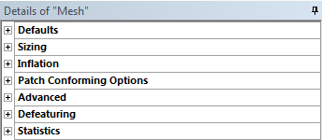
Defaults
Set Defaults
We’ll first demonstrate how a basic mesh can quickly be generated with the minimum of input.
Click Mesh in the Outline
This will display the Details of “Mesh” panel which contains Global Mesh Control settings.

Slide 8
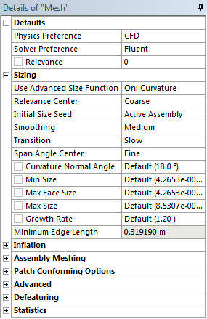
Defaults
Set Defaults
In the Details of Mesh panel expand Defaults and click in the box to the right of Physics Preference to activate the drop down box.
Select CFD
Set the Solver Preference to Fluent
Under Sizing set the following.
Use Advanced Size Function: On: Curvature.
Relevance Center: Coarse.
Click the Generate Mesh button located in the main toolbar.

Slide 9
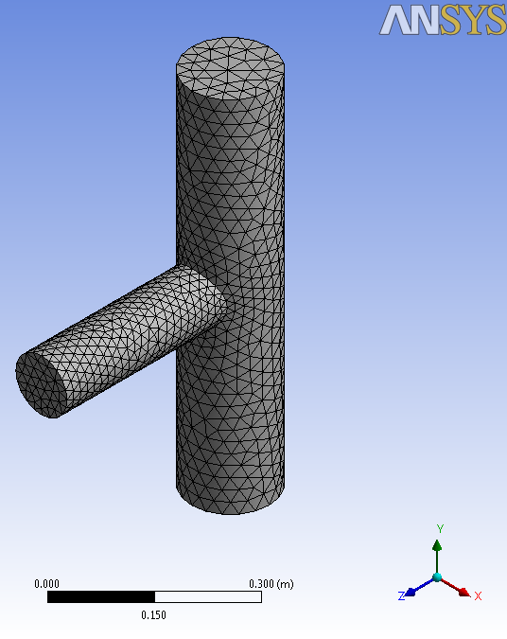
View the Mesh
Mesh
Check that the generated mesh matches that shown.
This is a fully automatic tetrahedron mesh.
Appropriate sizing and parameters have been set and calculated based upon the selected physics preference and geometry characteristics.
The next step is to specify which geometric entities will form boundaries for use in the solver by creating Named Selections.

Slide 10
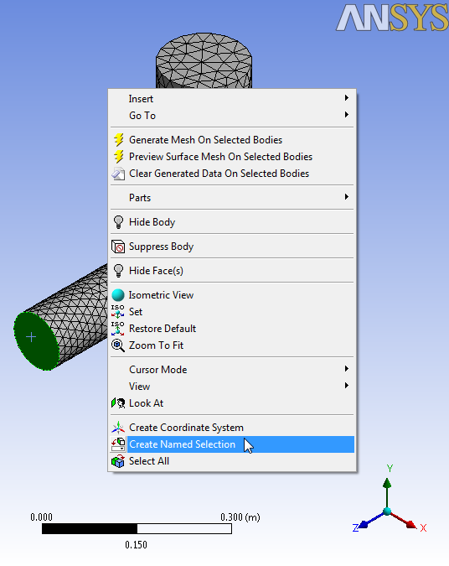
Named Selections
Add Named Selections
From the top toolbar select the Face Selection Filter
Select the face as shown by left clicking over it (will turn green).
With the face selected, right click and select Create Named Selection from the Context Menu that appears.
The Named Selection Dialog Box will appear.

Slide 11
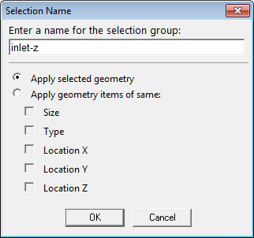
Named Selections (2)
Add Named Selections (Continued)
In the Named Selections Dialog Box enter the name “inlet-z” as shown.
Click OK
The Named Selection you have just created will be listed under the Named Selections object in the Outline.
Selecting it will highlight the corresponding faces.

Slide 12
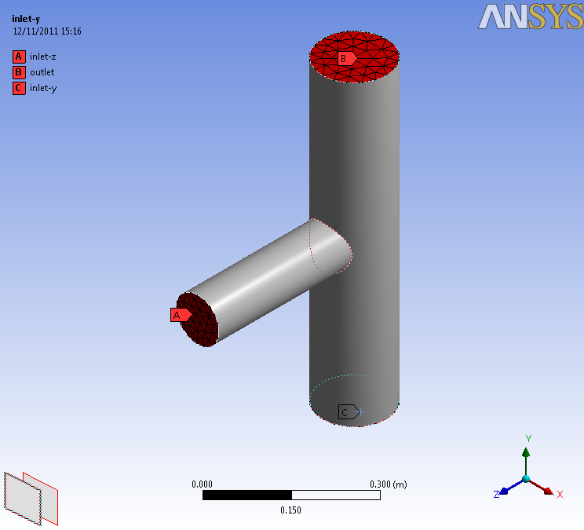
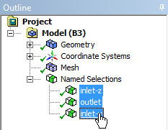
Named Selections (3)
Add Named Selections (Continued)
Use exactly the same procedure to create two more Named Selections “inlet-y” & “Outlet”.
These Named Selections will be used to define boundary conditions in the fluid solver.
outlet
inlet-z
inlet-y

Slide 13
Review
The mesh we have just generated may be suitable for a simple laminar flow calculation.
There are many ways in which a mesh can be generated to accommodate for the requirements of specific applications.
More complex physics, such as turbulence for example, have additional requirements.
We’ll now look at an example.

Slide 14
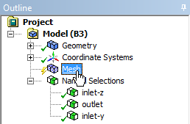
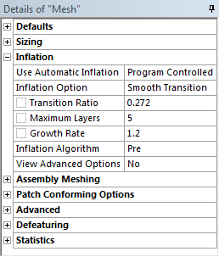
Inflation
Mesh with Inflation Layers
The fluid simulation will concern a wall bounded turbulent flow. To adequately resolve flow gradients near the wall we need smaller mesh cells near the wall.
An efficient way to achieve this is by ‘inflating’ the wall surface mesh to produce layers of thin prismatic cells called Inflation Layers.
In the Outline, click mesh to display the Details of Mesh panel.
Expand the Inflation Section and set Use Automatic Inflation to Program Controlled.
Click Generate.
The mesh will be regenerated with the new settings.

Slide 15
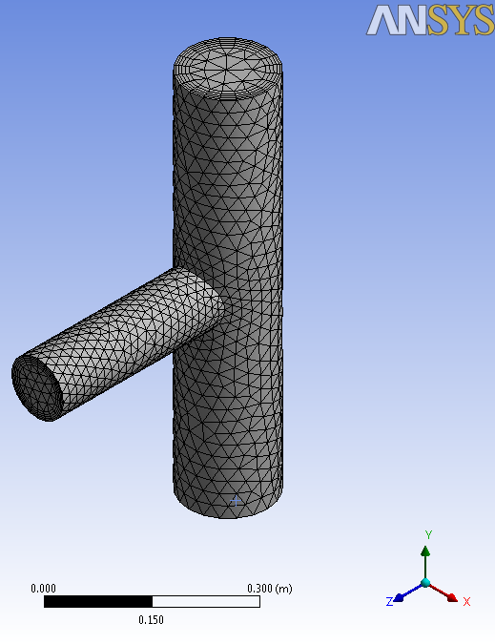
Inflated Mesh
Review the Inflated Mesh
The program controlled inflation has automatically excluded the Named Selection faces creating layers on the unnamed wall faces.

Slide 16
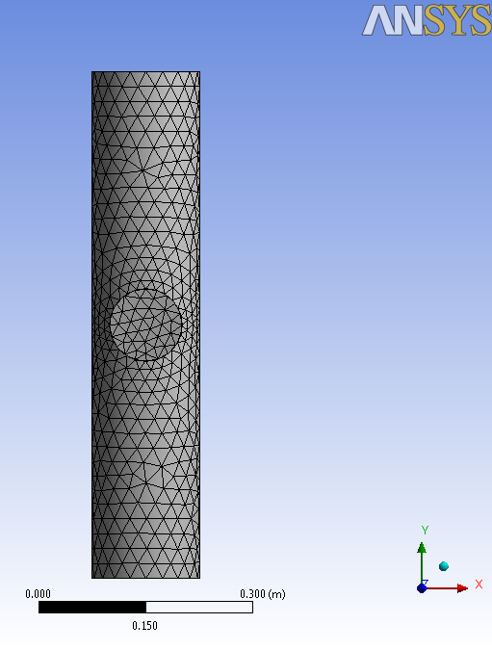
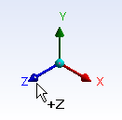
Section Planes
View Mesh Interior
To inspect the interior of a mesh Section planes are used.
Click the +Z axis to orientate the view as shown.
Click the New Section Plane button in the Section Planes panel (lower left).
If the panel is not visible activate it by selecting View→ Windows → Section Planes from the main menu bar.

Slide 17
Section Planes (2)
Click
View Mesh Interior (Continued)
Create the Section Plane by clicking and dragging a vertical line down through the geometry as shown.
It’s not necessary to drag the line all the way through the geometry – just far enough to establish a vertical line then release.
Click the blue iso ball to snap to the isometric view.
Drag
Release

Slide 18
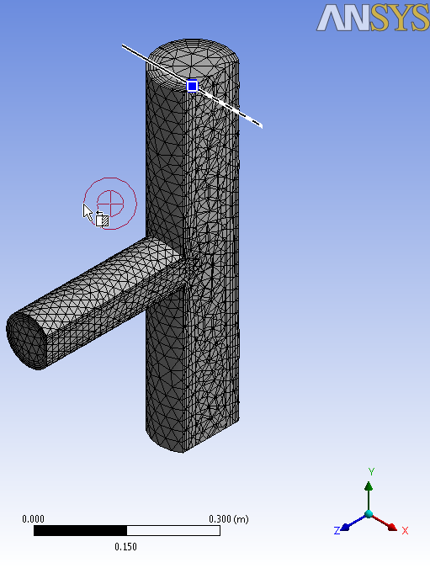
Section Planes (3)
Select the “Section Plane 1” and Click on Edit Section Plane tool to activate editing.
Click anywhere in the graphics window and drag to slide the Section through the mesh.
Release to set the new position.

Slide 19
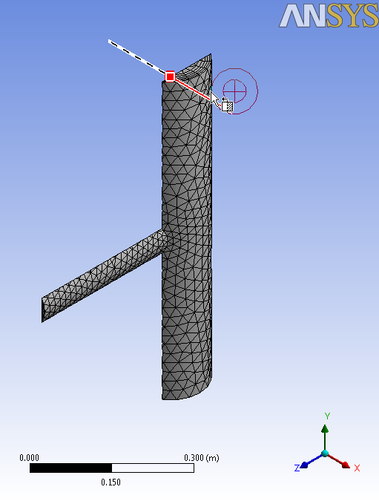
Section Planes (4)
Click either side of Section Plane tool to toggle the mesh display on cutting plane from reverse direction

Slide 20
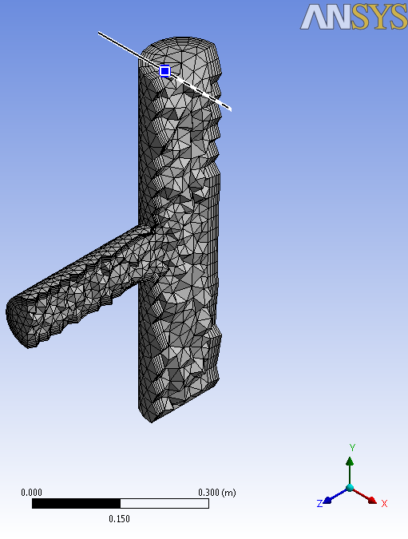
Section Planes (5)
Display whole elements using the Show Whole Elements button in the Section Planes Panel
Deactivate the Section Plane by unchecking the box “Slice Plane 1” in the Section Plane Panel.

Slide 21
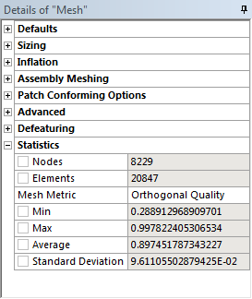
Mesh Statistics
Check Quality
Before using a mesh in any solver it is important to check the mesh quality.
Quality is defined through various metrics which measure the degree to which each mesh cell varies from an ideal shape.
In the Details of Mesh panel expand Statistics. Click in the box to the right of Mesh Metric and select Orthogonal Quality.
The minimum value for Orthogonal Quality is important and should not fall below 0.05. The minimum for this mesh is acceptable.

Slide 22
Save the Project
This completes the workshop.
From the main menu select File → Close Meshing
Workbench will save any application data.
From the Workbench Project Page use the file menu and save the project as “AMWS1.wbpj” to your working folder.

Slide 23
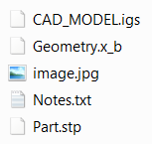
Appendix
Managing External Files
The Workbench project file structure provides a directory named “user_files” which may be used to store CAD, or any other files you wish to associate with the project.
If you have used imported geometry in your Workbench project and subsequently intend to transfer the project to another computer you can move or place a copy of the required files in the user_files folder.
Example Project Directory Containing User Files

Slide 24
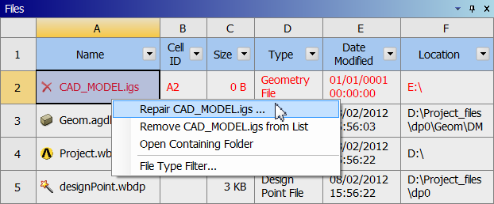
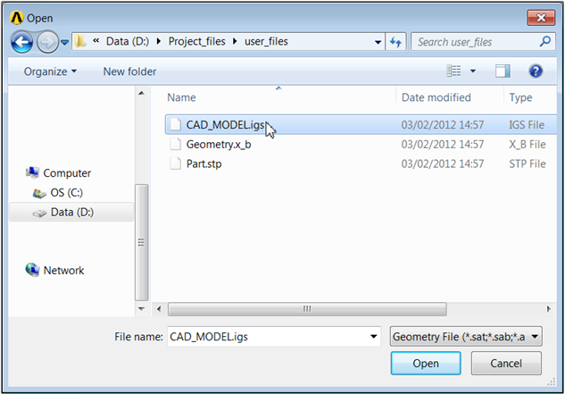
Appendix
Managing External Files (Continued)
When the project is reopened Workbench will prompt you to locate the file.
From the View Menu, select Files.
Right click on the relevant file in the list and select Repair “filename.xxx”.
Browse to the file in the user_files folder.
The new path will be saved with the project.

