Slide 1
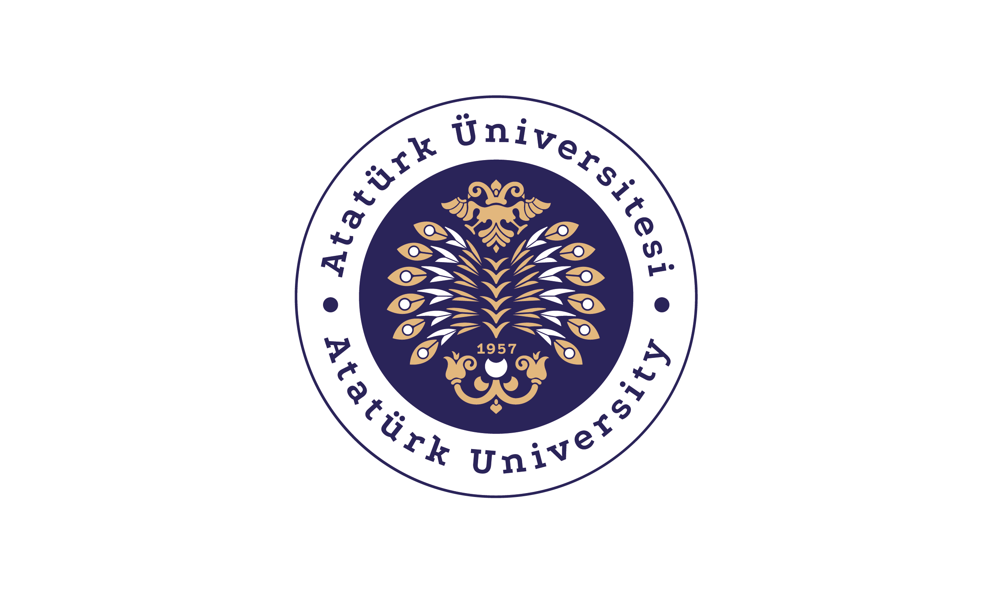
LET'S GET TO KNOW INSECTS

Slide 2
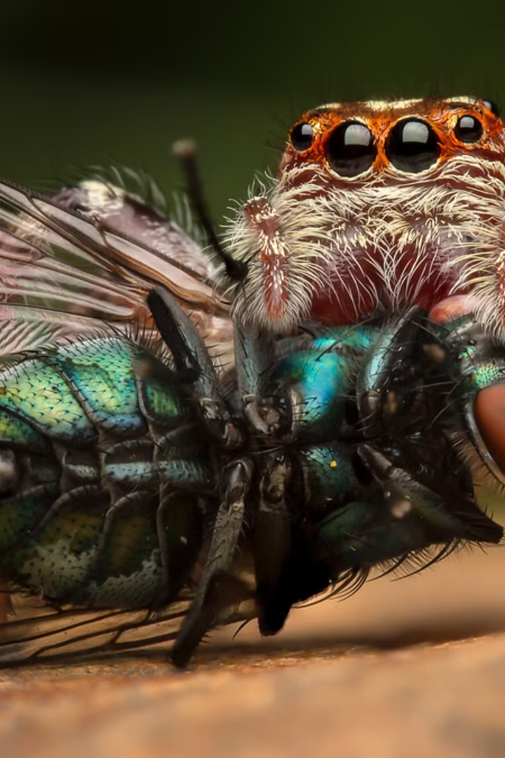
Introduction to Arthropods
Arthropods are a diverse group of invertebrate animals that include insects, arachnids, crustaceans, and other creatures. They are characterized by their segmented bodies, jointed appendages, and hard exoskeletons. Arthropods are found in nearly every habitat on Earth and play crucial roles in many ecosystems.

Slide 3
Characteristics of Arthropods
1
Exoskeleton
2
Segmented Bodies
Arthropods have a hard, external skeleton called an exoskeleton that provides support and protection.
Their bodies are divided into distinct segments, each with specialized functions.
3
Jointed Appendages
4
Molting
Arthropods have articulated appendages, such as legs and antennae, that allow for efficient movement and sensory perception.
Arthropods periodically shed their exoskeleton as they grow, allowing for expansion and development.

Slide 4
Terrestrial Insects
Diversity
Adaptations
Roles
Insects are the most diverse group of terrestrial arthropods, with over a million known species.
Terrestrial insects have evolved a variety of adaptations, such as wings, tough exoskeletons, and specialized mouthparts, to thrive in diverse land environments.
Insects play crucial roles in ecosystems, serving as pollinators, decomposers, and prey for other organisms.

Slide 5
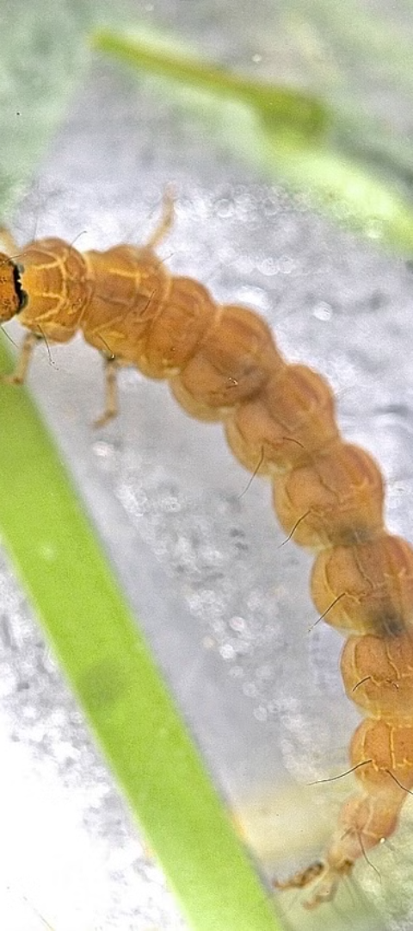
Aquatic Insects
1
Aquatic Larvae
Many insects, such as dragonflies and mayflies, have aquatic larval stages that live in freshwater habitats.
2
Adaptations
Aquatic insects have evolved features like gills, streamlined bodies, and specialized appendages to thrive in water.
3
Ecological Importance
Aquatic insects are a vital food source for fish, amphibians, and other aquatic predators, and they also help to break down organic matter in water bodies.

Slide 6
Adaptations to Terrestrial Environments
Exoskeleton
Respiration
The tough, waterproof exoskeleton of arthropods helps prevent desiccation and provides protection from predators and the elements.
Many terrestrial arthropods have specialized respiratory systems, such as tracheae or book lungs, to efficiently obtain oxygen from the air.
Locomotion
Water Conservation
Arthropods have developed a variety of locomotor adaptations, like legs, wings, and even silk-producing abilities, to move effectively on land.
Terrestrial arthropods have evolved mechanisms to retain water, such as impermeable cuticles and specialized excretory systems, to thrive in dry environments.

Slide 7
Adaptations to Aquatic Environments
Respiratory Adaptations
Hydrodynamic Shape
Buoyancy Mechanisms
Sensory Adaptations
Aquatic arthropods possess specialized structures, like gills, to efficiently extract oxygen from water.
Many aquatic arthropods have streamlined, hydrodynamic bodies to reduce water resistance and improve swimming efficiency.
Some aquatic arthropods, such as certain crustaceans, have adaptations to control their buoyancy in the water column.
Aquatic arthropods often have specialized sensory organs to detect chemical, tactile, and visual cues in their watery environments.

Slide 8
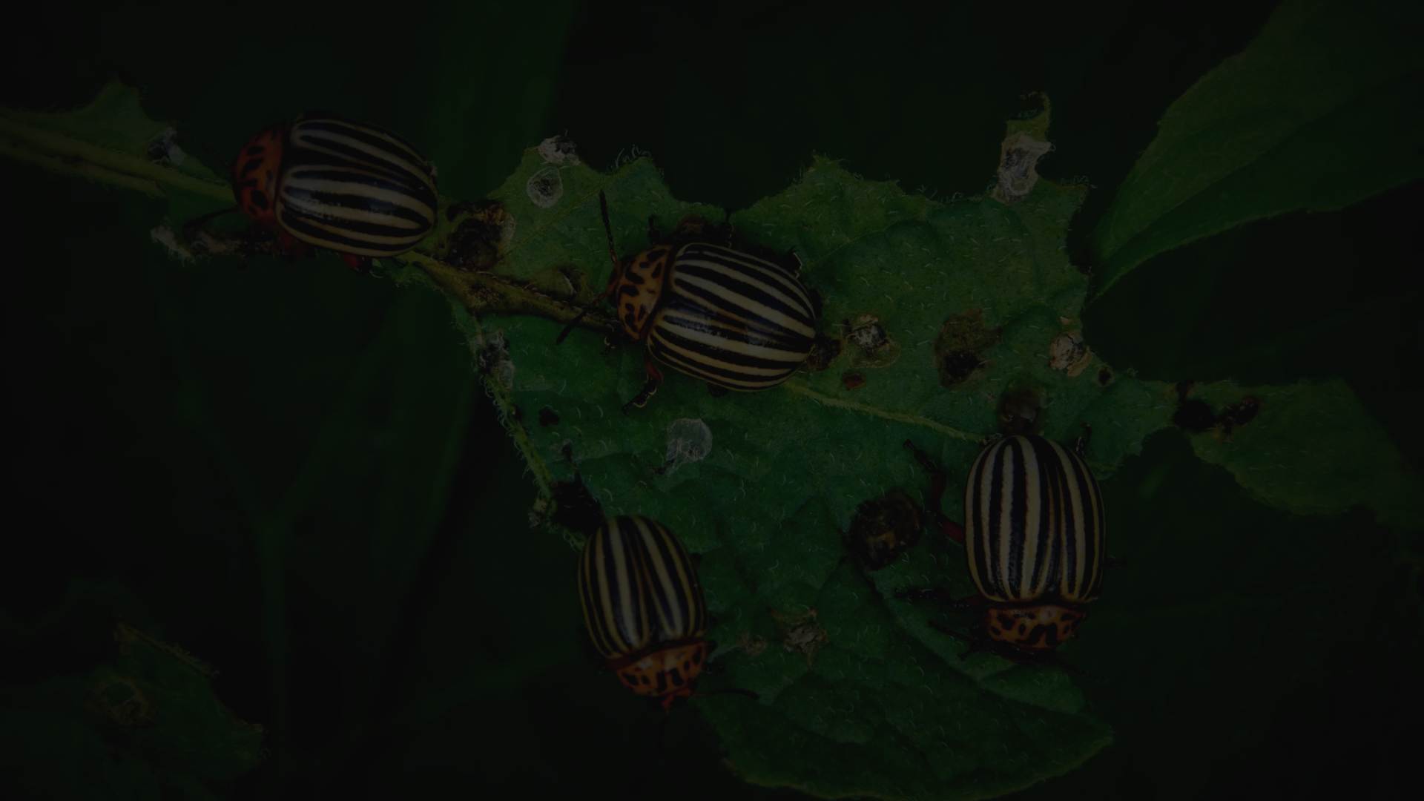
Ecological Importance of Arthropods
Decomposition
Pollination
Food Web
Arthropods, such as beetles and flies, play a crucial role in breaking down and recycling organic matter in ecosystems.
Many insects, including bees, butterflies, and moths, are essential pollinators that facilitate the reproduction of plants.
Arthropods serve as a vital food source for a wide range of predators, from birds and small mammals to larger predators.

Slide 9
When assessed from a nutritional standpoint, edible insects seem to be abundant sources of protein, fat, dietary fiber and minerals. Among these nutrients, the quantity and quality of protein are particularly noteworthy.
In contrast, cultivating edible insects in smaller areas requires less feed and water than traditional animal resources and produces minimal waste. The breeding of these insect species is considered edible.
However, it's a relatively new practice. It poses some risks in terms of both food safety and ecological balance. Hence, it is essential to know about insects (Smith and Pryor, 2014).
Zoologists divide the animal kingdom into 30-35 large groups or phyla. A phylum (plural: phyla) is the taxonomic rank that falls between "kingdom" and "class" and is equivalent to the term "division" in botany.
The nine largest phyla: Porifera, Cnidaria (Coelenterata), Platyhelminthes, Nematoda, Annelida, Mollusca, Arthropoda, Echinodermata and Chordata contain the majority (98%) of extant animal species (Güçlü, 1999; Adli Entomoloji, 2024).
The body is composed of non-homogeneous segments. These segments are divided into two or three very distinct groups, forming body parts. Their body protrusions, or extremities, are segmented. Their names are derived from the words "Arthro" (meaning joint) and "Poda" (meaning leg). Their bodies exhibit bilateral symmetry.
They have a chitinous exoskeleton (integument) that is periodically shed and renewed. The digestive system is tube-shaped, beginning with the mouth and ending with the anus. The circulatory system is open (Güçlü, 1999; Adli Entomoloji, 2024).

Slide 10
Insects (Hexapoda) Insects make up the largest class the number of species in the animal kingdom. They have a significant impact on living organisms.
This impact relates to their numbers and efficiency. They are the primary actors in pollination.
They also maintain ecological balance and the food chain pyramid (Kinyuru and Ndung’u, 2020; Klein et al., 2022).
Insects are the most speciesrich group among animals. Approximately four-fifths of the described species belong to this class.
Today, the number of known insect species exceeds one million. Several thousand new species are being discovered. Insects are abundant not only the number of species, but also in the number of individuals.
Ecosystems group insects into aquatic and terrestrial categories. This depends on their reliance on water areas (Demirsoy, 2006; Bektaş, 2015).

Slide 11
In insects adapted to terrestrial life, the tracheal system is more developed and their exoskeletons are stronger, enabling them to excrete uric acid and prevent water loss through their integuments (Cummings, 2024).
Aquatic insects are classified as such because they inhabit areas near water. Various factors such as nutrition, reproduction, mating and protection from enemies influence their choice to live near the water or in specialized galls within the water.
They differ from terrestrial insects in having swimming hairs on their legs and excreting a more diluted substance (Demirsoy, 2006; Bektaş, 2015). Commonly consumed edible insects (by Jongema, 2014).

Slide 12
Conclusion and Key Takeaways
Diverse Group
Arthropods are the most diverse group of animals, with over 1 million known species.
Adaptations
Arthropods have evolved a remarkable array of adaptations to thrive in a wide range of environments, both terrestrial and aquatic.
Ecological Importance
Arthropods play crucial roles in ecosystems, such as decomposition, pollination, and providing a food source for other organisms.
Continued Study
The study of arthropods continues to provide valuable insights into evolutionary biology, ecology, and biodiversity.

