Slide 1
SEARCH FOR ALTERNATIVE FOOD

Slide 2
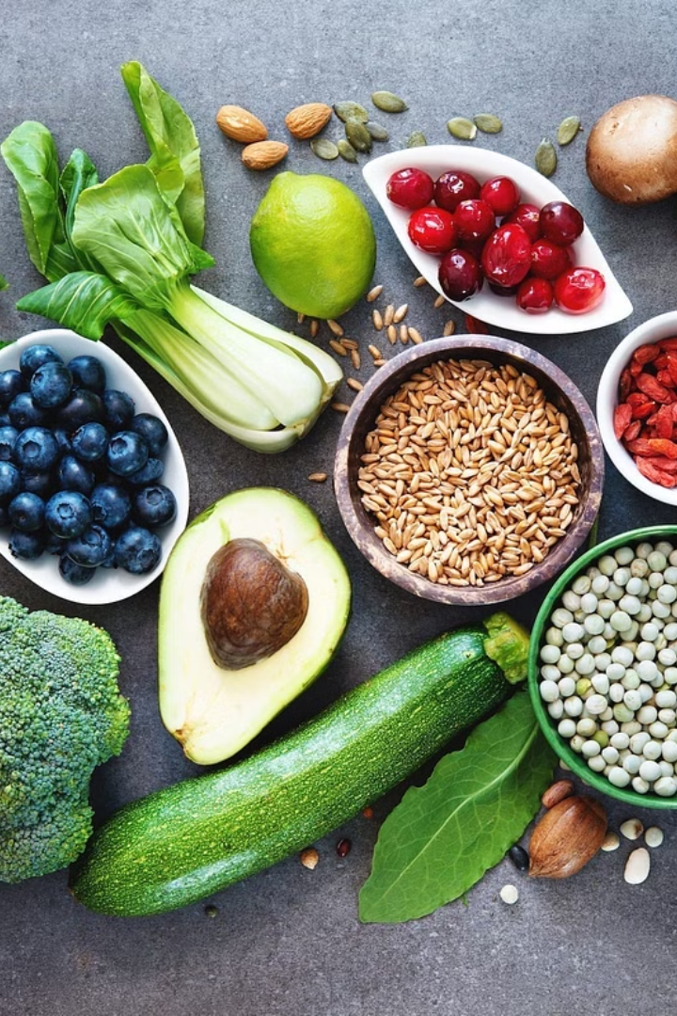
Introduction to Alternative Food Sources
The world is seeking sustainable and nutritious food solutions beyond the traditional agricultural model. This presentation explores the rise of edible insects as a promising alternative food source, highlighting their nutritional benefits, environmental advantages, and culinary innovations.

Slide 3
The Rise of Edible Insects
BOXES:
Growing Popularity
Edible insects are gaining traction globally as a sustainable and protein-rich food option, with an estimated 2 billion people worldwide already consuming them regularly.
Diverse Cuisine
Insects are incorporated into a wide range of dishes, from snacks and entrees to baked goods and beverages, showcasing their versatility in the culinary world.
Innovative Farming
Innovative insect farming techniques are being developed to scale production and make edible insects more accessible and cost-effective.

Slide 4
Nutritional Benefits of Insects
COLUMNS:
Protein-Rich
Insects are a excellent source of high-quality protein, often containing more protein per gram than traditional meat sources.
Nutrient-Dense
Insects are packed with essential vitamins, minerals, and healthy fats, making them a nutrient-dense addition to any diet.
Allergy-Friendly
Many people with food allergies or sensitivities can consume insects without issue, as they are less likely to trigger reactions.

Slide 5
Sustainability of Insect Farming
TIMELINE:
Low Resource Consumption
Insects require far less land, water, and feed compared to traditional livestock, making them a more sustainable food source.
Minimal Emissions
Insect farming generates significantly lower greenhouse gas emissions and environmental pollution than conventional animal agriculture.
Circular Economy
Insect farms can integrate waste streams and by-products, creating a more circular and efficient food production system.

Slide 6
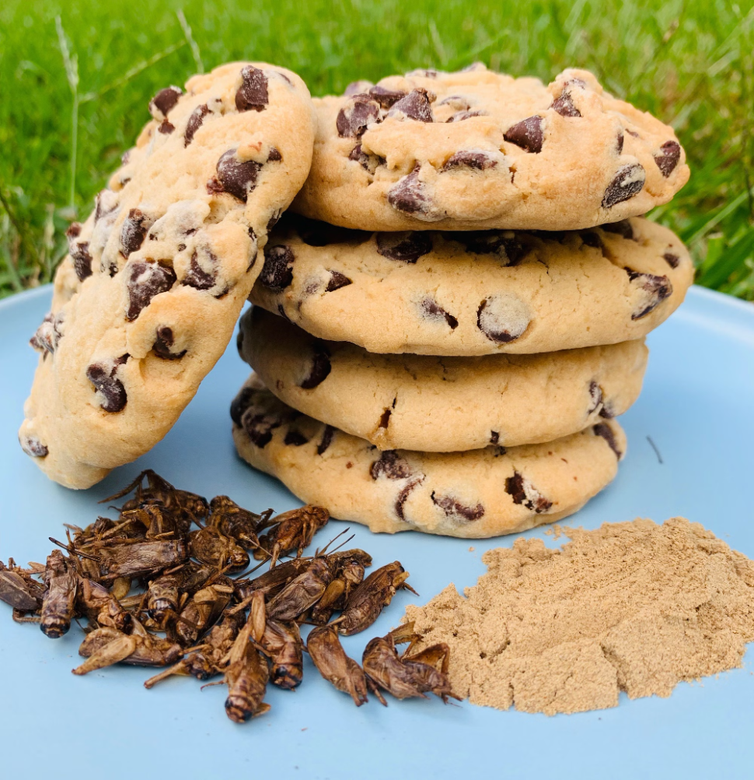
Culinary Innovations with Insects
IMAGES:
Protein Powders
Insect-based protein powders are being incorporated into a variety of food and beverage products, from protein bars to smoothies.
Crunchy Snacks
Insects are being transformed into savory and sweet snack foods, providing a novel and satisfying crunch.
Meat Alternatives
Insect-based meat alternatives, such as burgers and sausages, are emerging as sustainable and nutritious options.

Slide 7
Overcoming Stigma and Acceptance
BULLETS:
Educating the Public
Raising awareness about the benefits of edible insects and addressing misconceptions is key to promoting wider acceptance.
Changing Mindsets
Encouraging a more open-minded and adventurous approach to food can help overcome the initial stigma surrounding insects as a viable protein source.
Destigmatizing Consumption
Normalizing the inclusion of insects in everyday diets and cuisines can help destigmatize their consumption over time.

Slide 8
Regulatory Landscape and Food Safety
ARROWS:
Regulatory Frameworks
Governments and food safety authorities are establishing guidelines and standards to ensure the safe production and consumption of edible insects.
Quality Assurance
Rigorous testing and certification processes are being implemented to guarantee the quality and safety of insect-based food products.
Consumer Confidence
Transparent regulations and robust food safety measures help build consumer trust and acceptance of edible insects as a viable food option.

Slide 9
People have to eat to survive. The daily energy requirement of the human body is 1800 kilocalories (kcal). People cannot be fed due to the distribution of food resources and ecological problems (Van Eelen et al., 1999; Feng et al., 2001; Otaviano, 2023).
The growing demand for food, driven by the rapid increase in the world population (Otaviano, 2023) and the looming threat of famine (Figure 2), has prompted humanity to explore unconventional new food sources and to enhance existing resources.
The alternative food options are as follows: · Making non-food products usable as food for humans, · Evaluation of food waste, · Producing large quantities of microorganisms and using food residues as nutrients, · Food production from cellulose using bio-fermentation technology, · Protein manufacture from various microbial sources (single-cell protein), · Meat produced under laboratory enviroments, · Dairy drinks that are not farm products, · Assuring the utilization of insects, which are consumed as part of the diet in some countries around the world, as a food source by developing new food processing techniques (Van Eelen et al., 1999).
United Nations data shows that agricultural production must increase by 75% by 2050.
This is to meet the food needs of the world population. Modern technologies aim to enhance crop production by harnessing the biological resources of seas and ocean waters. They also use solar energy. They also use genetic advances to breed more productive animals.
These technologies also seek to boost global food production by enhancing soil fertility (Van Eelen et al., 1999; Feng et al., 2001; Otaviano, 2023).

Slide 10
Traditional foods and packaged edible insects (by Anonymous j) For this reason, developers intend to improve the well-being of a broad spectrum of people, including those suffering from malnutrition, through the development of modified organisms (GMOS) and GMO products. However, some believe that research on GMOS will benefit a select group of experts in this area (Van Eelen et al., 1999; Feng et al., 2001; Otaviano, 2023).
They also believe that the use of GMOS foods may lead to ecological problems. The world population is growing faster.
There is a growing demand for food. This is due to the threat of famine. This has prompted people to explore unconventional new food sources. It raises significant concerns for the future. Many materials and methods are being developed as alternatives to traditional foods (Van Eelen et al., 1999; Feng et al., 2001; Otaviano, 2023).
Edible Micro And Macro Algae Microalgae are microscopic organisms. They transform solar energy into chemical energy by using carbon dioxide (CO2). Most of the microalgae biomass is a valuable resource for obtaining a wide range of high-value products, including polyunsaturated fatty acids, carotenoids, phycobiliproteins, polysaccharides and phytotoxins. However, companies use products derived from microalgae as high-protein supplements for human nutrition, aquaculture and nutraceutical purposes (by Anonymous, d; Sathasivam et al., 2019; Nowruzi et al., 2020).

Slide 11
While 800,000 tons, which constitute 6% of macroalgae (multicellular eukaryotic organisms), are collected from nature, the remaining 94% are cultivated through aquaculture. However, it has not yet begun to be commercially cultivated in our country (Ak, 2015; Sathasivam et al., 2019; Nowruzi et al., 2020).
The economic contributions of algae to humans can be classified as follows (by Anonymous, d; Öztürk, 1996; Del-Campo et al., 2007; Raja et al., 2008; Sathasivam et al., 2019; Nowruzi et al., 2020):
► As food: More than a hundred species, mostly Phaeophyceae and Phodophycea species (spp), are consumed as food because of their rich macro and micronutrient contents.
► As animal feed: Some varieties of algae are utilized as animal feed.
► A study stated that beta (β)-glucans are a diverse group of polysaccharides naturally found in algae, including seaweed and Phaeophyceae. Although not all types of β-glucans exhibit similar immunomodulatory effects, they have demonstrated anti-tumor and immunomodulatory effects in laboratory conditions.
► The study also found that providing piglets with a diet containing βglucan reduced the frequency of diarrhea over the entire experimental period, improved intestinal integrity, alleviated diarrhea in pigs infected with F18 Escherichia coli (E. coli), and enhanced the immune system's response to E. coli infection.
► As fertilizer: In a study, a microbiologist from the United States Agricultural Research Service utilized algae to reclaim nearly 100% of the nitrogen and phosphorus nutrients in fertilizer. Based on his findings, he proposed that dried algae could be used as a fertilizer.
► Experiments have shown that algae can retain 60 to 90 percent of nitrogen and 70 to 100 percent of phosphorus from a manure-freshwater mixture. The United States Department of Agriculture proved this at four dairy farms.

Slide 12
Future Outlook and Opportunities
ICONS:
Market Expansion
The global edible insects market is expected to continue its rapid growth, driven by increasing consumer demand and product innovation.
Ongoing Innovation
Continued research and development will lead to new processing techniques, novel food products, and improved farming practices.
Environmental Impact
The widespread adoption of edible insects can contribute significantly to the shift towards more sustainable and eco-friendly food systems.
Global Potential
Edible insects have the potential to become a truly global solution to food security and nutrition challenges worldwide.

