Slide 1
INCREASING HUMAN POPULATION AND THE SEARCHING OF ALTERNATIVE FOOD

Slide 2
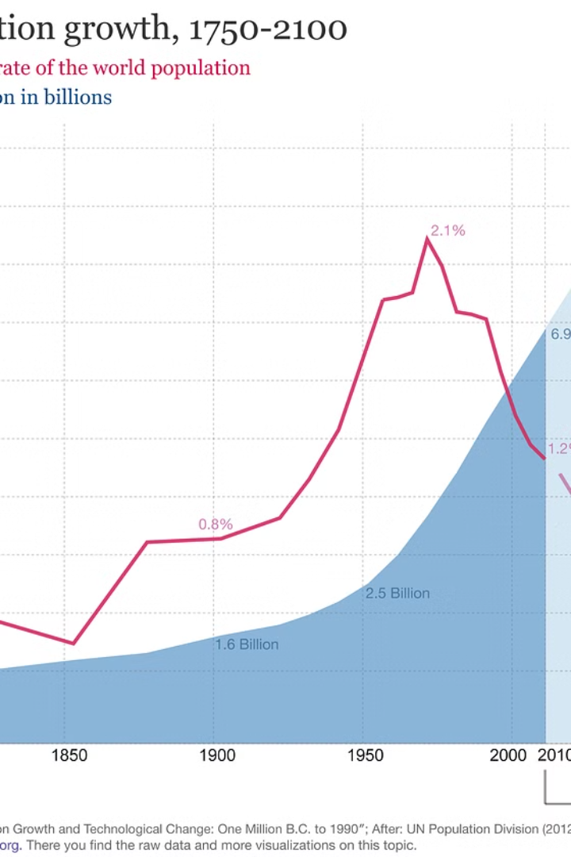
Feeding a Growing World
As the world's population continues to rise, the challenge of providing enough food for everyone has become increasingly critical. Innovative solutions are needed to address the limitations of traditional agriculture and ensure long-term food security.

Slide 3
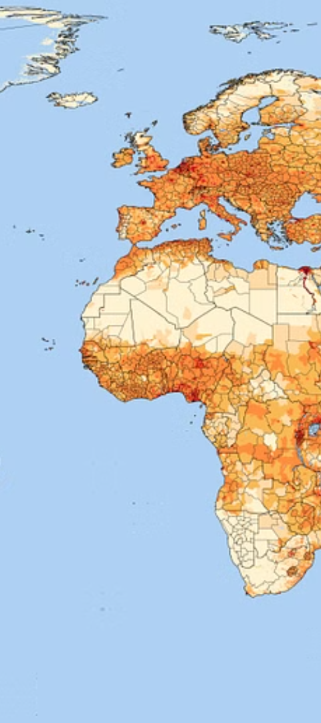
The Rise in Global Population
1
7.9 Billion People
2
Rapid Growth
The global population has surpassed 7.9 billion, with the majority living in developing countries.
The world's population has more than doubled in the last 50 years, putting immense pressure on food production.
3
Urbanization Trends
The increasing urbanization of the global population further complicates food distribution and availability.

Slide 4
Limitations of Traditional Agriculture
Land Scarcity
Water Shortages
Environmental Impact
Arable land suitable for agriculture is limited, especially in densely populated regions.
Increasing water scarcity due to climate change and overexploitation of groundwater resources.
Conventional farming practices can lead to soil degradation, biodiversity loss, and greenhouse gas emissions.

Slide 5
The Search for Alternative Food Sources
Plant-Based Proteins
Cultured Meat
Innovations in plant-based meat alternatives and protein-rich crops.
The development of lab-grown meat to reduce dependence on traditional livestock.
Insect Farming
Aquaculture
Exploring the potential of insects as a sustainable source of protein.
Expanding the production of seafood through controlled farming methods.

Slide 6
Advancements in Food Technology
Precision Farming
1
Using data-driven techniques to optimize crop yields and resource efficiency.
2
Vertical Farming
Cultivating crops in controlled indoor environments to increase production.
Blockchain Traceability
3
Leveraging blockchain technology to enhance food safety and supply chain transparency.

Slide 7
Sustainable Farming Practices
Regenerative Agriculture
Agroforestry
Organic Farming
Integrating the cultivation of trees and crops to mimic natural ecosystems.
Cultivating crops without the use of synthetic fertilizers and pesticides.
Farming methods that restore soil health and biodiversity, while sequestering carbon.

Slide 8
Insect-Based Protein: A Promising Alternative
Nutritious
Sustainable
Delicious
Healthy
Insects are rich in protein, vitamins, and minerals.
Insect farming requires far less land, water, and feed compared to traditional livestock.
Many insect-based foods have a pleasant, nutty flavor.
Insects are low in fat and high in fiber, making them a nutritious choice.

Slide 9
Scientists estimate that there are 10 quintillion insects on earth, which corresponds to 1018. In other words, they are practically everywhere. The thought of blood-sucking parasites and venomous bites may send shivers down your spine, but the vast majority of these insects are harmless to humans. Even better, many of these abundant insects can help us survive. We just need to be open to the idea of eating them (by Anonymous, a, b, c; Özkan, 2019; Chakravorty et al., 2013; Wikispecies, 2021; Worldometers, 2021; Sabri et al., 2023; O’Connor et al., 2023; Krongdang et al., 2023).
Many foods containing insects are already sold daily in some countries such as Thailand and Cambodia. Tequila-flavoured worm candies and sugarcoated ants are readily available in these areas. Australopithecines' bones and tooth enamel show marked enrichment of the isotope 13C. This appears in stable carbon isotope analysis. This suggests that their diet consisted of animals that fed on grasses. It also included insects. Termites are also reported to have been part of the diet of Plio-Pleistocene hominins.

Slide 10
An analysis of fossils from caves in the USA and Mexico revealed that coprolites from caves in Mexico contained ants, beetle larvae, lice, ticks and mites. This provides further evidence of entomophagy in human history. At least 2 billion people now include insects in their traditional diet, experts estimate.
They have reported using more than 1900 species as food. Researchers report that beetles (Coleoptera) are the most consumed insects worldwide, accounting for 31% of consumption.
Caterpillars (Lepidoptera) follow at 18%; and bees, wasps, and ants (Hymenoptera) at 14%. Locusts, grasshoppers, and crickets (Orthoptera) make up thirteen percent of the total. Cicadas, leafhoppers, grasshoppers, scale insects and bugs (Hemiptera) make up 10%; termites (Isoptera) make up 3%; dragonflies (Odonata) make up 3%; flies (Diptera) make up 2%; and other orders make up 5%.
Countries in Africa, Asia and Latin America limit the consumption of edible insect species as a food source, despite their wide variety. In Western countries, the idea of eating insects is often met with disgust (by Anonymous, b; Özkan, 2019; Chakravorty et al., 2013; Wikispecies, 2021; 7 | EDIBLE INSECTS Worldometers, 2021; Sabri et al., 2023; O’Connor et al., 2023; Krongdang et al., 2023). Trends for the year 2050 predict a durable increase in population to 9 billion people (Figure 1). This will increase demand for food and feed from agro-ecosystems. It will put even greater pressure on the environment.
Agricultural land, water, forests, fisheries resources and biodiversity are expected to become scarce. So are nutrients and non-renewable energy sources (by Anonymous e, f; Prosekov and Ivanova, 2018; Krongdang et al., 2023).
Shown is the total populations since 1950 and the medium variant projecitons by the UN population division until 2100 (by Anonymous i). In 2017, the global production volume of the main food categories was set at 117 grams (g) of meat or meat products, 303 g of milk or dairy outputs, 406 g of cereals and 117 g of fat per person per day. To maintain the current rate of food production and feed the growing population, production will need to increase by 75% by 2050 (Prosekov and Ivanova, 2018; Krongdang et al., 2023). This implies the need to increase global food reserves by 14% overall, 8% in Latin American countries, 14% in developing countries, 14% in Asian countries and 30% in African countries (by Anonymous e, f; Özkan, 2019; Chakravorty et al., 2013; Wikispecies, 2021; Worldometers, 2021; Sabri et al., 2023; O’Connor et al., 2023; Krongdang et al., 2023).

Slide 11
Embracing Innovation for Food Security
Diversify Food Sources
Explore a wider range of alternative protein options to supplement traditional agriculture.
Invest in Technology
Leverage advancements in food technology to improve efficiency and sustainability.
Promote Sustainable Practices
Adopt farming methods that prioritize environmental preservation and resource conservation.
By embracing innovative solutions and sustainable practices, we can ensure a future where everyone has access to nutritious and affordable food.

